Slide 1

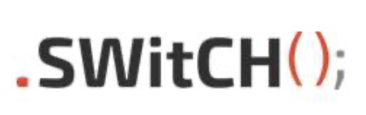
Project Management System Sprint 1 US09
Group 6:
André Silva
Andreia Alferes
Inês Lourenço
João Marques
Juliano Ventura
Lino Ribeiro
Luís Paiva
Marta Silveira
Ricardo Amorim
Salomé Pereira
10th January 2022

Slide 2
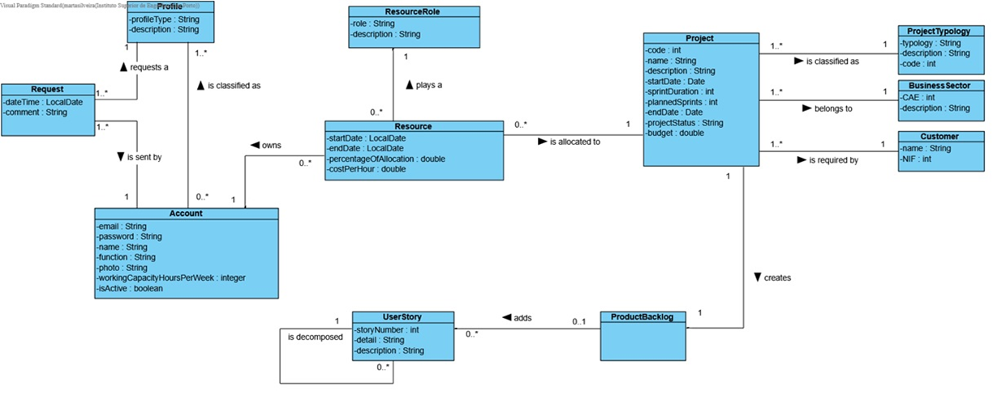
Domain Model

Slide 3
US009 - As Product Owner, I want to create a user story and add it to the Product Backlog.
Sequence Diagram
Class Diagram

Slide 4
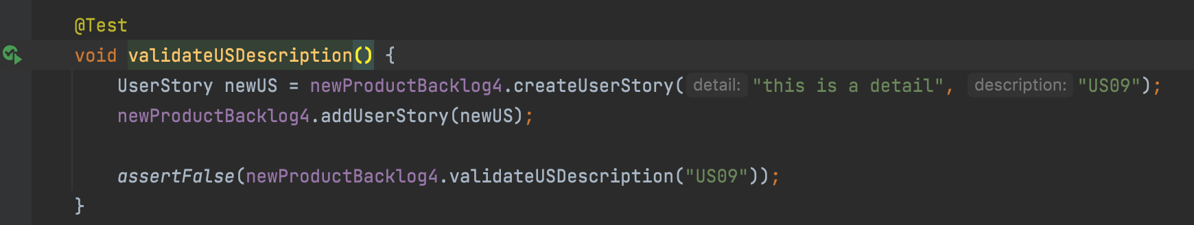
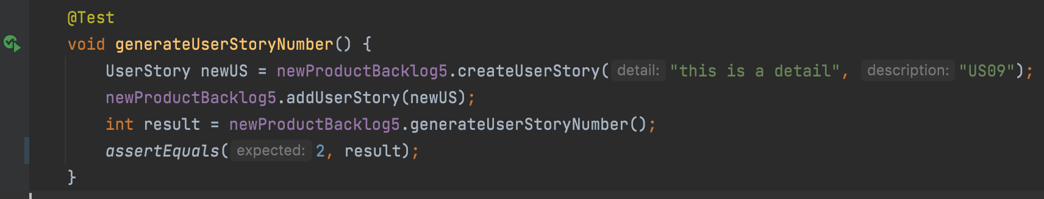
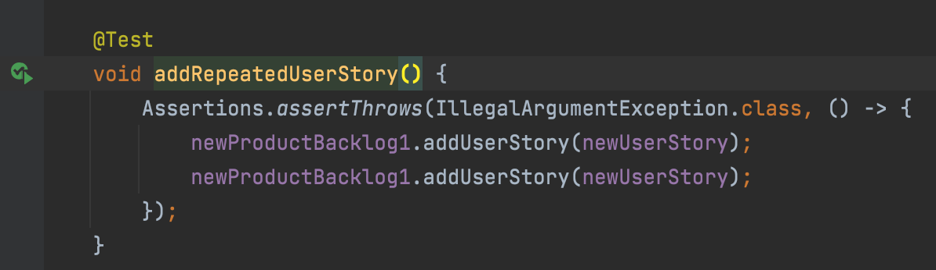
Methods
Tests
2.1.3.1: createUserStory
(detail, description)
-Validate description
-Generate US number
2.1.3.1.5: addUserStory(newUS)
-Validate US (not repeated)
-Add
Prod. Backlog
Tests Coverage: ProductBacklog class: 100% CreateUserStoryController: 100%

