Slide 1
Aircraft Collision Avoidance
Optimization and Algorithms
Andreia Chagas
Catarina Gaspar
Ines Lourençoo

Slide 2
INTRODUÇÃO

Slide 3
PROBLEM FORMULATION

Slide 4
APPROACH

Slide 5
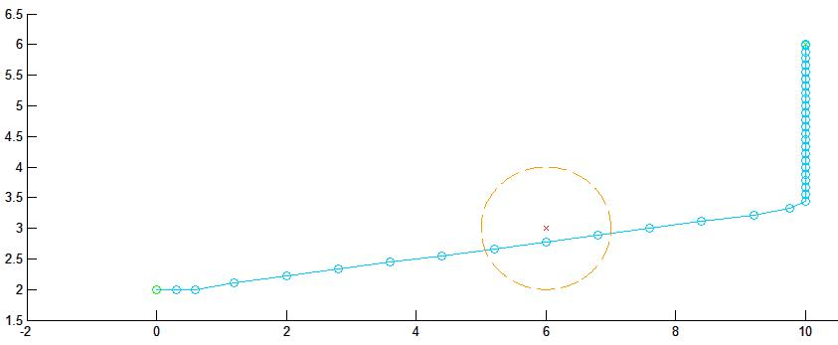
NUMERICAL RESULTS

Slide 6
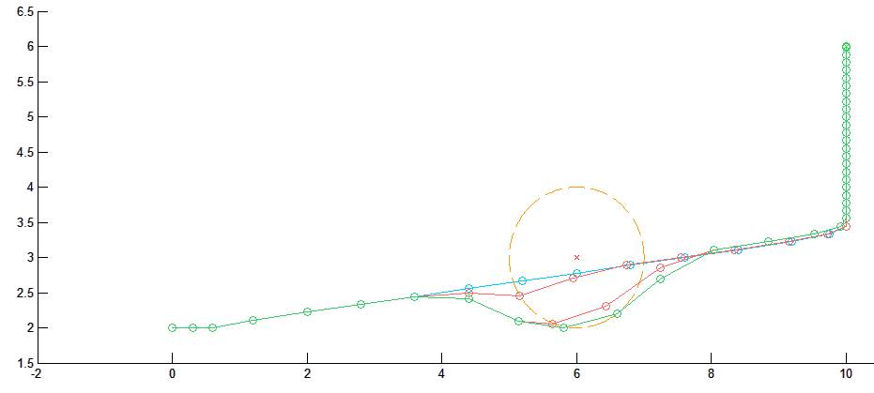
NUMERICAL RESULTS

Slide 7
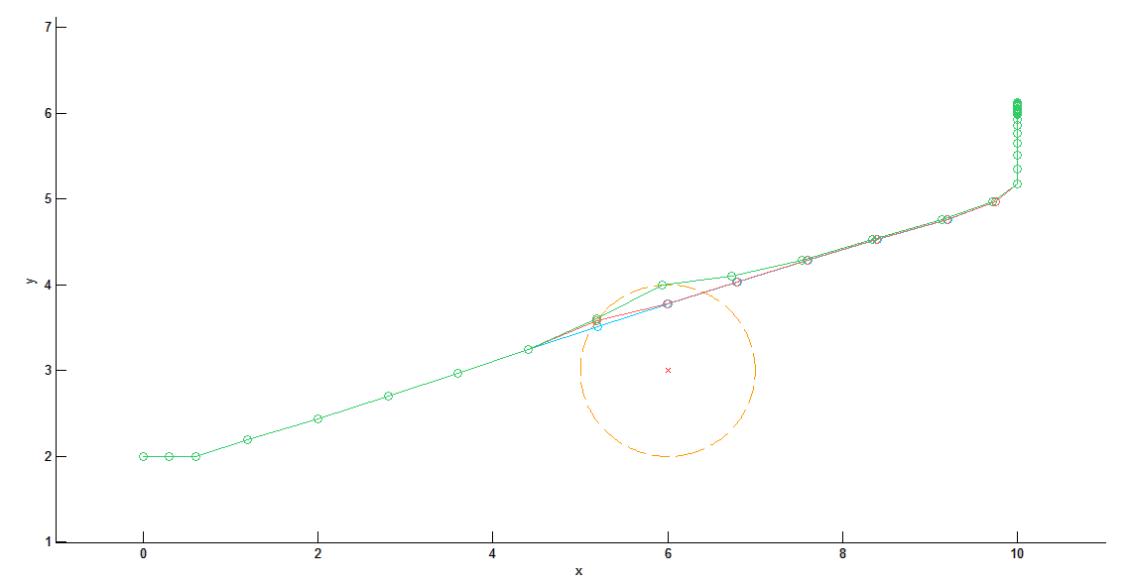
NUMERICAL RESULTS

Slide 8
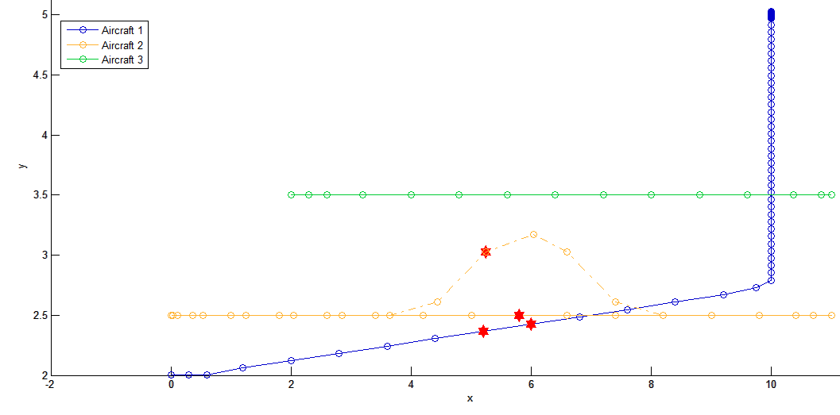
NUMERICAL RESULTS

Slide 9
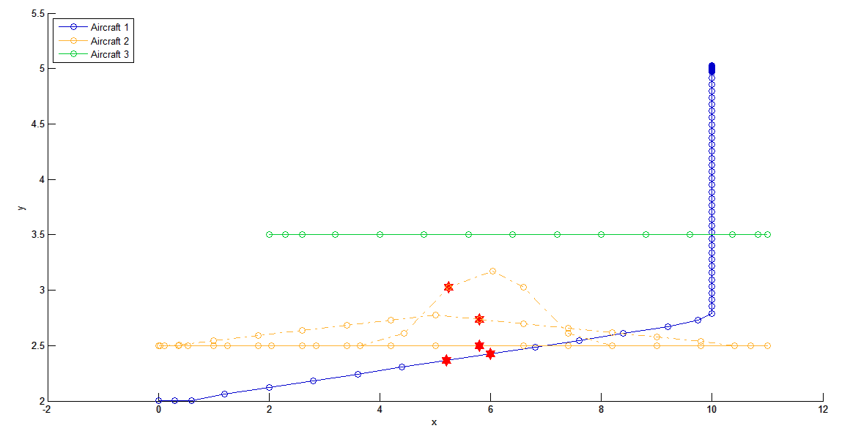
NUMERICAL RESULTS

Slide 10
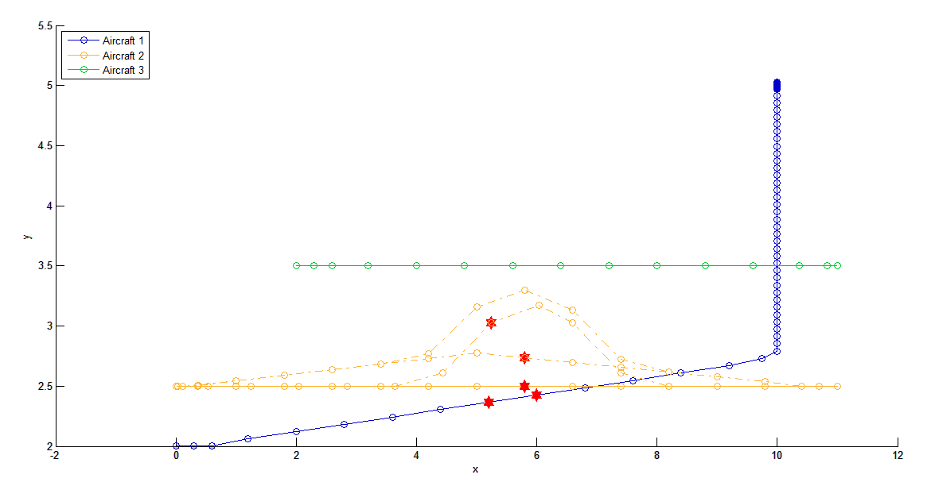
NUMERICAL RESULTS

Slide 11
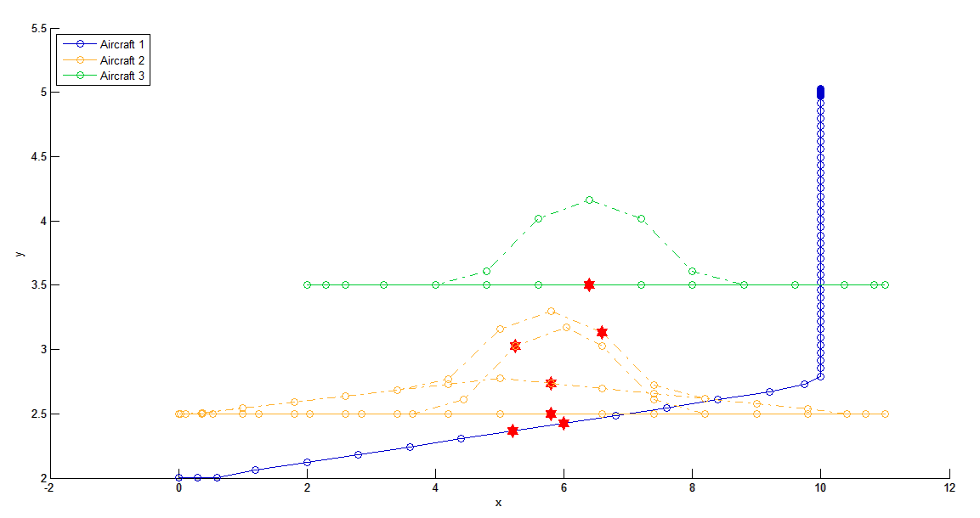
NUMERICAL RESULTS

Slide 12
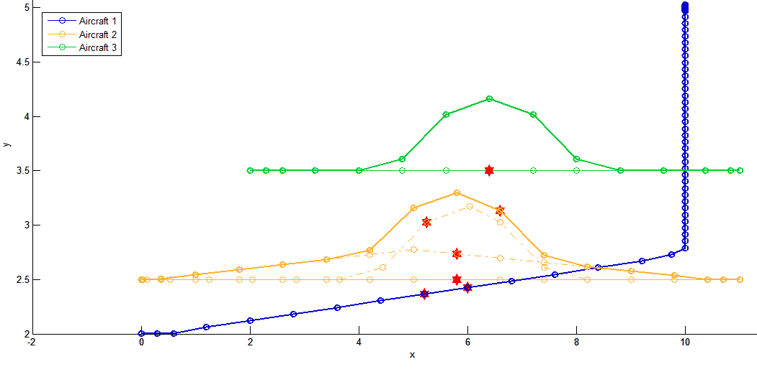
NUMERICAL RESULTS

Slide 13
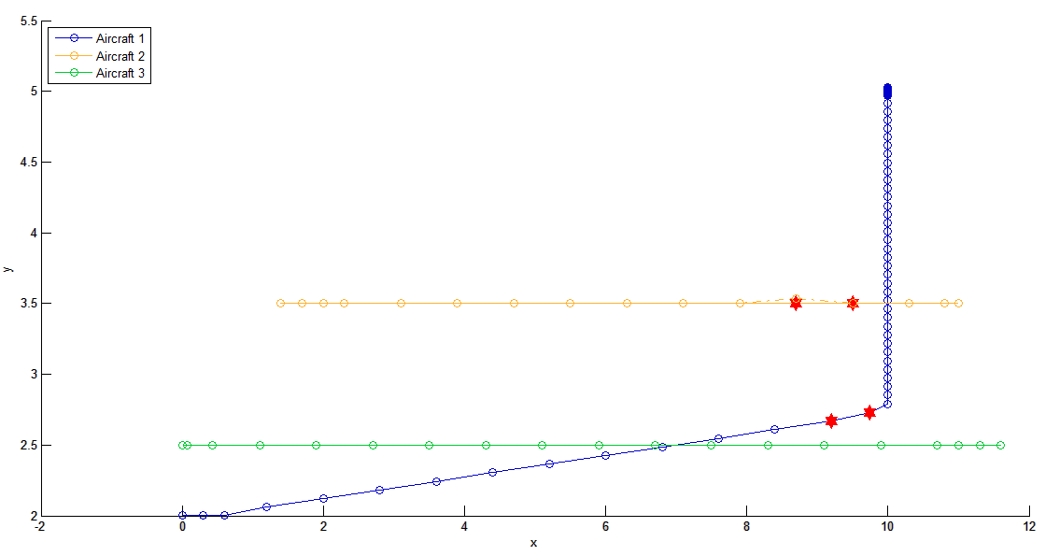
NUMERICAL RESULTS

Slide 14
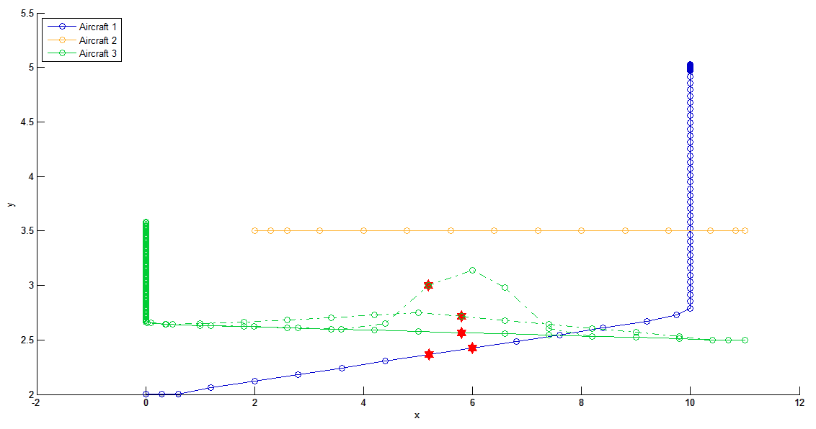
NUMERICAL RESULTS

Slide 15
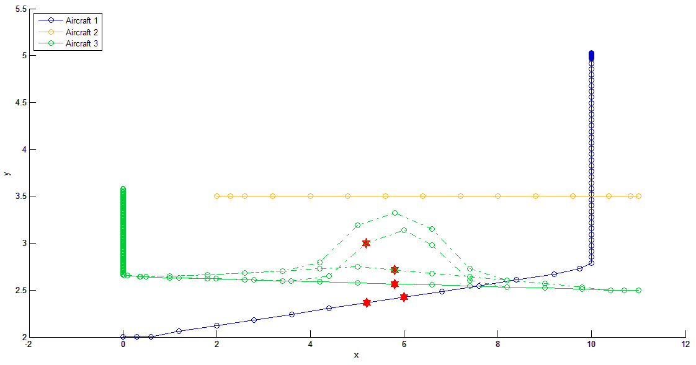
NUMERICAL RESULTS

Slide 16
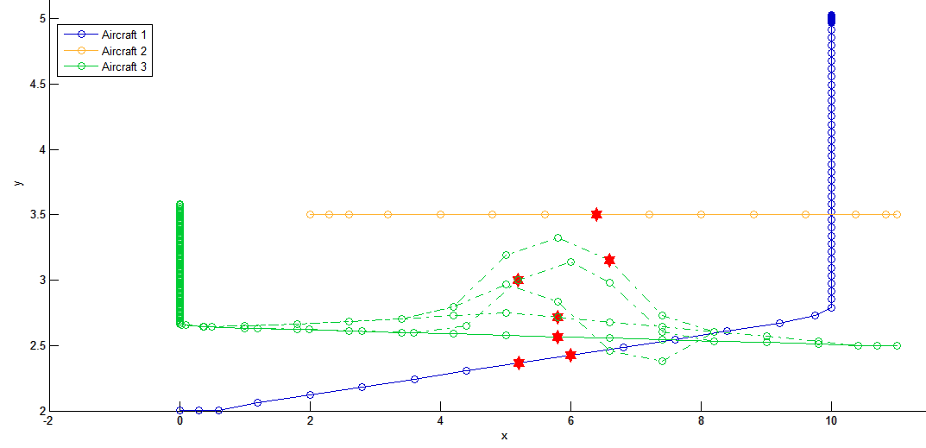
NUMERICAL RESULTS

Slide 17
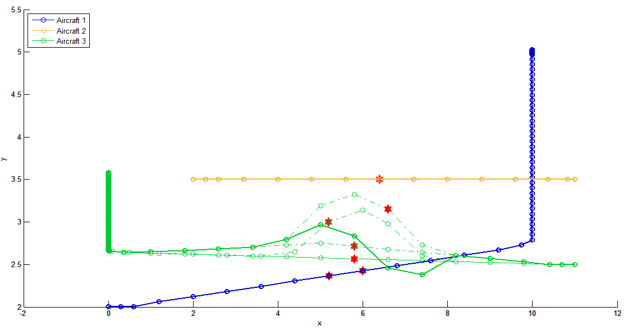
NUMERICAL RESULTS

Slide 18
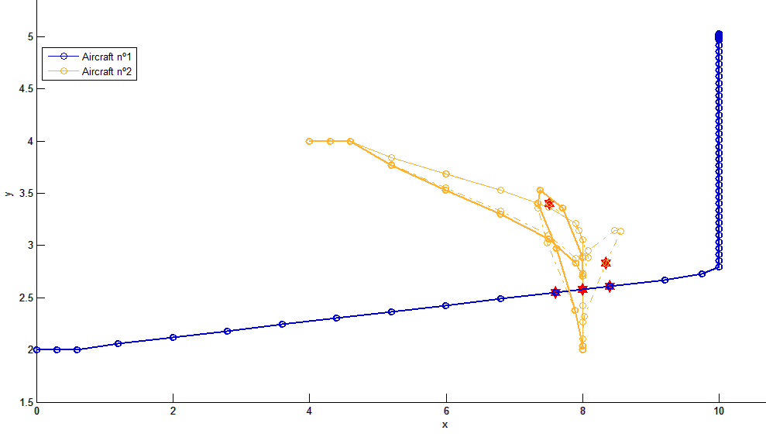
NUMERICAL RESULTS

