Slide 1
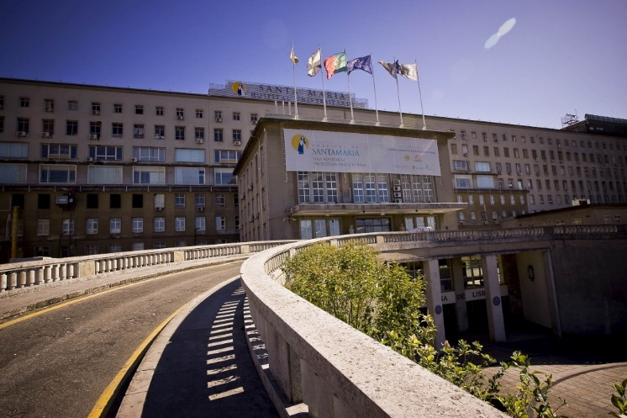
Automatic processes analysis at Santa Maria’s Hospital
Hematology Laboratory
Catarina Gaspar, Nº 75322
Francisco Oliveira, Nº 75167
Inês Lourenço, Nº 75637
Hugo Serieiro, Nº 84993

Slide 2
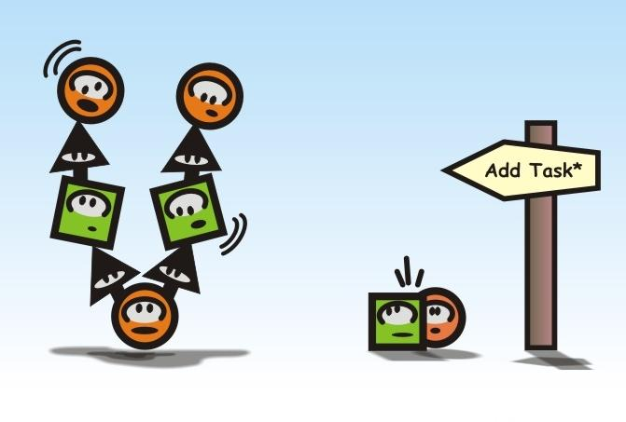
Structure
Context
Automatic Proccesses
Sub-Process
Inputs and Outputs
Sensors
Petri net representation
Properties
Conclusions

Slide 3

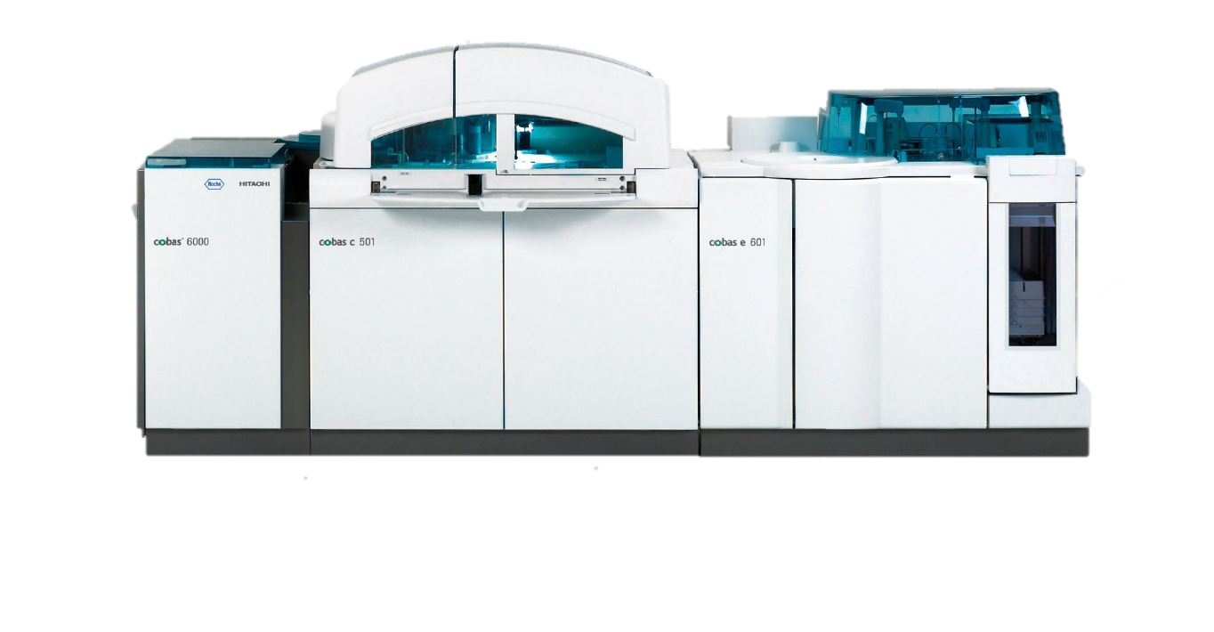
Recolha Laboratorio central Triagem Centrifugação
Context
LQC cobas
Hemograma – hematologia e coagulação Tubos secos Hemoglobina Urina
Notes:
Vão buscar as amostras à sala de recepção de amostras do hospital Santa Maria ou os técnicos trazem dos centros de colheitas Registo de triagem de tubos. Ás vezes perdem-se tubos. Hemograma – hematologia e coagulação Tubos secos Hemoglobina Urina inicialmente tem 15min de centrigugação. ACTH consoante a cor da tampa, vai para diferentes processos. Os de tampa vermelha vão para a centrifugação e cadeia. <27min desde que pipeta até ao resultado Quimica- 12,13min

Slide 4
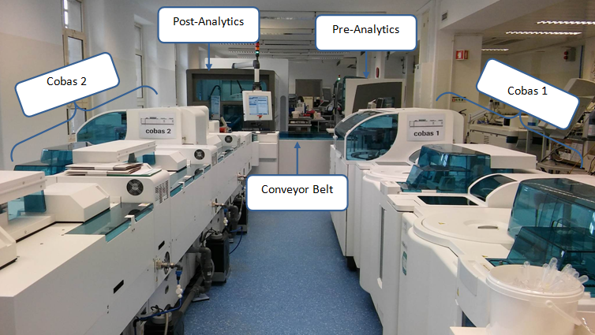
Cobas Machine System

Slide 5
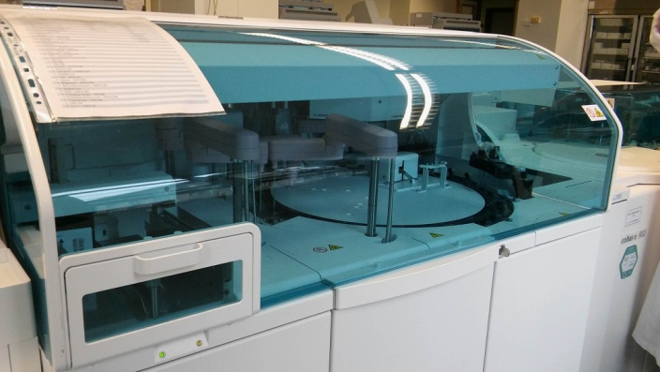
Cobas - Subprocesses
Initial Selection
Pre-analytical
Chain
Pos-analytical
Cobas 1
Cobas 2
Receive samples for testing and separate them in categories
Analysis period
Test various types of parameters.
Cleaning sensors.
Evaluating the response of the blood sample to specific reactants.
Notes:
O tubo primário entra dentro da cadeia.
Manda para o cobas 1 ou 2
1500 amostras/dia
O informático é que programa se quiser mudar alguma coisa.
Racks de entrada e saída
Pára uma coisa fica tudo congestionado.
Vê se tem espaço
Pré e pos têm luzes de alerta (outputs)
Durante a noite desliga das 8 ás 20h.

Slide 6
Cobas - Subprocesses
Pre-analytical
Chain
Pos-analytical
Cobas 1
Cobas 2
Final processing
Saves the test tubes during 6 days
Causes for tests’ failure:
Bubbles
Empty recipients
Low samples amount
Results:
- Concentration of sodium, glucose, chloride
Notes:
O tubo primário entra dentro da cadeia.
Manda para o cobas 1 ou 2
1500 amostras/dia
O informático é que programa se quiser mudar alguma coisa.
Racks de entrada e saída
Pára uma coisa fica tudo congestionado.
Vê se tem espaço
Pré e pos têm luzes de alerta (outputs)
Durante a noite desliga das 8 ás 20h.

Slide 7

Cobas - Subprocesses
Pre-analytical
Chain
Pos-analytical
Cobas 1
Cobas 2
Notes:
O tubo primário entra dentro da cadeia.
Manda para o cobas 1 ou 2
1500 amostras/dia
O informático é que programa se quiser mudar alguma coisa.
Racks de entrada e saída
Pára uma coisa fica tudo congestionado.
Vê se tem espaço
Pré e pos têm luzes de alerta (outputs)
Durante a noite desliga das 8 ás 20h.

Slide 8
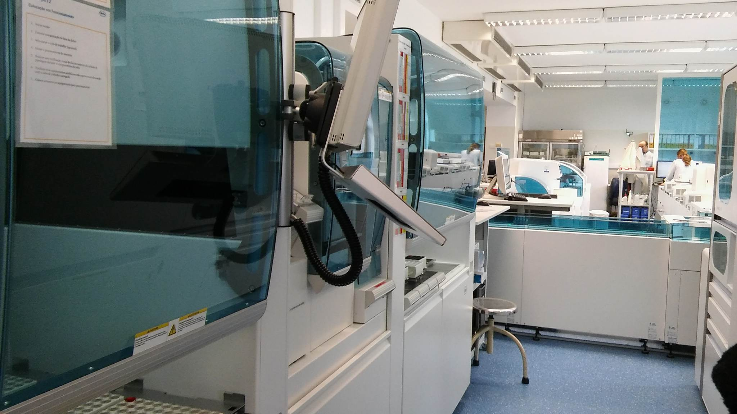
Pre - Analytical
Input sorting
Identification
Aliquoting
Output sorting

Slide 9
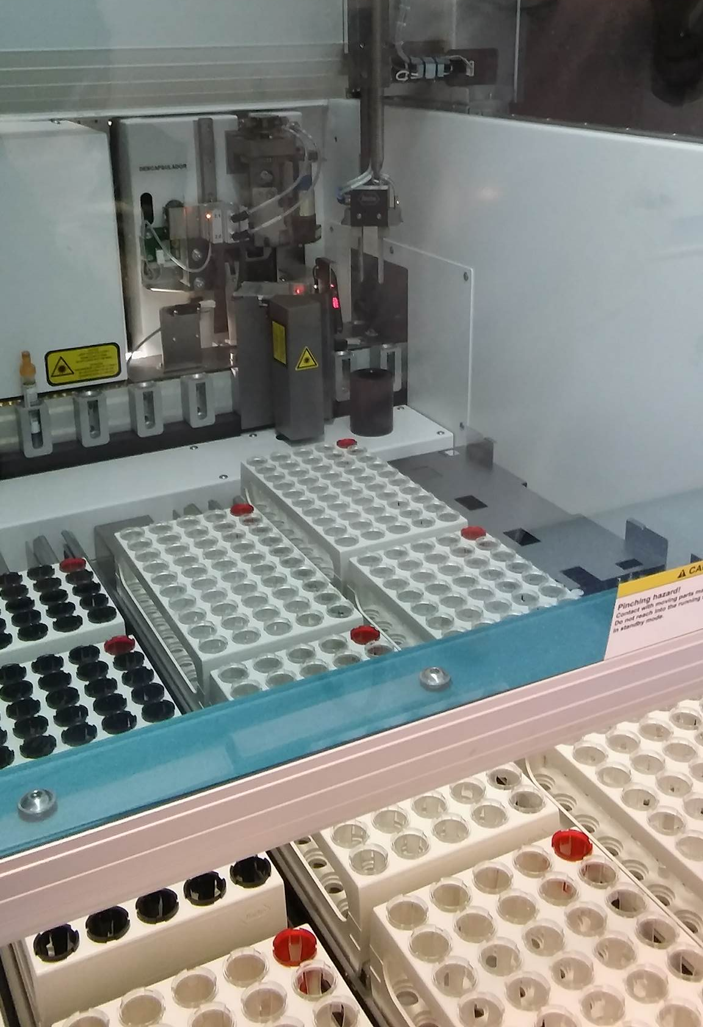
Input Sorting
Checks existing positions
Picks up test tubes
Puts in conveyor belt

Slide 10
Identification and Cap removal
Bar code reading
Volume check
Registers data
Selective cap removal

Slide 12

Aliquotation
Adds reactant to test tubes
New bar code inserted
Chain tests
Manual tests

Slide 13
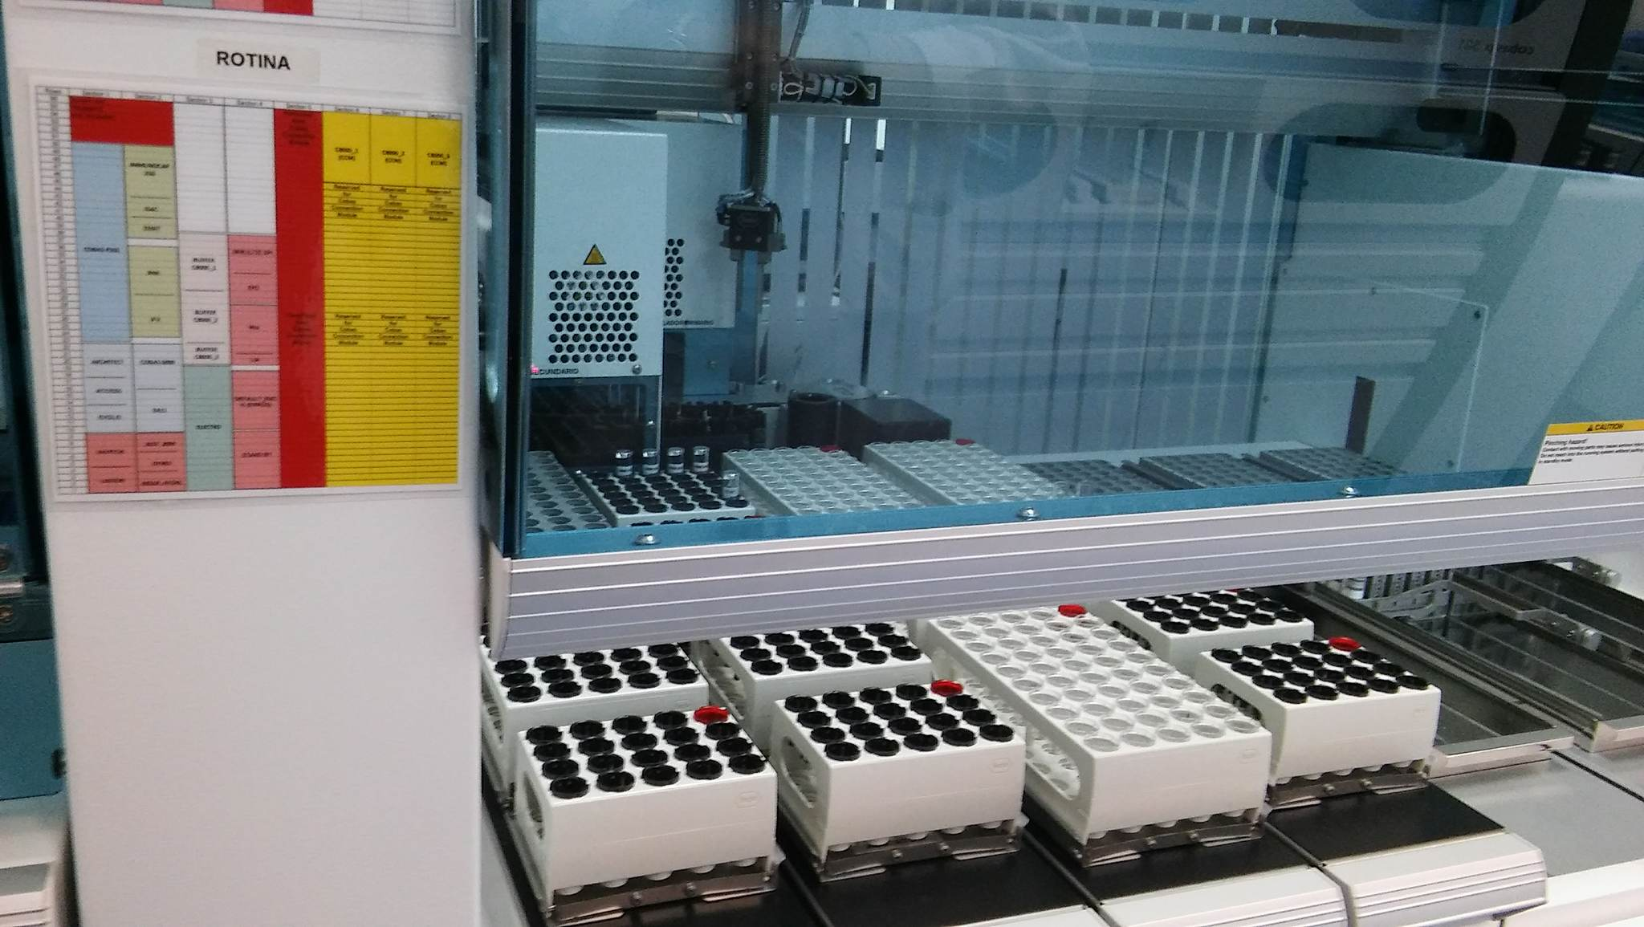
Output Sorting
Seperates tubes
Specific tests
Chain tests (Cobas 1 or Cobas 2)

Slide 14
Inputs / Outputs
Event-based
Inputs
Start Button
Contact sensor
Presence sensor
Bar code
Outputs
LEDs
Bar Code reader
Conveyor belt motors
Robotic arm motors
New marker

Slide 15
Petri Net

Slide 16
P1
Initial position,
X=1;

Slide 17
P1
Initial position,
X=1;
T1: Start button;
P2
1st Position of Rack X ;
Pick sample;

Slide 18
P1
Initial position,
X=1;
T1: Start button;
P2
1st Position of Rack X ;
Pick sample;
T2: Not
T3:
contact;
Contact;
P3
Next position of
Rack X;
P5
Conveyor belt
position;

Slide 19
P1
Initial position,
X=1;
T1: Start button;
P2
1st Position of Rack X ;
Pick sample;
T2: Not
T3:
contact;
Contact;
P3
Next position of
Rack X;
P5
T4: Not contact Ʌ
T7:
Contact;
Conveyor belt
End of Rack
position;
P4
Initial position, X=X+1;

Slide 20

P1
Initial position,
X=1;
T1: Start button;
P2
1st Position of Rack X ;
Pick sample;
T5:
X$≤3;$
T2: Not
T3:
T6:
contact;
Contact;
X> 3;
P3
Next position of
Rack X;
P5
T4: Not contact Ʌ
T7:
Contact;
Conveyor belt
End of Rack
position;
P4
Initial position, X=X+1;

Slide 21
P1
Initial position,
X=1;
T1: Start button;
P2
1st Position of Rack X ;
Pick sample;
T5:
X$≤3;$
X
T2: Not
T3:
T6:
contact;
Contact;
X> 3;
Next position of
T8: Conveyor belt
P3
Rack X;
OFF;
P5
P6
T4: Not contact Ʌ
T7:
Contact;
Conveyor belt
End of Rack
position;
Drop sample;
P4
Initial position, X=X+1;

Slide 22

P1
Initial position,
P7
Conveyor belt
moves 1 pos.
X=1;
T1: Start button;
P2
1st Position of Rack X ;
Pick sample;
T9:
Not contact Ʌ
T5:
Conveyor belt sensor Ʌ
X$≤3;$
X
T2: Not
T3:
Processn = 0;
T6:
contact;
Contact;
X> 3;
Next position of
T8: Conveyor belt
P3
Rack X;
OFF;
P5
P6
T4: Not contact Ʌ
T7:
Contact;
Conveyor belt
End of Rack
position;
Drop sample;
P4
Initial position, X=X+1;

Slide 23
P1
Initial position,
P7
Conveyor belt
moves 1 pos.
X=1;
T1: Start button;
P2
1st Position of Rack X ;
Pick sample;
T9:
Not contact Ʌ
T5:
Conveyor belt sensor Ʌ
X$≤3;$
X
T2: Not
T3:
Processn = 0;
T6:
contact;
Contact;
X> 3;
Next position of
T8: Conveyor belt
P3
Rack X;
OFF;
P5
P6
T4: Not contact Ʌ
T7:
Contact;
Conveyor belt
End of Rack
position;
Drop sample;
P4
Initial position, X=X+1;
Input Sorting

Slide 24

P1
Initial position,
P7
Conveyor belt
moves 1 pos.
X=1;
T10: Presence
Sensor 1
T1: Start button;
Flag process 1=1; Bar code reader; Quality check; Flag process1=0;
P2
1st Position of Rack X ;
P8
Pick sample;
T9:
Not contact Ʌ
T5:
Conveyor belt sensor Ʌ
T11: Presence Sensor 1 Ʌ
X$≤3;$
X
T2: Not
T3:
Processn = 0;
Processn = 0;
T6:
contact;
Contact;
X> 3;
Conveyor belt
moves 1 pos.
T8: Conveyor belt
P9
P3
Next position of
OFF;
Rack X;
P5
P6
T4: Not contact Ʌ
T7:
Contact;
Conveyor belt
End of Rack
position;
Drop sample;
P4
Initial position, X=X+1;
Input Sorting

Slide 25

Identification
P1
Initial position,
P7
Conveyor belt
moves 1 pos.
X=1;
T10: Presence
Sensor 1
T1: Start button;
Flag process 1=1; Bar code reader; Quality check; Flag process1=0;
P2
1st Position of Rack X ;
P8
Pick sample;
T9:
Not contact Ʌ
T5:
Conveyor belt sensor Ʌ
T11: Presence Sensor 1 Ʌ
X$≤3;$
X
T2: Not
T3:
Processn = 0;
Processn = 0;
T6:
contact;
Contact;
X> 3;
Conveyor belt
moves 1 pos.
T8: Conveyor belt
P9
P3
Next position of
OFF;
Rack X;
P5
P6
T4: Not contact Ʌ
T7:
Contact;
Conveyor belt
End of Rack
position;
Drop sample;
P4
Initial position, X=X+1;
Input Sorting

Slide 26

Identification
P1
Initial position,
P7
Conveyor belt
moves 1 pos.
X=1;
T10: Presence
Sensor 1
T1: Start button;
Flag process 1=1; Bar code reader; Quality check; Flag process1=0;
P2
1st Position of Rack X ;
P8
Pick sample;
T9:
Not contact Ʌ
T5:
Conveyor belt sensor Ʌ
T11: Presence Sensor 1 Ʌ
X$≤3;$
X
T2: Not
T3:
Processn = 0;
Processn = 0;
T6:
contact;
Contact;
X> 3;
Conveyor belt
moves 1 pos.
T8: Conveyor belt
P9
P3
Next position of
OFF;
Rack X;
P5
P6
T4: Not contact Ʌ
T13: Bar code 2;
End of Rack
T7:
Contact;
Conveyor belt
Drop sample;
T12: Bar code 1;
position;
Processn = 0;
Flag process 2=1;
P4
P10
Remove the cover;
Flag process2=0;
Initial position, X=X+1;
T14: Processn = 0;
Input Sorting

Slide 27

Identification
P1
Initial position,
P7
Conveyor belt
moves 1 pos.
X=1;
T10: Presence
Sensor 1
T1: Start button;
Flag process 1=1; Bar code reader; Quality check; Flag process1=0;
P2
1st Position of Rack X ;
P8
Pick sample;
T9:
Not contact Ʌ
T5:
Conveyor belt sensor Ʌ
T11: Presence Sensor 1 Ʌ
X$≤3;$
X
T2: Not
T3:
Processn = 0;
Processn = 0;
T6:
contact;
Contact;
X> 3;
Conveyor belt
moves 1 pos.
T8: Conveyor belt
P9
P3
Next position of
OFF;
Rack X;
P5
P6
T4: Not contact Ʌ
T13: Bar code 2;
End of Rack
T7:
Contact;
Conveyor belt
Drop sample;
T12: Bar code 1;
position;
Processn = 0;
Flag process 2=1;
P4
P10
Remove the cover;
Flag process2=0;
Initial position, X=X+1;
T14: Processn = 0;
Input Sorting
Decapping

Slide 28
Identification
P1
Initial position,
P7
Conveyor belt
moves 1 pos.
X=1;
T10: Presence
Sensor 1
T1: Start button;
Flag process 1=1; Bar code reader; Quality check; Flag process1=0;
P2
1st Position of Rack X ;
P8
Pick sample;
T9:
Not contact Ʌ
T5:
Conveyor belt sensor Ʌ
T11: Presence Sensor 1 Ʌ
X$≤3;$
X
T2: Not
T3:
Processn = 0;
Processn = 0;
T6:
contact;
Contact;
X> 3;
Conveyor belt
moves 1 pos.
T8: Conveyor belt
P9
P3
Next position of
OFF;
Rack X;
P5
P6
T4: Not contact Ʌ
T13: Bar code 2;
End of Rack
T7:
Contact;
Conveyor belt
Drop sample;
T12: Bar code 1;
position;
Processn = 0;
Flag process 2=1;
P4
P10
Remove the cover;
Flag process2=0;
Initial position, X=X+1;
T14: Processn = 0;
Input Sorting
P11
Conveyor belt
moves 1 pos.
Decapping

Slide 29
Identification
P1
Initial position,
P7
Conveyor belt
moves 1 pos.
Flag process 3=1; Analysis; Marking;
Flag process3=0;
X=1;
P12
T10: Presence
Sensor 1
T17:
Rectangle
Mark;
T1: Start button;
T16: Circle Mark;
Flag process 1=1; Bar code reader; Quality check; Flag process1=0;
P2
1st Position of Rack X ;
P8
P13
Waiting area;
P14 Waiting area 2;
Pick sample;
T9:
Not contact Ʌ
T5:
Conveyor belt sensor Ʌ
T11: Presence Sensor 1 Ʌ
X$≤3;$
X
T2: Not
T3:
Processn = 0;
Processn = 0;
T18: Human
intervention
T19: Next WS
available
T6:
contact;
Contact;
X> 3;
Conveyor belt
moves 1 pos.
T8: Conveyor belt
P9
P3
Next position of
OFF;
Rack X;
P5
P6
T4: Not contact Ʌ
T13: Bar code 2;
End of Rack
T7:
Contact;
Conveyor belt
Drop sample;
T12: Bar code 1;
T15: Presence
position;
Processn = 0;
Flag process 2=1;
sensor 2
P4
P10
Remove the cover;
Flag process2=0;
Initial position, X=X+1;
T14: Processn = 0;
Input Sorting
P11
Conveyor belt
moves 1 pos.
Decapping

Slide 30

Identification
Aliquoting & Output Sorting
P1
Initial position,
P7
Conveyor belt
moves 1 pos.
Flag process 3=1; Analysis; Marking;
Flag process3=0;
X=1;
P12
T10: Presence
Sensor 1
T17:
Rectangle
Mark;
T1: Start button;
T16: Circle Mark;
Flag process 1=1; Bar code reader; Quality check; Flag process1=0;
P2
1st Position of Rack X ;
P8
P13
Waiting area;
P14 Waiting area 2;
Pick sample;
T9:
Not contact Ʌ
T5:
Conveyor belt sensor Ʌ
T11: Presence Sensor 1 Ʌ
X$≤3;$
X
T2: Not
T3:
Processn = 0;
Processn = 0;
T18: Human
intervention
T19: Next WS
available
T6:
contact;
Contact;
X> 3;
Conveyor belt
moves 1 pos.
T8: Conveyor belt
P9
P3
Next position of
OFF;
Rack X;
P5
P6
T4: Not contact Ʌ
T13: Bar code 2;
End of Rack
T7:
Contact;
Conveyor belt
Drop sample;
T12: Bar code 1;
T15: Presence
position;
Processn = 0;
Flag process 2=1;
sensor 2
P4
P10
Remove the cover;
Flag process2=0;
Initial position, X=X+1;
T14: Processn = 0;
Input Sorting
P11
Conveyor belt
moves 1 pos.
Decapping

Slide 31
Petri Net
Identification
Aliquoting & Output Sorting
Input Sorting
Decapping

Slide 32
Petri Net – Incidence matrix
-1 | 0 | 0 | 0 | 0 | 1 | 0 | 0 | 0 | 0 | 0 | 0 | 0 | 0 | 0 | 0 | 0 | 0 | 0
1 | -1 | -1 | 0 | 1 | 0 | 0 | 0 | 0 | 0 | 0 | 0 | 0 | 0 | 0 | 0 | 0 | 0 | 0
0 | 1 | 0 | -1 | 0 | 0 | -1 | 0 | 1 | 0 | 0 | 0 | 0 | 0 | 0 | 0 | 0 | 0 | 0
0 | 0 | 0 | 1 | -1 | -1 | 0 | 0 | 0 | 0 | 0 | 0 | 0 | 0 | 0 | 0 | 0 | 0 | 0
0 | 0 | 1 | 0 | 0 | 0 | 1 | -1 | 0 | 0 | 0 | 0 | 0 | 0 | 0 | 0 | 0 | 0 | 0
0 | 0 | 0 | 0 | 0 | 0 | 0 | 1 | -1 | 0 | 0 | 0 | 0 | 0 | 0 | 0 | 0 | 0 | 0
0 | 0 | 0 | 0 | 0 | 0 | 0 | 0 | 1 | -1 | 0 | 0 | 0 | 0 | 0 | 0 | 0 | 0 | 0
0 | 0 | 0 | 0 | 0 | 0 | 0 | 0 | 0 | 1 | -1 | 0 | 0 | 0 | 0 | 0 | 0 | 0 | 0
0 | 0 | 0 | 0 | 0 | 0 | 0 | 0 | 0 | 0 | 1 | -1 | -1 | 0 | 0 | 0 | 0 | 0 | 0
0 | 0 | 0 | 0 | 0 | 0 | 0 | 0 | 0 | 0 | 0 | 0 | 1 | -1 | 0 | 0 | 0 | 0 | 0
0 | 0 | 0 | 0 | 0 | 0 | 0 | 0 | 0 | 0 | 0 | 1 | 0 | 1 | -1 | 0 | 0 | 0 | 0
0 | 0 | 0 | 0 | 0 | 0 | 0 | 0 | 0 | 0 | 0 | 0 | 0 | 0 | 1 | -1 | -1 | 0 | 0
0 | 0 | 0 | 0 | 0 | 0 | 0 | 0 | 0 | 0 | 0 | 0 | 0 | 0 | 0 | 1 | 0 | -1 | 0
0 | 0 | 0 | 0 | 0 | 0 | 0 | 0 | 0 | 0 | 0 | 0 | 0 | 0 | 0 | 0 | 1 | 0 | -1
D =

Slide 33
Petri Net Properties – Boundeness and Safeness
Not Safe
Unbounded
Notes:
Como mostramos para no estudo da Reachability, existe criação de tokens/jobs logo a nossa Petri net é unbounded

Slide 34
Petri Net Properties – Liveness
All transitions: Level 4

Slide 35
Petri Net Properties – Reachability

Slide 36
Petri Net Properties – Reachability

Slide 37
Petri Net Properties – Reachability

Slide 38
Petri Net Properties – Reachability

Slide 39
Petri Net Properties – Reachability

Slide 40
Petri Net Properties – Reachability

Slide 41
Petri Net Properties – Reachability

Slide 42
Petri Net Properties – Reachability

Slide 43
Petri Net Properties – Reachability

Slide 44
Petri Net Properties – Reachability

Slide 45
Petri Net Properties – Reachability

Slide 46
Petri Net Properties – Reachability
Infinite Reachability Set

Slide 47


Petri Net Properties – Coverability
$\left[\begin{matrix}1 \\ 0 \\ \begin{matrix}0 \\ 0 \\ \begin{matrix}0 \\ \begin{matrix}\begin{matrix}0 \\ ⋮\end{matrix} \\ \begin{matrix}0 \\ 0\end{matrix}\end{matrix}\end{matrix}\end{matrix}\end{matrix}\right]$ $\left[\begin{matrix}0 \\ 1 \\ \begin{matrix}0 \\ 0 \\ \begin{matrix}0 \\ \begin{matrix}\begin{matrix}0 \\ ⋮\end{matrix} \\ \begin{matrix}0 \\ 0\end{matrix}\end{matrix}\end{matrix}\end{matrix}\end{matrix}\right]$
$\left[\begin{matrix}0 \\ 0 \\ \begin{matrix}1 \\ 0 \\ \begin{matrix}0 \\ \begin{matrix}\begin{matrix}1 \\ 0\end{matrix} \\ \begin{matrix}⋮ \\ 0\end{matrix}\end{matrix}\end{matrix}\end{matrix}\end{matrix}\right]$ $\left[\begin{matrix}0 \\ 0 \\ \begin{matrix}1 \\ 0 \\ \begin{matrix}0 \\ \begin{matrix}\begin{matrix}0 \\ 0\end{matrix} \\ \begin{matrix}⋮ \\ 0\end{matrix}\end{matrix}\end{matrix}\end{matrix}\end{matrix}\right]$
Does not cover
Covers
Notes:
Na nossa Petri Net podemos ter as duas situaçãoes:
Tanto temos estados que não se cobrem (exemplo);
Como temos estados que cobrem os outros (exemplo).

Slide 48


Petri Net Properties – Conservation
$$w^{T}D=0$$
$$w=\left[1 1 1 1 1 1 0 0 ⋯0\right]$$

Slide 49
Petri Net Properties – Conservation
$$w^{T}D=0$$
$$w=\left[1 1 1 1 1 1 0 0 ⋯0\right]$$
Unbounded
Not Conservative

Slide 50
Petri Net Properties – Temporal invariance
There is at least one sequence of transitions that allows the Petri net to return to the same stage.

Slide 51


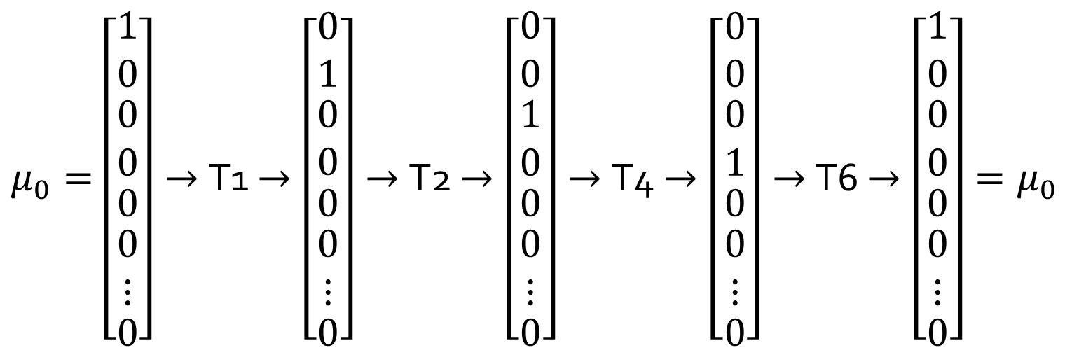
Petri Net Properties – Temporal invariance
There is at least one sequence of transitions that allows the Petri net to return to the same stage.
$$D q=0$$
$$q=\left[1 1 0 1 0 1 0 0 ⋯0\right]$$
$μ_{0}=$ $\left[\begin{matrix}1 \\ 0 \\ \begin{matrix}0 \\ 0 \\ \begin{matrix}0 \\ \begin{matrix}\begin{matrix}0 \\ ⋮\end{matrix} \\ 0\end{matrix}\end{matrix}\end{matrix}\end{matrix}\right]→$T1 $→\left[\begin{matrix}0 \\ 1 \\ \begin{matrix}0 \\ 0 \\ \begin{matrix}0 \\ \begin{matrix}\begin{matrix}0 \\ ⋮\end{matrix} \\ 0\end{matrix}\end{matrix}\end{matrix}\end{matrix}\right]→$T2 $→\left[\begin{matrix}0 \\ 0 \\ \begin{matrix}1 \\ 0 \\ \begin{matrix}0 \\ \begin{matrix}\begin{matrix}0 \\ ⋮\end{matrix} \\ 0\end{matrix}\end{matrix}\end{matrix}\end{matrix}\right]→$T4 $→\left[\begin{matrix}0 \\ 0 \\ \begin{matrix}0 \\ 1 \\ \begin{matrix}0 \\ \begin{matrix}\begin{matrix}0 \\ ⋮\end{matrix} \\ 0\end{matrix}\end{matrix}\end{matrix}\end{matrix}\right]→$T6 $→\left[\begin{matrix}1 \\ 0 \\ \begin{matrix}0 \\ 0 \\ \begin{matrix}0 \\ \begin{matrix}\begin{matrix}0 \\ ⋮\end{matrix} \\ 0\end{matrix}\end{matrix}\end{matrix}\end{matrix}\right]=μ_{0}$

Slide 52
Conclusions
It’s really hard to differenciate the real system from the mathematical system!

