Slide 1
Sentiment Analysis
What the presentation should include:
- The functionality of the application (what it is supposed to do)
- Which technologies or techniques from the course is used (semantics, sentiment analysis, recommender systems etc)
- Which data sources are used
- Architecture and any open source software used
- Challenges or difficulties your group has faced during the project
- How is, or could, the application be evaluated
- Three best and worst experiences with the project
- A short demo of the system
Our App
Sentiment Analysis
Data Sources
Architectures and open software
Challenges and difficulties
Evaluation
Best and Worst Experiences
Demo

Slide 2

Sentiment analysis

Slide 3
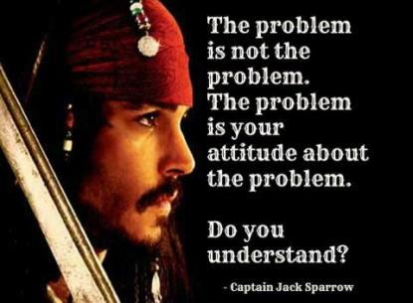

Our App
What do we want it to do

Slide 4
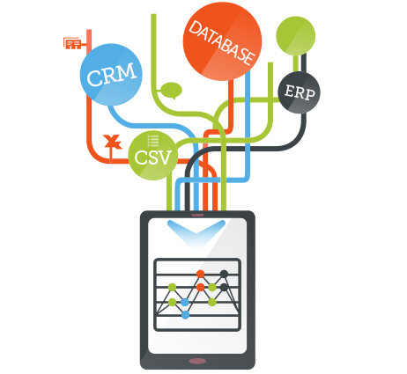
What do we need to do to make it work
Data Sources
Architectures and open software

Slide 5




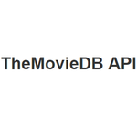
What do we need to do to make it work
NLP Compromise
VaderSentiment
Notes:
nlp_compromise is a natural language processing tool
vaderSentiment

Slide 6

Challenges and difficulties

Slide 7


Evaluation

Slide 8
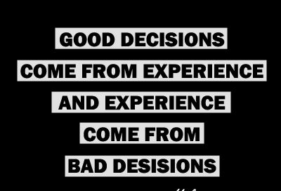
Best and Worst Experiences

Slide 9


Slide 10
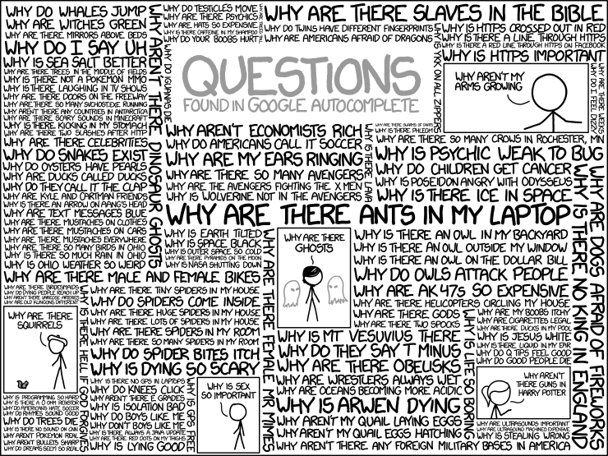
Thank you!
Source: xkcd.com/1256

