Slide 1

From Outcomes to Automation
Building an AI-powered ABM Studio in-house
Inês Piçarro
ABM and AI Transformation Manager
Daniele Quartana
Director, Marketing Operations (Global)

Slide 2
Think of one process that slows you down
Hold onto it

Slide 3
Project delivery times...
A YEAR AGO
90 days
TODAY
30 days
Same team, no developer, no big new budget

Slide 4
HANDS UP
How much of your marketing runs on AI today?
GROUP 1
GROUP 2
GROUP 3
0-25%
25-75%
75-100%
AI curious
Try tools like ChatGPT now and then
AI assisted
Use AI every week + pay for it
AI native
Build with AI agents e.g. Claude Code

Slide 5
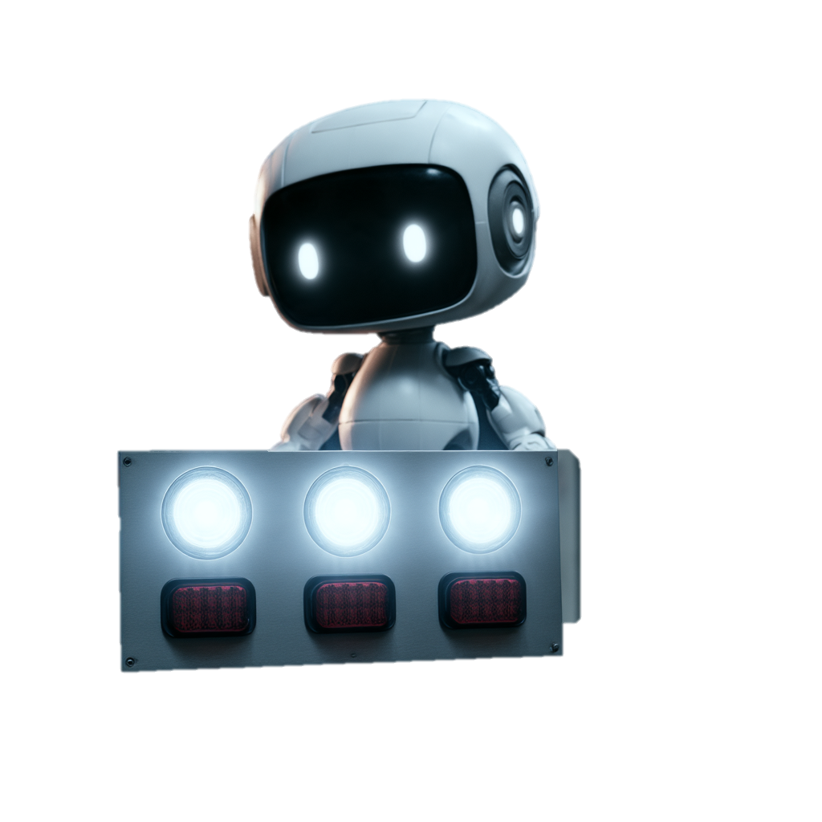
THE THESIS
Effort isn't a result
Activity doesn't count
Outcomes do

Slide 6

TODAY · 30 MINUTES
Four layers, one thing to take home

Slide 7

1
LAYER ONE
Outcomes
What should change for the team
Inês
1 Outcomes
2 Knowledge base
3 Procedures
4 Delivery

Slide 8
LAYER 1 · OUTCOMES
What changed for our ABM
WHAT CHANGED
A YEAR AGO
NOW
Brief to first draft
→
90 days
30 days
Personalization
→
One message for all
A version per account
Connecting a tool
→
Technical request,
weeks later
Plain words, same day

Slide 9
2
LAYER TWO
Knowledge base
What the AI needs to know to be correct
Inês
1 Outcomes
2 Knowledge base
3 Procedures
4 Delivery

Slide 10

LAYER 2 · KNOWLEDGE BASE
Everything we made, in one place the AI can read

Slide 11
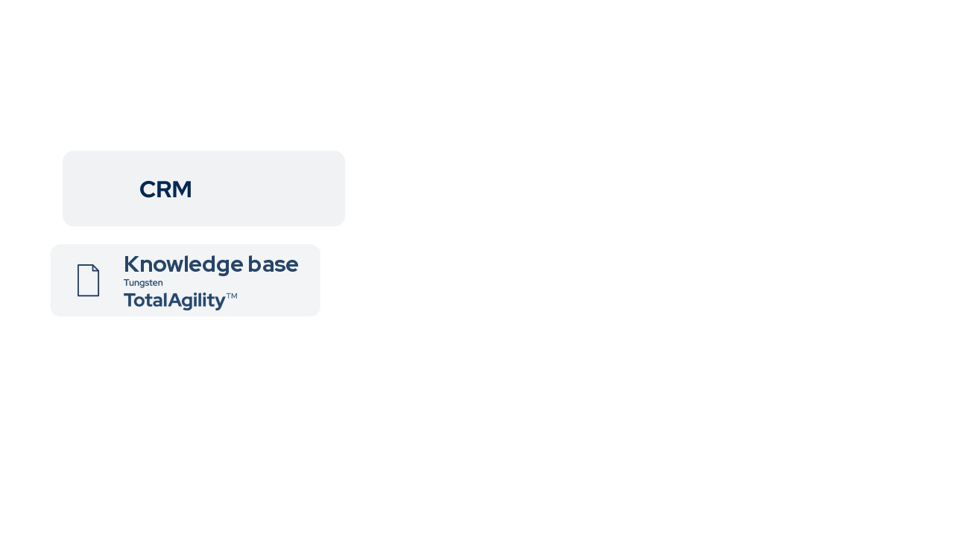
LAYER 2 · KNOWLEDGE BASE
One plug connects every tool to any LLM
FORGE (MCP): the connector the AI uses to reach your systems.

Slide 12


LAYER 2 · THE CONNECTIONS
We need more AI-first marketeers
BEFORE
writes a request
weeks later
Knowledge base
Project tool
2 hand-offs
Marketeer
Additional Team
CRM
Design system
MCP
(FORGE)
NOW
plain language
straight away
Knowledge base
Project tool
No hand-off
AI-first marketeer
One connector
CRM
Design system

Slide 13
3
LAYER THREE
Procedures
How the outcomes get produced
Inês
1 Outcomes
2 Knowledge base
3 Procedures
4 Delivery

Slide 14



LAYER 3 · PROCEDURES
Every procedure: a skill, agents, a check
Your request
→
→
Skill
Asks the questions first
Agents
One job each, then report back
Check
Nothing goes live until it passes

Slide 15




WHO DOES THE WORK · MEET THE CREW
The ABM Studio: one job each, a person signs off
FINDS
Researcher
CREATES
Kiwi
Our AI researcher agent
Blueberry
Our AI writer agent
Writer
BRAND CHECK
Reviewer
PERSONALIZES
ABM
Violet Guard
Our AI brand check agent
Cherry
Our AI personalization agent

Slide 16


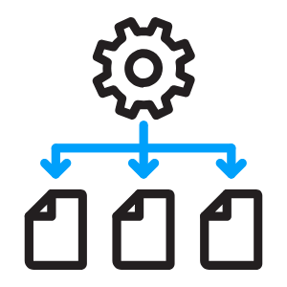





ABM Studio
LAYER 3 · THE 9 STEPS, IN DETAIL
9 steps divided into 4 phases
Finds
Writes
Checks
Personalizes
BRIEF
SUBSTANCE
BUILD
SHIP
1
2
3
4
5
6
7
8
9
Brief
Find
Draft
Brand check
Push Live
Approve
Personalize
Design
Measure
Interview
People · the idea, the expert, the sign-off, the design
AI · finds, writes, checks, personalizes, measures

Slide 17



LAYER 3 · PROCEDURES
One message, a version for every account
Many
100 to 500 accounts per region
One approved message
Few
20 to 50 per segment, by industry or role
Cherry
(Personalizes)
One
2 to 5 named accounts, an opening line each

Slide 18
4
LAYER FOUR
Delivery
Results in action
Daniele Quartana · Director, Marketing Operations (Global)
1 Outcomes
2 Knowledge base
3 Procedures
4 Delivery

Slide 19
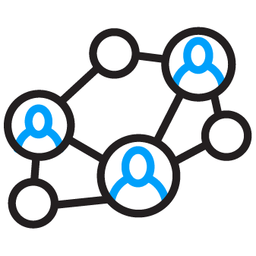


LAYER 4 · THREE AREAS
ABM is judged on three areas
LEADS
PIPELINE
BOOKINGS
94%
94%
of buying groups pick a favourite before first contact
47%
47%
say personalized content is their best-ROI ABM tactic
52%
52%
of marketing leaders can prove marketing's value and get credit
6sense, 2025 · 4,000+ buyers
Demand Gen Report, 2026
Gartner, 2024 · 378 leaders

Slide 20





LAYER 4 · WHAT THE AI READS
What we looked to improve in each area
LEADS
PIPELINE
BOOKINGS
Fix lead routing
Every lead on its account, to the right XDR
Personalization
A version per account, proof for every buyer
Correct attribution
Multi-touch attribution, human and technical credit fixes
6sense
ABM Studio
XDR: our sales development reps, inbound (IDR) and account-based (ADR).

Slide 21

LAYER 4 · WHAT IT MOVED
Results for each fix, and how it aided ABM
LEADS
PIPELINE
BOOKINGS
Match every lead to its account
A version for every account
Fix attribution errors
6sense
D&B
ABM Studio
39% → 94%
lead-to-account matching
+43% YoY
pipeline per ABM opportunity
$703K
re-attributed to marketing (Q4)

Slide 22
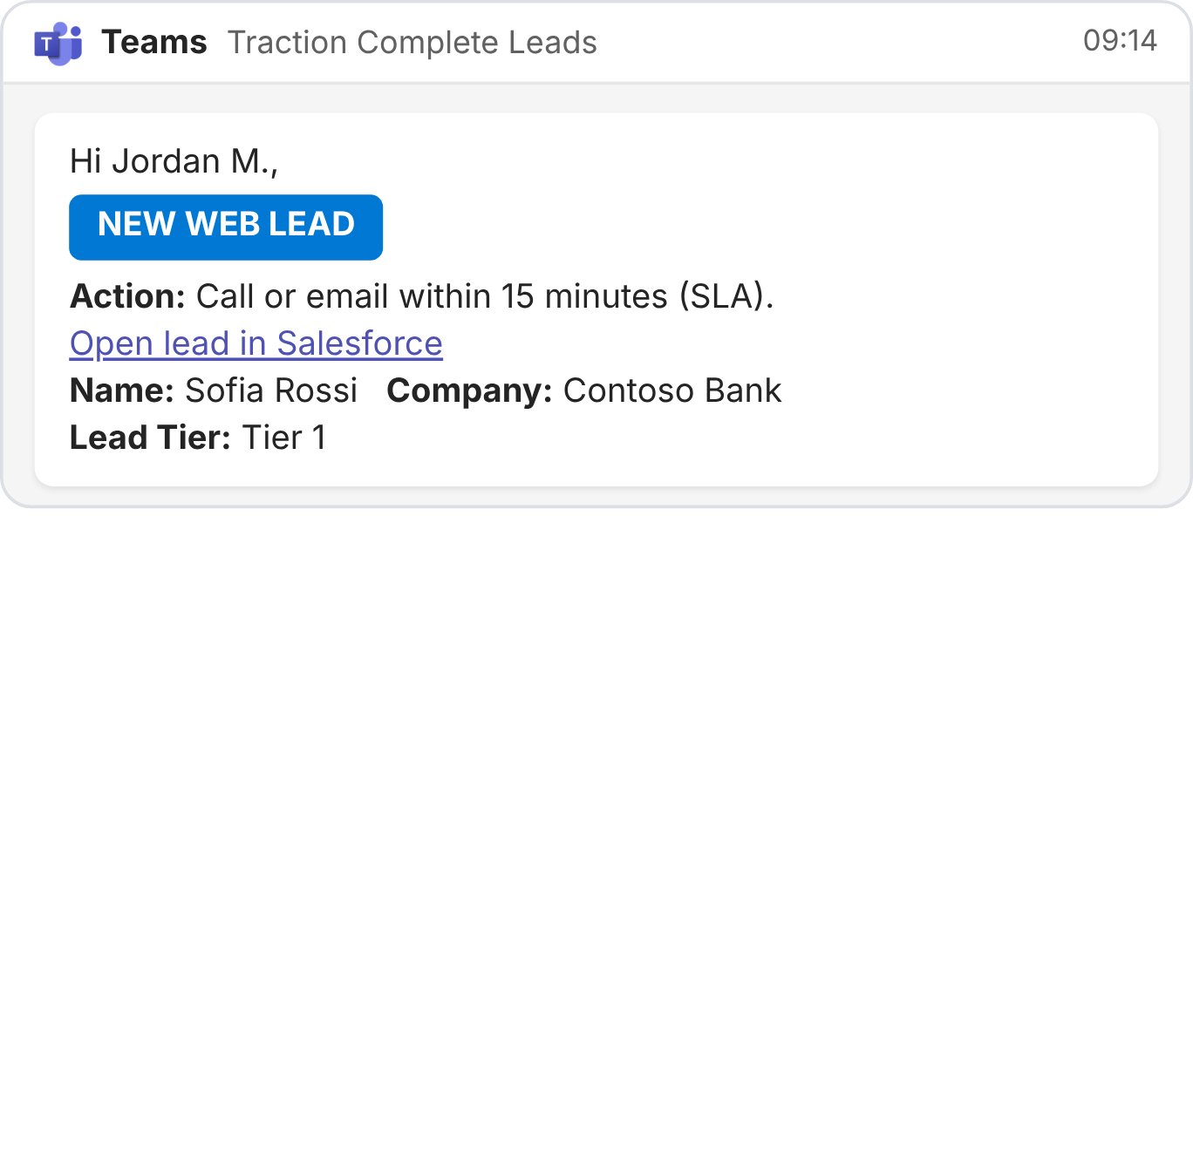
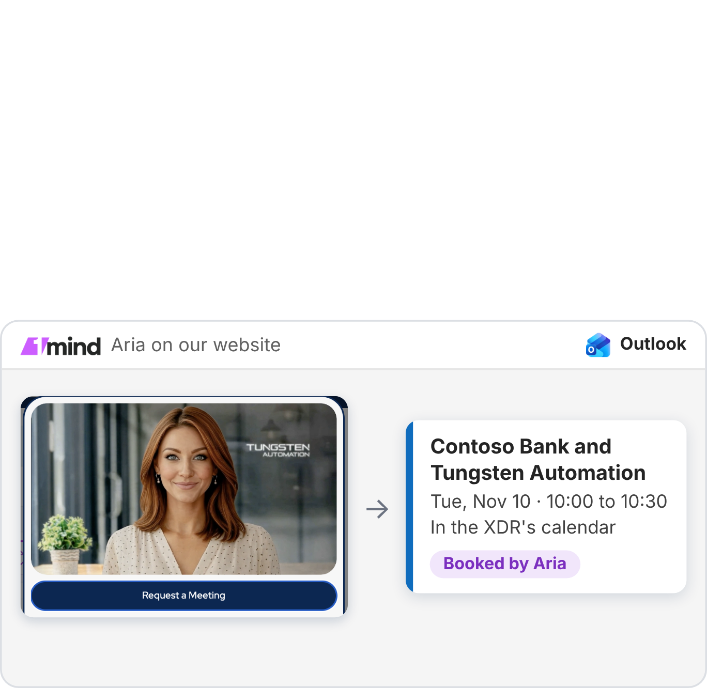
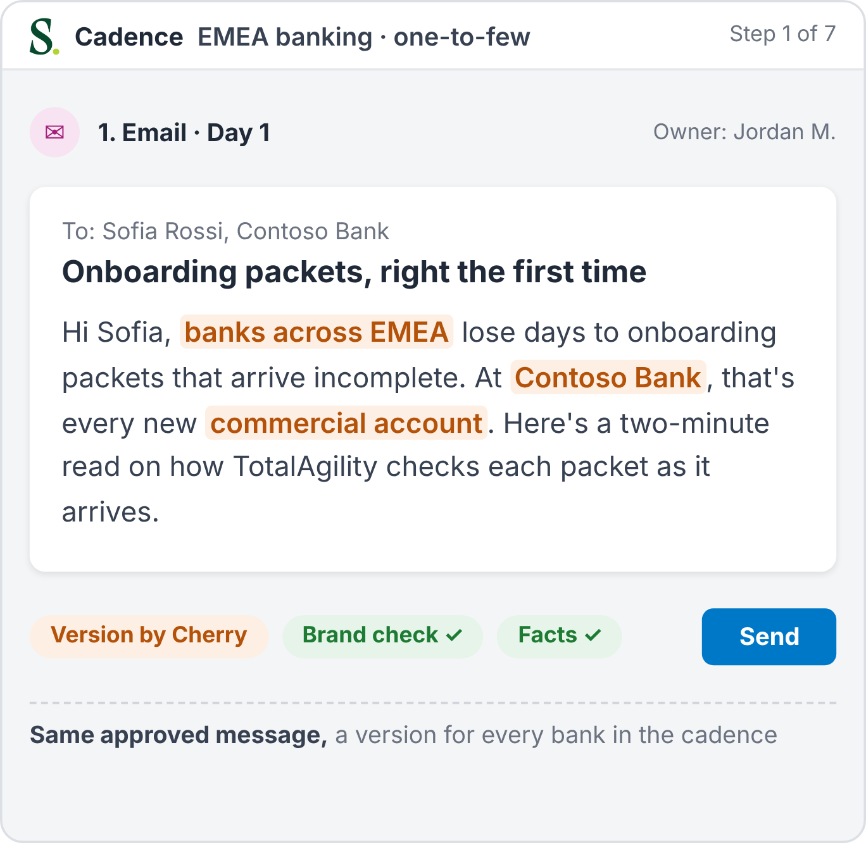
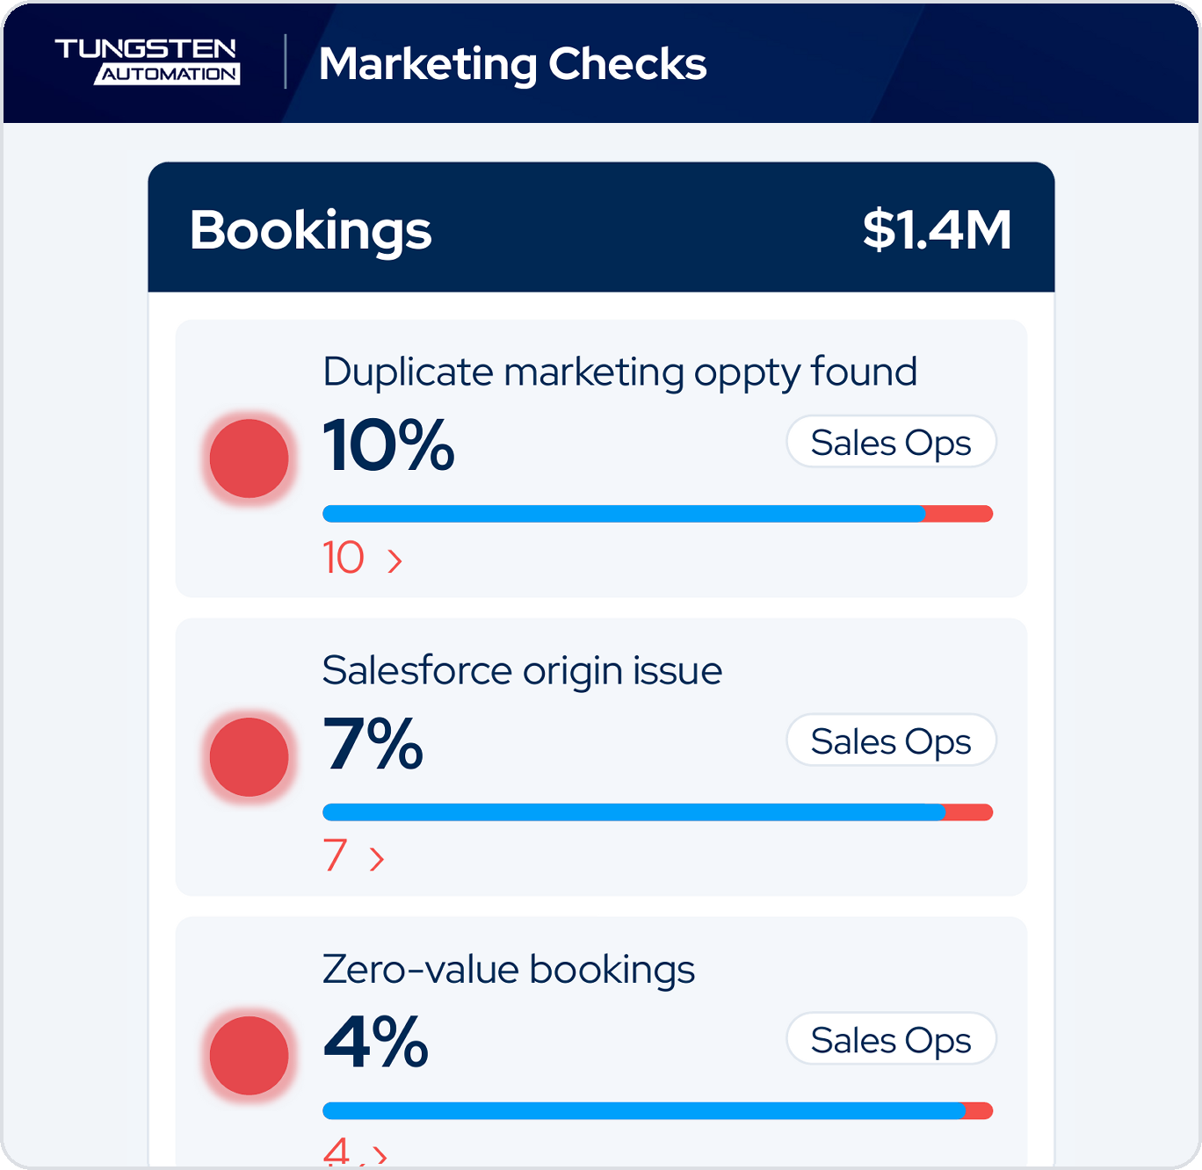
LAYER 4 · WHERE IT LANDS
Illustrative data
ABM Studio efforts land where the team works
LEADS
PIPELINE
BOOKINGS
Teams + Outlook
Personalized content
Marketing Checks

Slide 23

LAYER 4 · EVERY MONTH
Illustrative data
Every month: fix impact to ABM efforts
Marketing Checks
Marketing Operations
Fixes
Wins
Good
To fix
Campaigns ABM ▾
Month October 2026 ▾
Region All ▾
Team All XDRs ▾
Leads
1,240
Opportunities
$6.6M
Bookings
$1.4M
No first touch within 24 hours
No AE activity within 48 hours
Duplicate marketing oppty found
22%
XDR Mgmt
26%
Sales managers
10%
Sales Ops
273 ›
107 ›
10 ›
Not in a cadence
MEDDPICC issues
Salesforce origin issue
14%
XDR Mgmt
23%
AEs
7%
Sales Ops
174 ›
95 ›
7 ›
No lead-to-account match
No AE next step within a week
Zero-value bookings
9%
Marketing Ops
31%
AEs
4%
Sales Ops
112 ›
128 ›
4 ›

Slide 24

LAYER 4 · EVERY MONTH
Illustrative data
Every number opens to the records
Marketing Checks
Marketing Operations
Not in a cadence
✕
Fixes
Wins
Good
To fix
Campaigns ABM ▾
Month October 2026 ▾
Region All ▾
Team All XDRs ▾
Owner: XDR Mgmt
174 leads not in a cadence · Leads · October 2026
Leads
1,240
Opportunities
$6.6M
Bookings
$1.4M
LEAD ID
LEAD
COMPANY
OWNER (XDR)
REGION
XDR MANAGER
WAITING
00QPX00000kR7mT
Maya Chen
Contoso Bank
Jordan M.
EMEA
Elena V.
26 days
No first touch within 24 hours
No AE activity within 48 hours
Duplicate marketing oppty found
22%
XDR Mgmt
26%
Sales managers
10%
Sales Ops
00QPX00000kQ4xZ
Liam Turner
Fabrikam Logistics
Sam K.
EMEA
Elena V.
19 days
273 ›
107 ›
10 ›
00QPX00000kS1bH
Sofia Rossi
Northwind Traders
Lucia R.
Americas
Marcus D.
14 days
Not in a cadence
MEDDPICC issues
Salesforce origin issue
14%
XDR Mgmt
23%
AEs
7%
Sales Ops
00QPX00000kT9cW
Daniel Okafor
Woodgrove Bank
Priya S.
APAC
Marcus D.
9 days
174 ›
95 ›
7 ›
00QPX00000kU3dL
Hannah Weber
Litware Insurance
Jordan M.
EMEA
Elena V.
6 days
No lead-to-account match
No AE next step within a week
Zero-value bookings
9%
Marketing Ops
31%
AEs
4%
Sales Ops
Showing 5 of 174 · oldest first
Export
Open Salesloft
112 ›
128 ›
4 ›

Slide 25
LAYER 4 · EVERY MONTH
Illustrative data
Celebrate your ABM Studio wins
Marketing Checks
Marketing Operations
Fixes
Wins
Campaigns ABM ▾
Month October 2026 ▾
Region All ▾
Team All XDRs ▾
Leads
Opportunities
Bookings
TOP CAMPAIGN
Move Up 2.0
61 leads converted · $1.0M pipeline
TOP PUSH
Strategic accounts push
9 new opportunities · $647K pipeline
LARGEST BOOKING
$60K ACV
TotalAgility · 14 months to close
TOP XDR · LEAD CONVERSION
Jordan M.
14 leads converted to opportunities
TOP NEW OPPORTUNITY
$240K ACV
AP automation · Northwind Traders
TOP REGION
EMEA
48% of new licence value booked
AI WEBSITE AGENT
Aria (1mind)
14 meetings booked
MOST SALES ACCEPTED OPPORTUNITIES
Priya S.
XDR · 7 reached SQO
TOP CAMPAIGN
Summit follow-up
$1.1M booked · 101% of goal

Slide 26

LAYER 4 · EVERY MONTH
Illustrative data
Every win celebrates the people behind it
Marketing Checks
Marketing Operations
Strategic accounts push
ABM Studio
✕
Fixes
Wins
Campaigns ABM ▾
Month October 2026 ▾
Region All ▾
Team All XDRs ▾
9 new opportunities · $647K pipeline · Opportunities · October 2026
Leads
Opportunities
Bookings
OPP ID
OWNER (XDR)
ACCOUNT
CAMPAIGN NAME
DEPARTMENT
CAMPAIGN OWNER
ACV
O-1251187
Jordan M.
Contoso Bank
Summit follow-up
Field Marketing
Clara M.
$112K
TOP CAMPAIGN
Move Up 2.0
61 leads converted · $1.0M pipeline
TOP PUSH
Strategic accounts push
9 new opportunities · $647K pipeline
LARGEST BOOKING
$60K ACV
TotalAgility · 14 months to close
O-1251342
Priya S.
Woodgrove Bank
CFO roundtable
Field Marketing
Owen R.
$96K
O-1251409
Sam K.
Fabrikam Logistics
Intent nurture
Demand Generation
Nadia K.
$88K
O-1251566
Lucia R.
Northwind Traders
AP webinar
Demand Generation
Leo F.
TOP XDR · LEAD CONVERSION
Jordan M.
14 leads converted to opportunities
TOP NEW OPPORTUNITY
$240K ACV
AP automation · Northwind Traders
$81K
TOP REGION
EMEA
48% of new licence value booked
O-1251620
Omar H.
Litware Insurance
Intent ads
Demand Generation
Nadia K.
$74K
AI WEBSITE AGENT
Aria (1mind)
14 meetings booked
MOST SALES ACCEPTED OPPORTUNITIES
Priya S.
XDR · 7 reached SQO
TOP CAMPAIGN
Summit follow-up
$1.1M booked · 101% of goal
Showing 5 of 9 · largest first
Export
Share

Slide 27

TODAY, IN FOUR LAYERS
Outcomes first, then automation
1
Outcomes: decide what you should change
2
Knowledge base: create one library your AI can read
3
Procedures: give each agent one clear job
4
Delivery: govern the data, celebrate the wins

Slide 28
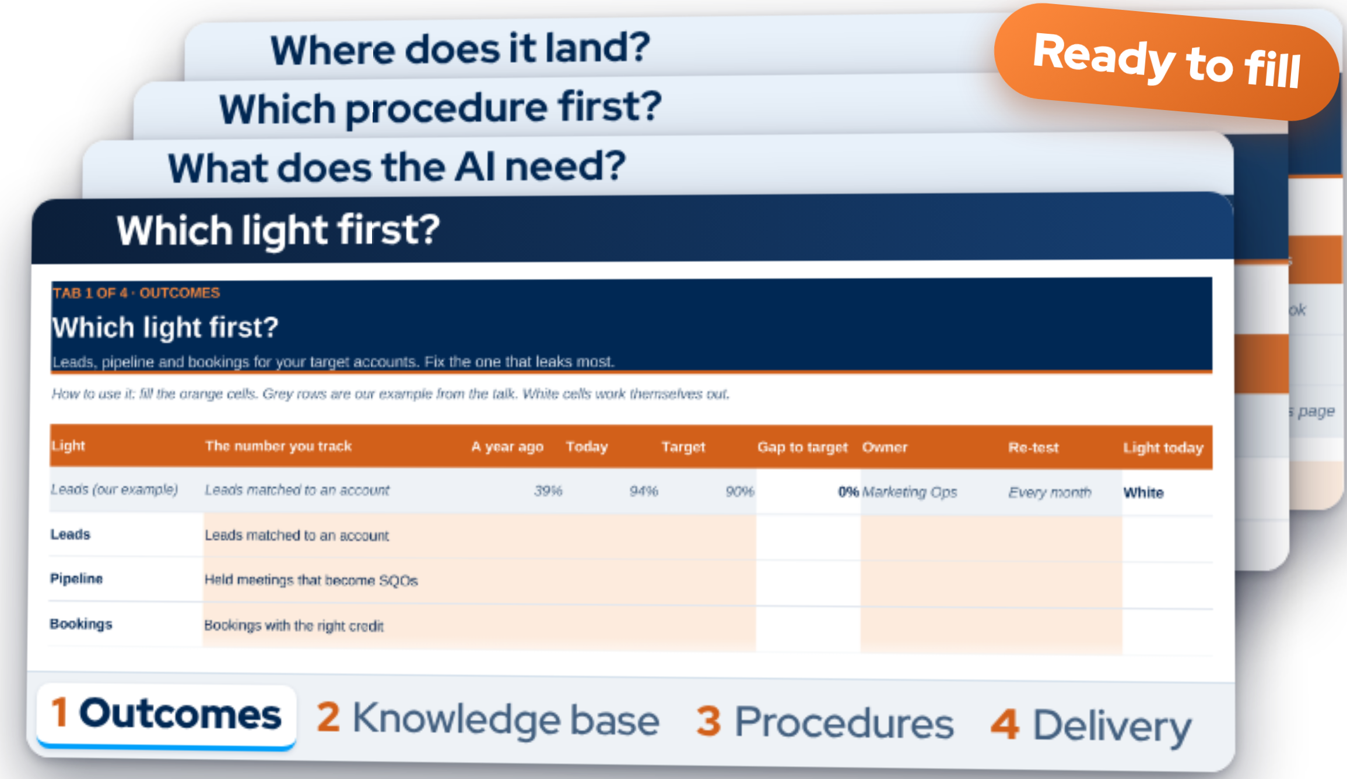
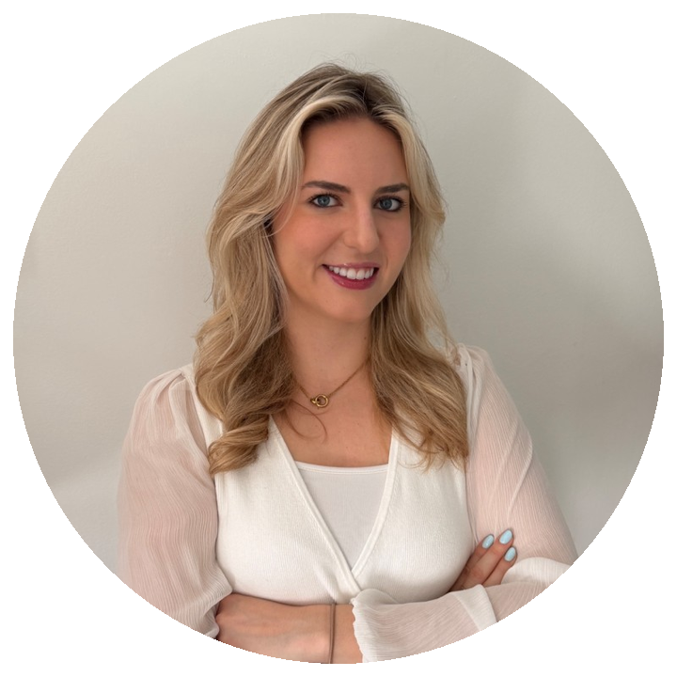
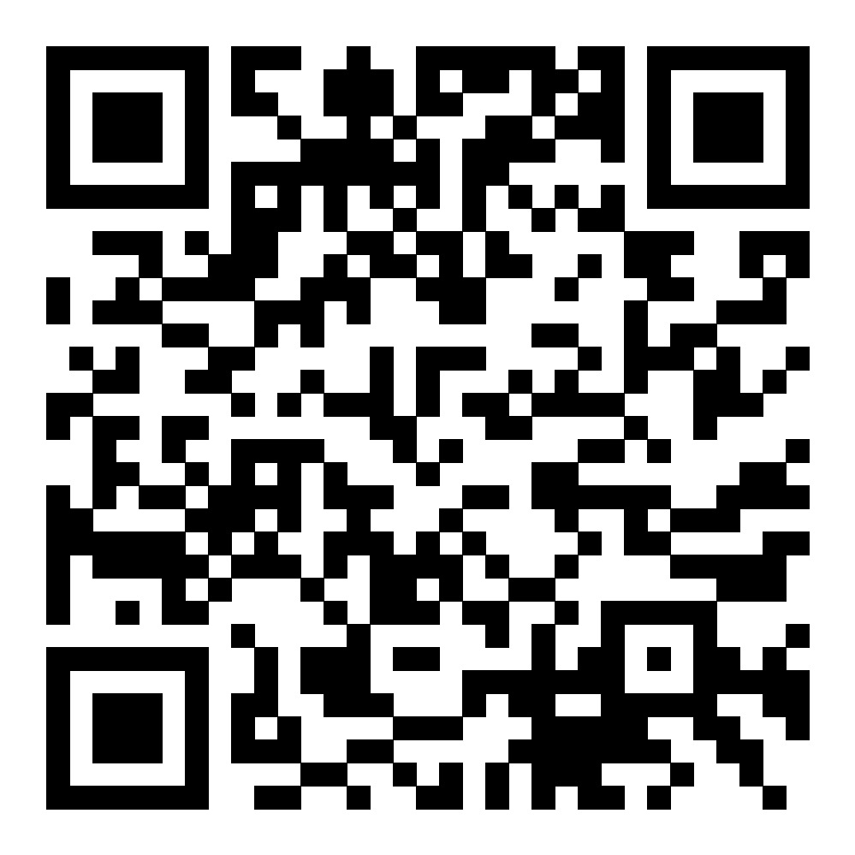
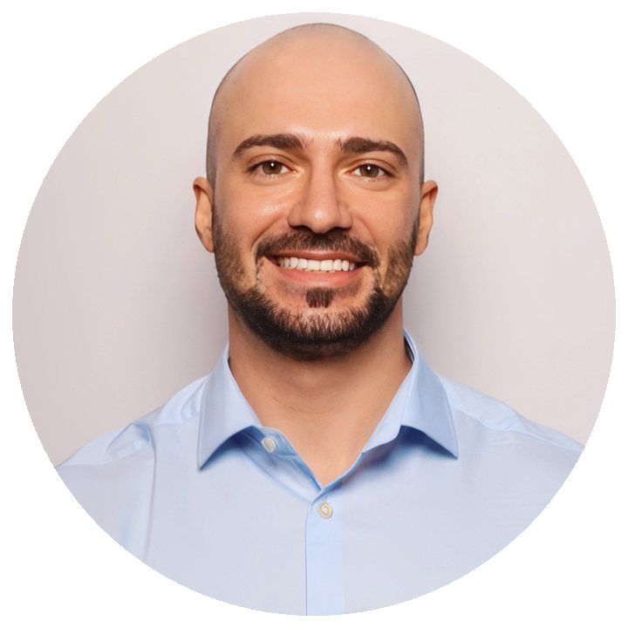

THE ABM STUDIO BUILD GUIDE
Scan the QR code for templates and to connect with us!
The workbook One tab per layer
Connect with us
4
Inês Piçarro
ABM and AI Transformation Manager
3
2
1
Daniele Quartana
Director, Marketing Operations (Global)
Starter pack
Workbook + today's PowerPoint

