Slide 1

Network and Computer Security
Retail: GrooveGalaxy
99236 Inês Pissarra
99261 Juliana Marcelino
99275 Mário Santos
Notes:
Hi everyone! We’re here to talk about GrooveGalaxy, the best music streaming app ever

Slide 2
Secure Document Library and Tool

Slide 3
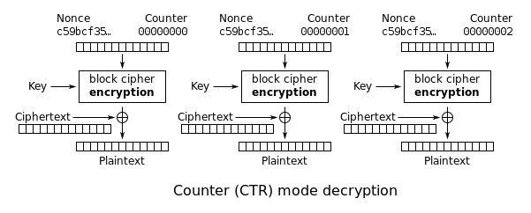
Secure Document Library and Tool
Protect with CTR
This encryption method allows you to decrypt content that is in the middle of the file.
Notes:
First I want to talk about the protect command.
In order to ensure the confidentiality, we created an IV, which is incremented throughout the blocks, and then we used a CTR cipher to encrypt all the data.
This encryption method allows to decrypt content that is in the middle of the file, which was one of our security challenge tasks
Extra —-----------—-----------—-----------—-----------—-----------
There is no need of padding with this method, since it transforms a block cipher into a stream cipher (with the use of the xor)

Slide 4


Secure Document Library and Tool
Protect with Nonce
To ensure the freshness, a nonce composed of a counter and a timestamp is implemented. This prevents replay attacks and old messages from being processed.
Notes:
To ensure the freshness, a nonce composed of a counter and a timestamp is implemented. This prevents replay attacks and old messages from being processed.

Slide 5
Secure Document Library and Tool
Protect with MAC
To ensure the integrity of the file, we used a MAC (with 256 bits) algorithm.
Encrypt-then-MAC:
It was used EtM method so that we can test the integrity of the file without having to decrypt it
Notes:
Finally, to ensure the integrity of the file, we used a MAC algorithm. All data including nonce and IV are encrypted, and this way we guarantee that our data is not changed.
It is also used Encrypt-then-MAC method so that we can test the integrity of the file without having to decrypt it.

Slide 6
Secure Document Library and Tool
Check
Uses MAC algorithm and checks the freshness of the file by comparing the nonce components, counter and timestamp with the current ones.
Unprotect
Reverses the protection process. Calls the check class to verify the integrity, and decrypts the file content using AES in CTR mode with the key and initialization vector (this last provided on the JSON).
Notes:
About other commands:
Check uses MAC algorithm and checks the freshness of the file by comparing the nonce components, counter and timestamp with the current ones.
Unprotect reverses the protection process. It starts by calling the check class to verify the integrity, and then decrypts the file content using AES in CTR mode with the key and initialization vector.

Slide 7
Secure Document Library and Tool
Encrypted File Structure:
iv: _________
encrypted File: _________
Nonce:
Counter: _________
Timestamp: _________
MAC: (all previous data encrypted)
Notes:
And this is the final structure of the encrypted file

Slide 8
Structure Of The System

Slide 9
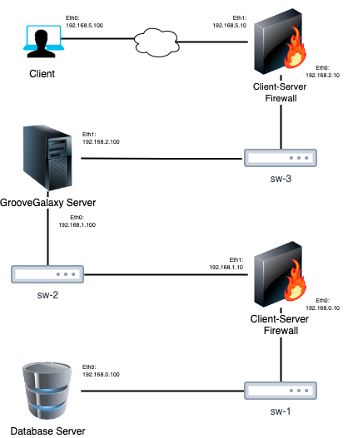
Structure Of The System
Virtual machines each with one of the following (total of 5 VMs):
1 Client
2 Firewalls
2 Servers (1 Main and 1 Database)
Notes:
Firewalls control, filter and monitor data traffic based on rules. This way the client, for example, communicates with the server without knowing its address.
It is also worth noting that the database is encrypted.

Slide 10
Secure Channels

Slide 11
Secure Channels
Client and the server communicate via gRPC
Both client-server and server-database communications use Transport Layer Security (TLS) and one CA for each communication.
Notes:
Client and the server communicate via gRPC
Both client-server and server-database communications use Transport Layer Security (TLS) that gives confidentiality and one CA for each communication granting authenticity. The server has two keys, one for each communication.
We have one CA that signs the keys of client and server (the respective key to this communication) and the other to sign the keys of server and database. This distribution is hand-made by the admin.

Slide 12
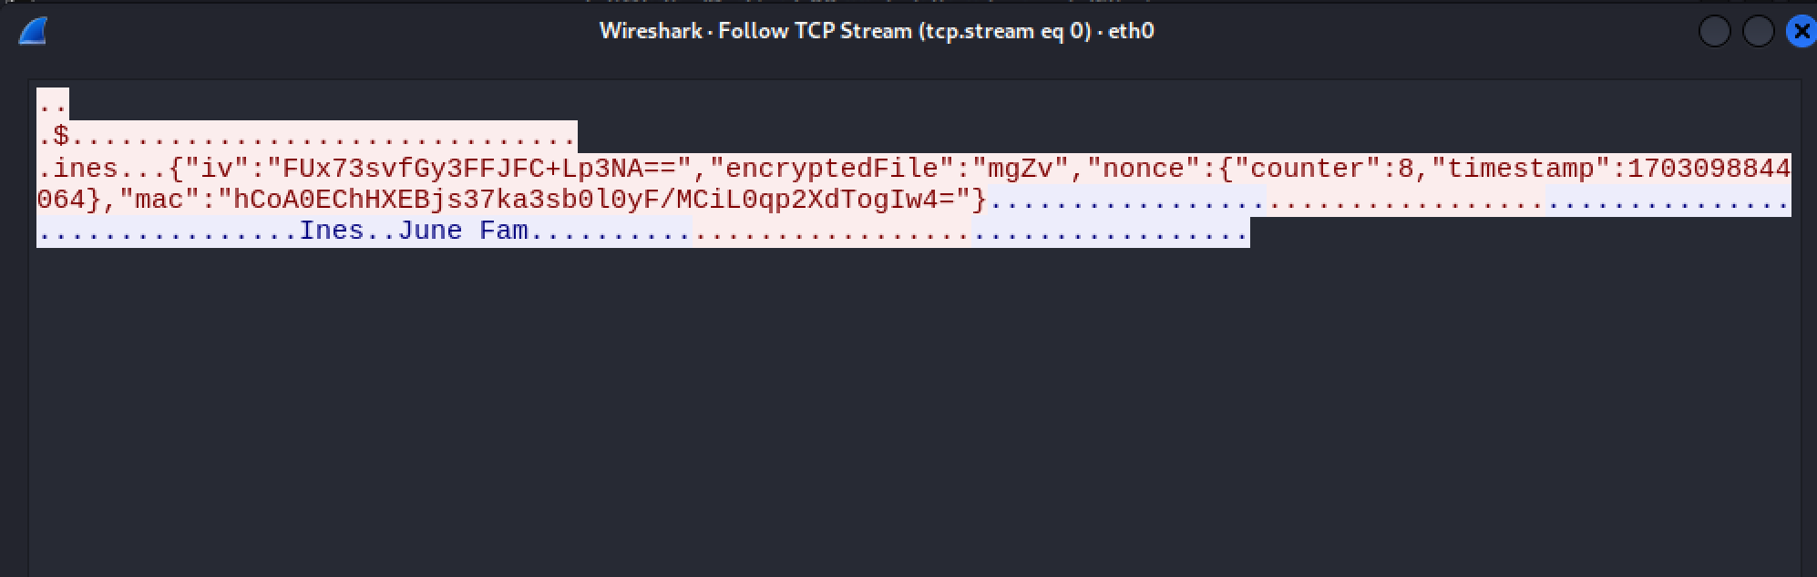
Secure Channels
Encryption without TLS (client-server)

Slide 13
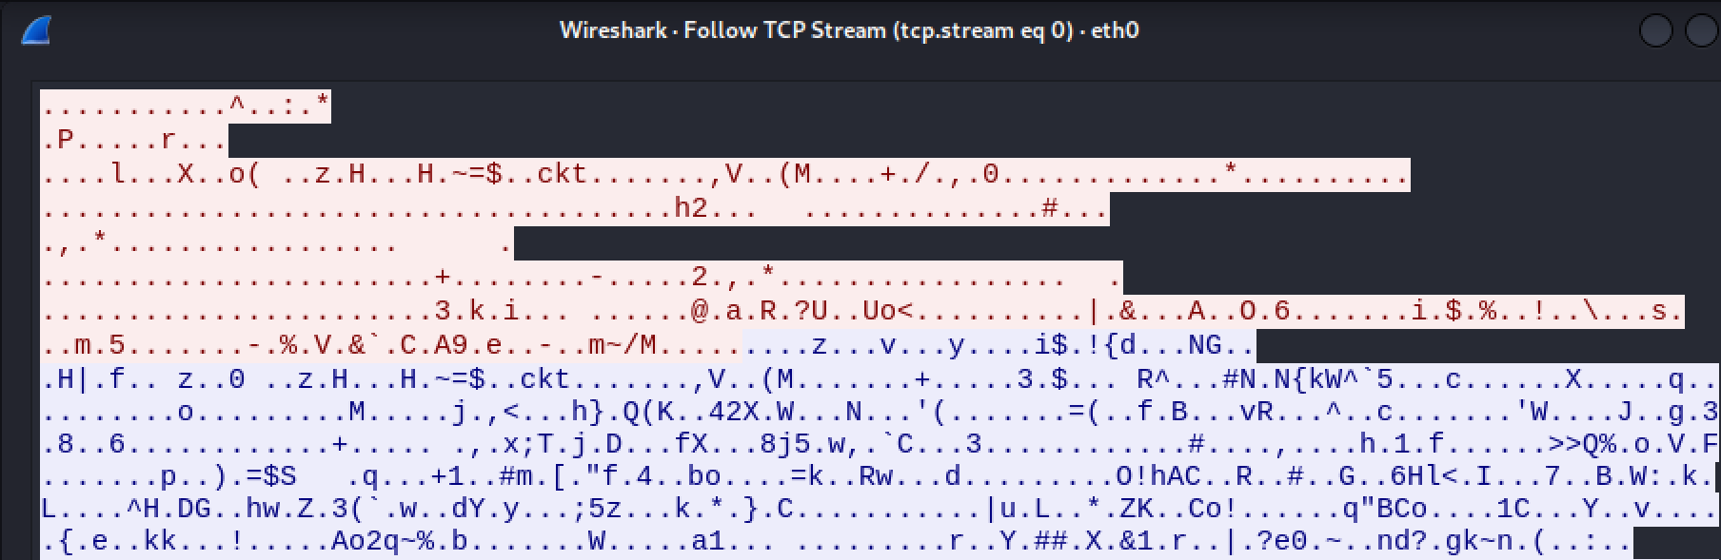
Secure Channels
Encryption with TLS (client-server)

Slide 14
Security Challenge

Slide 15

Family sharing
Each family has its own key that is sent to the family members when they join the family. The keys are encrypted with the member’s key when distributed.
This way, each family member has their own key and the family key.
Notes:
Each family has its own key that is sent to the family members when they join the family. The keys are encrypted with the member’s key when distributed.
This way, each family member has their own key and the family key.
A small aside: we also have a global key for commands we agreed there was no problem running without being logged in (like getSongs which returns the list of all songs)
To create a family, the person writes a name and a family code. To join the family, the person needs to know the code of that family.

Slide 16

Playback in the middle of an audio stream
Using CTR we can decrypt from the middle of a file, so it’s possible to decrypt the song from any place we want.
It works like a normal command “play” but when unprotecting the file for the client, we securely decrypt the part from where the client wants until the end, leaving the beginning encrypted.
Notes:
Initially we were using CBC but after decided to change so that we could incorporate the challenge.
Using CTR we can decrypt from the middle of a file, so it’s possible to decrypt the song from any place we want.
It works like a normal command “play” but when unprotecting the file for the client, we securely decrypt the part from where the client wants until the end, leaving the beginning encrypted.

Slide 17
Demonstration

