Slide 1
RPL-Observations
- Rahul (IETF 107)

Slide 2
Updates
Added clarification with respect to “Trickle timer reset”
Backward Compatibility issues with new RPL Control Options

Slide 3
DAO-ACK handling
Briefly the problem
DAO-ACK is local in case of storing MOP
Target not aware of E2E path establishment
If a intermediate-6LR returns -ve DAO-ACK status, target is not informed of it.

Slide 4
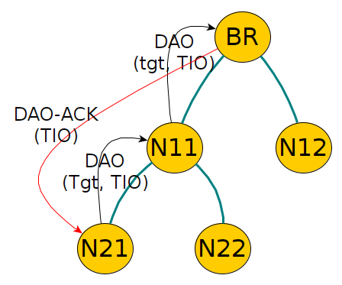
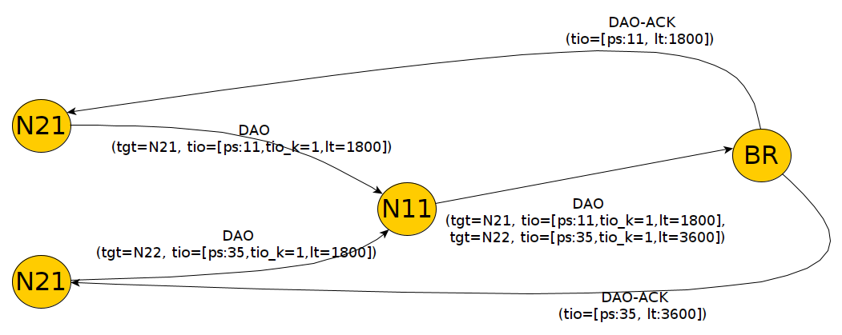
Proposition (draft-jadhav-roll-storing-rootack)
TIO = Transit Information Option

Slide 5
Proposition (draft-jadhav-roll-storing-rootack)
Root sends the DAO-ACK back “directly” to target
Target sets a flag in TIO to indicate Root to do this.
Address of target in Target Option
Root sends TIO option in DAO-ACK
TIO needed for PathSequence
Overall, just 1-bit change in TIO
0 1 2 3
0 1 2 3 4 5 6 7 8 9 0 1 2 3 4 5 6 7 8 9 0 1 2 3 4 5 6 7 8 9 0 1
+-+-+-+-+-+-+-+-+-+-+-+-+-+-+-+-+-+-+-+-+-+-+-+-+-+-+-+-+-+-+-+-+
| Type = 0x06 | Option Length |E|K| Flags | Path Control |
+-+-+-+-+-+-+-+-+-+-+-+-+-+-+-+-+-+-+-+-+-+-+-+-+-+-+-+-+-+-+-+-+
| Path Sequence | Path Lifetime | |
+-+-+-+-+-+-+-+-+-+-+-+-+-+-+-+-+ +
TIO = Transit Information Option

Slide 6
Following points are considered
Handling Target aggregation in DAO
Handling multiple DAOs in progress with different PathSequence
Handling prefixes in Target Option
How would a root know the Target address when the Target Option contains prefix?
What happens if a intermediate-6LR sends a -ve status in DAO-ACK?
Handling multiple preferred parents
Runtime memory efficiency
Incremental update possible: Root and subset of nodes can be upgraded.

Slide 7
Next Steps
What’s the plan?
DAO-ACK ... New draft in progress
Not sure how to organize
DTSN handling ... best practices draft?
Path control bits, lollipop counters (seq-window size recommendations, restart handling, worst case scenarios)
Should we extend the current observations draft itself?
Or a new draft with all combined?

