Slide 1
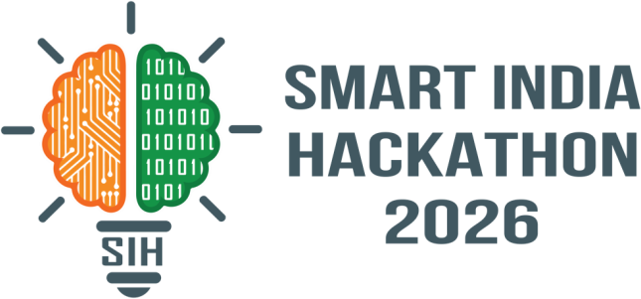
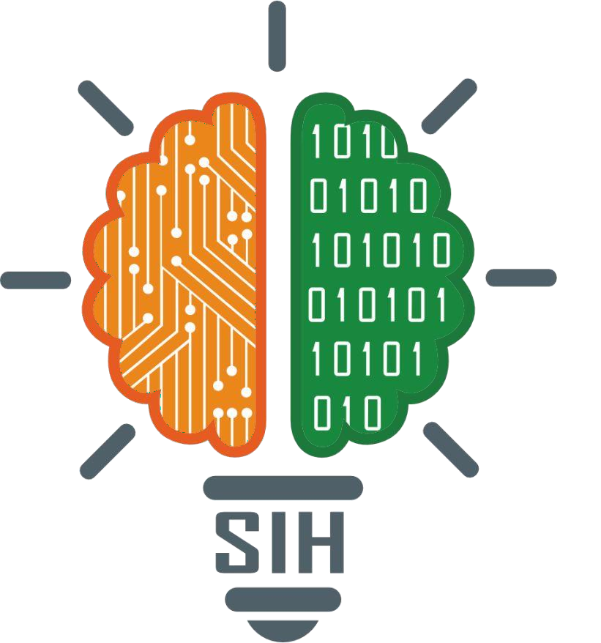
SMART INDIA HACKATHON 2026
TITLE PAGE
Problem Statement ID – SIH26042
Problem Statement Title – AI-Powered Vernacular Pedagogy and Real-Time Translation Tool for Mother Tongue-Based Primary Education
Theme – Smart Education
PS Category – Software
Team ID –
Team Name (Registered on portal) – Loading…

Slide 2
IDEA TITLE
Loading…
Curriculum-Synced Classroom Translation Companion for Ho, Mundari & Santhali Linguistic Tribes
THE PROBLEM
Only 23% of Grade-1 children in Jharkhand's tribal-area schools understand Hindi (PALASH language mapping survey, 2024) — most speak Ho, Mundari
or Santhali at home
5,000+ tribal-area schools need MTB-MLE, but Hindi-medium-trained teachers lack tribal-language proficiency — the core bottleneck blocking PALASH from scaling
General-purpose tools (e.g. Adi Vaani) solve one-off phrase translation — not real-time, curriculum-synced classroom teaching dialogue
OUR SOLUTION
AI-assisted translation & curriculum companion built for the PALASH FLN classroom — not a general translator
Curriculum-bounded Hindi ↔ Ho/Mundari/Santhali phrase-matching engine mapped directly to NIPUN Bharat FLN content
Real-time two-way voice dialogue between teacher and student, sub-3-second latency, fully offline on ≤2GB RAM tablets
Auto-generated bilingual worksheets & visual flashcards aligned to FLN learning outcomes
INNOVATION & UNIQUENESS
Adi Vaani solves general-purpose translation; we solve classroom-embedded, curriculum-synced teaching dialogue — a narrower, deployable-first problem
Honest, curriculum-bounded scope (~2,000–3,000 FLN words) makes accurate low-resource translation realistic today, instead of overpromising open-
domain MT
• Two-way interactive loop with graceful no-match fallback + teacher feedback loop that keeps improving the phrase bank

Slide 3
TECHNICAL APPROACH
Loading…
TECHNOLOGY STACK
CLASSROOM INTERACTION FLOW (TWO-WAY, WITH FALLBACK)
FRONTEND — Android (Kotlin, Offline-First)
Teacher Dashboard · Live Voice Companion · Worksheet/Flashcard Generator
ON-DEVICE AI ENGINE — TF Lite / ONNX (Quantized)
ASR: IndicWav2Vec/Vosk · Curriculum-Bounded Match & Retrieval Engine · TTS: Vakyansh/VITS
LOCAL STORAGE
SQLite — Curriculum Cache, FLN Phrase Bank & Translation Memory
BACKEND — Cloud (periodic sync only)
Node.js/FastAPI API Gateway · PostgreSQL Curriculum & Phrase-Bank DB · Update Server
Teacher speaks Hindi
↓
ASR captures & normalizes speech
↓
Match against FLN phrase bank
↓
Match found → play tribal-language audio to student
↓
Student responds → reverse match → Hindi output to teacher
No match → flagged & logged → added to phrase-bank expansion queue for teacher review
DATA SOURCES & SECURITY
PALASH FLN Curriculum + AI4Bharat/Bhashini (bootstrap & validation) · Teacher feedback loop · JWT + AES-256

Slide 4
FEASIBILITY AND VIABILITY
Loading…
FEASIBILITY
PALASH already has curated Hindi FLN curriculum content ready to seed the phrase bank
FLN vocabulary is domain-bounded (~2,000–3,000 words) — a realistic scope for accurate curation, unlike open-domain MT
AI4Bharat / Bhashini provide reference models & tooling to bootstrap and validate the pipeline, not a dependency for full fine-tuning
Retrieval-based matching (not generative inference) keeps latency low and works fully offline on ≤2GB RAM devices
CHALLENGES & RISKS
MITIGATION STRATEGIES
⚠ Very limited existing digital parallel corpora for Ho and Mundari
specifically
➤ Start with Santhali (Ol Chiki script, strongest existing resource base),
then expand to Ho & Mundari
⚠ Dialect variation within a single tribal language
➤ Partner with PALASH linguists & native speakers for structured validation sprints to build the seed phrase bank
⚠ Teacher trust/adoption of AI-suggested translations
⚠ Intermittent connectivity for the initial content sync in remote schools
➤ Human-in-the-loop design — teachers approve/correct translations
before use, feeding continuous improvement
➤ Offline-first architecture with Wi-Fi hotspot / SD-card sync fallback for zero-connectivity schools

Slide 5
IMPACT AND BENEFITS
Loading…
Target Audience: Teachers & students across 5,000+ tribal-area primary schools in Jharkhand under the PALASH MTB-MLE programme
5,000+
tribal-area primary
schools reachable
3
languages addressed
(Ho, Mundari, Santhali)
<3 sec
voice translation
latency, fully offline
Educational
Social
Economic
Scalability
Enables genuine mother-tongue instruction; improves foundational literacy & numeracy outcomes aligned to NIPUN Bharat targets.
Removes the teacher-language bottleneck blocking MTB-MLE at scale; children learn in the language they understand at home.
Cuts the cost and time of recruiting/training native tribal-language teachers — technology bridges the gap.
Retrieval-based framework is language-agnostic in design — extensible to other underserved mother tongues beyond Jharkhand.
POLICY ALIGNMENT
Directly supports the NIPUN Bharat Mission and NEP 2020 mandate for mother-tongue / home-language-based foundational education, and strengthens the state's MTB-MLE (PALASH) rollout at scale without requiring large-scale hiring of tribal-language teachers.
5

Slide 6
RESEARCH AND REFERENCES
Loading…
PALASH Programme – Dept. of School Education & Literacy, Govt. of Jharkhand — MTB-MLE case study featured in UNESCO's State of the Education Report for India 2025
NIPUN Bharat Mission – Ministry of Education, Govt. of India — Foundational Literacy & Numeracy (FLN) guidelines
AI4Bharat – IndicTrans2, IndicWav2Vec, Vakyansh TTS — open Indic-language NLP models — ai4bharat.iitm.ac.in
Digital India Bhashini Mission – National multilingual AI translation platform — bhashini.gov.in
Adi Vaani – Ministry of Tribal Affairs' AI tribal-language translator (IIT Delhi-led consortium) — reference point for differentiation: general-purpose translation vs. our classroom-embedded, curriculum-synced approach
NCERT – Foundational Literacy and Numeracy (FLN) curriculum framework
6

