Slide 1
Parallelization: process and architectures
Inf-2202 Concurrent and Data-intensive Programming
Fall 2017
Lars Tiede (lars.tiede@uit.no)

Slide 2
Outline
The parallelization process
“How to parallelize programs”
Based mostly on book chapters 2 and 3 in Parallel Computer Architecture: A Hardware/Software Approach. David Culler, J.P. Singh, Anoop Gupta. Morgan Kaufmann. 1998
Also a few of Lars Ailo Bongo’s slides from last year (lectures 5-6)
Parallel (hardware) architectures
If we have time! Just for an overview of what’s out there
CPUs with special instructions, multicore CPUs, GPUs, clusters, clouds…

Slide 3
Parallelization process: goals
High performance
solve larger problems, solve them faster
Efficient resource utilization
waste no time, energy, money, on processors being idle or busy with overhead (work)
Low developer effort
parallel program should be reasonably simple, little overhead (code) compared to sequential program
Goals are sometimes at odds with each other
Different hardware architectures favor different solutions
Notes:
When are processors idle?
When there is no work (duh)
When they wait on some synchronization event
When they wait on I/O, memory access
What constitutes overhead?
Communication between processes (esp. when using message passing)
Synchronization
Context switches between OS threads / processes
Rigging up data for processes (prep) and
Aggregation of results

Slide 4
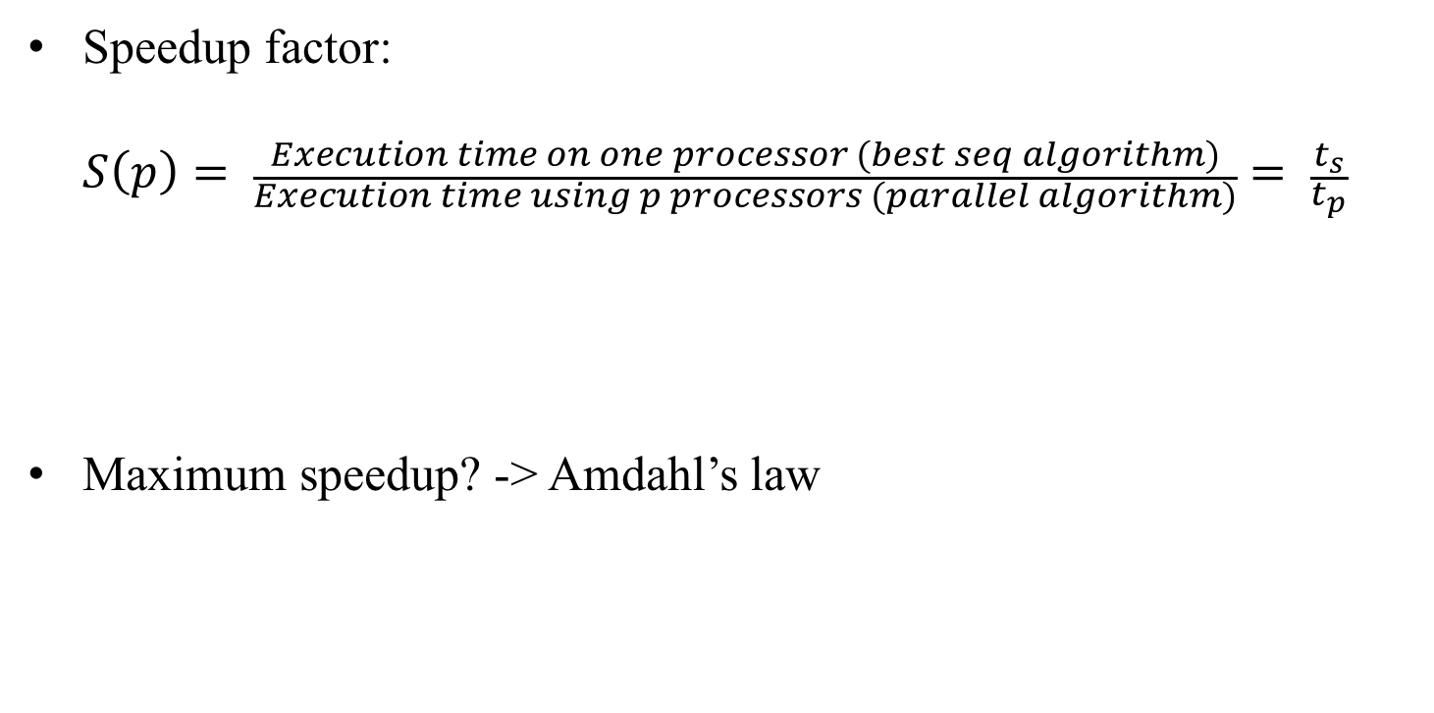
Performance: (Maximum) speedup
Speedup factor: $S\left(p\right)= \frac{Execution time on one processor (best seq algorithm)}{Execution time using p processors (parallel algorithm)}= \frac{t_{s}}{t_{p}}$
Maximum speedup? -> Amdahl’s law
Notes:
How much performance can we possibly get?
Algorithms for sequential processor and parallel algorithm will be at least slightly different. It would be unfair to compare the parallel algorithm on p processors against the parallel algorithm on one processor.

Slide 5
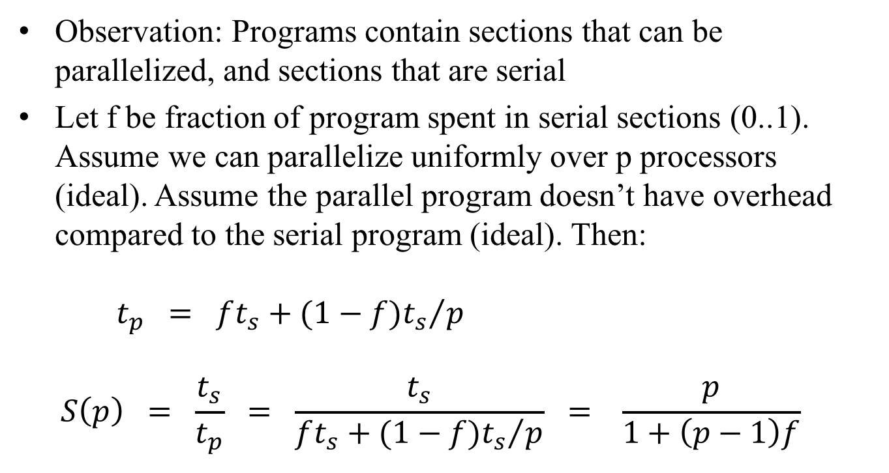
Amdahl’s law
Observation: Programs contain sections that can be parallelized, and sections that are serial
Let f be fraction of program spent in serial sections (0..1). Assume we can parallelize uniformly over p processors (ideal). Assume the parallel program doesn’t have overhead compared to the serial program (ideal). Then: $t_{p} = ft_{s}+{(1−f)t_{s}}/p$ $S\left(p\right) = \frac{t_{s}}{t_{p}} = \frac{t_{s}}{ft_{s}+{(1−f)t_{s}}/p} = \frac{p}{1+\left(p−1\right)f}$

Slide 6

Maximum speedup (Amdahl’s law)
For p processors, speedup is: $S\left(p\right)=\frac{p}{1+\left(p−1\right)f}$
Maximum speedup: f=0 (i.e. no serial sections in program) $S\left(p\right)=p$

Slide 7
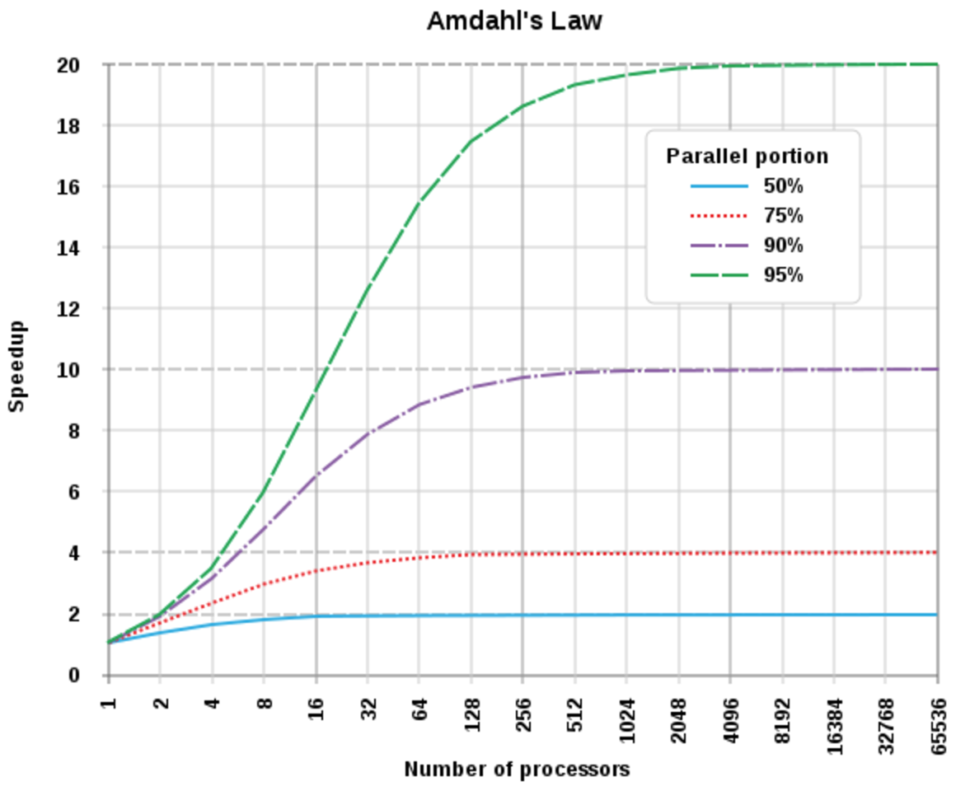
Speedup against number of processors
Image CC-BY-SA Daniels220 on wikipedia

Slide 8
Superlinear speedup
In practice, we sometimes measure speedups greater than p (“superlinear speedup”)
This due to:
Hardware, for example extra memory in multiprocessor system
Nondeterministic algorithms
Search algorithms (e.g. when finding result in p-th partition)

Slide 9
Parallelization process: nomenclature
Task: piece of work
Process/thread: entity that performs the work
Processor/core: physical processor cores

Slide 10
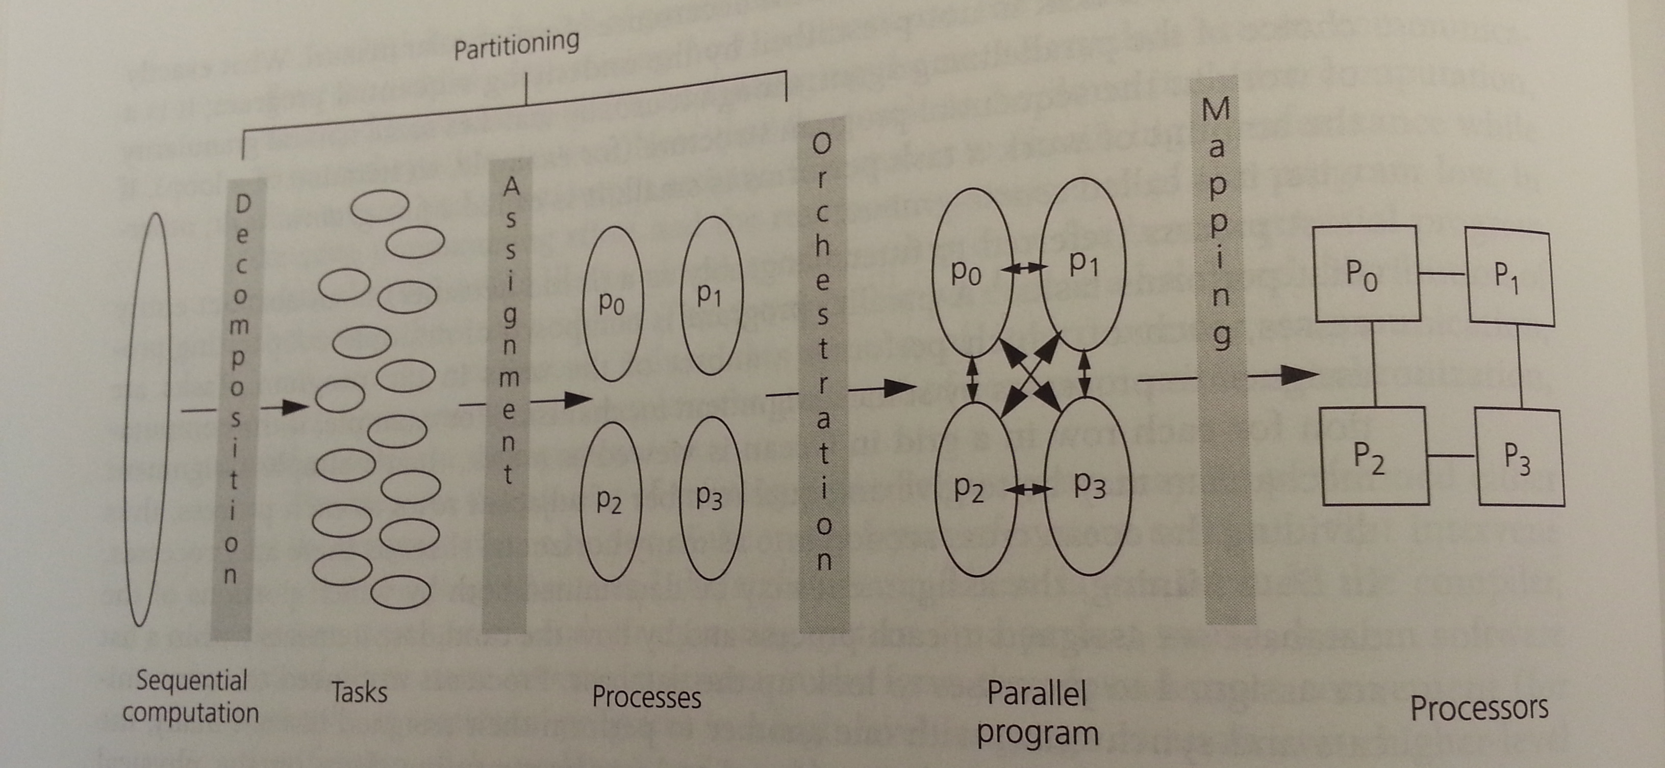
Parallelization process: steps (overview)
Notes:
Decomposition of the computation into tasks
Assignment of tasks to processes
Orchestration of necessary data access, communication, and synchronization among processes
Mapping of processes to cores

Slide 11
Parallelization process: decomposition
Split computation into a collection of tasks
Goal: expose opportunities for parallelism
Task granularity (-> # tasks) limits parallelism
Deals mostly with algorithm, less with hardware architecture

Slide 12
Slightly abstract example: pizza preparation
Task decomposition from simple sequential algorithm:
For each of the many pizzas (each with a spec) you want to make:
Prepare dough
Let dough rise
Roll out dough
Sauce
Toppings (several tasks, one for each? Tasks for preparing toppings?)
Bake
Cut to slices

Slide 13
Very concrete example: word count in Python
f = open(“huge_text_file.txt”, “r”)
wordcount = {} # { word: count }
for w in f.read().split():
wordcount[w] = wordcount.get(w,0) + 1
for item in wordcount.items():
print(“{}\t{}”.format(*item))
Possible decomposition into tasks that expose opportunities for parallelism?
Read the file into text. Perhaps not whole but in chunks? (Many tasks then)
Split text(s) at word boundaries, yield word after word
Count word(s) (could go crazy and say it’s one task per word)
Print result
Is the above the only decomposition?

Slide 14
Common decomposition tactics (given a sequential program)
Look at loops in the sequential program - can we decompose a loop into its iterations?
Works well if an iteration does not depend on the result of a previous iteration
If an iteration uses results of earlier iterations, we have a data dependency that will at least cost us later, maybe make parallelization outright impossible
If the sequence of iterations is critical wrt correctness, we call the loop a “sequential loop”. Can’t parallelize this.
Maybe rewrite loops?
We may get rid of data dependencies by using private instead of shared data structures (but this necessitates merging those later on)
Modify algorithm or use another one
Requires good understanding of the underlying problem

Slide 15
Parallelization process: assignment
Goal: load balancing
All processes should do equal amount of work
Important for performance and resource efficiency
Goal: reduce communication volume
Communication is not free (might be very expensive), so send around minimum amount of data, and minimum amount of messages
Deals mostly with algorithm, less with hardware architecture
Two types: static and dynamic (next slides)

Slide 16
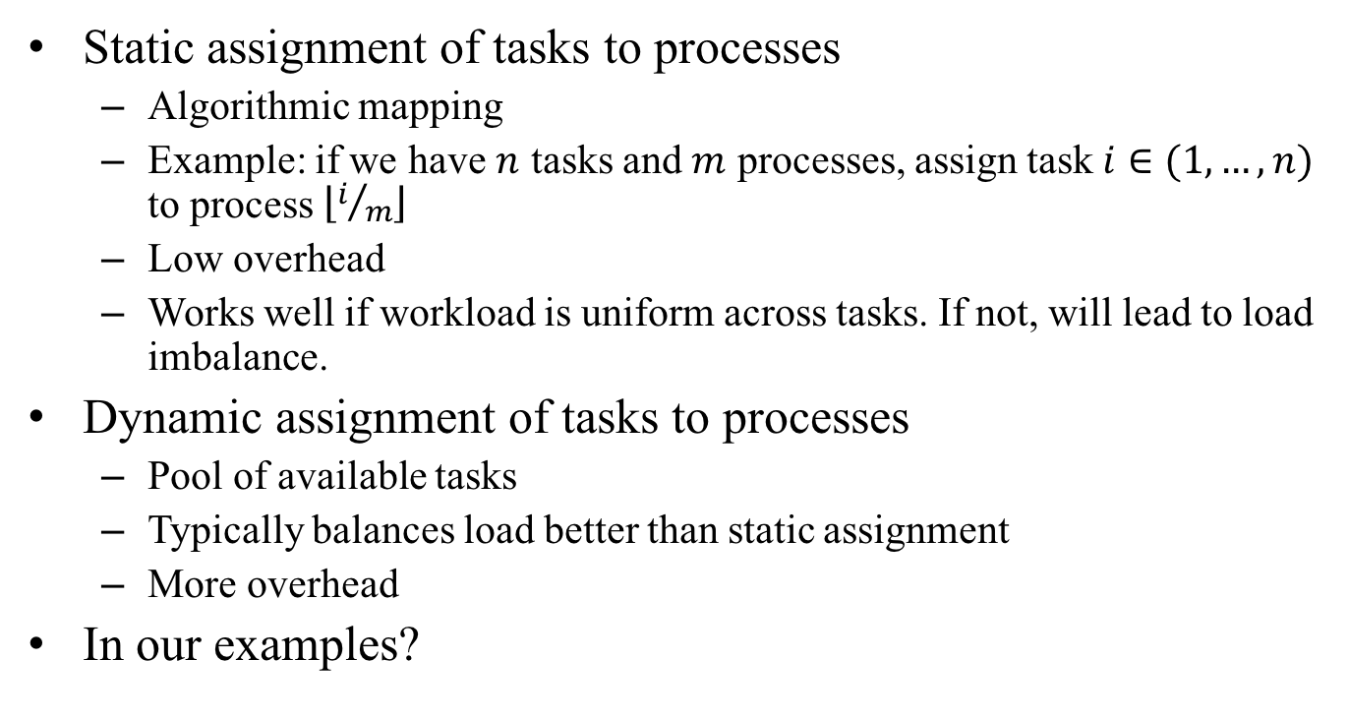
Static and dynamic assignment
Static assignment of tasks to processes
Algorithmic mapping
Example: if we have $n$ tasks and $m$ processes, assign task $i∈(1,…,n)$ to process $\left\lfloor i/m\right\rfloor$
Low overhead
Works well if workload is uniform across tasks. If not, will lead to load imbalance.
Dynamic assignment of tasks to processes
Pool of available tasks
Typically balances load better than static assignment
More overhead
In our examples?

Slide 17
Assignment in our examples: pizza prep
Static example: each cook does the whole process for a predetermined set of n/p pizzas.
Works if every cook operates at same speed, every pizza takes equally long to prepare
Otherwise: load imbalance. The slowest cook who got the most complex pizzas to make will cause overall runtime to go up
Dynamic example: each cook does the whole process for a pizza, then picks another pizza spec to make from a pool
Balances workload better among
Overhead: need a pool of pizza specs to make, communication and synchronization for pool’s operations

Slide 18
Assignment in our examples: word count
Static example: text is cut into p equally sized chunks (size given in bytes), each processor does one chunk
Works well if word length is uniform over the whole text
If not: some processes have many words to count, others fewer. Load imbalance.
Dynamic example: text is cut into 100*p equally sized chunks, chunks are placed into a work pool, processors pick chunks from pool
Balances work better
Overhead: need pool, need communication and synchronization for pool’s operation

Slide 19
Kinds of concurrency in to seek out in partitioning
(Partitioning = decomposition + assignment)
Data parallelism
Processes do same computation on different parts of the data
Opportunity for parallelism grows with data size
Most often used
Functional parallelism
Processes do different computations, often in the form of pipelined computation
Typically used in combination with data parallelism
Often modest amount

Slide 20
Concurrency in our examples: pizza prep
Data parallelism
Many cooks can prepare pizza in parallel (from a-z), assuming plenty resources and place
Functional parallelism
Cooks specialize on one (or short sequence of) tasks
Pass intermediate results between cooks
Pizza prep pipeline.
Best solution might use both functional and data parallelism

Slide 21
Concurrency in our examples: word count
Data parallelism
if we split the text into p smaller chunks, we can let p processes count words in the individual chunks
Do we need/want chunk-local word count that must be merged at the end? Or rather global word count that all processes write into?
Functional parallelism: maybe pipelined processes for
text loading
splitting into chunks
count words in chunks
merge and print results
Best solution might use both functional and data parallelism (but sketched functionally parallel partitioning probably not good)

Slide 22
Parallelization process: orchestration
Goals:
Reduce communication cost
Reduce synchronization cost
Locality of data
Efficient scheduling
Reduce overhead
Specific to computer architecture, programming model, and programming language

Slide 23
Orchestration in our examples: pizza prep
Pizza prep:
Determine “communication lanes”. Pass intermediate results directly from one cook to another? Or use a big central table in the kitchen to stash them?
Determine when and how to pass around intermediate results between cooks
Determine where to store, perhaps cache, supplies
…
Word count:
Shared memory? Or message passing? Or does the language/library we use have other comm/sync primitives?

Slide 24
Parallelization process: mapping
Specific to system or programming environment
Parallel system resource allocator
Queuing systems
OS scheduler

Slide 25
Summary: goals of the parallelization process
Step | Architecture dependent? | Major performance goals
Decomposition | Mostly no | Expose enough concurrency but not too much
Assignment | Mostly no | Balance workload Reduce communication volume
Orchestration | Yes | Reduce noninherent communication via data locality Reduce communication and synchronization cost as seen by the processor Reduce serialization to shared resources Schedule tasks to satisfy dependencies early
Mapping | Yes | Put related threads on the same core if necessary Exploit locality in chip and network topology

Slide 26
Parallel hardware architectures
Subset of chapter 6 from “Computer Organization and Design”
Google knows this book, the library probably too
These slides cannot be published on a publically accessible web site. Distribution through other channel (will be announced on slack)

Slide 27
Common parallel hardware architectures - overview
CPUs
Vector and multimedia instructions
Hyperthreading
Multicore
GPUs
Plenty cores
plenty*plenty threads, switching between them super fast
But: groups of threads run in lockstep (if/then/else possible, but threads that don’t enter some branch will be idle)
Double-But: rabbit hole
Clusters
Plenty of computers connected through a network
Requires programming with message passing (at least on low abstraction level)

