Slide 1
Introduction
inf-2202 Concurrent and Data-intensive Programming
Fall 2017
Lars Ailo Bongo (larsab@cs.uit.no)

Slide 2
Outline
Why?
What?
How?

Slide 3
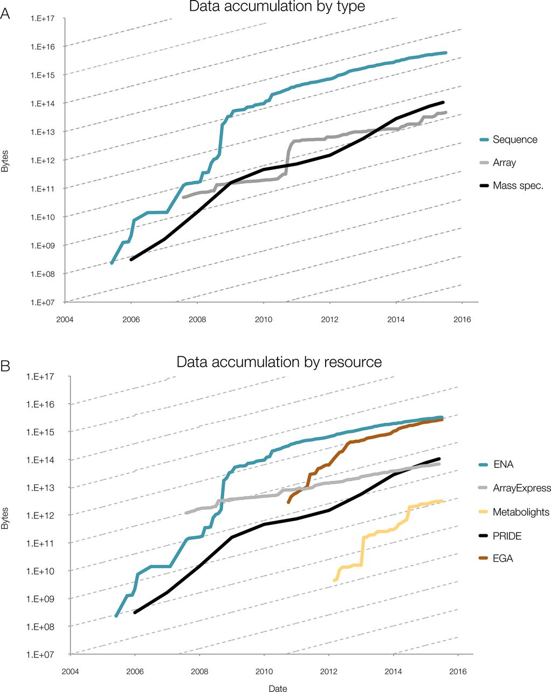
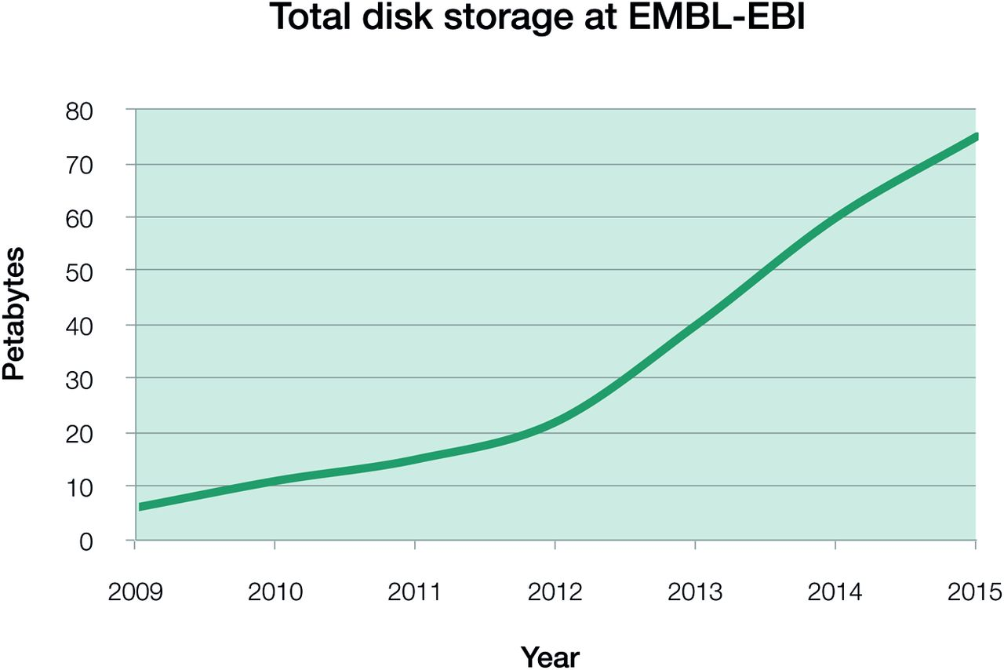
Data growth at EMBL-EBI
Source: Charles E. Cook et al. Nucl. Acids Res. 2016;44:D20-D26
Notes:
Phenomenal data growth – dotted lines represents doubling every twelve months
(A) Data accumulation at EMBL-EBI by data type, for example mass spectrometry (MS); (B) Data accumulation by dedicated resource, for example PRIDE. The y-axis is log-scale, with the slope of the dashed lines indicating a 12-month doubling time. Continued data growth is seen in all types of data at EMBL-EBI and all data resources. In all data resources shown here, growth rates are predicted to continue increasing, with notable sustained exponential growth in PRIDE, the European Genome-phenome Archive (EGA) and MetaboLights: all have doubling times of around 12 months. All three contributing platforms show rates that are increasing over time, with data growing exponentially with around a 12-month doubling time.
EGA – European Genome-phenome Archive, PRIDE – Proteome identification database

Slide 5
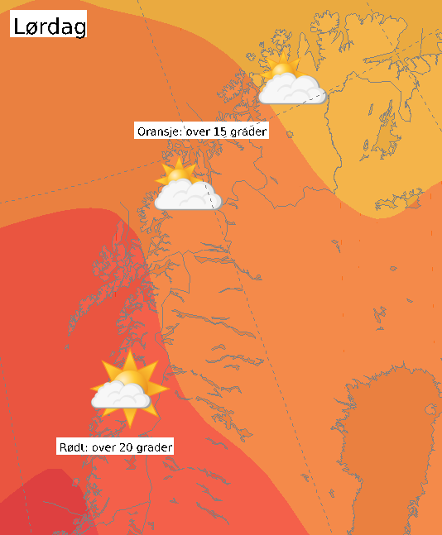
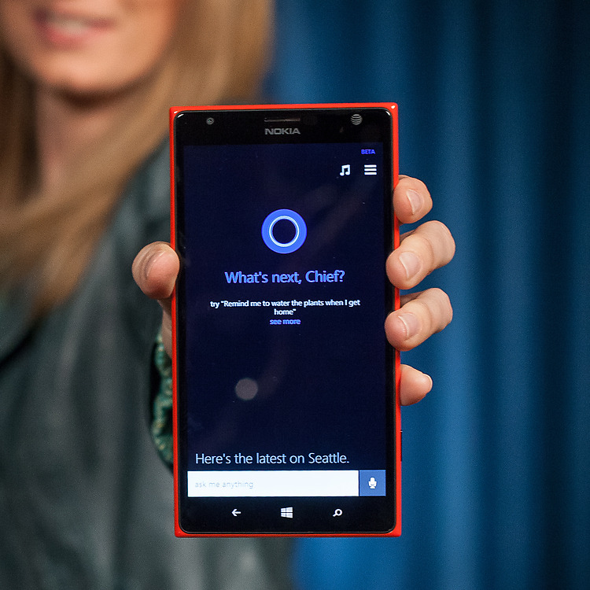

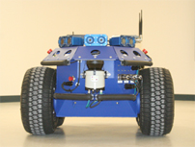
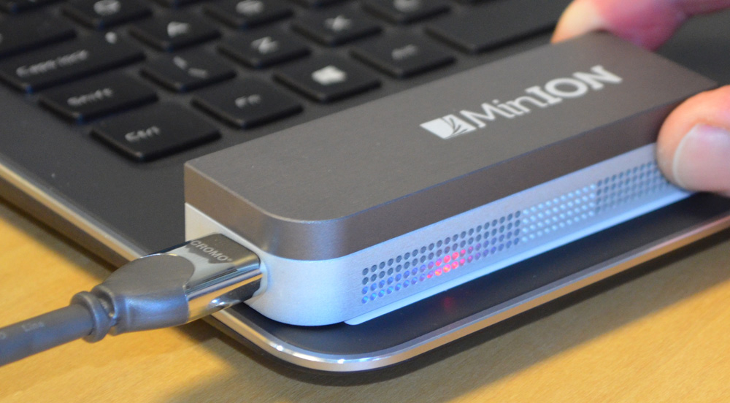

What can we do with all the data and cores?
Notes:
Sources:
http://engineering.stanford.edu/news/stanford-researchers-break-million-core-supercomputer-barrier
http://techcrunch.com/2012/08/22/how-big-is-facebooks-data-2-5-billion-pieces-of-content-and-500-terabytes-ingested-every-day/

Slide 6
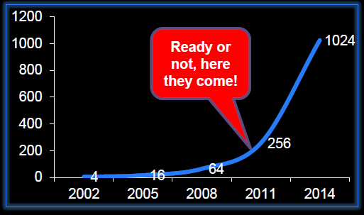
Motivation
“The core is the logic gate of the 21st century” Anant Agarwal, MIT
The number of cores will double every 18th month
Figure from a lecture by Bruce Shriver, Feb 2012, UiT
Notes:
Figure from a lecture by Bruce Shriver, Feb 2012, UiT

Slide 7
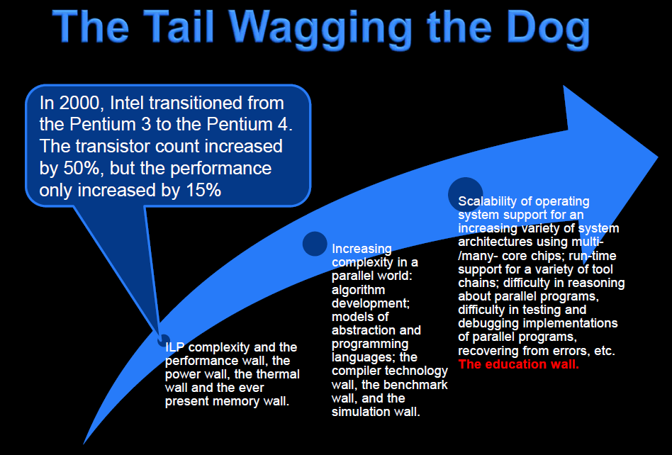
Slide from a lecture by Bruce Shriver, Feb 2012, UiT
Notes:
Slide from a lecture by Bruce Shriver, Feb 2012, UiT

Slide 8
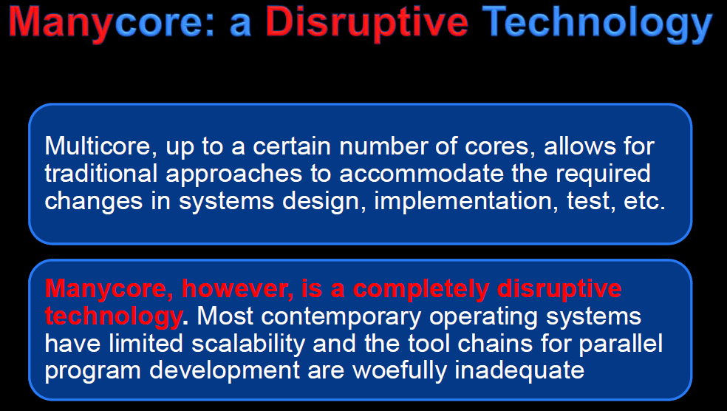
Slide from a lecture by Bruce Shriver, Feb 2012, UiT
Notes:
Slide from a lecture by Bruce Shriver, Feb 2012, UiT

Slide 9
Motivation - summary
Application pull
Supercomputing
Data-intensive computing
Games
Robotics
…
Technology push
How to utilize 1000’s of cores?

Slide 10
Teaching staff
Associate Prof. Lars Ailo Bongo
Teaching Assistants:
Einar Holsbø
Tengel Ekrem Skare
Guest lectures:
Lars Tiede (ITA, UiT)
Dag Brattli (Microsoft)
Åge Kvalnes (Microsoft)
Steffen Viken Valvåg (Microsoft)
Tor Kreutzer (Microsoft)
Jan-Ove Karlberg (Microsoft)
…?

Slide 11
Course content
3 main topics:
Concurrent programming
Data-intensive computing
Performance evaluation
Not included:
In-depth study of systems and approaches
GPU/ accelerator programming
Concurrency theory
No textbook

Slide 12
Information sources and contact info
Web page: http://www.cs.uit.no/kursinfo/inf2202
Or https://inf-2202-f17.github.io/
Mailing list: inf-2202-f17@list.uit.no
Github organization: https://github.com/inf-2202-f17
Slack team: inf-2202-f17
We will not use Fronter/ whatever

Slide 13
TODO list 1:
Make sure you are subscribed to the mailing list
https://list.uit.no/sympa/info/inf-2202-f17
Can use non-UiT email
Create github account, send Einar username
Join slack channel or ask Einar or Tengel for invitation
Receive invitation to join github organization

Slide 14
Lecture plan
https://inf-2202-f17.github.io/
Most lectures on Thursdays 14:15-16:00
Fridays 12:15-13:00 may also be used
Colloquium on Tuesdays 14:15-16:00 (A016 or p-lab)

Slide 15
Mandatory assignments
Parallel programming
Reactive programming
Big data processing on cloud

Slide 16
Exercises
Note! This is a programming course. You need to spend a significant amount of time designing, implementing, testing, and evaluating programs.
Note! Concurrent and data-intensive programming is easy if:
It is a simple problem
There is a library for it
You do not care about performance/ scalability
You do not care about correctness
Someone tells you how to do it
But, usually this is not the case

Slide 17
TODO list 2
Read:
Modern operating systems, 3ed, Andrew S. Tanenbaum. Prentice Hall. 2007. Chapters: 2.2, 2.3, 2.5, 10.3, 11.4
Alternative to MOS: another operating systems textbook: the chapters about threading, IPC mechanisms, and classical IPC problems.
Do:
Compare the overhead of forking a process vs. creating a Pthread
Compare the overhead of forking a process vs. creating a Python thread
Implement a solution the following classical IPC problems using pthreads/Python threads and semaphores/condition variables. Note that you also need to generate a use case, test data, and useful output:
Producer/ consumer
Reader/ writer
Sleeping barber
Dining philosophers
Modify the code in c) to use message passing.

