Slide 1
Performance Evaluation II Distributed systems and web applications
Steffen Viken Valvåg
Microsoft

Slide 2

Just because the wheels are spinning, it doesn’t mean the car is moving!
In a distributed system there are many moving parts.
To monitor performance, we need to measure the end-to-end performance, using meaningful metrics.
We also need to monitor the performance of each part to identify problems. (Is the wheel jammed?)

Slide 3
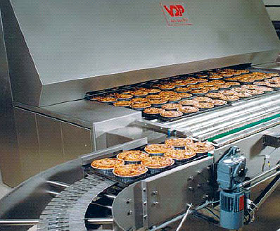
Data Parallelism
Bake many pizzas in one oven
(Don’t use many ovens to bake one pizza.)

Slide 4
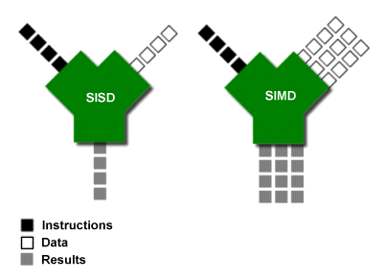
Data Parallel Hardware Architectures
SIMD [Flynn 1966]
Apply the same instruction to multiple data streams
Notes:
Vector processing was especially popularized by Cray in the 1970s and 1980s. Vector-processing architectures are now considered separate from SIMD machines, based on the fact that vector machines processed the vectors one word at a time through pipelined processors (though still based on a single instruction), whereas modern SIMD machines process all elements of the vector simultaneously.^{[1]}
Supercomputing moved away from the SIMD approach when inexpensive scalar MIMD approaches based on commodity processors such as the Intel i860 XP [1] became more powerful, and interest in SIMD waned.
The first widely-deployed desktop SIMD was with Intel's MMX extensions to the x86 architecture in 1996.
How much ILP exists in programs is very application specific. In certain fields, such as graphics and scientific computing the amount can be very large. However, workloads such as cryptography exhibit much less parallelism.
Micro-architectural techniques that are used to exploit ILP include:
Instruction pipelining where the execution of multiple instructions can be partially overlapped.
Superscalar execution, VLIW, and the closely related Explicitly Parallel Instruction Computing concepts, in which multiple execution units are used to execute multiple instructions in parallel.
Out-of-order execution where instructions execute in any order that does not violate data dependencies. Note that this technique is independent of both pipelining and superscalar. Current implementations of out-of-order execution dynamically (i.e., while the program is executing and without any help from the compiler) extract ILP from ordinary programs. An alternative is to extract this parallelism at compile time and somehow convey this information to the hardware. Due to the complexity of scaling the out-of-order execution technique, the industry has re-examined instruction sets which explicitly encode multiple independent operations per instruction.
Register renaming which refers to a technique used to avoid unnecessary serialization of program operations imposed by the reuse of registers by those operations, used to enable out-of-order execution.
Speculative execution which allow the execution of complete instructions or parts of instructions before being certain whether this execution should take place. A commonly used form of speculative execution is control flow speculation where instructions past a control flow instruction (e.g., a branch) are executed before the target of the control flow instruction is determined. Several other forms of speculative execution have been proposed and are in use including speculative execution driven by value prediction, memory dependence prediction and cache latency prediction.
Branch prediction which is used to avoid stalling for control dependencies to be resolved. Branch prediction is used with speculative execution.
Dataflow architectures are another class of architectures where ILP is explicitly specified, but they have not been actively researched since the 1980s.

Slide 5
Data Parallel Software Architectures
Execute the same (sequential) code on multiple distinct pieces of data in parallel
One independent task to execute per piece of data
Typically designed for a shared-nothing cluster
Run-time systems to orchestrate:
Storage and partitioning of the input data set(s)
Distribution of data to relevant machines
Parallel execution (load-balanced and fault-tolerant)
Collection/collation of output/results

Slide 6

Toaster Analogy
Data Set

Slide 7

Toaster Analogy
Data Set
Data Partitioning

Slide 8
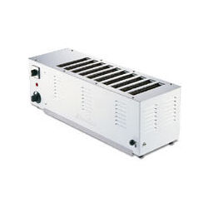
Toaster Analogy
Data Set
Parallel Processing Engine
Data Partitioning

Slide 9
MapReduce Programming Model
Specify a computation in terms of:
A map function to apply to each input record
An intermediary key space that determines how to group records output by the map function
A reduce function that defines how to aggregate groups of intermediate records for the final output
Map and reduce functions are typically sequential
Map executes in parallel for different input partitions; invoked once per input record
Reduce executes in parallel for different partitions of the intermediate key space; invoked once per unique intermediate key
Execution amounts to executing a certain number of map tasks, followed by a certain number of reduce tasks
Two-phase execution dictated by data dependencies

Slide 10
Dryad/DryadLINQ
Compose a flexible communication graph with customizable vertices passing data over channels
Vertex code is typically sequential, invoked with a set of input and output channels
Higher-level data-parallel abstractions akin to MapReduce available through DryadLINQ
Executed as a collection of tasks, where each task executes one vertex, and independent tasks may execute in parallel
Split into stages that manifest synchronization barriers
Notes:
Akin to the dataflow engines embedded in parallel databases, but with a virtualized execution plan
Graph topology may also be modified at run-time
Stage managers implement stage-specific scheduling policies

Slide 11
Data Dependency Graphs
Tasks require certain input data, and produce certain output data that other tasks may depend on
Below is a MapReduce graph with 3 map tasks and 2 reduce tasks; Dryad allows more flexible graph topologies
Virtualized execution plan

Slide 12
Apache Hadoop
Hadoop is a widely deployed implementation of MapReduce
Also a popular research vehicle
Jobs are submitted to a central job tracker component
Makes all scheduling decisions, tracking multiple concurrent jobs
Every node runs a task tracker that communicates regularly with the job tracker to obtain scheduling decisions
Each task tracker has a number of task execution slots, bounding the number of concurrent tasks on a node
Free slots are filled by requesting additional tasks from the job tracker; the received tasks may belong to any ongoing job
Input and output data are stored in a block-based distributed file system (HDFS)
Intermediate data stored locally, outside HDFS

Slide 13
Hadoop Architecture
Master/worker pattern with task trackers that are loosely coupled to the job tracker
Communicating through heartbeat RPCs
Same architecture for the underlying HDFS
Heartbeat
Job Tracker
Task Tracker
Task Tracker
Task Tracker
Task Tracker
Task
Notes:
Colloquially known as the Hollywood principle: “Don’t call us, we’ll call you.”
Task trackers with idle slots request new tasks to execute (receiver-initiated load sharing)

Slide 14
Evaluating the performance of Hadoop
100+ configuration options for MapReduce
100+ configuration options for the underlying HDFS
Selecting factors was a nightmare!
I relied on folklore and recommendations in the documentation for “good” configurations, and used those as starting points.

Slide 15
HDFS Block Size
Throughput
HDFS Block Size

Slide 16
Anomaly: Idle Time
Hadoop’s task trackers communicate with the central job tracker using heartbeat RPCs
Heartbeats occur at most every 3 seconds, and task completion is only reported then
Consequently, task trackers may go idle if tasks are short-lived
Since tasks tend to start at the same time (upon receiving a heartbeat response), they also tend to finish at the same time
Slot 1
Slot 2
Time

Slide 17
Anomaly: Idle Time
Unexpected interaction with HDFS block size
Bigger block size => more work per mapper => less idle time
For Grep, task trackers were idle 34% of the time using the default Hadoop configuration
A simple patch allowed completed tasks to be reported immediately
Hadoop 0.21 introduced a new option that may help
mapreduce.tasktracker.outofband.heartbeat
Enable this to send out-of-band heartbeats upon task completion

Slide 18
Anomaly: Multi-Core CPU Utilization
For sequential scanning of data, and whenever costly UDFs are invoked, Hadoop quickly becomes CPU bound
Multiple cores are not well utilized, so there may well be spare CPU cycles that go unused
Increasing the number of concurrent processes is ineffective, because of memory footprint and less optimal I/O access patterns
Remedy: employ multiple threads to read, parse and process records in parallel
Fully exploits all cores when costly UDFs are employed
By implementing a similar approach in Hadoop, plugging in multi-threaded Cogset code as a custom input format, performance was greatly improved

Slide 19
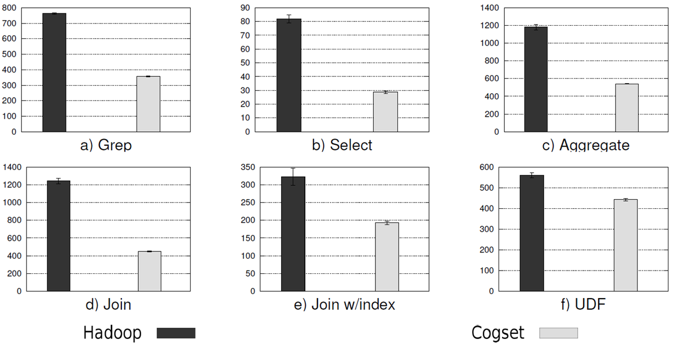
MR/DB Results for 25 nodes
The Hadoop optimizations close some of the gap
Cogset still performs significantly better

Slide 20
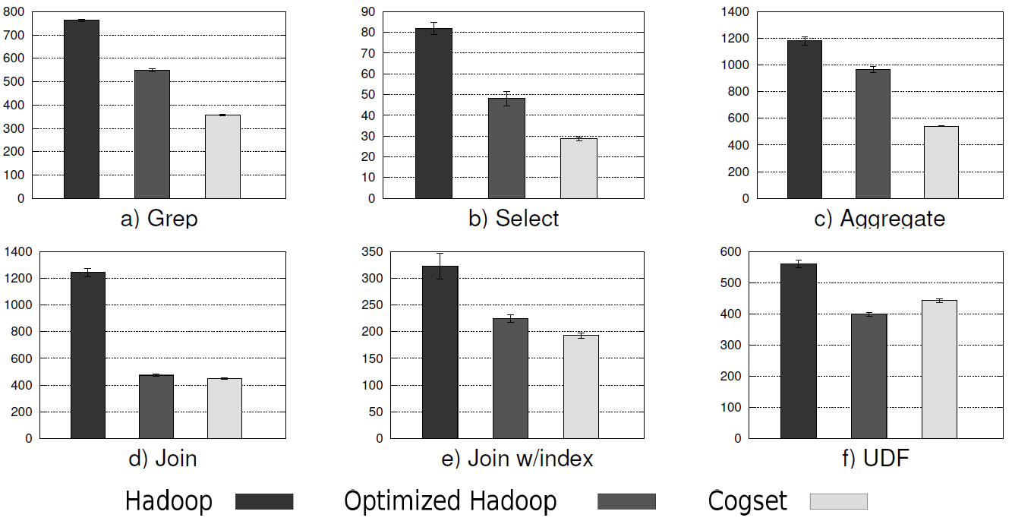
MR/DB Results for 25 nodes
The Hadoop optimizations close some of the gap
Cogset still performs significantly better

Slide 21

Performance in web applications

Slide 22
Single-page web applications (SPAs)
Load a single web page into the browser
Dynamically update the page based on user interaction

Slide 23
Typical architecture
Frontend (web browser)
Middle-tier service (Backend For Frontend)
Backend service
Backend service
Backend service
Backend service

Slide 24
Relevant metrics for web applications
Backend throughput
Latency for individual requests
Bandwidth consumption
Browser frame rate
End-user perceived latency (EUPL)
The time from a click until the UI has finished updating
Initial page load time
Javascript bundle size matters! => minification, compression, staged loading
Cost of goods sold (COGS)
How much money did this cost us

Slide 25
Browser quirks
Max 6 concurrent connections
=> domain sharding
=> pipe requests through a websocket
=> HTTP/2
Updating the DOM is expensive
=> React, a library to efficiently update the DOM tree based on a synthetic DOM tree
Javascript is single-threaded, but highly concurrent:
=> Redux, to manage state in a predictable way in the face of concurrency

Slide 26
Correlating events
A customer reports that the UI says “something went wrong”.
How do we figure out what went wrong?
We see that EUPL is high for some users.
Why?
To answer questions like these, we must be able to correlate log events produced by multiple services.
=> Use randomly generated GUIDs called “correlation IDs” and pass them along with requests, making sure they are logged on both ends.

Slide 27
Demo time

