Slide 1
November, 2008
Project: IEEE P802.15 Working Group for Wireless Personal Area Networks (WPANs)
Submission Title: [Time Slotted, Channel Hopping Standards]
Date Submitted: [1 Sep, 2008]
Source: [Chol Su Kang, Rick Enns, Clint Powell, José A. Gutierrez, Ludwig Winkel] Companies [Dust Networks, Freescale, Emerson, Siemens AG]
Address: [30695 Huntwood Avenue, Hayward, CA 94544 USA; 890 N. McCarthy Blvd, Suite 120, Milpitas, CA 95035 USA; 8000 West Florissant Avenue St. Louis, Missouri 63136 USA; Siemensallee 74, Karlsruhe, Germany]
Voice:[+1 (510) 400-2900, +1 (408) 904-2705, +1 (650) 327-9708, +1 (480) 413-5413, +1 (314) 553-2667, +49 (721) 595-6098]
E-Mail:[ckang@dustnetworks.com, enns@stanfordalumni.org, clinton.powell@freescale.com, Jose.Gutierrez@emerson.com, ludwig.winkel@siemens.com ]
Re: [n/a]
Abstract: [This document proposes extensions for IEEE802.15.4 MAC]
Purpose: [This document is a response to the Call For Proposal, IEEE P802.15-08-373-01-0043]
Notice: This document has been prepared to assist the IEEE P802.15. It is offered as a basis for discussion and is not binding on the contributing individual(s) or organization(s). The material in this document is subject to change in form and content after further study. The contributor(s) reserve(s) the right to add, amend or withdraw material contained herein.
Release: The contributor acknowledges and accepts that this contribution becomes the property of IEEE and may be made publicly available by P802.15.
Slide <number>
Rick Enns et al.
Notes:
doc.: IEEE 802.15-<doc#>
<11 January, 2008r>
<author>, <company>
Page <number>
doc.: IEEE 802.15-<doc#>
<11 January, 2008r>
<author>, <company>
Page <number>

Slide 2
November, 2008
Time Slotted, Channel Hopping
(TSCH) Standards
Chol Su Kang - Dust Networks
Rick Enns - Consultant
Clinton Powell - Freescale
José A. Gutierrez – Emerson
Ludwig Winkel – Siemens
November, 2008
Slide <number>
Rick Enns et al.
Notes:
doc.: IEEE 802.15-<doc#>
<11 January, 2008r>
<author>, <company>
Page <number>
doc.: IEEE 802.15-<doc#>
<11 January, 2008r>
<author>, <company>
Page <number>

Slide 3
Wireless Standards for the Industry and by the Industry
November, 2008
Two industrial wireless network standards have implemented similar extensions to the 802.15.4 MAC:
ISA100.11a D2 (in draft comment review by ISA100 and ANSI)
WirelessHART 7.1 published with a active conformance test process in place and devices developed to the spec. (submitted to IEC/PAS 62591ed1)
Slide <number>
Rick Enns et al.
Notes:
doc.: IEEE 802.15-<doc#>
<11 January, 2008r>
<author>, <company>
Page <number>
doc.: IEEE 802.15-<doc#>
<11 January, 2008r>
<author>, <company>
Page <number>

Slide 4
Industrial Standards
November, 2008
ISA100.11a and WirelessHART are designed for process and control applications
Both standards are based on the 2.4 GHz IEEE802.15.4 PHY and the MAC.
ISA100.11a developed a full protocol stack from the new MAC extensions to a new application layer. The stack incorporates portions of the IETF 6LowPAN RFC.
WirelessHART also has a full stack protocol. It has similar MAC extensions and the protocol stack is integrated into the existing HART application protocol layer.
Slide <number>
Rick Enns et al.
Notes:
doc.: IEEE 802.15-<doc#>
<11 January, 2008r>
<author>, <company>
Page <number>
doc.: IEEE 802.15-<doc#>
<11 January, 2008r>
<author>, <company>
Page <number>

Slide 5

Proposed Timeslot Access
November, 2008
Slot Frame Cycle
Unallocated Slot
Allocated Slot
Tx
CCA: RX startup, listen, RX->TX
Transmit Packet: Preamble, SFD, Headers, Payload, CRC
RX startup or TX->RX
RX ACK
Rx
RX startup
RX packet
Verify MIC
Calculate ACK MIC
Transmit
ACK
RX/TX turnaround
timeslot
TX/RX packet
TX/RX ACK
Slide <number>
Kris Pister et al.
Notes:
doc.: IEEE 802.15-<doc#>
<11 January, 2008r>
<author>, <company>
Page <number>
doc.: IEEE 802.15-<doc#>
<11 January, 2008r>
<author>, <company>
Page <number>

Slide 6
Timeslot Access
November, 2008
Determinist access and shared access requirements, and alarm requirement
ISA100.11a | WirelessHART | Proposal
CCA, packet transmission and ACK reception | CCA, packet transmission and ACK reception | CCA, packet transmission and ACK reception
Used for dedicated and shared transmissions. Timeslots can be merged to form a configurable CAP period. | Used for dedicated and shared transmissions | Used for dedicated and shared transmission. Can be extended to support a configurable CAP period too.
Configurable size | Fixed 10 ms size | Configurable to support multiple PHYs
Slide <number>
Rick Enns et al.
Notes:
doc.: IEEE 802.15-<doc#>
<11 January, 2008r>
<author>, <company>
Page <number>
doc.: IEEE 802.15-<doc#>
<11 January, 2008r>
<author>, <company>
Page <number>

Slide 7
Proposed Slotframe
November, 2008
Slot frames have configurable periods
Multiple slotframes with different lengths can operate at the same time.
Devices can be configured with more than one slotframe
250ms
250ms
250ms
250ms
1,000ms
Slide <number>
Rick Enns et al.

Slide 8
November, 2008
SlotFrames
Resource allocation requirement, low power requirement, scalability requirement, and fast join requirement
ISA100.11a | WirelessHART | Proposal
Configurable slotframe period | Configurable slotframe period | Configurable slotframe period
Multiple slotframes in one device | Multiple slotframes in one device | Multiple slotframse in one device
Options for CAP frames, slotted frames or hybrid frames | Only slotted frames | Slotted frames described but CAP periods can be accomodated
Slide <number>
Rick Enns et al.

Slide 9
November, 2008
Proposed Channel Hopping
Slot n-2
Slot n-1
Slot n
Slot n+1
Slot n+2
11
12
13
14
15
16
17
18
19
20
21
22
23
24
25
26
802.15.4 Channels
Slide <number>
Rick Enns et al.

Slide 10
November, 2008
Channel Hopping
Channel diversity requirement, reliability requirement
ISA100.11a | WirelessHART | Proposal
Hoping over channels Hop every timeslot and every CAP period | Hoping over channels Hop every timeslot | Hoping over channels Hop every timeslot Hop every CAP period
Configure channel blacklist | Configure channel blacklist | Configure channel blacklist
Multiple channel hopping sequence options | One channel hopping sequence | One channel hopping sequence
Slide <number>
Rick Enns et al.

Slide 11
November, 2008
Mesh Support
Reliability requirement, coverage requirements, and path diversity requirement
ISA100.11a | WirelessHART | Proposal
Transmissions and retransmissions are spread over multiple paths (and channels) | Transmissions and retransmissions are spread over multiple paths (and channels) | Transmissions and retransmissions are spread over multiple paths (and channels)
Slide <number>
Rick Enns et al.

Slide 12
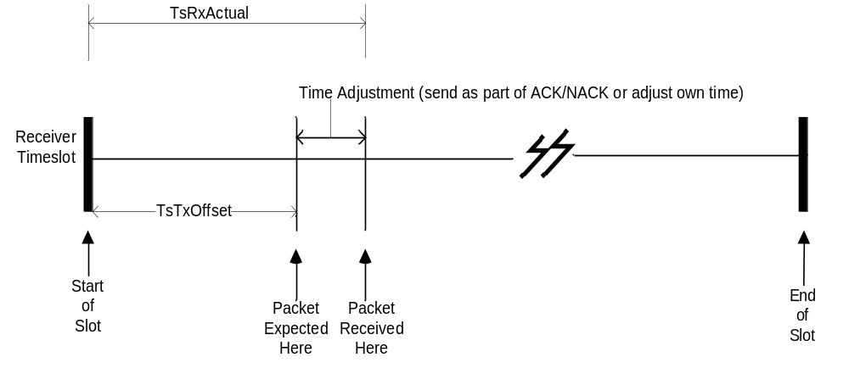
November, 2008
Proposed Time Synchronization
Slide <number>
Rick Enns et al.

Slide 13
November, 2008
Time Synchronization
Clock propagation requirement
ISA100.11a | WirelessHART | Proposal
Node-to-node (parent-to-child) clock propagation | Node-to-node (parent-to-child) clock propagation | Node-to-node (parent-to-child) clock propagation
Requires minimum parental traffic to keep time. Generates keep alive packets when traffic is low. | Requires minimum parental traffic to keep time. Generates keep alive packets when traffic is low. | Requires minimum parental traffic to keep time. Generates keep alive packets when traffic is low.
Slide <number>
Rick Enns et al.

Slide 14
November, 2008
MAC Security
Enhanced security requirement
ISA100.11a | WirelessHART | Proposal
MIC32 DLL data integrity default, options for MIC64 or MIC128 | MIC32 DLL data integrity | MIC32 DLL data integrity
Nonce is the 64 bit UID and time | Nonce is the 64 bit UID and time | Nonce is the 64 bit UID and time
Options for CAP frames, slotted frames or hybrid frames | Only slotted frames | Slotted frames described but CAP periods can be accomodated
Slide <number>
Rick Enns et al.

Slide 15
November, 2008
Extended ACK
Clock propagation and security requirements
ISA100.11a | WirelessHART | Proposal
Carries time propagation information | Carries time propagation information | Carries time propagation information
Protected by the MIC | Protected by the MIC32 | Protected by the MIC32
Slide <number>
Rick Enns et al.

