Slide 1
HumbleDevs
Even
Bendik
Joachim
Linh (kundekontakt)
Amalie (teamlead)

Slide 2
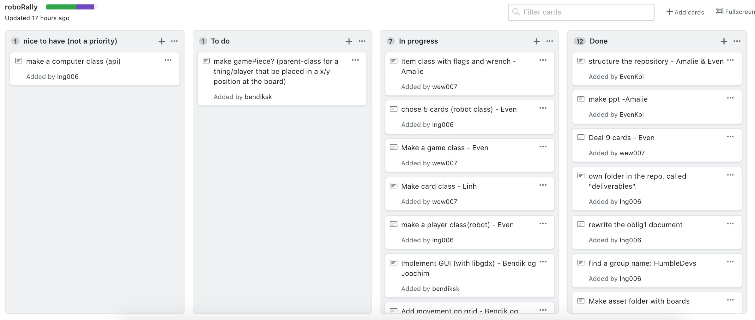
Project methodology
Kanban
Pair programming
Notes:
Linh

Slide 3
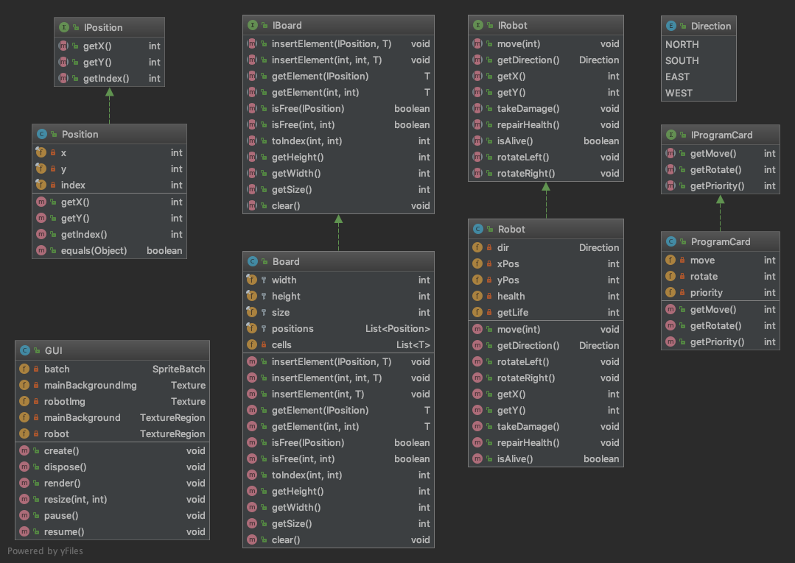
Class Diagram 1st Iteration

Slide 4

Demo
Tiled
Placing robot with (x,y) coordinates
Notes:
Bendik

Slide 5

Challenges
Slow start
LibGDX
Git and Github
How to construct the map
Dynamic map?
Pool of premade maps?
Notes:
Joachim

Slide 6
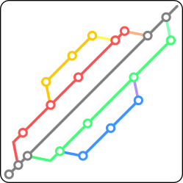
Solutions
Library - practise
Practise in both git and Github
Responsibility
Notes:
Amalie

Slide 7

Improvements
Use the tools (Slack, GitHub, kanban) more actively
More open communication
Better workflow
Notes:
Amalie

Slide 8

Eventual Changes
Ask each other for help
Better use of Kanban
Better commit messages
Clearer work allocation - everybody knows what to do
Notes:
Even

