Slide 1


Bubble Sort

Slide 2
Bubble Sort
Initial
5 | 2 | 3 | 7 | 1
PASS 1
PASS 2
Step 1
5 | 2 | 3 | 7 | 1
Step 1
2 | 3 | 5 | 1 | 7
Step 2
2 | 5 | 3 | 7 | 1
Step 2
2 | 3 | 5 | 1 | 7
Step 3
2 | 3 | 5 | 7 | 1
Step 3
2 | 3 | 5 | 1 | 7
Step 4
2 | 3 | 5 | 7 | 1
Step 4
2 | 3 | 1 | 5 | 7
2 | 3 | 5 | 1 | 7
2 | 3 | 1 | 5 | 7
PASS 3
PASS 4
PASS 5
Step 1
2 | 3 | 1 | 5 | 7
Step 1
2 | 1 | 3 | 5 | 7
Step 1
1 | 2 | 3 | 5 | 7
Step 2
2 | 3 | 1 | 5 | 7
Step 2
1 | 2 | 3 | 5 | 7
Step 2
1 | 2 | 3 | 5 | 7
Step 3
2 | 1 | 3 | 5 | 7
Step 3
1 | 2 | 3 | 5 | 7
Step 3
1 | 2 | 3 | 5 | 7
Step 4
2 | 1 | 3 | 5 | 7
Step 4
1 | 2 | 3 | 5 | 7
Step 4
1 | 2 | 3 | 5 | 7
Step 5
2 | 1 | 3 | 5 | 7
1 | 2 | 3 | 5 | 7
1 | 2 | 3 | 5 | 7

Slide 3
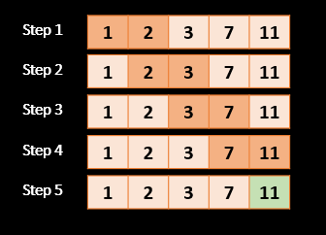
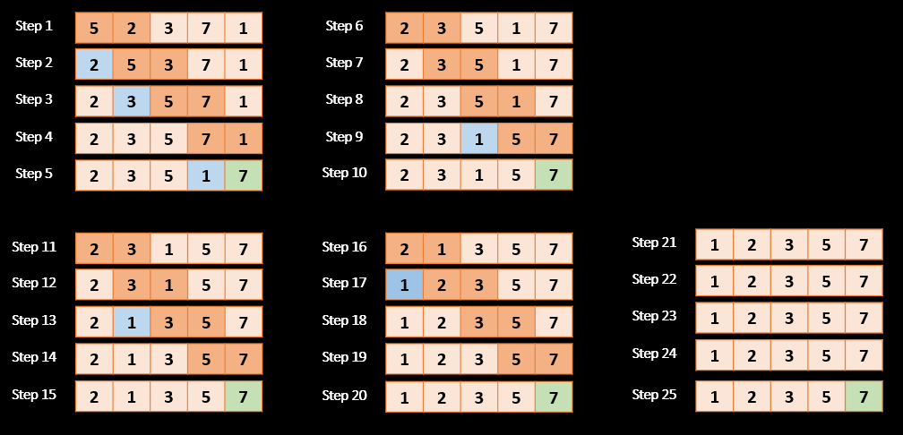
Bubble Sort Overall Performance
BEST CASE | AVERAGE CASE | WORST CASE | SPACE
O(n) | O(n^2) | O(n^2) | O(1)
Initial
1 | 2 | 3 | 7 | 11
Initial
5 | 2 | 3 | 7 | 1

