Slide 1


Bubble Sort

Slide 2
Bubble Sort
Initial
5 | 2 | 3 | 7 | 1
Step 1
5 | 2 | 3 | 7 | 1
Step 6
2 | 3 | 5 | 1 | 7
Step 2
2 | 5 | 3 | 7 | 1
Step 7
2 | 3 | 5 | 1 | 7
Step 3
2 | 3 | 5 | 7 | 1
Step 8
2 | 3 | 5 | 1 | 7
Step 4
2 | 3 | 5 | 7 | 1
Step 9
2 | 3 | 1 | 5 | 7
Step 5
2 | 3 | 5 | 1 | 7
Step 10
2 | 3 | 1 | 5 | 7
Step 11
2 | 3 | 1 | 5 | 7
Step 16
2 | 1 | 3 | 5 | 7
Step 21
1 | 2 | 3 | 5 | 7
Step 12
2 | 3 | 1 | 5 | 7
Step 17
1 | 2 | 3 | 5 | 7
Step 22
1 | 2 | 3 | 5 | 7
Step 13
2 | 1 | 3 | 5 | 7
Step 18
1 | 2 | 3 | 5 | 7
Step 23
1 | 2 | 3 | 5 | 7
Step 14
2 | 1 | 3 | 5 | 7
Step 19
1 | 2 | 3 | 5 | 7
Step 24
1 | 2 | 3 | 5 | 7
Step 15
2 | 1 | 3 | 5 | 7
Step 20
1 | 2 | 3 | 5 | 7
Step 25
1 | 2 | 3 | 5 | 7

Slide 3
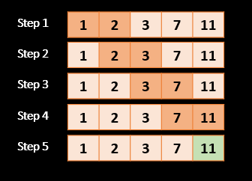
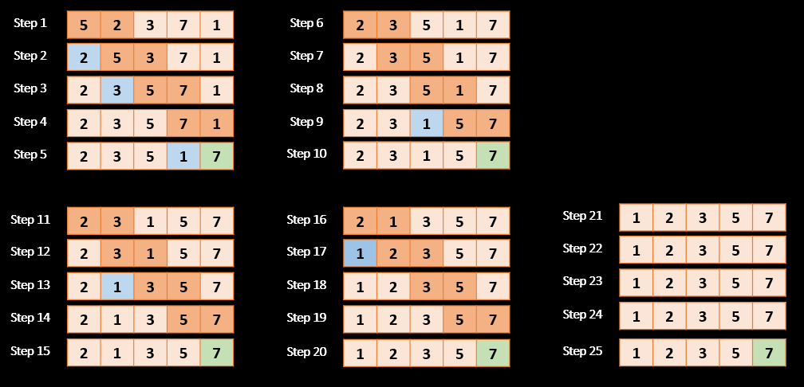
Bubble Sort Overall Performance
BEST CASE | AVERAGE CASE | WORST CASE | SPACE
O(n) | O(n^2) | O(n^2) | O(1)
Initial
1 | 2 | 3 | 7 | 11
Initial
5 | 2 | 3 | 7 | 1

