Slide 1

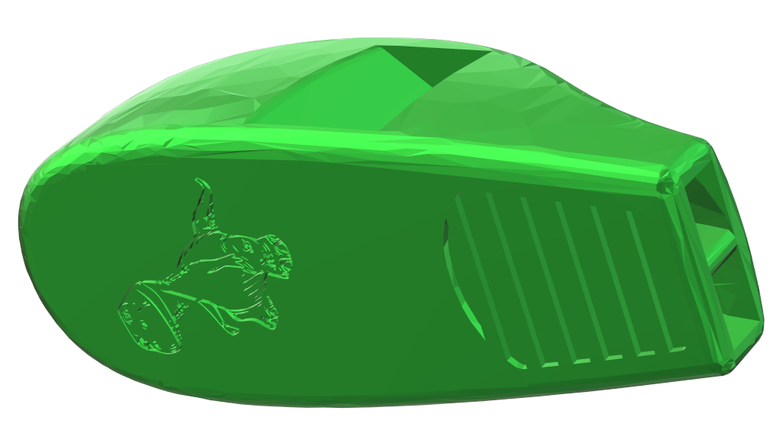
7 Tracey
10 Tracey

