Slide 1

Machine Learning Engineer in the Generative AI Era
Week 7: Alignment

Slide 2
Agenda
What is Alignment?
Reward Models & RLHF
Preference Data: Collection & Annotation
DPO, PPO, and the latest: GRPO
Iterative DPO (Llama-3 style)
Modern Open-Source Tools
Project 7 Overview

Slide 3
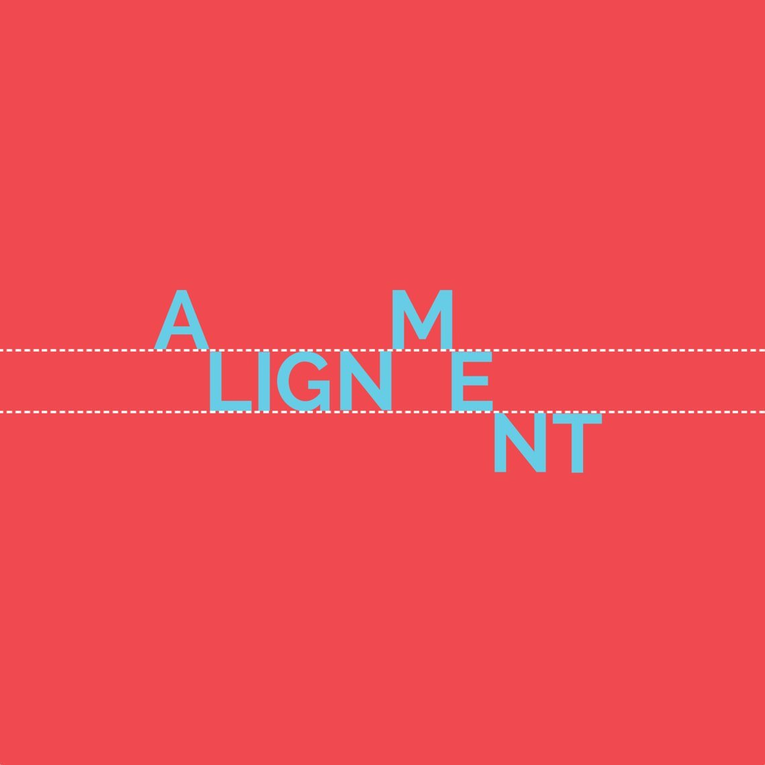
What is Alignment?
Alignment ensures the model’s outputs reflect human values, intent, and safety.
Key phase in modern LLM pipelines: Pretraining → SFT → Alignment (RLHF/DPO/GRPO)
Without alignment, LLMs may produce harmful, biased, or useless results.

Slide 4
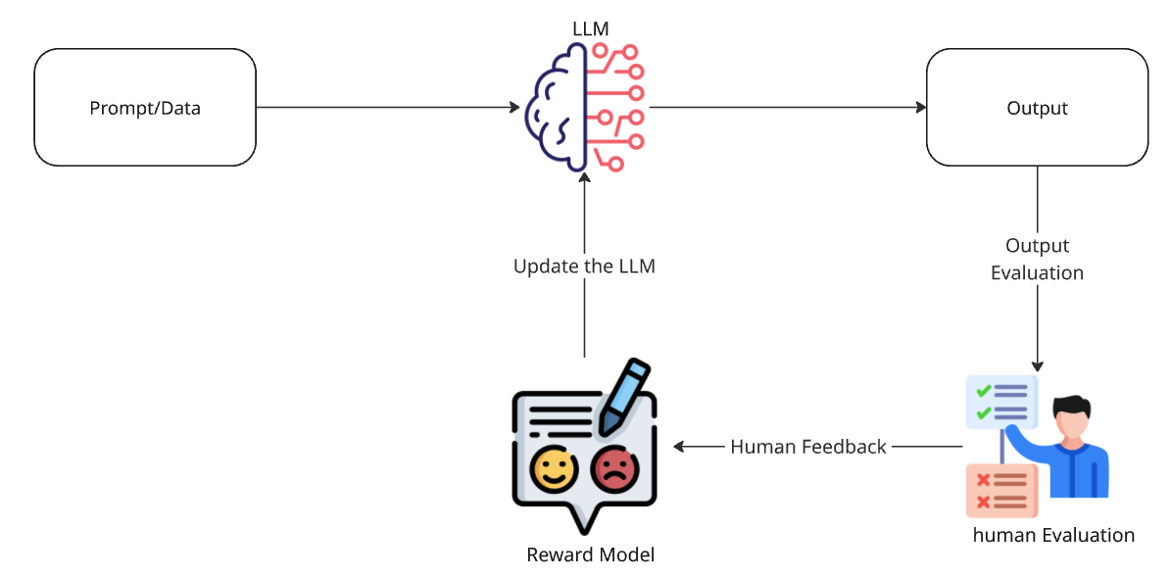
Reward Models & RLHF (Reinforcement Learning from Human Feedback)
Reward Model: A model that scores outputs based on human preferences.
RLHF Workflow:
Collect preference data (human feedback on outputs)
Train reward model on this data
Optimize LLM using RL (usually PPO)
RLHF is behind major models (ChatGPT, Claude, Llama-3/4).

Slide 5
Collecting Preference Data
Data types: Chosen output vs. rejected output (pairs, rankings, thumbs up/down)
Collection tools:
Gradio, Label Studio, Hugging Face Data Lab, Open-Source UIs
In-house annotation (Gradio app: label candidate LLM completions)
Good data = better alignment!

Slide 6
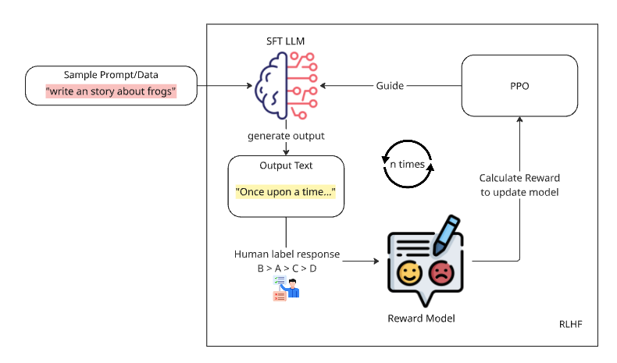
PPO (Proximal Policy Optimization)
Classic RL algorithm for LLM alignment.
How PPO works:
LLM generates output
Reward model scores it
PPO updates LLM to maximize expected reward, with safety constraints
Used in OpenAI's original RLHF pipeline (ChatGPT paper).

Slide 7
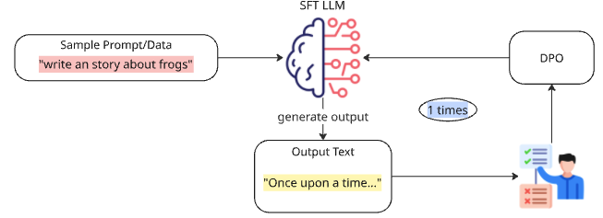
DPO – The New Alignment Standard
DPO: Aligns models using pairs of human feedback (“good” vs. “bad” answers), no reward model or RL needed.
Simple: Just do one round of DPO training—no need for loops or extra labeling.
Stronger Results: DPO models generalize better and are easier to train than PPO/RLHF models.
Why switch?
Faster and cheaper than PPO/RLHF.
Less complexity—no reward tuning or instability.
Backed by new research (Anthropic 2024, Stanford 2024).
Bottom line: If you want to align your LLM, DPO is now the recommended approach.

Slide 8
GRPO – The Next Step in Alignment
GRPO = Generalized Reward Preference Optimization
All Feedback Types: Trains on pairs, rankings, or even numeric scores—not just “good/bad.”
Built-in Reward Modeling: Learns a reward model and a policy at the same time, more sample-efficient.
Why GRPO?
Handles more kinds of human feedback (flexible!)
More stable and often stronger than DPO, especially for tough alignment tasks.
Now available in Hugging Face TRL (docs)
Still new: Fewer open datasets and recipes than DPO, but rapidly improving.
Bottom line: GRPO is the most advanced and flexible way to align LLMs with real human preferences

Slide 9
Modern Open-Source Repos & Ecosystem
HuggingFace TRL (transformers-rl): DPO, PPO, SFT, RewardTrainer.
trlx: RLHF and preference-based fine-tuning.
Label Studio: Build custom data annotation pipelines for preference collection.
Gradio: Fast UIs for data labeling and feedback.

Slide 10
Alignment—Key Takeaways
Alignment is the core of safe, reliable LLMs.
DPO is the modern standard; PPO and GRPO are powerful alternatives.
Best practice: Start with open datasets, add your own annotation, iterate with DPO!
Mastering alignment = unlocking the full power of LLMs for enterprise or research agents.

Slide 11
References & Further Reading
Hugging Face TRL docs
DPO in Language Model Alignment (UnfoldAI)
Hugging face GRPO Trainer
trlx repo
RLHF(PPO) vs DPO
DeepSeekMath: Pushing the Limits of Mathematical Reasoning in Open Language Models

Slide 12
Thank you

