Slide 1

Week 5 - Supervised Fine-Tuning (SFT) I
Machine Learning Engineer in the Generative AI Era

Slide 2
Agenda:
What is SFT?
How to Get SFT Data
ChatML Format
Fine-Tuning Approaches: Full vs. LoRA
Tools: DeepSpeed & TRL
Project 5 Introduction

Slide 3
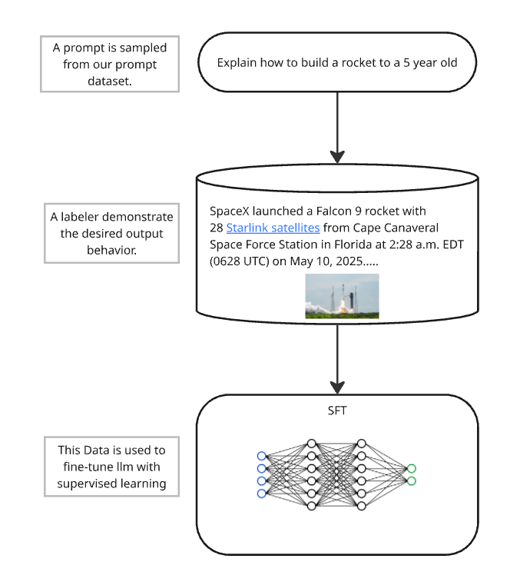
What is Supervised Fine-Tuning (SFT)
Adapting a pre-trained LLM to a specific downstream task
Uses labeled input-output pairs
Bridges the gap between general language modeling and task-specific performance
Part of the alignment pipeline (Pretraining → SFT → RLHF)

Slide 4
Why SFT Matters
Enables domain adaptation (e.g., legal, finance, education)
Makes models safer and more helpful
Key stage before deploying models in production
Cheaper than pretraining; accessible to smaller teams

Slide 5
Where to Get SFT Data
Hugging Face: Explore Openassistant, Sharegpt, BAAI/Infinity-instruct
Scale AI: Commercial, expert-annotated datasets
Synthetic Data: Generated Using Prompt + Model Outputs (Cover In Week 6)
Your own scraped & annotated data (Week 4)

Slide 6
ChatML Format
Structure:
[
{"role": "system", "content": "You are a helpful assistant."},
{"role": "user", "content": "What is LoRA?"},
{"role": "assistant", "content": "LoRA stands for Low-Rank Adaptation..."}
]
Required for models like LLaMA 3/4, GPT-4-style models
Encourages multi-turn formatting

Slide 7
Fine-Tuning Approaches
Full Fine-Tuning:
All model weights are updated: Imagine the model is a giant LEGO robot. Full fine-tuning means we take apart all its pieces and rebuild them to perform a new trick.
Highest resource usage
Maximum performance improvement potential
LoRA (Low-Rank Adaptation):
Inserted trainable rank-decomposition matrices: Instead of rebuilding the whole robot, we just add a few new small parts (tiny LEGO bricks) on top of what’s already there. These small parts are like special sunglasses or a new hat that tell the robot how to act in a certain way.
Updates ~0.1% of model parameters
Efficient, fast, lightweight

Slide 8
LoRA - How It Works
The core idea is to decompose the weight matrices (some or all) of the original model into low-rank matrices and train them instead.
For instance, in the graphic on the right side, the bottom network represents the large pre-trained model, and the top network represents the model with LoRA layers.
Freeze original model weights
Inject low-rank matrices into attention and FFN layers
Train only LoRA matrices
Add minimal parameters and computation

Slide 9
Recent Advancements in LoRA
QLoRA (Quantized LoRA): Imagine you have a coloring book. Normally, you'd use 16 crayons (16-bit precision). But what if you only had 4 crayons? QLoRA trains models using just 4-bit "crayons" to save space while still coloring nicely. It makes training large models possible even on smaller GPUs.
LowRA (2025): This is like using extra-mini crayons—fewer than 2 bits! It's a brand-new method that makes your model super compact. It's not perfect, but it's great when you really want to save memory.
These improvements let us train models like LLaMA 3 or Mistral on laptops or cloud GPUs without needing supercomputers.
Tools that help:
PEFT: Easily add LoRA to Hugging Face models
QLoRA: Compresses your model smartly while keeping it useful
Why it matters: These tricks make it possible for students, researchers, and small teams to fine-tune powerful LLMs without spending thousands on GPUs! We will performer those tool in the code lecture with Inference AI GPU

Slide 10
LoRA, QLoRA, LowRA – What's Different?
LoRA: Fast and light add-on training – great for quick model adaptations
QLoRA: Uses quantized weights (4-bit) – helps train large models on small GPUs
LowRA: Latest method (2025) – even lower memory (<2-bit), suitable for ultra-constrained environments

Slide 11
Key Tools for SFT
DeepSpeed
ZeRO Offloading: Spread model memory across multiple GPUs to handle large models
Mixed-Precision Training (FP16/8): Speeds up training and reduces memory usage
Gradient Accumulation: Combines gradients across mini-batches to simulate large batch sizes
Hugging Face TRL (Transformer Reinforcement Learning)
SFTTrainer: For supervised fine-tuning with ChatML-style data
RewardTrainer, DPOTrainer: For preference learning (covered in Weeks 6–7)

Slide 12
Setup for Fine-tuning
Model: meta-llama/Meta-Llama-3-8B-Instruct
Dataset: openassistant-guanaco, alpaca-cleaned
Format data to ChatML
Use peft, transformers, trl, deepspeed

Slide 13

GPU Infrastructure
All fine-tuning exercises (LoRA, QLoRA, LowRA) will be run on InferenceAI GPUs
Recommended: A100 80GB or H100 GPUs per group
Account setup guide will be shared via lecture code
Finetuning time: ~30 min for LoRA; ~2 hrs for full
Monitor with wandb, tensorboard

Slide 14
Project 5 - Hands-On Tasks Challenging Project
Task 1: Select Hugging Face dataset, convert to ChatML
Task 2: LoRA finetuning (~30 min run)
Task 3: Full finetuning (~2hr run), compare results
Metrics: loss, accuracy, eval on new prompts

Slide 15
Evaluation Criteria
Correct formatting & preprocessing
GPU setup & logs (InferenceAI)
Hyperparameter tuning: LR, epochs, batch size
Clear report: LoRA vs Full
Bonus: try QLoRA or 2-bit LowRA

Slide 16
RAG vs. Fine-Tuning - Comparison
Aspect | Retrieval-Augmented Generation (RAG) | Supervised Fine-Tuning (SFT)
How it Works | Retrieves up-to-date info to augment prompts | Specializes model using labeled data
Strengths | Transparent, dynamic, sources info | Influences model behavior, faster inference
Weaknesses | Does not change model weights | Cutoff after training, static knowledge
Best For | Changing data, explainability | Domain expertise, task alignment
Combo | Great when paired with fine-tuning | Enables dynamic + specialized reasoning

Slide 17
Wrap-Up
SFT is foundational for task-specific model deployment
LoRA makes fine-tuning accessible
Use modern toolchains (TRL, DeepSpeed)
Start prepping your data today!

Slide 18
Resources
Hugging Face LoRA Guide
DeepSpeed Docs
TRL Package
LoRA Paper

Slide 19
Next Week - SFT Part II
Synthetic data generation
Model evaluation
Data diversity & quality
Using LLMs as judges (Elo, Rejection Sampling)

Slide 20
Thank You

