Slide 1
Machine Learning Engineer in the Generative AI Era
Week 1 - Introduction to Large Language Models & Prompt Engineering

Slide 2
Course Structure
10 Weeks, 2-Hour Weekly Lectures & TA Sections
Weekly Projects: Medium & Challenging Levels
Focused on Data Engineering for LLMs
Everything Builds Toward the Final Research Agent
Notes:
Speaker Notes:
Welcome the students.
Introduce the purpose of the course: training engineers for the generative AI era.
Mention the 3-part course series and focus on Series 1: Data Engineering.
Briefly outline the final project: building a research agent.

Slide 3
Course Schedule
Weeks 1–3: Data Engineering
Week | Topic | Lecture Themes | Project
1 | Intro to LLMs & Prompt Engineering | Generative AI & agents, LLM capabilities, prompting techniques (CO-STAR, JSON/XML output) | Prompt design for research agent, using CO-STAR and structured formats
2 | LLM Architecture & Training Lifecycle | Transformers, hallucination, SFT/DPO/PPO, test-time scaling, pretraining data requirements | Run inference with local LLMs (e.g., LLaMA 3/4), evaluate with designed prompts
3 | Pretraining Data Collection & Extraction | Web scraping, OCR (Tesseract/Surya), ASR (Whisper), data cleaning/filtering (PII removal, deduplication) | Scrape arXiv, OCR PDFs, filter & clean data for pretraining

Slide 4
Course Schedule
Weeks 4–7: Introduction to AI & Model Training
Week | Topic | Lecture Themes | Project
4 | Retrieval-Augmented Generation (RAG) | Embeddings, chunking, vector DBs, LangChain, RAG workflows | Build a RAG pipeline to augment an LLM with external knowledge
Project insight I | Review for the project idea
5 | Supervised Fine-Tuning (SFT) I | Full vs. LoRA fine-tuning, ChatML format, TRL/Deepspeed | Apply LoRA and full fine-tuning using public datasets, explore overfitting
6 | Supervised Fine-Tuning (SFT) II | Synthetic data, quality checks, LLM-as-judge, data diversity ablation | Generate synthetic SFT data, tune with mixed datasets, perform ablation studies
7 | Model Alignment | RLHF, DPO/PPO, reward modeling, data labeling platforms | Build a labeling tool in Gradio, label preference data, run a DPO alignment experiment
Project insight II | Decide what project you will work on
8 | Hallucination, Jailbreak, and Ethics | Safety alignment, jailbreak cases, hallucination prevention | Try jailbreaking models, simulate hallucination, explore safety datasets

Slide 5
Course Schedule
Weeks 8–10: Course Project & Wrap-up
Week | Topic | Lecture Themes | Project
9 | Voice Agent (Multimodal AI, GPT-4o, ASR/TTS) | GPT-4o real-time, Emilia pipeline, chained vs end-to-end agents | Build a voice agent (GPT-4o style), optionally explore NotebookLM-like pipeline
10 | Final Capstone Project: Research Agent | Agents, MCP protocol, function calling, task chaining | End-to-end pipeline: search papers → OCR → summarize → generate podcast → voice agent output

Slide 6
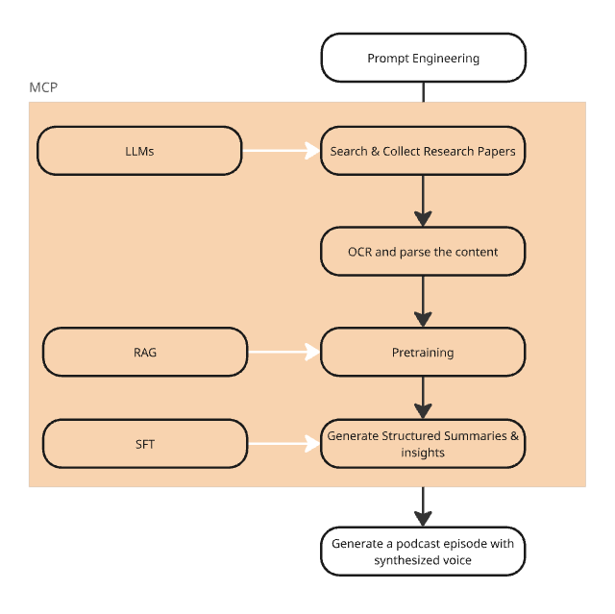
What We’re Building
Research Agent: The Final Project

Slide 7
Generative AI & Agentic AI
Generative AI = systems that generate new content (text, images, audio, code)
Agentic AI = autonomous, task-completing systems that use generative models
LLMs are the core of most GenAI systems today
Notes:
Use real-world examples (ChatGPT, GitHub Copilot, Midjourney).
Clarify how LLMs are central to both consumer and enterprise applications.

Slide 8
Large Language Models (LLMs)
Trained on massive internet-scale text corpora
Predict the next token based on prior context
Capable of reasoning, summarizing, translating, coding, and more
Notes:
Emphasize their flexibility.
Use analogy: autocomplete on steroids + pattern understanding.

Slide 9

LLM Applications
To-Consumer: Chatbots, Virtual Tutors, Personal Assistants, Copilots
To-Enterprise: Contract Analysis, Research Automation, Customer Service, Code Review
Notes:
Highlight applications relevant to the student audience (e.g., research agents, productivity).

Slide 10
The Lifecycle of an LLM
Pretraining → SFT → Alignment
Use next-token prediction during pretraining
Scaling laws guide model size & data size
Notes:
Keep it high-level. We’ll dive deep in Week 2.
Mention that today's models (e.g., GPT, LLaMA 4) use this full stack.

Slide 11
How We Use LLMs
Prompt
System prompt
User prompt
Types
the message we send to the LLM
configures behavior
task-specific input
zero-shot, few-shot, chain-of-thought, Agent
Notes:
Use examples to show how prompts shape the model’s behavior.
Show a CoT prompt for step-by-step reasoning.

Slide 12

Best Practices with CO-STAR
Context
Provide background
Objective
Define clear goals
Style
Formal vs casual, concise vs verbose
Tone
Authoritative, exploratory…
Audience
Who’s reading the result?
Response Format
Define output structure (e.g. JSON)

Slide 13
Practice: Prompting for Research Agents
Design
Design a prompt to act as your research agent
Rewrite
Rewrite it using CO-STAR
Explore
Explore structured outputs (JSON, XML)
Identify
Identify model limitations and edge cases

Slide 14
What is MCP? Why Should We Care?
The Model Context Protocol (MCP) is an open protocol that enables seamless integration between LLM applications and external data sources and tools.
MCP enables Claude Desktop to interact seamlessly with external tools and AI models, enhancing its capabilities.
MCP = lightweight, modular protocol for chaining AI tools
Enables interoperability between tools, APIs, and models
Core to building agents with multiple capabilities (Search + OCR + summary)
Notes:
Mention how MCP allows us to connect pieces like LLMs, OCR, TTS, and retrieval into a workflow.
This is critical for the Week 10 Agent Project.

Slide 15
MCP Setup Instructions
Prerequisites
Claude Desktop Application: Ensure it's installed and updated to the latest version.​
Node.js: Required for running MCP servers.​
Download: Visit Node.js Official Website and download the LTS version.
Installation: Run the installer and follow the on-screen instructions.
Step-by-Step MCP Integration
Locate the Configuration File:
Open Claude Desktop and go:
setting – developers – edit config
Edit the Configuration File
Open the claude_desktop_config.json file in a text editor.​
Add or update the mcpServers section with the desired server configuration.
Restart Claude Desktop

Slide 16
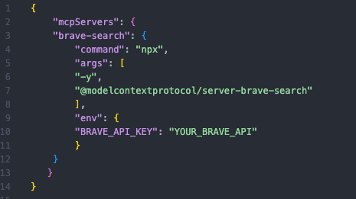
MCP server example Online function - Brave-search
An MCP server implementation that integrates the Brave Search API, providing both web and local search capabilities.

Slide 17
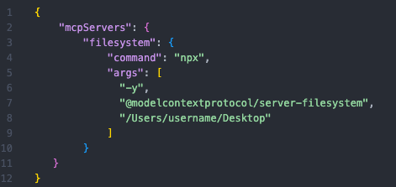
MCP server example File access – server-filesystem
Node.js server implementing Model Context Protocol (MCP) for filesystem operations.

Slide 18
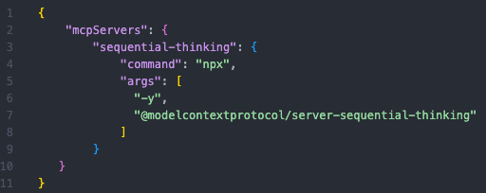
MCP server example Sequential Thinking- server-sequential-thinking
An MCP server implementation that provides a tool for dynamic and reflective problem-solving through a structured thinking process.

Slide 19
Project Schedule
Week | Milestone | Description
1 | Project Kickoff | Introduction to course project: "Your Personalized Research Agent". Define goals & start experimenting with prompts.
4 | Project Insight I (TA Section) | First review of project idea. Share initial progress, receive peer/TA feedback. Adjust scope if needed.
7 | Project Insight II (TA Section) | Second review checkpoint. Final decision: lock in project direction & components.
10 | Final Presentation | Present your working agent: share learnings, showcase demo, and reflect on technical depth.

Slide 20
Kickstart of Your Project
Explore Use Cases Investigate real-world research agents (e.g., paper summarizers, citation tools, QA systems). Brainstorm how LLMs can boost your own research workflows.
Define Your Agent’s Goal Write a 1-sentence mission: “My agent helps me [task] by [method].”
Start Prompt Engineering Design your first prompt using CO-STAR and chain-of-thought techniques. Format output with JSON/XML for structured results.
Join Discord & Collaborate Introduce yourself. Share your agent idea. Join a feedback group.
Study Examples Review prompt demos & agent walkthroughs. Note what works — and what doesn’t.
Track Model Limitations Record hallucinations, logic gaps, or failures — these will shape your future projects (RAG, SFT, alignment).

Slide 21
Key Takeaways
Generative AI is powerful — but needs smart prompting
LLMs respond differently based on how we talk to them
Prompt engineering is both art and science
MCP is our agent-building protocol — learn it well!

Slide 22
Homework
Complete all tasks in Project 1 (see class repo)
Join Discord group for Q&A and code sharing
Setup MCP server in your local
Write a 1-sentence project idea and share in the Discord group
Next week: deep dive into Transformers and Pretraining

