Slide 1

Week 4: Retrieval-Augmented Generation (RAG)
Enhancing LLMs with External Knowledge
Course: Machine Learning Engineer in the Generative AI Era
Series 1: Data Engineering

Slide 2
Lecture Overview
Topics Covered:
Introduction to RAG
Text Embedding and Distance Metrics
Tokenization, Filtering, and Chunking
Vector Databases
RAG and LLM Integration with LangChain
Evaluation Metrics
Project 4 Overview

Slide 3
Introduction to RAG
Benefits:
Reduces hallucinations in LLMs
Enables access to proprietary or recent data
Improves response accuracy and relevance
Definition: RAG combines retrieval mechanisms with generative models to enhance the accuracy of outputs by accessing external knowledge sources.
Purpose: To provide up-to-date and contextually relevant information beyond the model's training data.

Slide 4
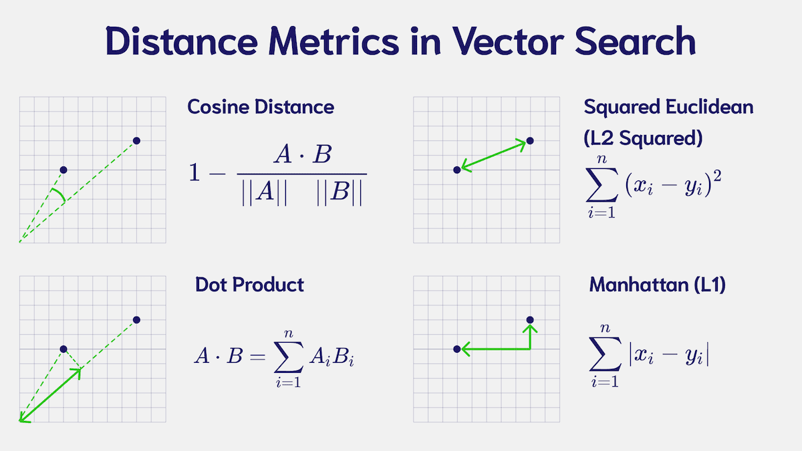
Text Embedding and Distance Metrics
Text Embedding: Transforms text into numerical vectors representing semantic meaning.
Common Embedding Models:
OpenAI's text-embedding-ada-002
Sentence-BERT
Hugging Face Transformers
Distance Metrics:
Cosine Similarity: Measures the cosine of the angle between two vectors.
Squared Euclidean Distance: Calculates the straight-line distance between two points in vector space.
Manhattan Distance: Computes the sum of absolute differences across dimensions.
Dot Product Distance: Calculates the sum of the products of corresponding vector components:
Application Example: Used to determine the similarity between user queries and document embeddings in retrieval tasks.​
Cardenas, Erika. "Distance Metrics in Vector Search." Weaviate, 15 Aug. 2023, https://weaviate.io/blog/distance-metrics-in-vector-search.

Slide 5

Tokenization, Filtering, and Chunking

Slide 6
Tokenization
Definition: Tokenization is the process of breaking down text into smaller units called tokens, which can be words, subwords, or characters. This step is crucial for converting unstructured text into a structured format that machines can understand and process. ​
Importance:
Facilitates text analysis by enabling the identification of meaningful elements.
Serves as the foundation for subsequent NLP tasks like parsing, stemming, and lemmatization.
Essential for preparing text data for machine learning models.​
Tools:
NLTK (Natural Language Toolkit)
spaCy
Hugging Face Tokenizers

Slide 7
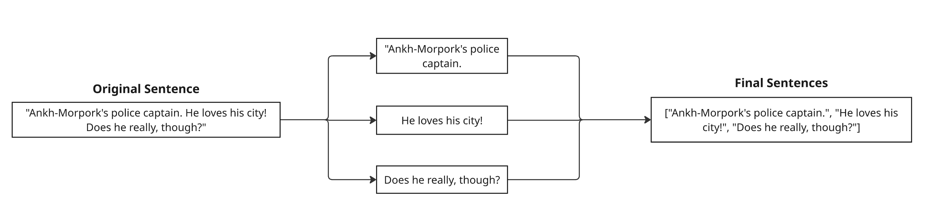
Sentence Tokenization
Sentence tokenization splits text into individual sentences, typically using punctuation marks like periods (.), exclamation points (!), and question marks (?) as delimiters.

Slide 8
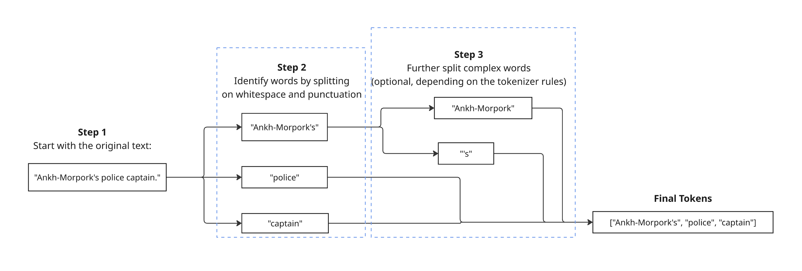
Tokenization by Words
This is the simplest form of tokenization, splitting text based on whitespace and punctuation.
Good for basic text processing and analysis.

Slide 9
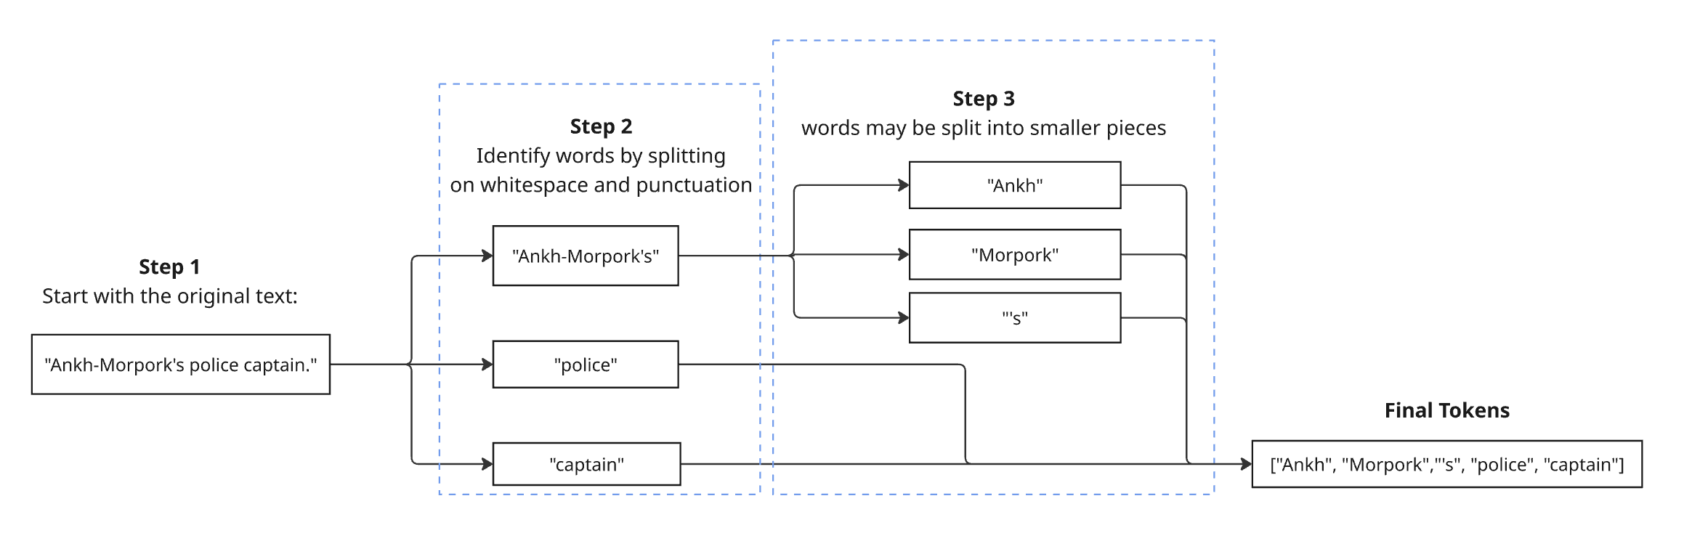
Tokenization by Subwords
Common in models like BERT
Good for handling uncommon or composite words.

Slide 10
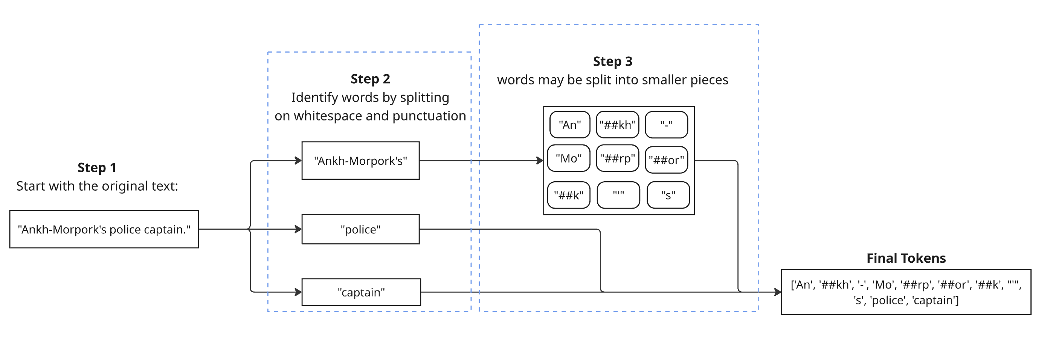
Tokenization using WordPiece/BPE
Used by models like BERT, GPT
Ideal for NLP models, balancing between vocabulary size and language complexity.

Slide 11
Filtering
Definition: Filtering involves removing irrelevant or low-quality data from text to enhance the efficiency and accuracy of NLP models. This step ensures that the models are trained on clean and meaningful data. ​
Importance:
Improves model performance by eliminating noise.
Reduces computational resources by focusing on pertinent data.
Enhances the quality of insights derived from text analysis.​
Tools:
NLTK
spaCy
Regular Expressions (Regex)​

Slide 12
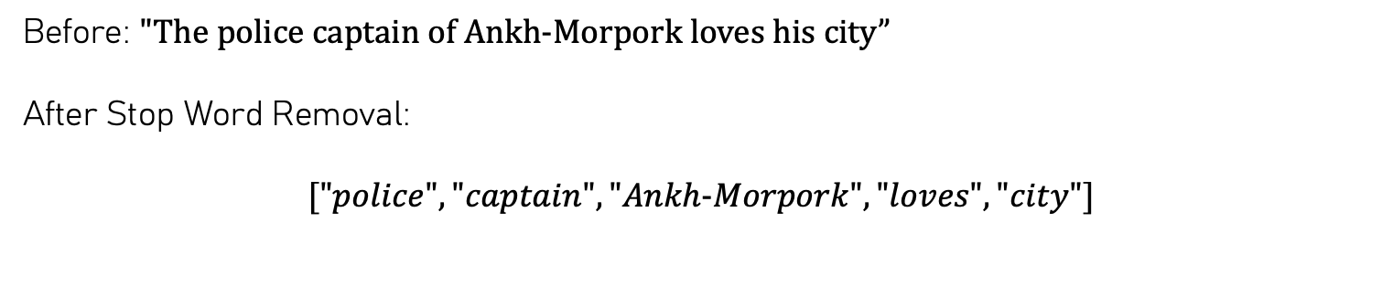
Stop Word Removal
Stop word removal eliminates common words ("the," "of," "his," etc.) that often carry minimal meaning for NLP tasks.
Before: $"The police captain of Ankh−Morpork loves his city”$
After Stop Word Removal:
$$["police", "captain", "Ankh−Morpork", "loves", "city"]$$
Explanation:
Removed stop words: "The", "of", "his"
Remaining words convey clear meaning and context.

Slide 13
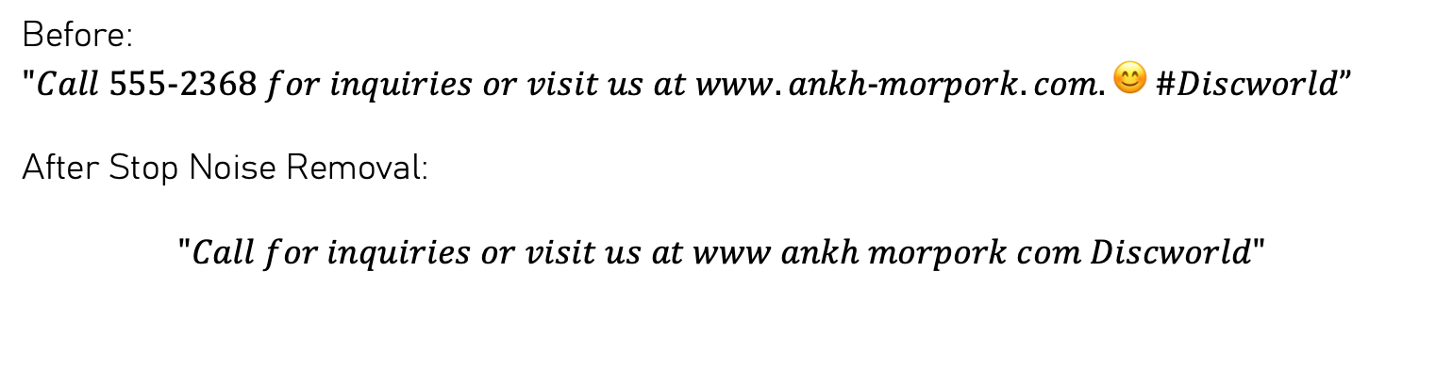
Noise Removal
Noise removal strips irrelevant characters, symbols, numbers, and emojis from text, leaving clean, meaningful language.
Before: $"Call 555−2368 for inquiries or visit us at www.ankh−morpork.com. 😊 \#Discworld”$
After Stop Noise Removal:
$$"Call for inquiries or visit us at www ankh morpork com Discworld"$$
Explanation:
Removed phone number: 555-2368
Removed emoji: 😊
Removed special characters: ., #, -
Converted URLs to simple text (www.ankh-morpork.com → www ankh morpork com)

Slide 14
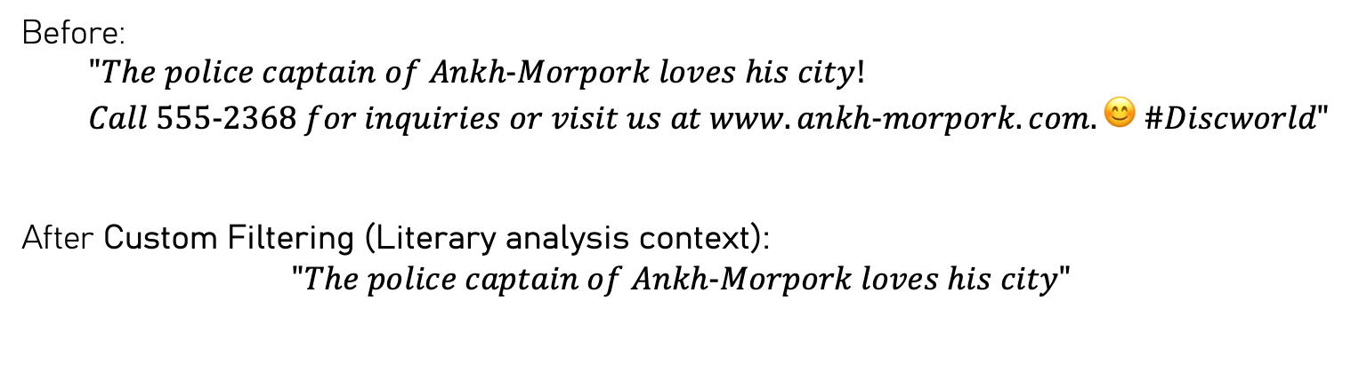
Custom Filtering
Custom filtering applies specific rules relevant to the domain or topic, removing content irrelevant to analysis. For example, filtering out URLs, hashtags, or promotional content for literary analysis:
Before:
$$"The police captain of Ankh−Morpork loves his city!$$
$$Call 555−2368 for inquiries or visit us at www.ankh−morpork.com. 😊 \#Discworld"$$
After Custom Filtering (Literary analysis context):
$$"The police captain of Ankh−Morpork loves his city"$$
Explanation:
Removed URL (www.ankh-morpork.com), hashtags (#Discworld), phone numbers (555-2368), and emojis (😊) because these do not contribute meaningfully to literary text analysis.

Slide 15
Chunking
Definition: Chunking, also known as shallow parsing, is the process of segmenting text into syntactically correlated parts like noun or verb phrases. It helps in identifying the structure and meaning within sentences.
Importance:
Aids in extracting meaningful phrases for tasks like information retrieval and question answering.
Enhances the understanding of sentence structure, benefiting downstream NLP applications.
Facilitates the development of more accurate and context-aware language models.​
Tools:
NLTK
spaCy
OpenNLP

Slide 16
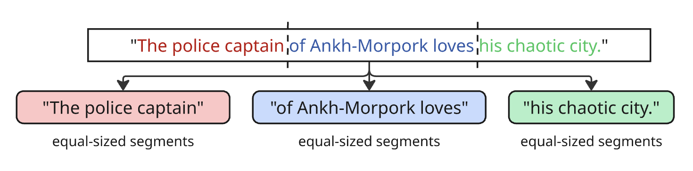
Fixed-size Chunking
Divides the text into equal-sized segments without considering grammatical structure.
Explanation:
The sentence is split simply by groups of three words.
The chunks may or may not reflect coherent phrases.

Slide 17
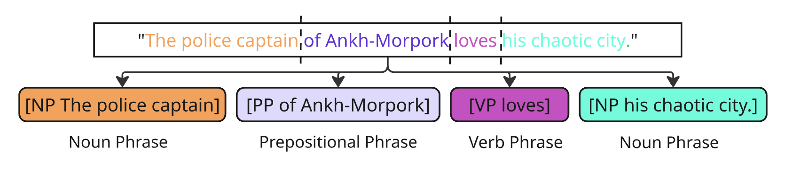
Syntactic Chunking
Uses grammatical rules to segment text into phrases like noun phrases (NP), verb phrases (VP), and prepositional phrases (PP).
Explanation:
[NP]: Noun Phrase, e.g., "The police captain", "his chaotic city"
[PP]: Prepositional Phrase, e.g., "of Ankh-Morpork"
[VP]: Verb Phrase, e.g., "loves"
This technique accurately captures grammatical structure.

Slide 18
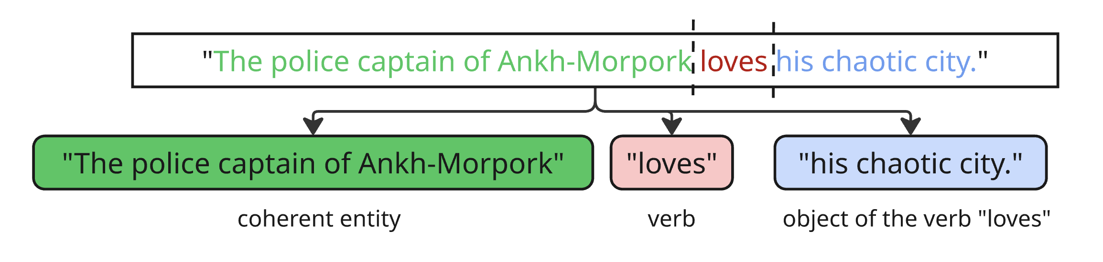
Semantic Chunking
Segments text based on meaning, often leveraging context-aware language models.
Explanation:
The model identifies meaningful semantic groups.
"The police captain of Ankh-Morpork" is recognized as a coherent entity.
"his chaotic city" is seen as the object of the verb "loves".

Slide 19

Vector Databases

Slide 20
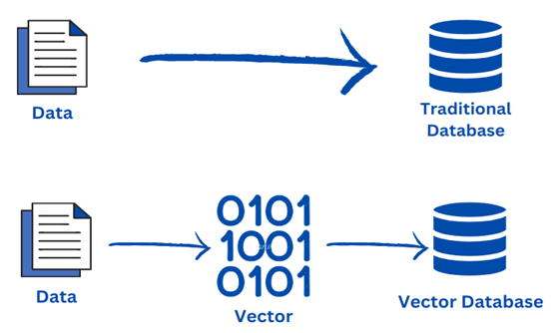
Vector Databases
Purpose: Store and manage vector embeddings for efficient similarity search.
Features:
Scalable storage of high-dimensional vectors
Fast approximate nearest neighbor (ANN) search
Integration with machine learning pipelines
Use Case: Facilitates quick retrieval of relevant documents or data points based on similarity to a query vector.​
Popular Vector Databases:
Pinecone
Weaviate
Qdrant
Chroma
Redis
Milvus
FAISS

Slide 21
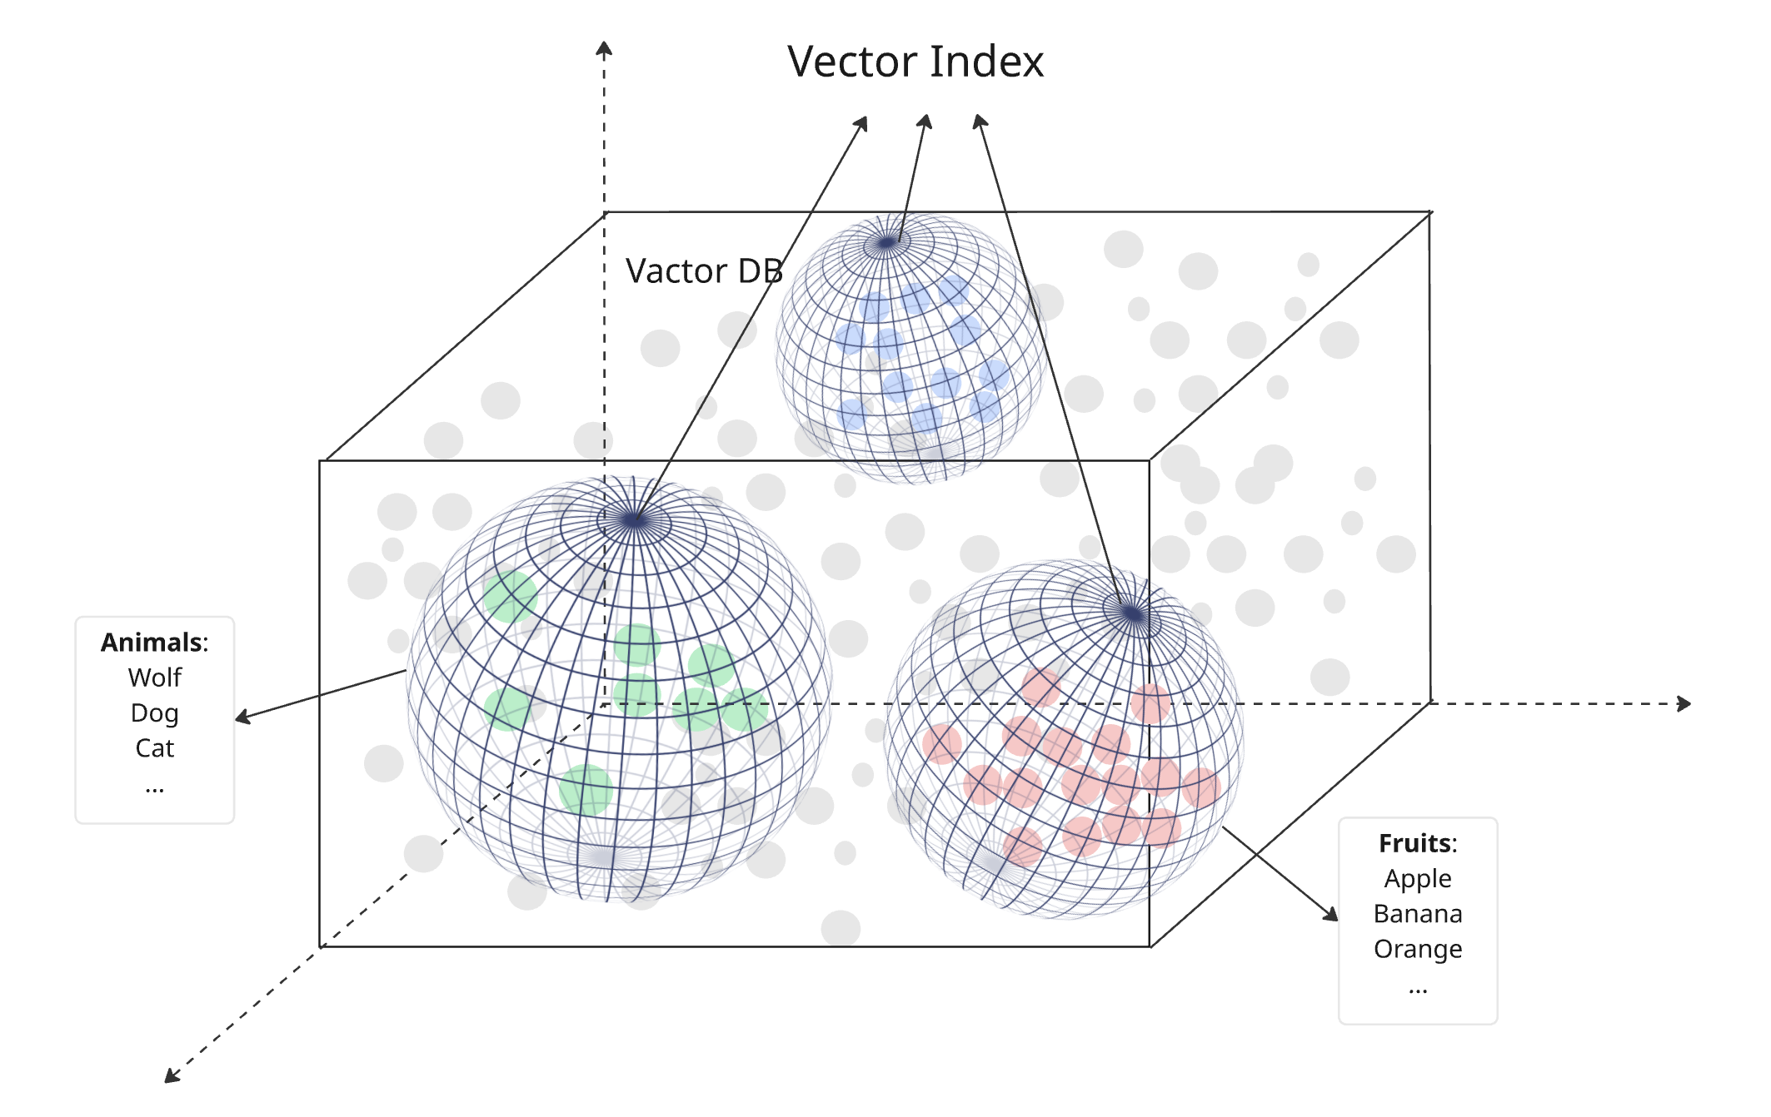
Vector Indexing
Vector databases store and manage high-dimensional data from machine learning models, enabling efficient, scalable similarity search and real-time analysis by computing distances (e.g., cosine or Euclidean) between query and stored vectors using advanced indexing—powering applications like recommendation engines and Kubernetes-based systems.

Slide 22
Retrieval-Augmented Generation (RAG)

Slide 23
Understanding Retrieval-Augmented Generation (RAG)
Definition: Retrieval-Augmented Generation (RAG) is a framework that enhances the capabilities of Large Language Models (LLMs) by integrating external knowledge sources into the generation process. ​
Purpose:
To provide LLMs with access to up-to-date and domain-specific information beyond their training data.
To reduce hallucinations by grounding responses in real, retrieved documents.
To enable dynamic updating of the model's knowledge without retraining.
Key Components:
Retriever: Fetches relevant documents from an external knowledge base based on the user's query.
Generator: Generates responses by conditioning on both the user's query and the retrieved documents.​
Benefits:
Improved accuracy and relevance of responses.
Enhanced transparency by providing source references.
Flexibility to incorporate new information as it becomes available.

Slide 24
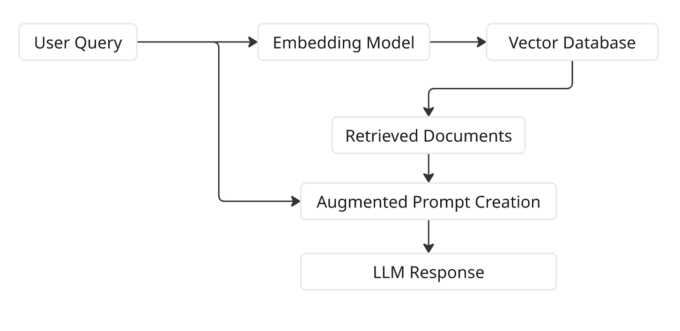
The RAG Workflow
User Query: The user inputs a question or prompt.
Embedding Generation: The query is converted into a vector representation using an embedding model.
Document Retrieval: The system searches the vector database to find documents semantically similar to the query.
Contextual Augmentation: The retrieved documents are combined with the original query to form an augmented prompt.
Response Generation: The LLM generates a response based on the augmented prompt.​

Slide 25
RAG vs. Traditional LLM Approaches
Traditional LLMs:
Rely solely on pre-trained knowledge.
Cannot access information beyond their training cutoff.
Prone to hallucinations when handling queries about recent or niche topics.
RAG-Enhanced LLMs:
Integrate external, up-to-date information at inference time.
Provide responses grounded in real documents, reducing hallucinations.
Allow for dynamic updating of knowledge without retraining the model.

Slide 26
RAG and LLM Integration with LangChain
LangChain: A framework for developing applications powered by language models.
Integration Steps:
Document Loading: Ingest and preprocess documents.
Embedding Generation: Convert documents into vector embeddings.
Vector Store Creation: Store embeddings in a vector database.
Retriever Setup: Configure retrieval mechanisms to fetch relevant documents.
LLM Integration: Combine retrieved documents with prompts for the language model.
Benefits: Streamlines the development of RAG applications by providing modular components.

Slide 27
Evaluation Metrics
Context Recall: Measures the proportion of relevant information retrieved.
Precision and Recall: Assess the accuracy and completeness of retrieved documents.
nDCG (Normalized Discounted Cumulative Gain): Evaluates the quality of ranked retrieval results.
Chunk Attribution: Determines which chunks contributed to the generated response.
Tools:
RAGAS: An open-source tool for evaluating RAG systems.
RAGEval: A framework for generating evaluation datasets for RAG applications.

Slide 28
Project insight I (TA Section)
Prepare Your Initial Project Idea Define your agent's purpose, target users, and core capabilities. Bring early results or prompt drafts if available.
Ask Questions During TA Section Use this session to get clarity on scope, technical feasibility, or dataset access. Come ready to discuss!
Post Your Project Idea on Discord Share your idea in the #project-discussion channel with a short description and your goals for the next few weeks.
Engage With Your Peers Leave thoughtful comments or questions on at least 2 classmates’ posts. Build a feedback loop!

Slide 29
Thank You

