Slide 1

Week 3: Pretraining Data Collection & Extraction
Building Foundations for Large Language Models

Slide 2
Agenda
Why Pretraining Data Matters
Pretraining Data Sources: Crawl, OCR, ASR
Techniques for Cleaning & Filtering Data
Case Study: LLaMA 3/4 Pretraining Data Strategy
Hands-on Project Walkthrough

Slide 3
Why Pretraining Data Matters
Pretraining defines model capabilities, bias, and generalization
Data quality, diversity, and volume directly impact performance
Your LLM is only as good as the data it sees
Garbage in, garbage out — data is the soul of pretraining.

Slide 4
Data Sources for Pretraining
Type | Examples | Tools/Libraries
Web Crawl | Common Crawl, Wikipedia, arXiv | requests, scrapy, newspaper3k
PDFs | Scientific papers, books | PyMuPDF, pdfplumber
Images | Scanned docs, screenshots | Tesseract, Surya, OpenAI OCR
Audio | Podcasts, YouTube lectures | Whisper, OpenAI ASR, faster-whisper

Slide 5

Common Crawl 101
The Internet's Library of Web Pages
Common Crawl is a giant public project that saves copies of websites — like a snapshot of the entire internet — and updates it every month.
Why It Matters
Used to train many LLMs like ChatGPT and Claude
It helps models learn how people write online (blogs, articles, Wikipedia)
What's Inside?
HTML files (raw website code)
Text from articles and blogs
Metadata like page title, publish date
How We Use It (No Coding Required at First!)
Let’s try “trafilatura” to clean messy HTML into readable text
https://trafilatura.readthedocs.io/en/latest/ (Code in the notebook)
Analogy
Imagine printing out millions of webpages and using a highlighter to extract just the important sentences. That’s what we do with Common Crawl data

Slide 6

OCR – Extracting Text from Images
Convert scanned PDFs or screenshots to text
Tools:
Tesseract (open-source, works offline, https://github.com/tesseract-ocr/tesseract )
Surya (https://github.com/VikParuchuri/surya)
OpenAI GPT-4o Vision API (accurate, multi-column aware)
Tips:
Pre-process images (denoise, grayscale)
Use layout-preserving extraction for structure

Slide 7

ASR – From Audio to Text
Automatic Speech Recognition (ASR) turns podcasts, lectures into text
Popular Models:
Whisper (OpenAI)
faster-whisper (for speed)
Google Cloud Speech, AssemblyAI
Applications:
Transcribing YouTube educational content
Creating pretraining corpora from speech

Slide 8
Pretraining Data Cleaning Pipeline
Remove duplicates (MinHash, SimHash)
Filter for language, HTML noise
Strip PII (emails, names, credit cards)
Remove repetitive n-grams
Deduplicate URLs & near-duplicate paragraphs

Slide 9
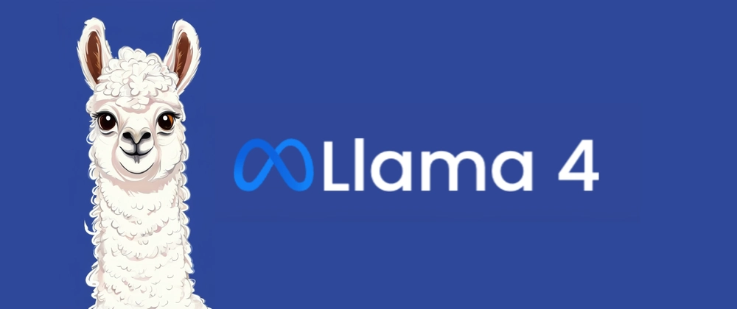
Case Study — LLaMA 4 Data Pipeline: From Raw Data To Multimodal Intelligence
1. Diverse Data Sources
Publicly Available Data: Web pages, academic papers, and open-source repositories.
Licensed Data: Books, proprietary datasets, and licensed media.
Meta-Proprietary Data: Public posts from Facebook and Instagram, and user interactions with Meta AI.​Reuters+2
2. Data Filtering & Cleaning
Deduplication: Using techniques like MinHash to remove duplicate content.
Language Classification: Ensuring data is in supported languages.
HTML & Noise Removal: Stripping unnecessary HTML tags and irrelevant content.​
3. Ablation Studies
Purpose: To identify which data types most effectively improve model performance.
Findings: Inclusion of science, technology, and fiction books led to significant performance gains on benchmarks like BooIQ and SIQA.​
Meta AI Blog: The LLaMA 4 Herd — The Beginning of a New Era of Natively Multimodal AI Innovation Published: April 5, 2025

Slide 10
Case Study — LLaMA 4 Data Pipeline: From Raw Data To Multimodal Intelligence
4. Pretraining
Token Volume: Between 22 to 40 trillion tokens.
Techniques: Utilizing FP8 precision and Mixture of Experts (MoE) architecture.​
5. Post-training & Alignment
Methods: Supervised Fine-Tuning (SFT), Direct Preference Optimization (DPO), and online Reinforcement Learning (RL).
Goal: To align the model's outputs with human preferences and values.​
6. Multimodal & Multilingual Capabilities
Languages: Supports 12 languages.
Modalities: Handles both text and image inputs.
Models:
Scout: 17B active parameters, 16 experts, 10M context window.
Maverick: 17B active parameters, 128 experts, 1M context window.​
Meta AI Blog: The LLaMA 4 Herd — The Beginning of a New Era of Natively Multimodal AI Innovation Published: April 5, 2025

Slide 11
Project 3 Introduction
Goal: Build your own high-quality pretraining dataset
Tasks:
Scrape arXiv for papers in a chosen topic (e.g., NLP)
Convert PDFs to text using OCR (e.g., Surya, Tesseract)
Deduplicate content + remove PII
Resources: Sample notebook provided in repo

