Slide 1
/convergence-review
Discussion

Slide 2
Purpose
Use several reviewers (number depends on type of review)
Synthesize results from reviewers:
Deduplication
Fix CRITICAL and IMPORTANT issues
Fixer may skip a fix if it feels it has already been addressed or is a non-issue
Repeat until:
No CRITICAL and IMPORTANT issues
Max number of rounds passes
The review process fails to make progress

Slide 3
Original Architecture
Process embedded in SKILL.md as orchestrator
Reviewers are agents
Orchestrator reviews results and fixes document
Problems observed
Run out of context after just 1 or 2 rounds
Fail to re-review after fixing
Bias towards “fixed”
Key issue: context too large
Biases decisions
Makes orchestrator “forget” its instructions

Slide 4
Architecture
LLM
Reviewer
(http/openai)
Each reviewer has a different perspective.
Reviewer
(http/openai)
Reviewer
(http/openai)
/convergence-review
doc
history
calls
LLM
Orchestrator
(python)
reformatter
Despite the rules, sometimes reviewers or the assessor don’t return the required JSON format. This is a fallback.
history
LLM
writes
reviews
Assessor
(http/openai)
reads/forwards
Reviews the results from the reviewer to remove duplicates and any already fixed in the past.a
history
convergence-state
review summary
reviews
Claude code
doc
Fixer
(claude –p)
Fixes problems – may choose not to take action if it believes it has already been fixed.
skill readable
Human readable
modifies

Slide 5
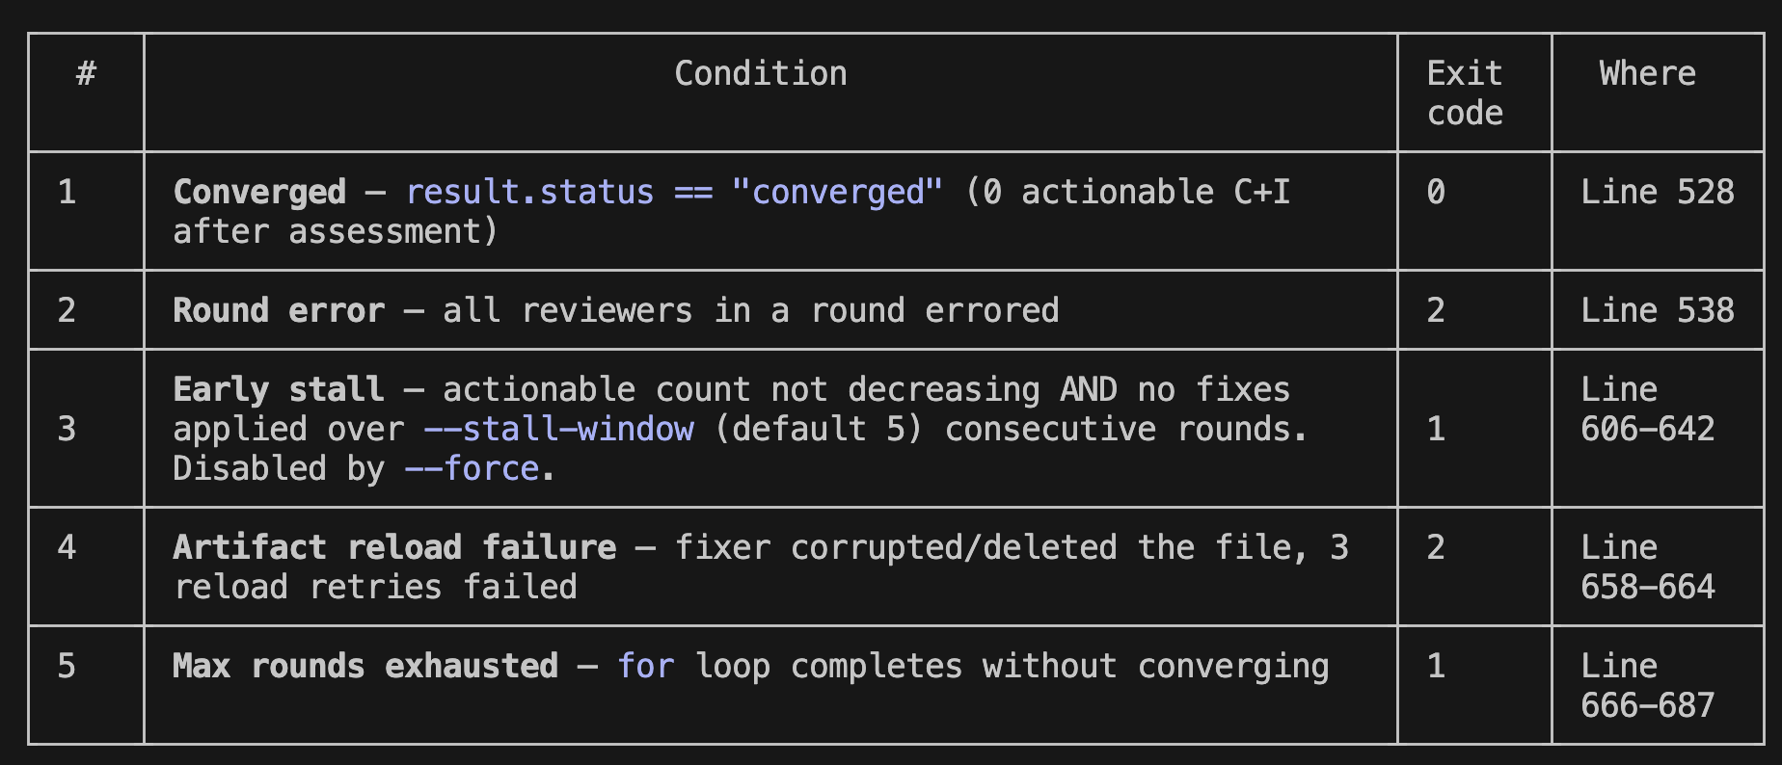
Starting Prompt
do /convergence-review for x-pr-plan gate on
@docs/plans/2026-03-09-pr1-mapping-scaffolding-cli-plan.md using `--force`.
Defaults:
Max 10 rounds
Reviewers use haiku
Fixer uses opus
--force overrides ”stall” calculations
Finishes when:
Can:
Change reviewer/assessor model (openai compatible)
Change fixer model (claude compatible
Set man number rounds

Slide 6
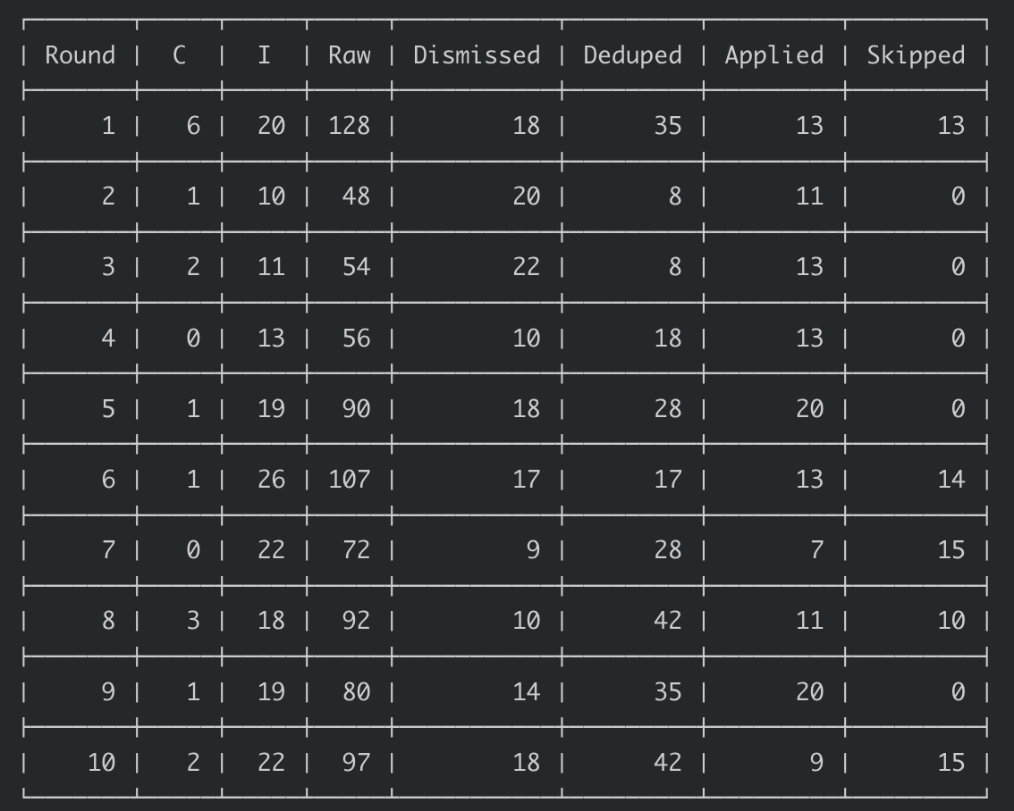
Common Behavior
No convergence
Wants to please?
Finding the same problems (not getting fixed?)
What should definition of convergence be?

Slide 7
Exploration
The fixer can decide to not fix an issue:
Already fixed
Out of scope
Mitigated elsewhere (the reviewer missed)
This is not captured by the assessor

Slide 8
Exploration
There are duplicates identified among reviewers; not between rounds
This is different – they were not fixed and may represent
Things out of scope
Things mitigated elsewhere (the reviewer misses)
Real problems that LLM can’t fix on its own

Slide 9
Fixes?
Track number of issues addressed by fixer.
Remove issues that persist over may rounds (3)

Slide 10
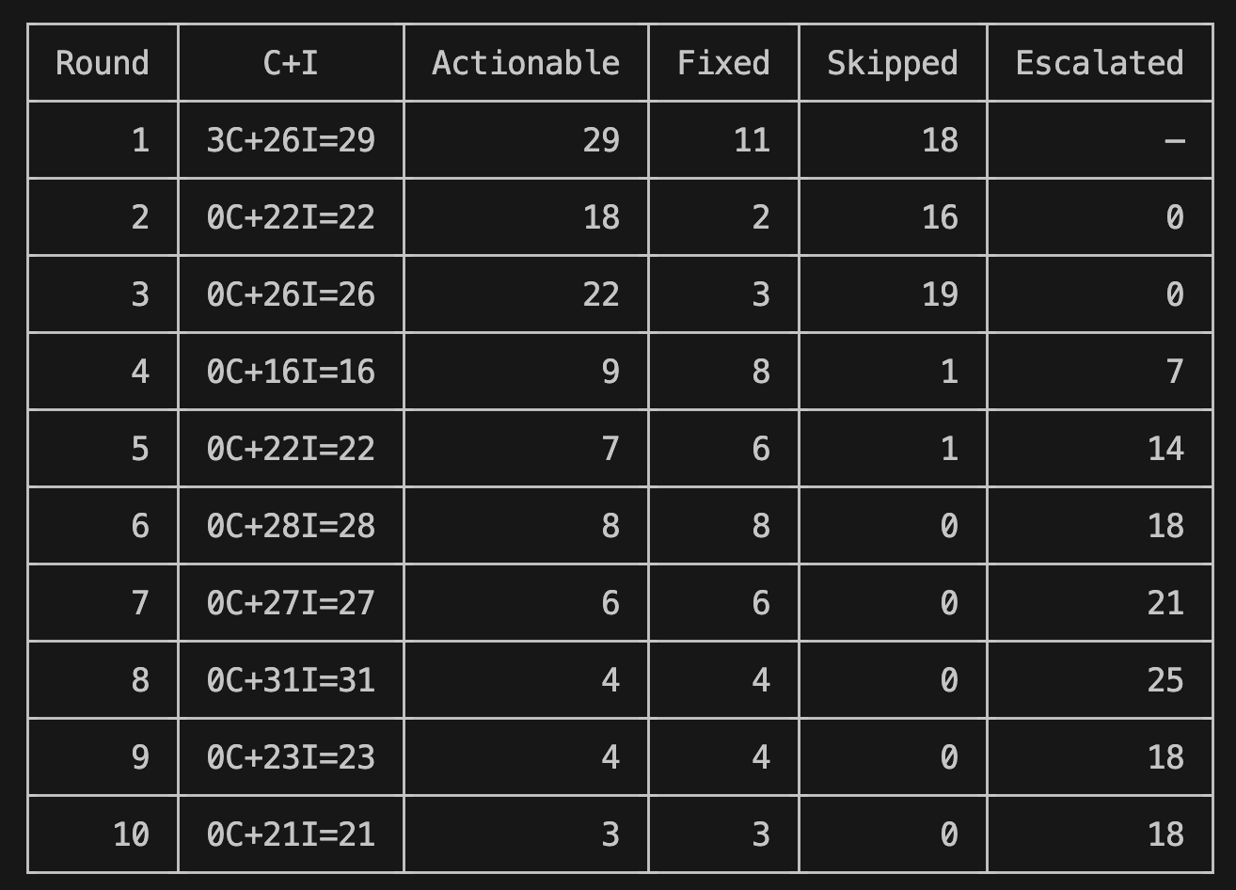
Round History
When is it done?

Slide 11
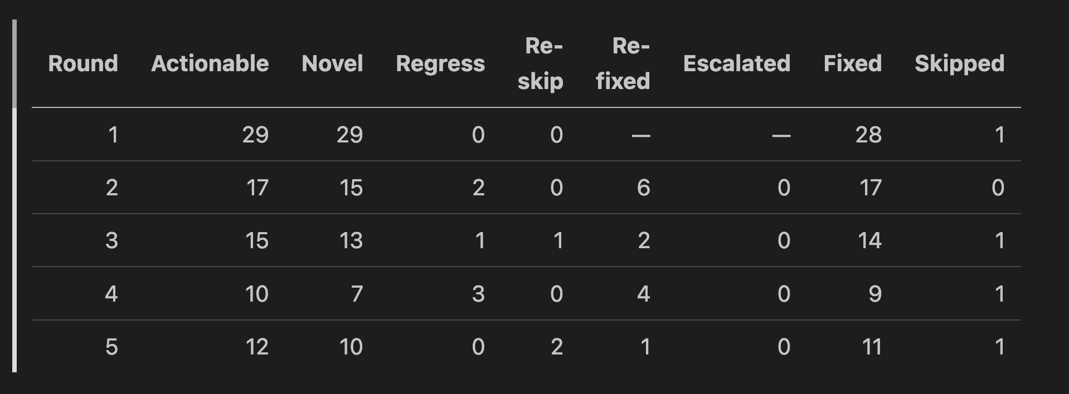
Exploration
Provide additional context to reviewers
List of issues already fixed
List of issues the fixer felt were already fixed
List of issues fixer decided not to fix
With instructions to re-raise only if the reviewer has a strong opinion

