Slide 1
Llama 3.1 70B Config Exploration
Sim2Real Validation Results
Model: Llama 3.1 70B Instruct (FP8) on H100 80GB
Workload: Chatbot, 10 QPS Poisson, 10K requests
ISL: Gaussian(512, 200), OSL: Gaussian(256, 100)
SLO: Mean TTFT <= 300 ms
Tools compared: BLIS (inference-sim), AIConfigurator, llm-optimizer
9 configs tested, 5 deployed successfully, 4 failed (KV cache OOM)

Slide 2
BLIS Search Algorithm: NSGA-II Multi-Objective Optimization
How It Works
1. Generate initial population
40 random configs from the parameter space
2. Evaluate each config
Run BLIS simulation (~100-250ms each, parallelized)
3. Rank by Pareto dominance
Non-dominated sorting into fronts
4. Select parents
Tournament selection favoring front rank + crowding distance
5. Crossover + mutate
Uniform crossover of config params, 15% per-param mutation
6. Repeat for 4 generations
~200 total evaluations, 3-5 seconds wall time
Result: Pareto-optimal set of configs
4 Objectives (simultaneous)
Maximize throughput (responses/sec)
Minimize TTFT P99 (latency)
Minimize GPU count (cost)
Minimize KV memory (blocks)
6-Parameter Search Space
TP: 1, 2, 4, 8
Replicas: 1..floor(8/TP)
Scheduler: FCFS, SJF
Max batch size: 32, 64, 128, 256, 512
KV blocks: 2K, 3K, 4K, 5K, 7.5K, 10K
Block size: 16, 32 tokens
Why NSGA-II?
Reaches 99.2% of exhaustive hypervolume at 200 evals
Random search plateaus at 94.3%
Crossover of Pareto parents produces Pareto offspring ~65% of the time

Slide 3
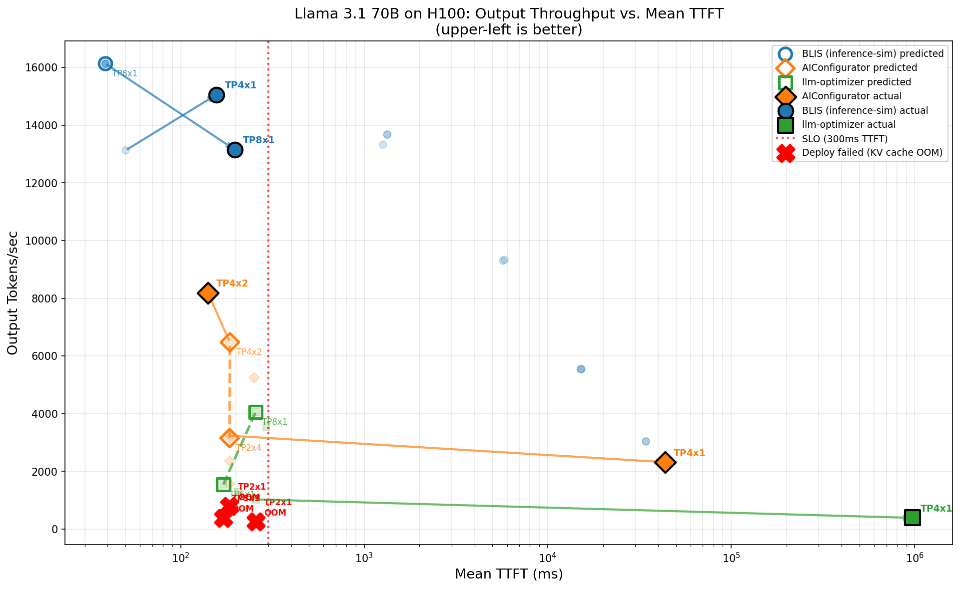
Pareto Front: Predicted vs Actual (TTFT vs Throughput)

Slide 4
Results Summary
Actual Results (Stable Configs)
BLIS TP4x1 (4 GPU): TTFT=157ms, Max=15,056 tok/s
BLIS TP8x1 (8 GPU): TTFT=197ms, Max=13,155 tok/s
AICfg TP4x2 (8 GPU): TTFT=141ms, Max=8,188 tok/s
Overloaded (batch size too small for 10 QPS):
AICfg TP4x1 (4 GPU, seqs=96): TTFT=43.6s
llm-opt TP4x1 (4 GPU, seqs=8): TTFT=970s, 68% timeouts
Key Findings
• BLIS wins: best throughput prediction accuracy (within 15-18% of actual)
• Critical differentiator: batch size selection. BLIS uses max_num_seqs=512; AIConfigurator=96; llm-optimizer=8
• All TP<=3 configs fail (KV cache OOM with 131K context). None of the tools predicted this.
• BLIS underestimates TTFT by 3-5x but gets capacity right. For capacity planning, throughput accuracy matters more.
Winner: BLIS (inference-sim)
BLIS's binary search for max sustainable throughput produces the most operationally useful metric. Its aggressive batch sizes (512) correctly model real vLLM continuous batching behavior, while other tools' conservative settings (8-96) cause queuing failures at moderate load.

