Slide 1

Basic Details of the Team and Problem Statement
Ministry/Organization Name: AutoDesk
PS Code: SIH-1444
Problem Statement Title:
Develop a Smart Glass Cleaning Robot that efficiently and quickly cleans dust from high-rise buildings, ensuring hygiene.
Team Name: High Risers x360
Team Leader Name: Garv Kumar
Institute Code (AISHE): U-0747
Institute Name: Chandigarh University
Theme Name: Robotics and Drones (Software)

Slide 2
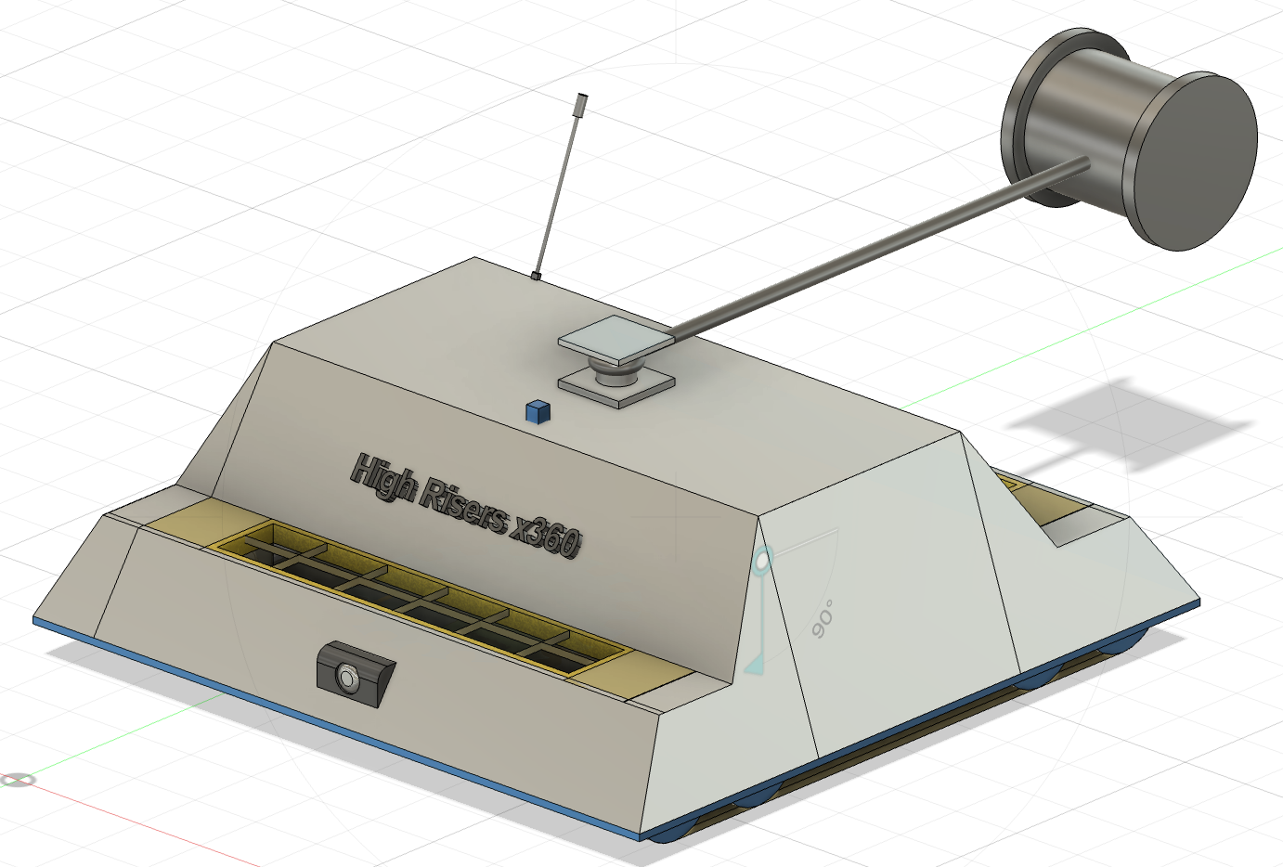
Idea/Approach Details
Describe your idea/Solution/Prototype here:
Our Idea is to create Simple yet Effective High Riser Cleaning Robot with that makes it highly effective and scalable at the same time.
The approach is as follows :
The prototype will be hanged from the top of the building.
It will be either controlled by AI with integration of IOT or Human.
It will get power from integrated wire in pulley rather than Battery. Cost effective, increased work capacity & No E-Waste.
Autonomous or Semi autonomous depends on necessity .
light weight (Aluminum exterior) and aerodynamic design.
Describe your Technology stack here:
1. Fusion 360
2. 3D Modeling
3. IOT (Internet of Things)
4. Basic Electrical and Electronic Engineering
5. Machine Learning & Artificial intelligence (AI ML)

Slide 3
Idea/Approach Details
Describe your Use Cases here
Describe your Dependencies / Show stopper
Skyscrapers : Cleaning the glass panels on Mutli-Storey Buildings.
Glass Structures : Tall and Flat glass structures.
Solar Pannels : on Rooftops as well as in Solar Fields.
Business : Business based profitable design.
Safe cleaning : no human lives are at risk.
Power Supply : Continues supply from integrated wires.
Supervisor : monitoring working is both a valuable advantage and essential dependency.
Quality of components : Aluminum (exterior cover) and relabel electrical components
Control unit (CPU) : autonomous working (AI & IOT )
Revenue stream
Service and business based prototype design.

Slide 4
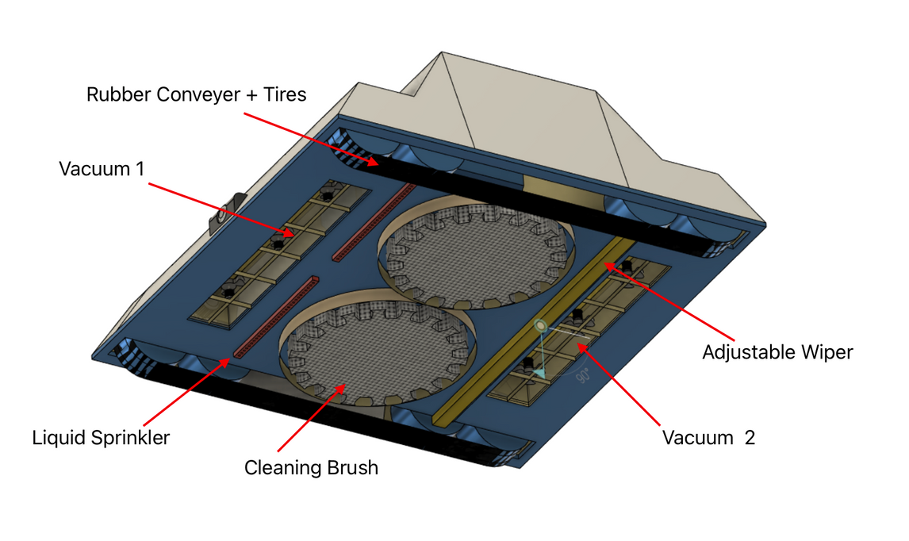
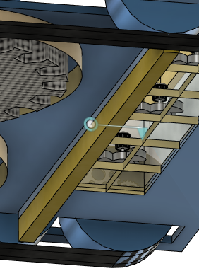
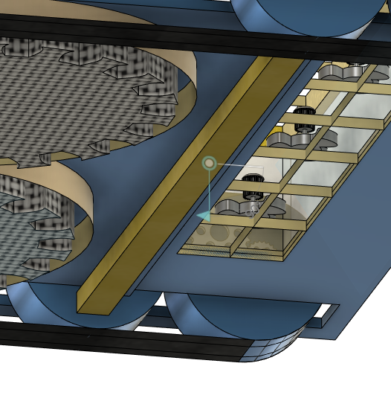
WORKING
Camera detects the area needed to be cleaned
The vacuum cleans the dust particles.
The cleaning brushes clean the window with cleaner.
Adjustable Wiper clean the excess liquid.
Adjustable wipers work only on wet areas and on dry areas they fold inside to avoid scratches on glass pane.
Adjustable wipers

Slide 5
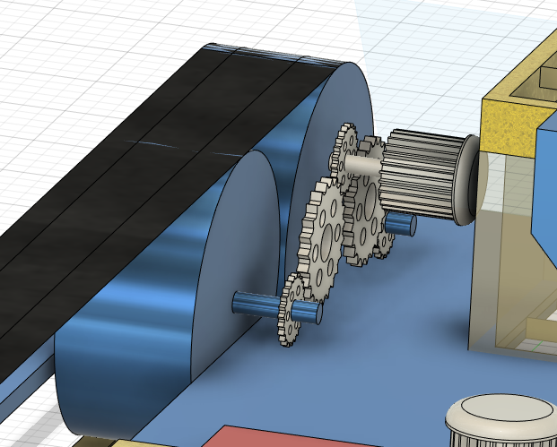
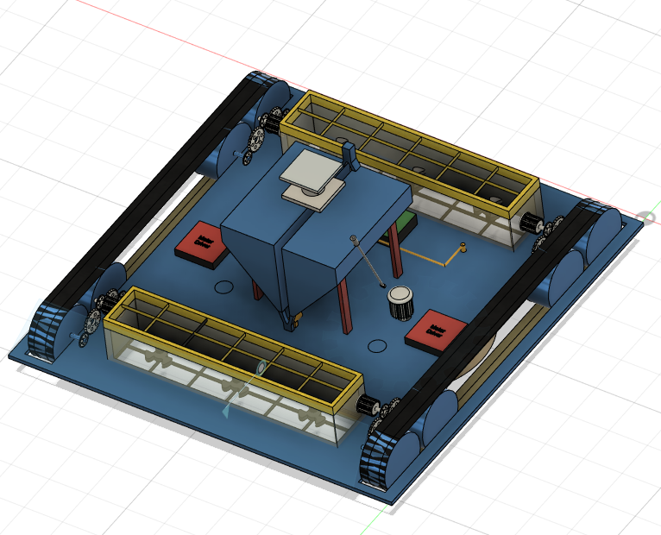
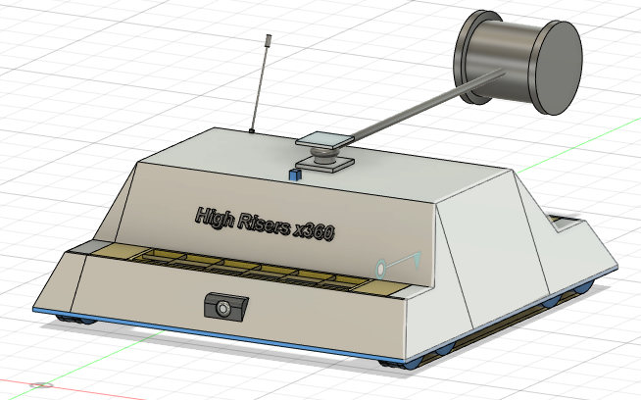
CONCEPTUAL SKETCHES AND IMAGES
TIER-GEAR SYSTEM SKETCH
BOTTOM-BODY SKETCH
INTERIOR SKETCH
TOP-BODY SKETCH

Slide 6
ADVANTAGES
Issues with the solutions available in the market :
Big size
High cost
Limited working time
Our solution:
Compact: Dimensions = (1 x 1 x 1)m.
Portability: The robot can easily be moved
Cost Effective: Removing the concept of batteries hence reducing the cost.
No E-Waste : The robot generates minimal waste as there are no disposable batteries .
More Cleaner capacity : 10L of cleaner capacity

Slide 7
Team Member Details
Team Leader Name: Garv Kumar
Branch : BE Stream : CSE AIML Year : II
Team Member 1 Name: Shivam Kumar Kaushik
Branch : BE Stream : CSE Year : III
Team Member 2 Name: Sujal Dua
Branch : BE Stream : CSE Year : III
Team Member 3 Name: Ishita Verma
Branch : BE Stream : CSE Year : II
Team Member 4 Name: Abhinav Karn
Branch : BE Stream : CSE Year : III
Team Member 5 Name: Movin Naurd
Branch : BE Stream : CSE Year : II
Team Mentor 1 Name: Type Your Name Here
Category (Academic/Industry): Expertise (AI/ML/Blockchain etc): Domain Experience (in years):
Team Mentor 2 Name: Type Your Name Here
Category (Academic/Industry): Expertise (AI/ML/Blockchain etc): Domain Experience (in years):

