Slide 1
Inferno Tech Talk – Nov 2023
Robert Scanlon
MITRE Inferno Team
November 8, 2023

Slide 2
Inferno Tech Talk Introduction
Purpose: to provide regularly scheduled updates on the Inferno tool and its implementation of the (g)(10) test procedure
Typical agenda to include:
Announcements about upcoming releases
Training on new features
Highlight outstanding issues or known problems
Open discussion
Monthly recurrence: 2nd Wednesday at 1PM ET
Content reflects Inferno’s implementation of applicable Test Procedure
and does not necessarily reflect ONC policy.

Slide 3
Today’s Agenda
(g)(10) Standardized API Test Kit v4.0.0
Discussions / Questions

Slide 4
ONC (g)(10) Standardized API Test Kit v4.0.0
Major Update:
Support ONC SVAP 2023
USCDI v3 / US Core v6.1.0
Updates terminology to UMLS 2023AA and to support US Core v6.1.0 relevant ValueSets
Other Updates: 2

Slide 5
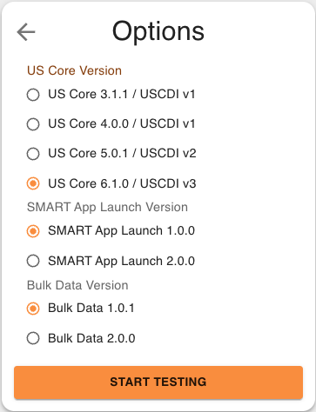
ONC SVAP 2023
USCDI v3 / US Core v6.1.0

Slide 6
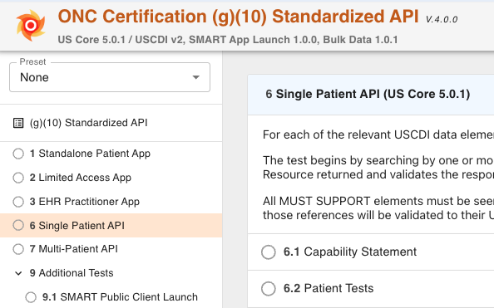
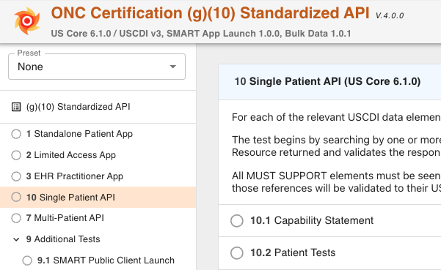
New Test Group ID
This update is mostly isolated to new Single Patient API test group, which includes the US Core v6.1.0 tests for new profiles, resources and associated search parameters

Slide 7
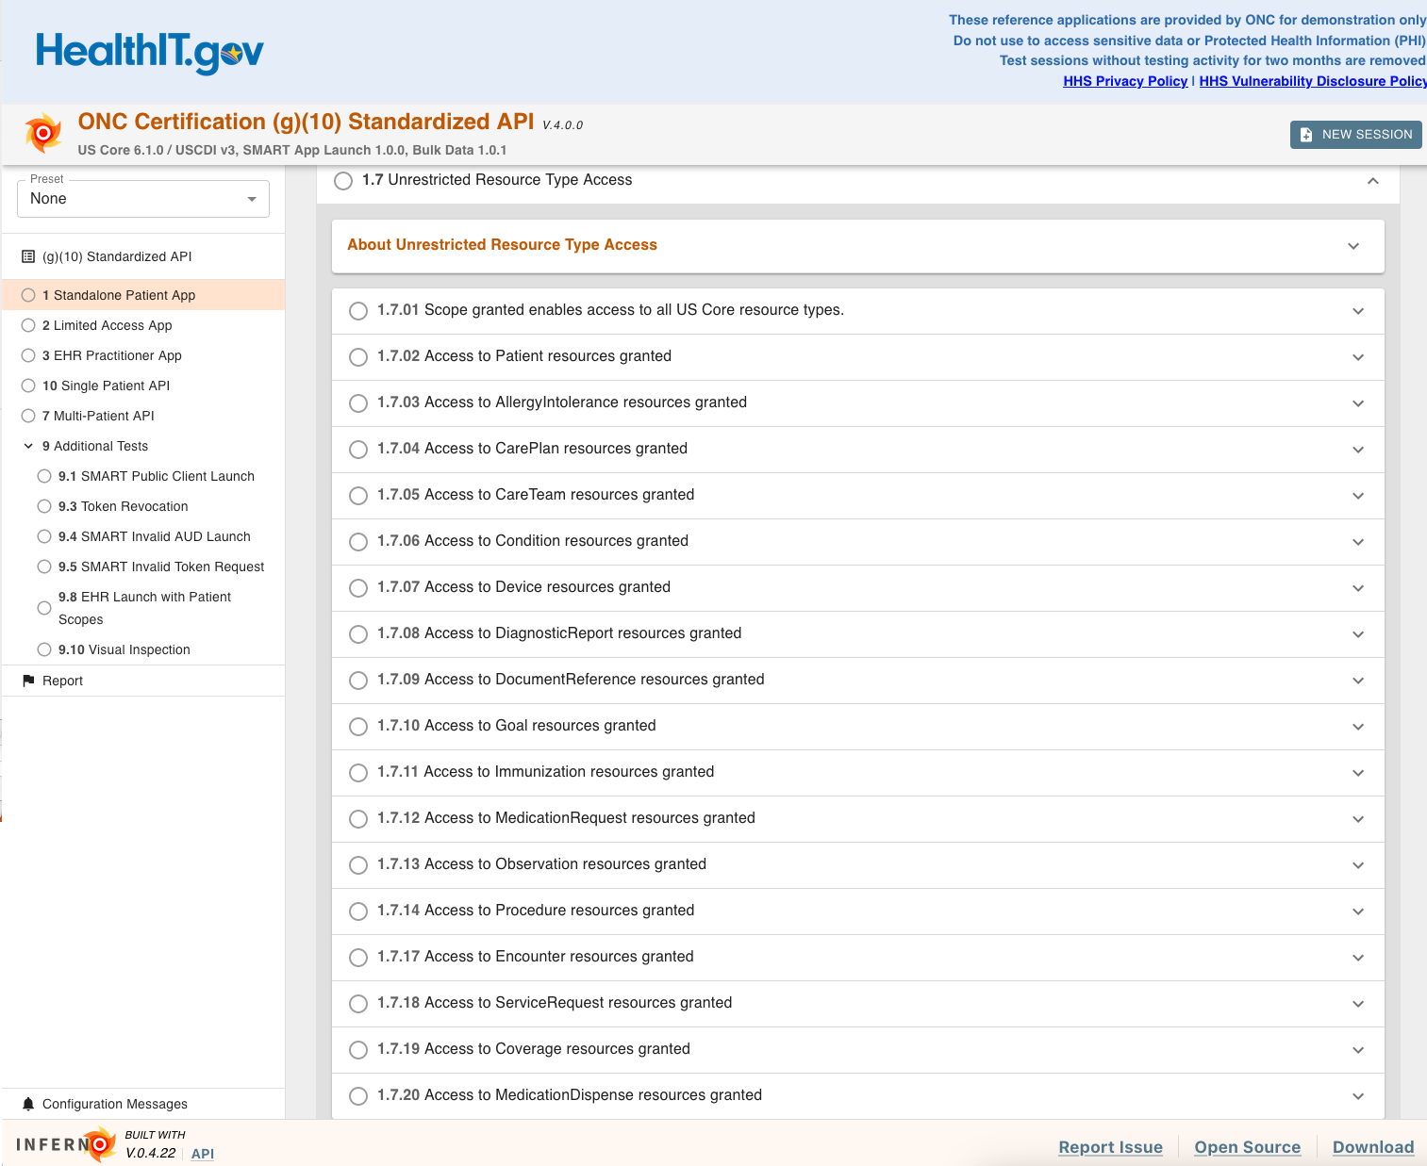
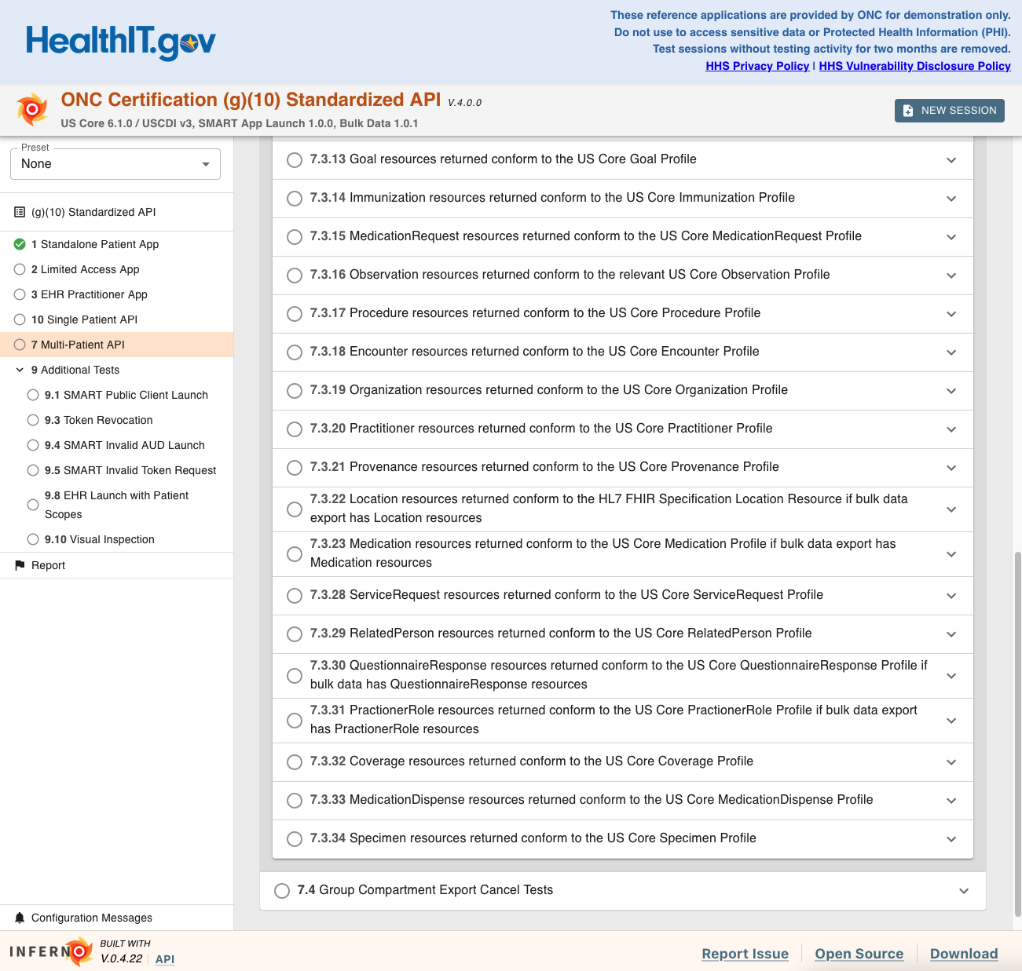
New tests added elsewhere as needed for new resources

Slide 8
Other Updates (1/2)
Change required_resources to required_profiles (#462).
US Core v4.0.0 and above
US Core IG 2.2.2 Conforming to US Core
SHALL specify the full capability details from the US Core CapabilityStatement it claims to implement.
Declare support for the US Core Profile by including its official URL in the server’s CapabilityStatement.rest.resource.supportedProfile element

Slide 9
Other Updates (2/2)
Medication inclusion test for MedicationRequest and MedicationDispense (#463).
.../MedicationRequest?xyz&_include=MedicationRequest:medication
Old test behavior:
Verifies that Bundle has Medication resource(s)
New test behavior:
Verifies that Bundle has Medication resource(s)
Verifies that Medication resources in the Bundle match the references used in MedicationRequest.medicationReference

Slide 10
Additional Notes
Users with a local installation:
Must re-run terminology build process because of additional value sets and new UMLS version; please reach out on Zulip or GitHub Issues if experiencing any issues with this
No changes intended for Inferno API users; existing test IDs remain stable
Awaiting official publication of the Test Procedure to provide a mapping between tests and the updated Test Procedure
Certification test options for US Core v.5.0.1 are expected to be removed in January release. (SVAP Fact Sheet)

Slide 11
Open Discussion / Feedback

Slide 12
Resources and Contact Information
https://inferno.healthit.gov/
General materials & live demonstration server
https://github.com/onc-healthit/onc-certification-g10-test-kit/
ONC Certification tests repository, downloads, issues
“Watch” repository to receive alerts (new releases, etc)
Note: this repository is specific to ONC Certification testing
https://groups.google.com/forum/#!forum/inferno-testing
Announcements & community discussion
inferno@groups.mitre.org (or rscanlon@mitre.org)
Also, FHIR Zulip Chat: https://chat.fhir.org/#narrow/stream/179309-inferno

Slide 13
Upcoming Meetings
Next Inferno Tech Talk: Wednesday December 13 at 1 PM ET
Please reach out with questions & issues

Slide 14
NOTICE
This technical data was produced for the U. S. Government under Contract Number 75FCMC18D0047, and is subject to Federal Acquisition Regulation Clause 52.227-14, Rights in Data-General.
No other use other than that granted to the U. S. Government, or to those acting on behalf of the U. S. Government under that Clause is authorized without the express written permission of The MITRE Corporation.
For further information, please contact The MITRE Corporation, Contracts Management Office, 7515 Colshire Drive, McLean, VA 22102-7539, (703) 983-6000.
© 2023 The MITRE Corporation.

