Slide 1
Inferno Tech Talk – Dec 2023
Yunwei Wang
MITRE Inferno Team
December 13, 2023

Slide 2
Inferno Tech Talk Introduction
Purpose: to provide regularly scheduled updates on the Inferno tool and its implementation of the (g)(10) test procedure
Typical agenda to include:
Announcements about upcoming releases
Training on new features
Highlight outstanding issues or known problems
Open discussion
Monthly recurrence: 2nd Wednesday at 1PM ET
Content reflects Inferno’s implementation of applicable Test Procedure
and does not necessarily reflect ONC policy.

Slide 3
Today’s Agenda
(g)(10) Standardized API Test Kit v4.1.0
Other Updates
Discussions / Questions

Slide 4
ONC (g)(10) Standardized API Test Kit v4.1.0
Test Update:
Changes that may result in new failure: 4
Other Updates: 1

Slide 5
Other Change: New Inferno Core
Inferno Core v0.4.24
Database Migration
Docker
setup.sh
Ruby
bundle exec inferno migrate

Slide 6
Blood Pressure component.dataAbsentReason
US Core 4.0.0, all Vital Sign profiles:
US Core 5.0.1, Blood Pressure profile:
US Core 6.1.0, Blood Pressure profile:

Slide 7
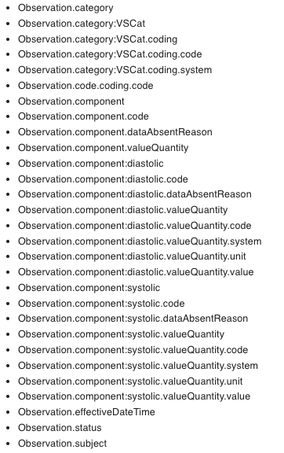
Restore component.dataAbsentReason MS
What Changed:
Add component.dataAbsentReson MustSupport for Observation Blood Pressure profile
Versions applied:
US Core v5.0.1
US Core v6.1.0
Profile applied:
US Core Observation Blood Pressure profile

Slide 8
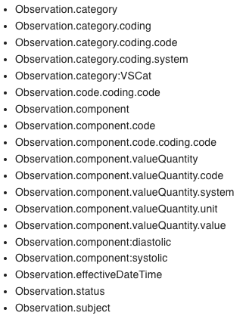
MustSupport elements within a MustSupport slice
Inferno 4.1.0
Inferno 4.0.0

Slide 9
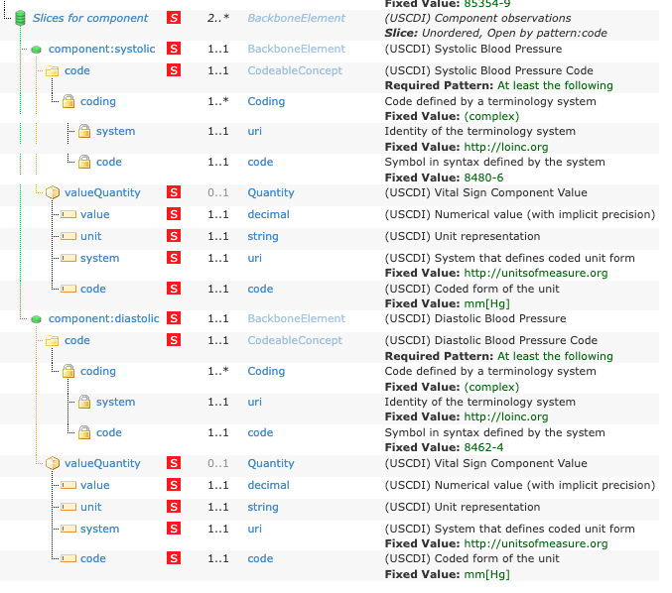
MustSupport elements within a MustSupport slice

Slide 10
MustSupport elements within a MustSupport slice
What Changed:
MustSupport elements are moved under parent’s MustSupport slice
Versions applied:
All US Core versions
Profiles applied:
All US Core profiles
In practice:
US Core Coverage in US Core v6.1.0
US Core Observation Occupation in US Core v6.1.0

Slide 11
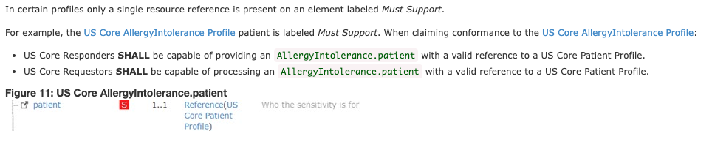
Reference validation on single target profile
Ex: AllergyIntolerance.patient
Inferno 4.0.0
”patient” element is MS.
Reference(US Core Patient Profile) is not MS
US Core Conformance Expectation (US Core 4.0.0 - 2.2.5.4)

Slide 12
Reference validation on single target profile
What changed:
Single target profile on a MustSupport element is treated as MustSupport
Versions applied:
US Core 4.0.0
US Core 5.0.1
US Core 6.1.0
Profiles applied:
All US Core profiles
Test affected:
Reference validation test
At least one reference is accessible AND is a valid US Core resource

Slide 13
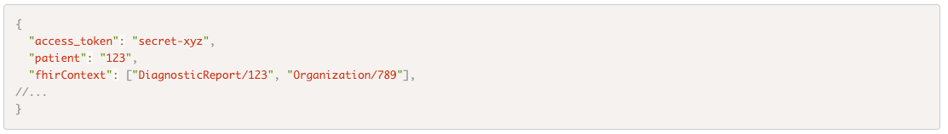
fhirContext in SMART
fhirContext is optional in SMART app launch token response (link)
What changed:
Inferno validates the format of fhirContext, if provided in token response.
Versions applied:
SMART App Launch v2.0.0

Slide 14
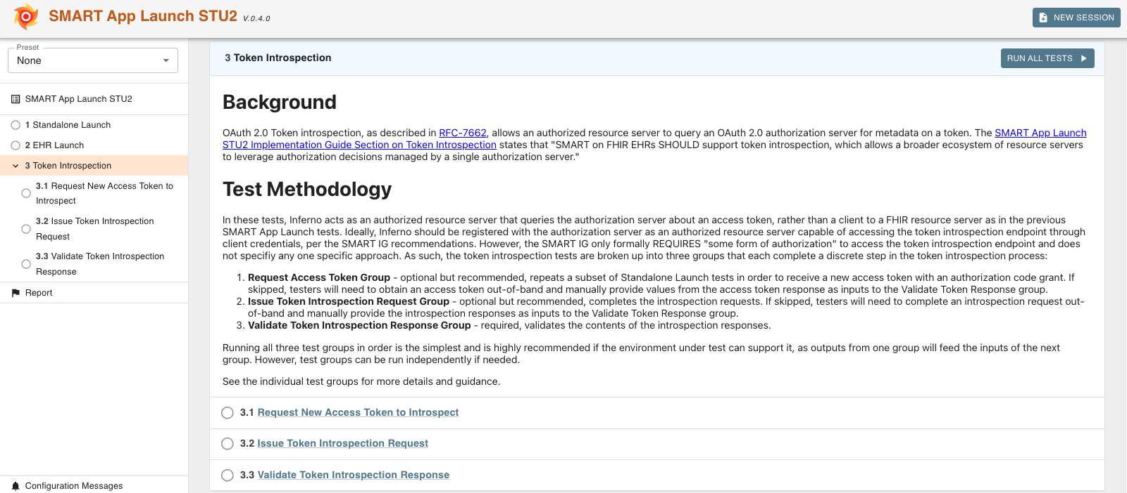
HTI-1
HTI-1 Rule is finalized today (link)
Preview of Token Introspection tests added to SMART App Launch STU2 suite
Feedback welcome as we prepare to update (g)(10) Tests for HTI-1

Slide 15
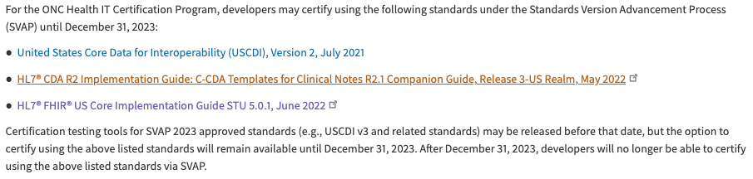
US Core 5 test in (g)(10) certification
US Core 5.0.1 will be removed from (g)(10) certification test in the next release
Inferno will post a survey on zulip on options of keeping existing test results

Slide 16
US Core v7.0.0 ballot
US Core v7.0.0 January Ballot
Ballot signup deadline: Dec 21
Ballot opens: Dec 22
January Connectathon 35: US Core testing track (link)

Slide 17
Open Discussion / Feedback

Slide 18
Resources and Contact Information
https://inferno.healthit.gov/
General materials & live demonstration server
https://github.com/onc-healthit/onc-certification-g10-test-kit/
ONC Certification tests repository, downloads, issues
“Watch” repository to receive alerts (new releases, etc)
Note: this repository is specific to ONC Certification testing
https://groups.google.com/forum/#!forum/inferno-testing
Announcements & community discussion
inferno@groups.mitre.org (or rscanlon@mitre.org)
Also, FHIR Zulip Chat: https://chat.fhir.org/#narrow/stream/179309-inferno

Slide 19
Upcoming Meetings
Next Inferno Tech Talk: Wednesday January 10 at 1 PM ET
Please reach out with questions & issues

