Slide 1
Inferno Tech Talk – Sep 2023
Robert Scanlon
MITRE Inferno Team
September 13, 2023

Slide 2
Inferno Tech Talk Introduction
Purpose: to provide regularly scheduled updates on the Inferno tool and its implementation of the (g)(10) test procedure
Typical agenda to include:
Announcements about upcoming releases
Training on new features
Highlight outstanding issues or known problems
Open discussion
Monthly recurrence: 2nd Wednesday at 1PM ET
Content reflects Inferno’s implementation of applicable Test Procedure
and does not necessarily reflect ONC policy.

Slide 3
Today’s Agenda
(g)(10) Standardized API Test Kit v3.8.1
US Core v6.1.0
Discussions / Questions

Slide 4
ONC (g)(10) Standardized API Test Kit v3.8.1
Test Updates:
Changes that may result in new failures: 0
Improvements to provide implementation flexibility: 0
Other Updates: 2
This is a very minimal update; but local installers should periodically update to ensure all dependencies are up-to-date

Slide 5
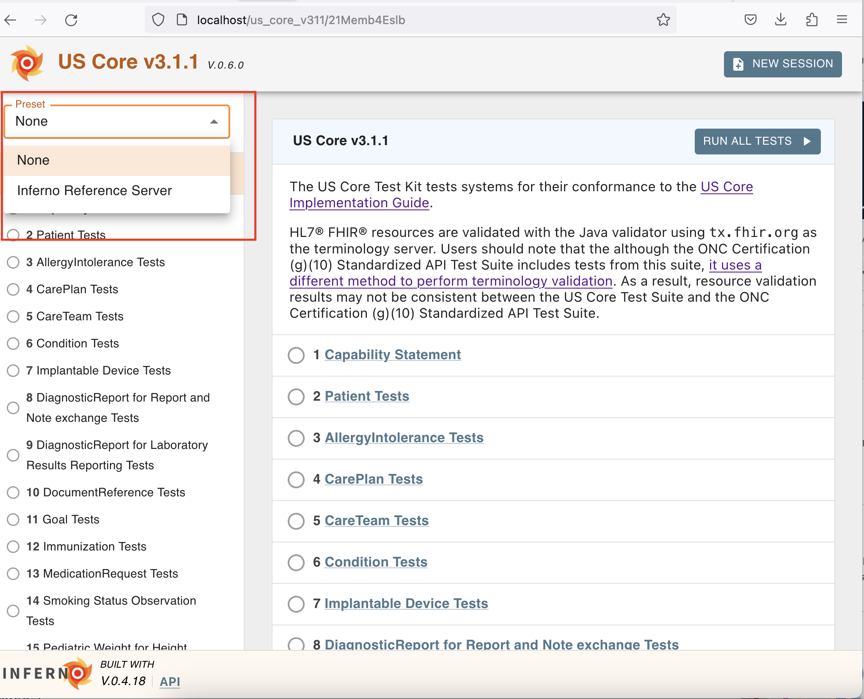
Other Updates (1/2)
Add presets for the US Core Test Suites so that they will be available for users who run the tests locally (#456).

Slide 6
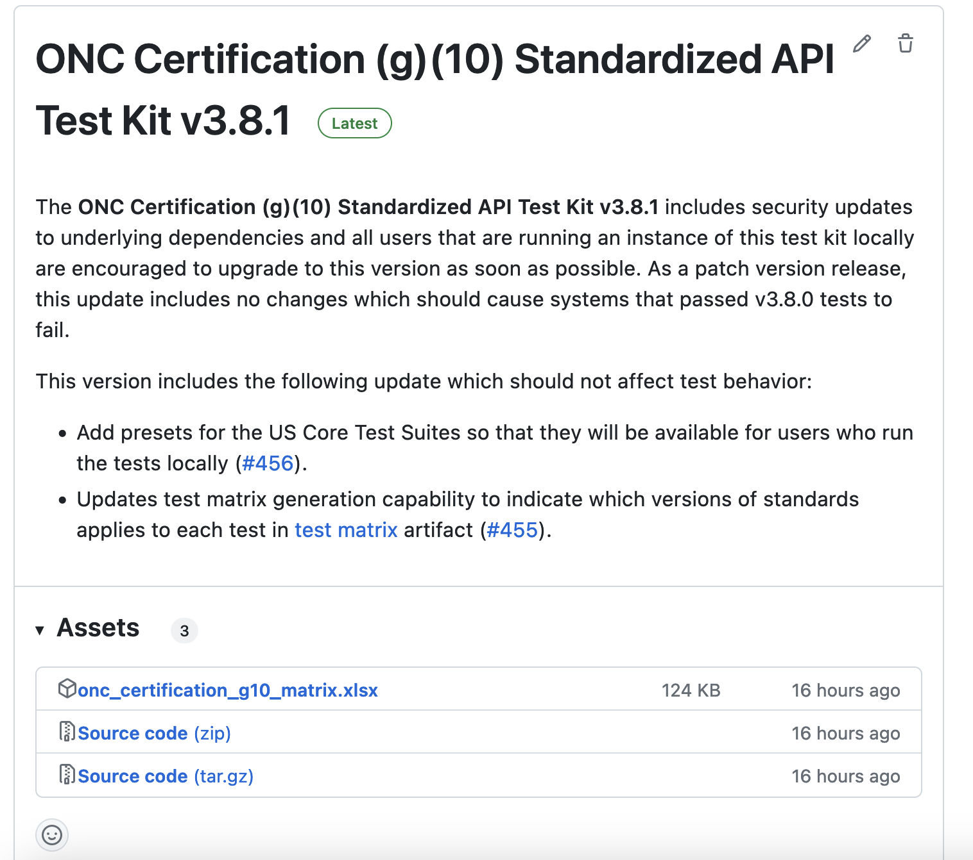
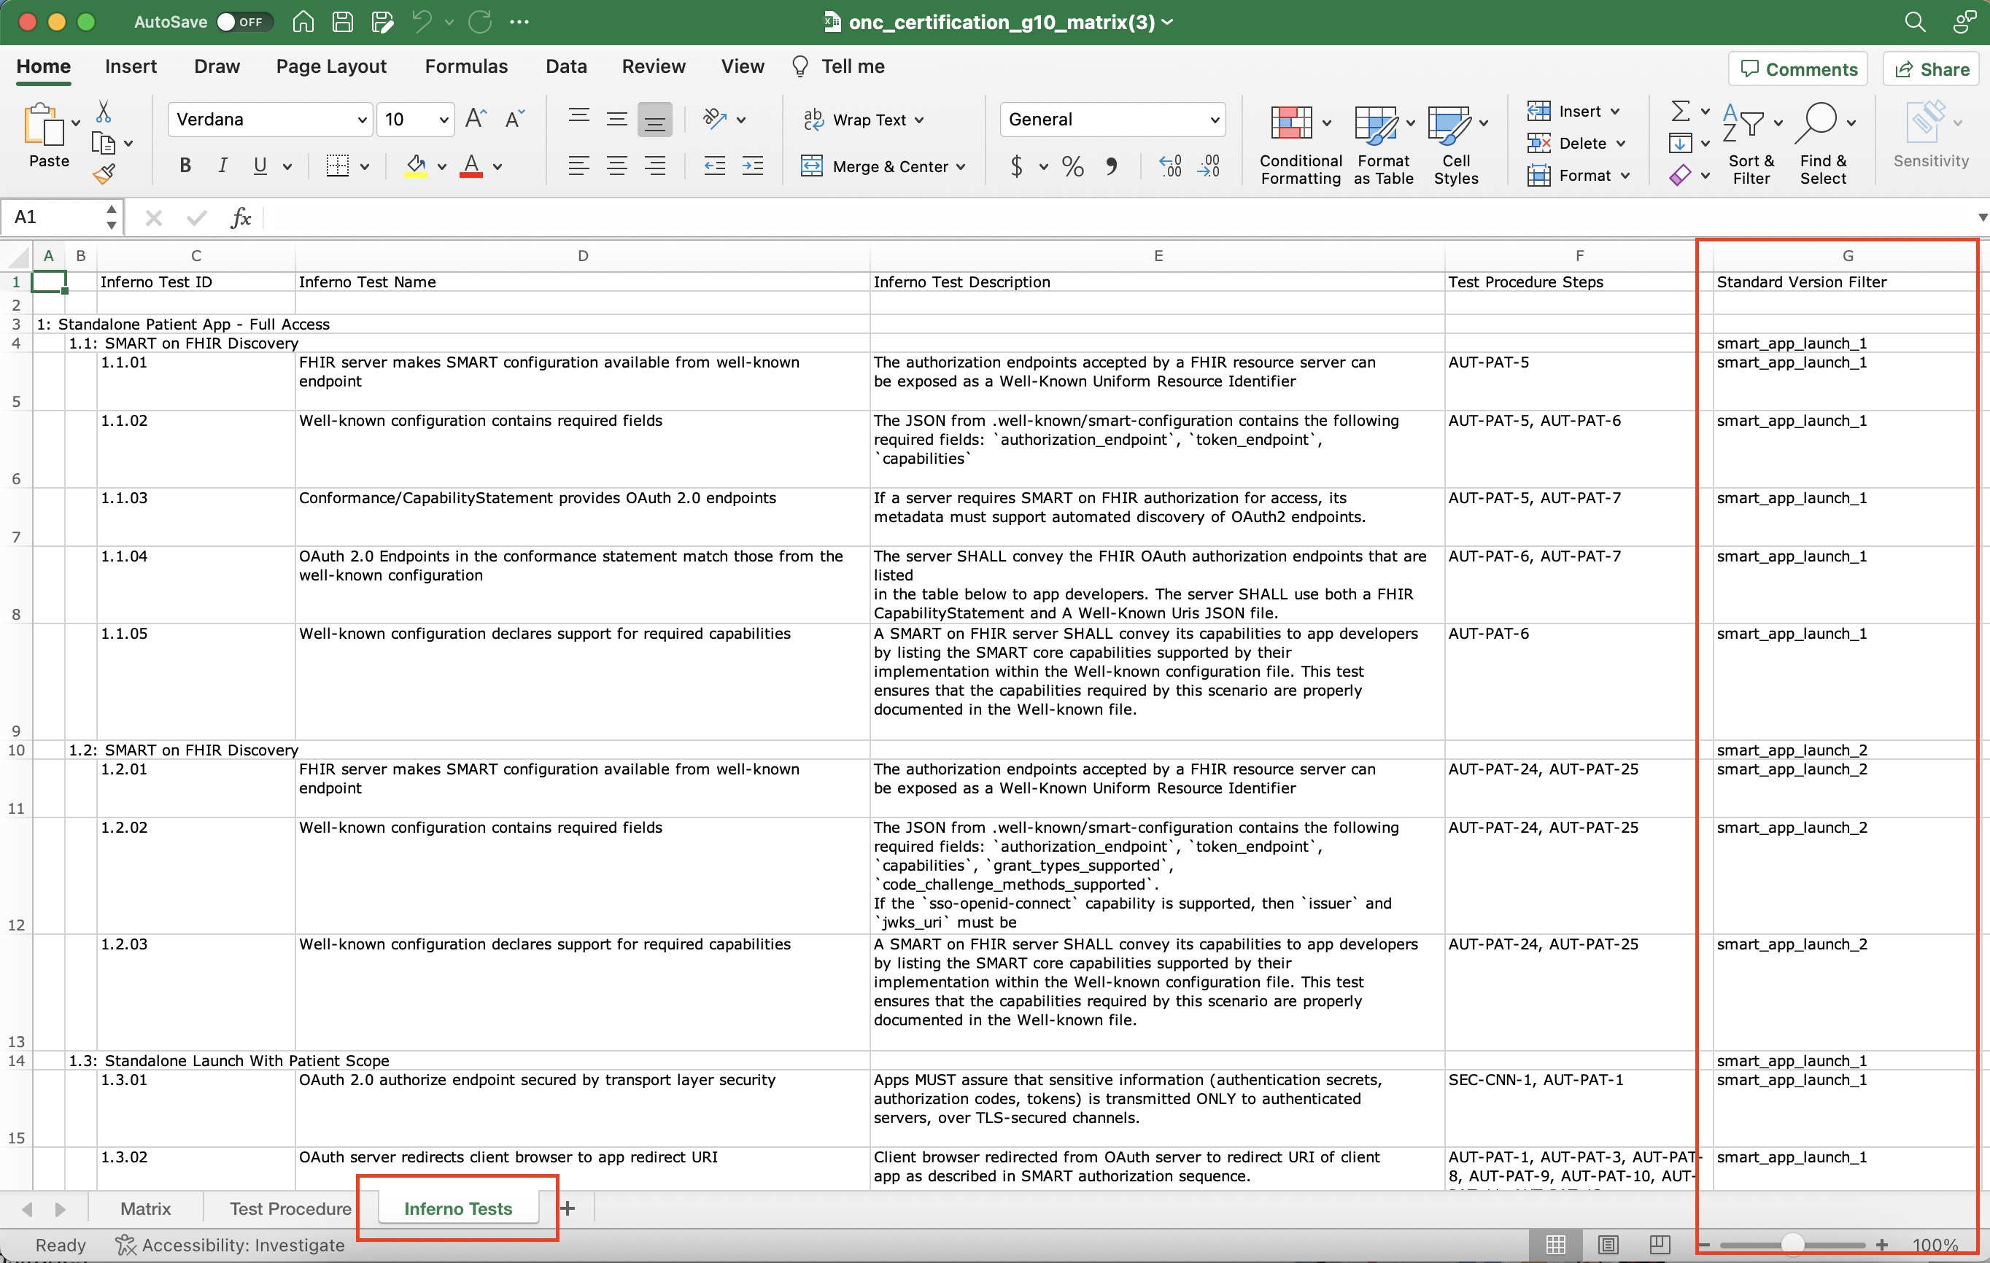
Other Updates (2/2)
Updates test matrix generation capability to indicate which versions of standards applies to each test in test matrix artifact (#455).

Slide 7
US Core v6.1.0
US Core v6.1.0 test suite is currently available
https://inferno.healthit.gov/suites/us_core_v610
Or download the US Core Test Kit to run the tests locally
https://github.com/inferno-framework/us-core-test-kit/releases/tag/v0.6.0
These tests are expected to be very similar to Single Patient API tests in future (g)(10) Test Kit release
Begun integration into (g)(10) Test Kit
Interest has been shown in the availability of this test kit by the community
December at latest; but likely much earlier

Slide 8
Open Discussion / Feedback

Slide 9
Resources and Contact Information
https://inferno.healthit.gov/
General materials & live demonstration server
https://github.com/onc-healthit/onc-certification-g10-test-kit/
ONC Certification tests repository, downloads, issues
“Watch” repository to receive alerts (new releases, etc)
Note: this repository is specific to ONC Certification testing
https://groups.google.com/forum/#!forum/inferno-testing
Announcements & community discussion
inferno@groups.mitre.org (or rscanlon@mitre.org)
Also, FHIR Zulip Chat: https://chat.fhir.org/#narrow/stream/179309-inferno

Slide 10
Upcoming Meetings
Next Inferno Tech Talk: Wednesday October 11 at 1 PM ET
Please reach out with questions & issues

