Slide 1
Inferno Tech Talk – Dec 2023
Yunwei Wang
MITRE Inferno Team
December 13, 2023

Slide 2
Inferno Tech Talk Introduction
Purpose: to provide regularly scheduled updates on the Inferno tool and its implementation of the (g)(10) test procedure
Typical agenda to include:
Announcements about upcoming releases
Training on new features
Highlight outstanding issues or known problems
Open discussion
Monthly recurrence: 2nd Wednesday at 1PM ET
Content reflects Inferno’s implementation of applicable Test Procedure
and does not necessarily reflect ONC policy.

Slide 3
Today’s Agenda
(g)(10) Standardized API Test Kit v4.1.0
Other Updates
Discussions / Questions

Slide 4
ONC (g)(10) Standardized API Test Kit v4.1.0
Test Update:
Changes that may result in new failure: 4
Other Updates: 1

Slide 5
Other Change: New Inferno Core
Inferno Core v0.4.24
Database Migration
Docker
setup.sh
Ruby
bundle exec inferno migrate

Slide 6
Blood Pressure component.dataAbsentReason
US Core 4.0.0, all Vital Sign profiles:
US Core 5.0.1, Blood Pressure profile:
US Core 6.1.0, Blood Pressure profile:

Slide 7
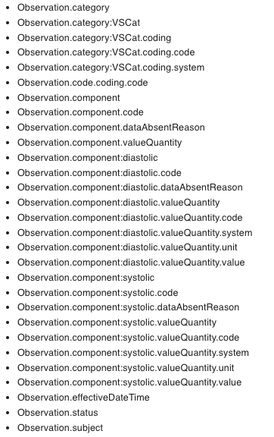
Restore component.dataAbsentReason MS
What Changed:
Add component.dataAbsentReson MustSupport for Observation Blood Pressure profile
Versions applied:
US Core v5.0.1
US Core v6.1.0
Profile applied:
US Core Observation Blood Pressure profile

Slide 8
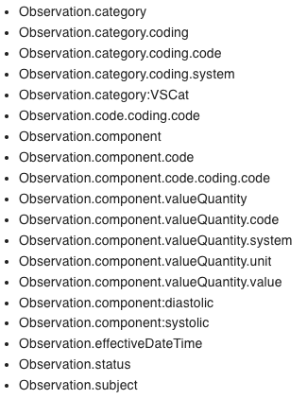
MustSupport elements within a MustSupport slice
Inferno 4.1.0
Inferno 4.0.0

Slide 9
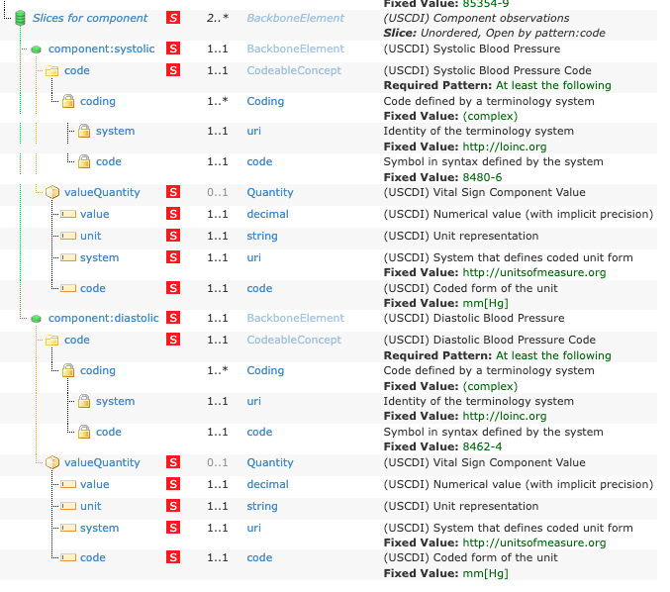
MustSupport elements within a MustSupport slice

Slide 10
MustSupport elements within a MustSupport slice
What Changed:
MustSupport elements are moved under parent’s MustSupport slice
Versions applied:
All US Core versions
Profiles applied:
All US Core profiles
In practice:
US Core Coverage in US Core v6.1.0
US Core Observation Occupation in US Core v6.1.0

Slide 11
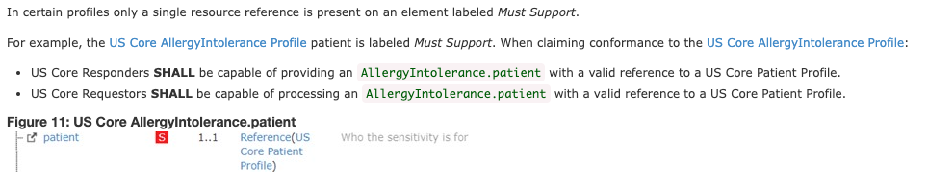
Reference validation on single target profile
Ex: AllergyIntolerance.patient
Inferno 4.0.0
”patient” element is MS.
Reference(US Core Patient Profile) is not MS
US Core Conformance Expectation (US Core 4.0.0 - 2.2.5.4)

Slide 12
Reference validation on single target profile
What changed:
Single target profile on a MustSupport element is treated as MustSupport
Versions applied:
US Core 4.0.0
US Core 5.0.1
US Core 6.1.0
Profiles applied:
All US Core profiles
Test affected:
Reference validation test
At least one reference is accessible AND is a valid US Core resource

Slide 13
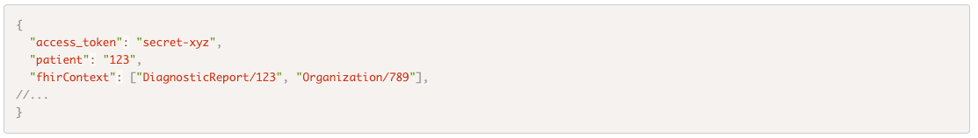
fhirContext in SMART
fhirContext is optional in SMART app launch token response (link)
What changed:
Inferno validates the format of fhirContext, if provided in token response.
Versions applied:
SMART App Launch v2.0.0

Slide 14
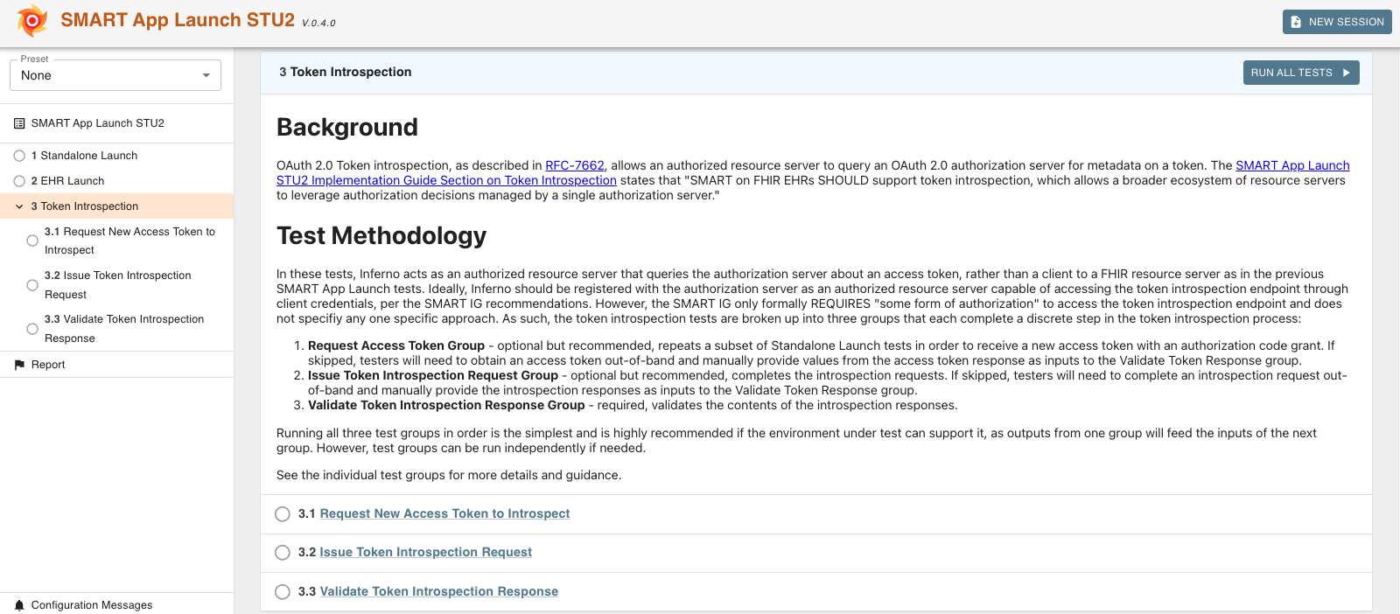
HTI-1
HTI-1 Rule is finalized today (link)
Preview of Token Introspection tests added to SMART App Launch STU2 suite
Feedback welcome as we prepare to update (g)(10) Tests for HTI-1

Slide 15
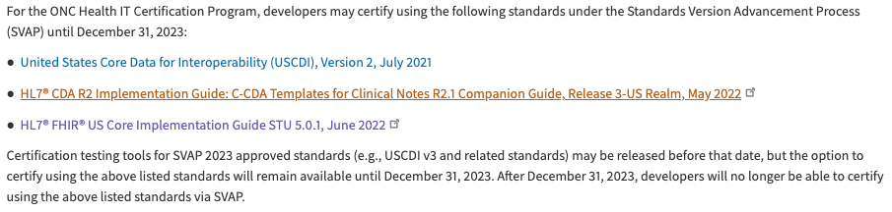
US Core 5 test in (g)(10) certification
US Core 5.0.1 will be removed from (g)(10) certification test in the next release
Inferno will post a survey on zulip on options of keeping existing test results

Slide 16
US Core v7.0.0 ballot
US Core v7.0.0 January Ballot
Ballot signup deadline: Dec 21
Ballot opens: Dec 22
January Connectathon 35: US Core testing track (link)

Slide 17
Open Discussion / Feedback

Slide 18
Resources and Contact Information
https://inferno.healthit.gov/
General materials & live demonstration server
https://github.com/onc-healthit/onc-certification-g10-test-kit/
ONC Certification tests repository, downloads, issues
“Watch” repository to receive alerts (new releases, etc)
Note: this repository is specific to ONC Certification testing
https://groups.google.com/forum/#!forum/inferno-testing
Announcements & community discussion
inferno@groups.mitre.org (or rscanlon@mitre.org)
Also, FHIR Zulip Chat: https://chat.fhir.org/#narrow/stream/179309-inferno

Slide 19
Upcoming Meetings
Next Inferno Tech Talk: Wednesday January 10 at 1 PM ET
Please reach out with questions & issues

Slide 20
NOTICE
This technical data was produced for the U. S. Government under Contract Number 75FCMC18D0047, and is subject to Federal Acquisition Regulation Clause 52.227-14, Rights in Data-General.
No other use other than that granted to the U. S. Government, or to those acting on behalf of the U. S. Government under that Clause is authorized without the express written permission of The MITRE Corporation.
For further information, please contact The MITRE Corporation, Contracts Management Office, 7515 Colshire Drive, McLean, VA 22102-7539, (703) 983-6000.
© 2023 The MITRE Corporation.

