Slide 1
English Draughts
23233_Yash Kale
23228_Ashmika Gupte

Slide 2
Requirement Analysis
This project is a Draughts game, wherein two human players will be able to play against each other.
The goal is to jump the opponent's pieces, and remove them from the board, in an effort to win back one's players and remove every opposing piece from the board.

Slide 3
Functional Specifications
System shall be able to keep check of valid moves.
System shall be able to keep check of invalid moves.
System shall be able to keep track that currently which player has turn.
System shall be able to tell which player has won the game.
System shall be able to save intermediate state of the game and resume the game from the saved state.

Slide 4
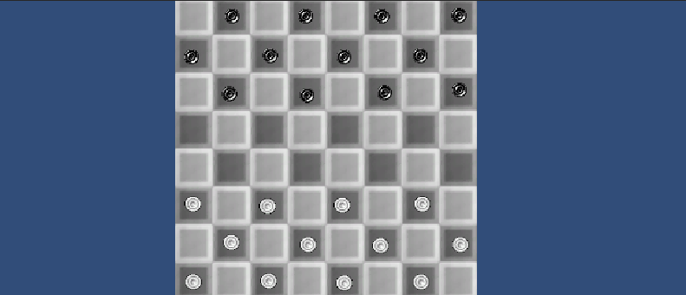
External Interface
*This is a Working beta interface

Slide 5
External Interface
The first version of the game will run only on a desktop,
The player will be able to move the pieces with a mouse-click.
The Multiplayer interface will use Transmission control Protocol (TCP)

Slide 6
Technical Specifications
Operating System | Windows | Universal Windows Platform | MacOS | Linux
Operating System Version | Windows 7 (SP1+) and Windows 10 | Xbox One, Hololens | Sierra 10.12+ | Ubuntu 16.04 and Ubuntu 18.04
CPU | x86, x64 architecture with SSE2 instruction set support. | x86, x64 architecture with SSE2 instruction set support, ARM, ARM64. | x64 architecture with SSE2. | x64 architecture with SSE2 instruction set support.
Graphics API | DX10, DX11, DX12 Capable | DX10, DX11, DX12 capable GPUs. | Metal capable Intel and AMD GPUs | OpenGL 3.2+, Vulkan capable.

Slide 7
Operating System | Windows | Universal Windows Platform | MacOS | Linux
Additional requirements | Hardware vendor officially supported drivers. | Hardware vendor officially supported drivers. For development: Windows 10 (64-bit), Visual Studio 2015 with C++ Tools component or later and Windows 10 SDK. | Apple officially supported drivers. | Gnome desktop environment running on top of X11 windowing system Other configuration and user environment as provided stock with the supported distribution (such as Kernel or Compositor) Nvidia and AMD GPUs using Nvidia official proprietary graphics driver or AMD Mesa graphics driver.

Slide 8
Thank You!!

