Slide 1
Course Allotment Recommender System
- Dua Manpriya, Jammula Rakesh and Monga Bhawna
CS-787 Decision Guidance Systems
Department of Computer Science, George Mason University

Slide 2
Outline
Overview
Existing System
Proposed Project
Project Requirements
Project Implementation
Input
Flow Diagram
Output
Future Scope
Conclusion

Slide 3
Overview
Recommender systems have changed the way people find products, information and their interests
Recommender systems help in addressing the information overload problem by retrieving the information desired by the user
Rather than providing the same static experience for all the users, recommender systems not just automate the process but also try to fine tune them based on individual user preference

Slide 4
Existing System
The current registration system in many schools and universities, manually allocates the classes in future semesters to available Instructors based on two conditions:
The availability of the instructor
Their expertise to take that particular class
During manual allotment, taking instructor preference while allotting courses complicates the process

Slide 5


Slide 6
Proposed Project
In our project, we try to automate the process of registration and course allocation, by taking into account the professor/instructor preference into consideration
We aim to achieve this, by first taking in an input list of preferred courses for each semester for every available Professor
The input list per professor would also have a preference order for the courses mentioned in his/her list

Slide 7
Project Requirements
Software : Atom
Languages : JSONiq (to manipulate JSON data)
Hardware : Laptop

Slide 8
Project Implementation
1. Input: A JSON structure of
Professors and Classes they can teach
Courses to be offered per semester for the next 4 semesters.
List of all core courses that can be offered
Professor and their preferences per semester, for next 4 semesters
Demand of each course per Professor
2. Constraints:
All classes are assigned to a Professor who can teach the assigned class
Each Professor can teach n (min<= n <=max) courses
3. Metrics:
Each Professor total satisfaction ratio [0..1]
Total no. of core courses offered
Full Time Equivalents (FTE) per semester
Average Professor Satisfaction ratio
Variance (Fairness Metric )

Slide 9
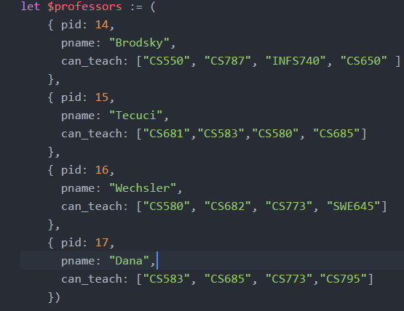
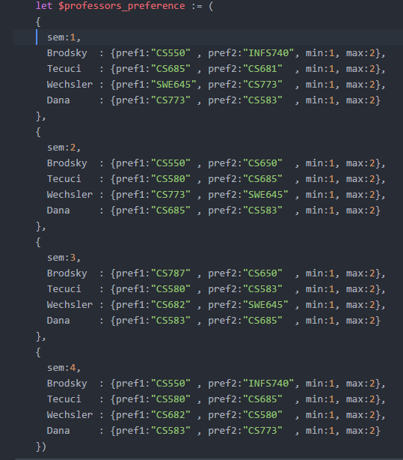
Input JSON Data

Slide 10
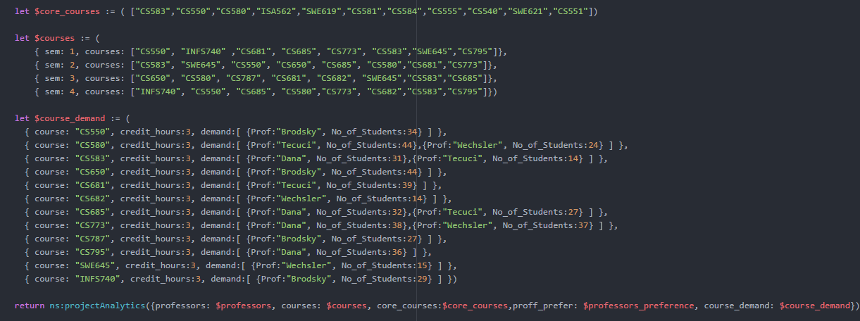
Input JSON Data (cont.)

Slide 11
Flow Diagram
1.First Allotment: For each semester, find all the courses which can be taught by only one professor. Assign professor to each of those courses
Calculate remaining professors and courses for each sem
4.Fourth Allotment: From the remaining professors and courses check second preference of each professor and if the course exist, assign professor to the course.
Calculate remaining professors and courses for each sem
Final Allotment : Assign the remaining professor to the courses they can teach from remaining courses
3.Thrid Allotment: From the remaining professors and courses, check first preference of each professor and if the course exists, assign professor to the course
Calculate remaining professors and courses for each sem
2.Second Allotment : From the remaining professors and courses check If a professor can teach only one of the remaining courses. Assign Professors to those course
Calculate remaining professors and courses for each sem
Remaining Courses : Courses which are not assigned after each respective allotment
Remaining Professors: Professors who have not exhausted their maximum teaching count per semester after the respective allotment

Slide 12
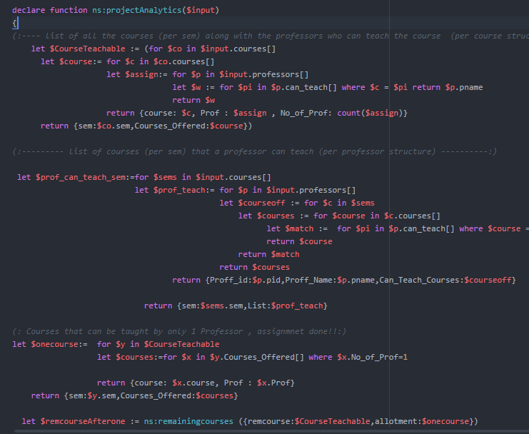
Sample Code

Slide 13
Expected Output
Output: A JSON structure consisting of
Professor and courses taught by him/her per semester
Constraints Satisfied
Core Courses offered each semester
Average Professor Satisfaction Ratio
Fairness Variance
Total FTE’s

Slide 14
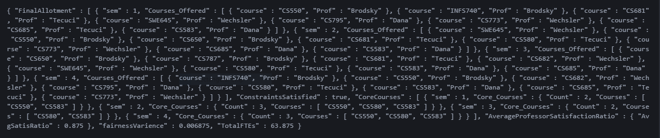
Obtained Output

Slide 15
Future Scope
Currently Professor satisfaction is being calculated after allotment of all courses for all the available semesters.
In future, professor satisfaction can be calculated every semester,
after allotting courses of that particular semester.
This will help in improving the allotment of courses according to preference in future semesters and thus balance the overall satisfaction of the professor.
Scaling the current system to accommodate more no of Professors and courses and courses from different streams as well.

Slide 16
Conclusion
The current project automates the process of course allocation to professors
The main feature being, it takes the Professor’s preference into account while allotting him/her courses
It also makes sure that no Professor is burdened with too many courses or too less courses
It also gives an idea of the number of core courses being offered and also gives the FTE details

Slide 17
Thank You!!
Questions ??

