Slide 1

Cotswold raspberry jam
TUTORIAL DOWNLOADS www.cotswoldjam.org/downloads
Children: Must be supervised by parent or guardian at all times
Food: No food or drinks in the labs please. The Student Union bar and café should be open for drinks & snacks.
Toilets: On 1st floor. Wheelchair-accessible toilet on ground floor.
Fire assembly point: Lawn in front of entrance where you came in
Fire exit: By stairwell near lift
Burglar alarms: Many doors in this building have alarms. Please do not attempt to enter closed rooms.
Floor boxes: Please do not open the floor boxes nor attempt to connect to the wired network – use WiFi.
www.cotswoldjam.org admin@cotswoldjam.org Twitter: @cotswoldjam
WiFi: CotswoldJam.org Password: raspberry

Slide 2
Cotswold raspberry jam
Time | Downstairs | Tutorial Room A | Tutorial Room B
1:00
1:15 | Welcome
1:30 | Show & Tell Projects | 1:30pm Servos & Robots | 1:30pm Enigma Messages
1:45
2:00
2:15
2:30 |  | 2:30pm Servos & Robots | 2:30pm Minecraft Skyscraper
2:45
3:00
3:15
3:30
3:45 | Raffle & Prizes
4:00 | Close
www.cotswoldjam.org admin@cotswoldjam.org Twitter: @cotswoldjam
WiFi: CotswoldJam.org Password: raspberry

Slide 3
MICRO SD CARDS FOR SALE!
£10 each
All profit to Cotswold Raspberry Jam
16GB Class 10 UHS-1 fast random I/O cards with full size adapter
Custom version of Raspbian Jessie with all Cotswold Jam tutorials pre-installed plus all Raspbian updates as of this week.
Also pre-installed: Sample code from books Adventures In Raspberry Pi and Adventures In Minecraft; O’Hanlon Minecraft tutorial files.
Need to borrow a card for a tutorial but don’t have £10? Ask to borrow a blue card. Please return these before the end of today’s event (4pm).

Slide 4
Cotswold raspberry jam
Time | Downstairs | Tutorial Room A | Tutorial Room B
1:00
1:15 | Welcome
1:30 | Show & Tell Projects | 1:30pm Servos & Robots | 1:30pm Enigma Messages
1:45
2:00
2:15
2:30 |  | 2:30pm Servos & Robots | 2:30pm Minecraft Skyscraper
2:45
3:00
3:15
3:30
3:45 | Raffle & Prizes
4:00 | Close
www.cotswoldjam.org admin@cotswoldjam.org Twitter: @cotswoldjam
WiFi: CotswoldJam.org Password: raspberry

Slide 5
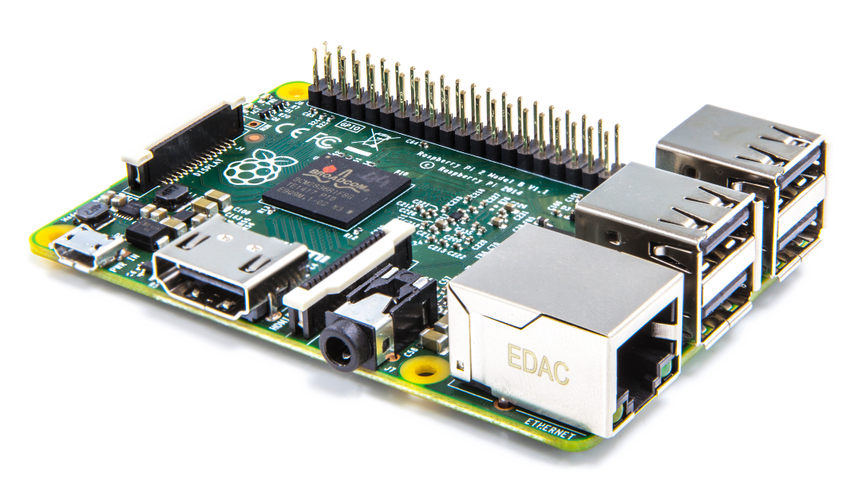

Slide 6
Cotswold raspberry jam
Time | Downstairs | Tutorial Room A | Tutorial Room B
1:00
1:15 | Welcome
1:30 | Show & Tell Projects | 1:30pm Servos & Robots | 1:30pm Enigma Messages
1:45
2:00
2:15
2:30 |  | 2:30pm Servos & Robots | 2:30pm Minecraft Skyscraper
2:45
3:00
3:15
3:30
3:45 | Raffle & Prizes
4:00 | Close
www.cotswoldjam.org admin@cotswoldjam.org Twitter: @cotswoldjam
WiFi: CotswoldJam.org Password: raspberry

