Slide 1
Inferogenesis
Build a curious rocket
cpomdp · continuous active inference in Python, hands-on
6th Applied Active Inference Symposium · 2026
cpomdp 0.5.1
1 the 1960 rocket
2 the beacon
3 the blackout
Notes:
Planned at 0:00. Keyboard shares the screen with this slide up and pastes the Colab link in the chat. Kev opens.
Welcome, everyone. Over the next two hours, we'll build three rockets and watch how each one decides where to fly. Do open the notebook now, even while we're talking. The next few slides say how, and the installs can run while we introduce ourselves.

Slide 2
Who we are
welcome
Presenter 1 (keyboard)
Kevin (concepts)
Independent research software engineer, UK. Builds cpomdp, a JAX-native continuous-state active inference toolbox and the continuous sibling to pymdp, under Inferogenesis. Background in numerical general relativity and event-driven orchestration of RL models at scale. Author of State-Dependent Observation Noise Reintroduces Epistemic Value in Linear-Gaussian Active Inference (arXiv:2607.20306). Co-leads the Certifiable Active Inference programme.
Kevin Backhouse is a PhD researcher in Cognitive Neuroscience at Durham University. His research examines how reward and expectation shape awareness, attention and memory. He also collaborates on CPOMDP, developing and evaluating artificial agents within the active inference framework.
cpomdp
The open-source library we'll use today, for active inference with continuous states.
It's written in Python on JAX, and it's the continuous-state sibling of pymdp.
cpomdp.inferogenesis.com/
Notes:
Kev introduces us both while the installs run.
cpomdp is the library we'll use today. It does active inference with continuous states, which makes it the continuous-state sibling of pymdp. If you've used pymdp, its agent runs the same loop of perceiving and then acting. We'll come back to what it adds at the end.

Slide 3
Disclosure
welcome
[owner: the AI-use panel and the review it describes]
today's notebook pins 0.5.1. Some of its src was written by Claude Code under the review described.
Notes:
TODO owner: the panel.
Q&A. Asked whether Claude wrote the release the room is running, the answer is: some of it.

Slide 4
Two hours, three tasks
welcome
Welcome
introductions and setup
Task 1 the 1960 rocket
brief
you code
discussion
Task 2 the beacon
brief
you code
discussion
Task 3 the blackout
brief
you code
discussion
Why it matters
what cpomdp adds, and what's next
Questions
questions, or leave early
While you code, a 15-minute timer stays on the screen.
Notes:
Kev. We present for an hour in all, and you code for 45 minutes, 15 on each task. The last 15 minutes are left open for questions and discussion, and you're welcome to leave early.
Planned: Task 1 at 0:12, Task 2 at 0:39, Task 3 at 1:06, why it matters at 1:33, questions from 1:45.
There's no break in the plan. If the room needs one, take it from the open time at the end.

Slide 5
How we'll work
welcome
Two lines per task
Each task has two lines marked ... for you to write. We've written the rest, so you can focus on the key concepts without worrying about the Python. Some bonus exercises ask you to write your own.
Hints when you need them
Each task has two hints and a reference solution, collapsed below the code cell. Open them whenever you like, and using them is absolutely fine.
Run the checkpoint
Run the checkpoint cell at the end of every task, even if everything worked. It restores the setup the next task needs.
One number in the chat
Each task ends with one number to paste in the chat, then a 60-second poll.
The aim is to explore the ideas behind the code, rather than test your programming skills. Questions are welcome any time, in the chat or on the anonymous form.
Notes:
Keyboard. Each task has two lines to write, and we've written the rest of the code, so the Python stays out of the way. Some of the bonus exercises ask you to write your own.
Each task has two hints and a reference solution, collapsed below the cell. A hint shows its nudge first, and the line itself is behind Show code. Open them whenever you like, and using them isn't failing.
At the end of every task, run the checkpoint cell, even if everything worked. It puts the reference names back, so the next task starts from the same place for everyone.
Each task closes with one number in the chat. It lets us see how the room is doing without anyone writing a sentence. Then there's a one-minute poll.

Slide 6
Get set up
welcome
Google Colab
Recommended
It runs in your browser, so there's nothing to install.
Open the notebook link below, then run cell 1. It installs the workshop and checks it's ready.
Your own Python
VS Code or Jupyter
Python 3.11 or newer, then install the workshop:
pip install cpomdp-workshop==0.2.0
Open the notebook from the repository below and run cell 1.
notebook in Colab
colab.research.google.com/github/inferogenesis/cpomdp-workshop/blob/main/notebooks/build_a_curious_rocket.ipynb
repository
github.com/inferogenesis/cpomdp-workshop
Notes:
Keyboard. We recommend Colab. It runs the notebook in your browser, so nothing needs installing. Open the link from the chat, then run cell 1, which installs the workshop from PyPI.
If you'd rather work locally, that's fine too. You'll need Python 3.11 or newer and the pip line, or uv as the README shows. Then open notebooks/build_a_curious_rocket.ipynb from the repository.
Either way, cell 1 stops if cpomdp isn't 0.5.1 or Python is older than 3.11, and it prints what it found.

Slide 7
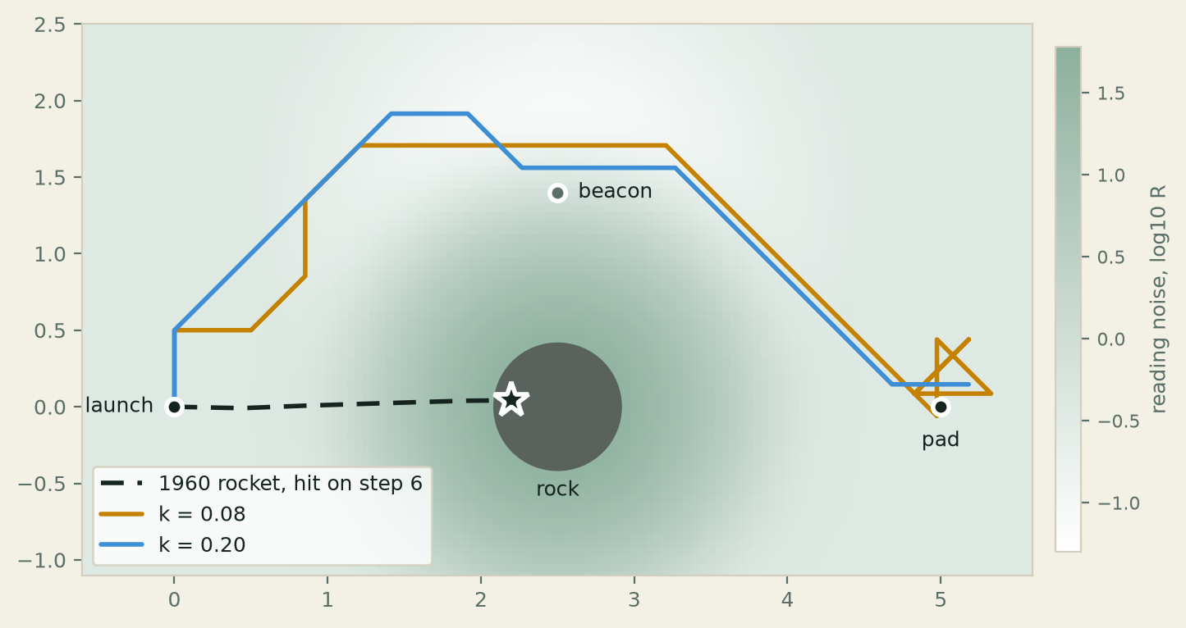
Where we're heading
welcome
By the end of Task 3, we'll have built this picture.
Three rockets, one rock. The dashed line is the 1960 rocket.
Cell 2 draws it. workshop.preview()
Seed 3.
Notes:
Kev. Before we build anything, here's where we're heading. Run cell 2 and you'll see this picture.
The dashed line is the 1960 rocket. It hits the rock on step 6. The two solid lines are curious rockets, and on seed 3 both fly round the rock.
Don't worry if you can't explain it yet. Neither rocket knows the rock is there, and working out what's going on is what the three tasks are for.

Slide 8
Task 1 · The 1960 rocket
task 1
A Kalman filter estimates where the rocket is from noisy sensor readings, and a linear quadratic regulator (LQR) steers it to the landing pad.
The sensor is equally reliable wherever the rocket flies.
Does that make every move equally informative?
A
the observation likelihood
observation_matrix,
observation_noise
B
the transition
dynamics_matrix,
control_matrix
C
the preference
Preference
from Task 2
D
the prior
prior
Notes:
Planned at 0:12. Kev.
Our first rocket is the classic one. A Kalman filter estimates its position from noisy readings, and a linear quadratic regulator steers it to the pad. Its sensor is equally reliable everywhere. So does every move give the rocket the same amount of information? Hold that question.
If you know pymdp, the cards map its letters onto cpomdp's fields. A is the observation likelihood. In cpomdp that's the observation_matrix together with the observation_noise, R, because the noise is part of what a reading says about the state. B is the transition, so dynamics_matrix, with control_matrix for where a move enters. C is the preference, which we meet in Task 2 as Preference. D is the prior.
The 1960 rocket's StateGoal has no pymdp letter. It's a goal over states with a thruster cost, which is what makes it an LQR controller.

Slide 9
Task 1 · Two lines to write
task 1
observation_matrix = ... # pymdp's A, with R below: the reading sees the position
observation_noise = ... # R: variance 0.05 on each axis, the same everywhere
model = LinearGaussianModel(
jnp.eye(2), # dynamics, pymdp's B: the rocket stays put unless moved
control_matrix=jnp.eye(2), # a move adds straight to the position
observation_matrix=observation_matrix,
observation_noise=observation_noise,
dynamics_noise=1e-3 * jnp.eye(2), # Q: a little drift each step
prior=Belief(mean=LAUNCH, cov=4 * jnp.eye(2)), # pymdp's D: unsure where it is
)
goal = StateGoal(PAD, precision=jnp.eye(2), effort=100 * jnp.eye(2)) # thruster cost
rocket = Agent(model, goal)
check_agent(rocket)
report = probe_model(model, model.prior, compass_moves())
show_probe(report) # paste the spread in chat
Then the bonuses. Can you make the spread move?
Write the two amber lines
Hints are below the cell
Paste in chat spread
Notes:
Keyboard. Two lines to write: what the sensor observes and how noisy its readings are. The rest is written, the thruster cost included. The imports sit at the top of the cell.
Run it, and check_agent prints the rocket and where it lands. probe_model then evaluates how much information the rocket could expect to gain from each of the nine moves. The spread is the difference between the most and the least. That's the number for the chat.

Slide 10
Task 1 · Over to you
task 1
1 Write the two amber lines and run the cell.
2 Paste your spread in the chat.
3 Finished early? Try the two bonuses.
0
5
10
15 min
Time's up. Run checkpoint 1, even if everything worked.
Stuck on an error? workshop.symptoms() lists the five most common, with their fixes.
Notes:
Planned at 0:16. Keyboard. Leave this slide up for the whole 15 minutes. The bar starts when the slide appears and needs no click. It starts again if you leave the slide and come back, so share the notebook from another window if you need to.
Nobody pastes hints. Each person opens the collapsed hint and reference cells when they like. Whoever isn't at the keyboard watches the chat and the anonymous form. We don't debug anyone's code from the front. Point people at the hints, the reference cell and workshop.symptoms().
When the bar fills, the line under it appears. Read it out. Checkpoint 1 restores the reference setup the next part needs.

Slide 11
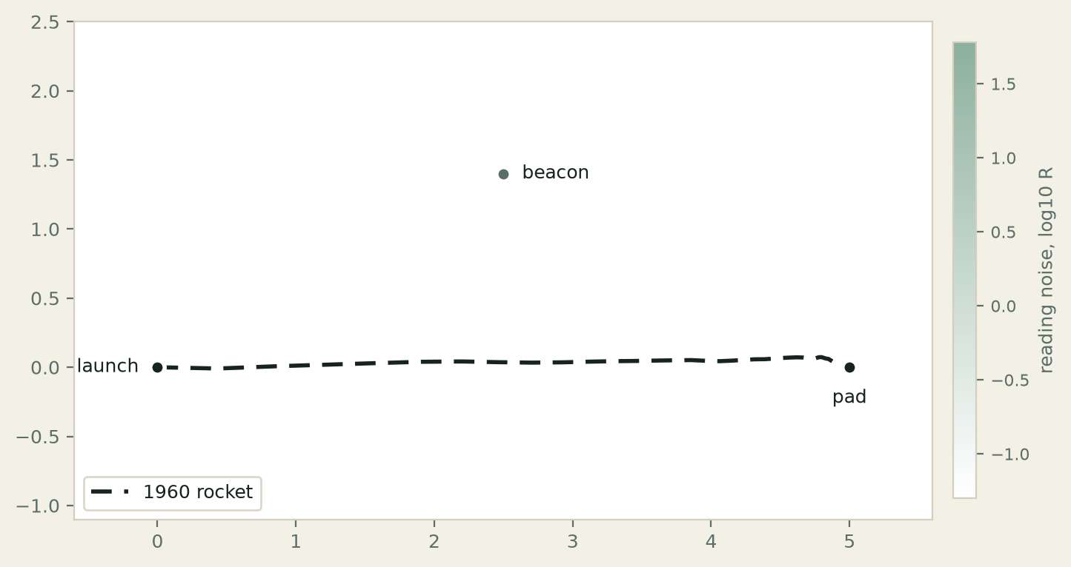
The 1960 rocket flies the straight line
task 1
spread
0.000000
nats between the most and the least informative move
Paste in chat
spread
Agent(objective=StateGoal, selector=LQRSelector(controller=LQRController(gain=[[0.0951, 0.0], [0.0, 0.0951]])), backend=KalmanBackend)
after 36 moves it is at (4.87, 0.04), 0.13 from the pad
epistemic_varies = False flattens = True spread = 0.000000 nats
Poll 1 · 60 s
Notes:
Planned at 0:31. Keyboard shows what the cell printed. The rocket is LQR, and lands 0.13 from the pad.
The probe compares the information each of the nine compass moves is expected to give. spread = 0.000000 nats, so no move gives more than any other. Every spread in the chat should read zero, whatever the bonuses changed.
Then poll 1 for 60 s. Kev reads the split.
Poll 1
The 1960 rocket's spread is zero whatever you change. Why?
1. The prior is too wide for any one reading to matter.
2. The noise is the same everywhere, so every move leaves the rocket equally unsure.
3. A step of 0.5 is too short to reach anywhere different.
4. LQR ignores what the probe reports.
Answer.
2. The uncertainty after a reading depends on the noise where the reading is taken. Here that noise never changes, so no move can teach more than another. The other three change nothing about that, which bonus 1 lets you check.

Slide 12
Under a fixed sensor, expected free energy is LQR
task 1
R
the 1960 rocket
The sensor noise is the same everywhere.
So every move leaves the rocket equally uncertain.
Expected free energy reduces to LQR.
R(x)
a curious rocket
The sensor noise depends on where the rocket is.
So where a move lands changes how informative the next reading is.
Tasks 2 and 3 build it.
With fixed noise in a linear Gaussian model, the expected information gain is the same for every action, so curiosity can't change what the rocket does.
Koudahl, Kouw & de Vries, 2021
Notes:
Kev. If you've built a continuous active inference agent and watched it behave like a controller, you didn't do anything wrong.
The Kalman filter's uncertainty after a reading depends on the noise and the uncertainty before it, never on the move or the position. With the same noise everywhere, every move leaves the rocket equally uncertain, so the information term is the same for all of them. What's left of expected free energy is LQR. Koudahl, Kouw and de Vries published that result in 2021.
Bonus 2 asked whether unequal noise across the axes would change that. It changes how much each reading tells the rocket, but not the spread between moves, because the noise is still fixed in place. That's the bridge to Task 2.
The rest of the session changes one thing. The noise depends on where the rocket is.

Slide 13
What changes when observations depend on location?
task 2
Task 1: fixed sensor noise
Sensor reliability is the same wherever the rocket travels.
Task 2: location-dependent noise
Observations are more reliable near the beacon and noisier further away.
A change in the objective
The rocket now has a preference over observations. It wants a reading that says it's on the landing pad.
Will the rocket change its route when some places give more reliable observations?
Notes:
Planned at 0:39. Kev. In Task 1, the sensor was equally reliable everywhere. Now we'll introduce a navigation beacon. Readings are more reliable near it and noisier further away. k, beacon_gain in the code, sets how quickly the noise grows with distance, up to a cap.
The goal changes too. This rocket prefers a reading, the one that says it's on the pad, where the 1960 rocket preferred a position. At each step its planner scores the nine compass moves by expected free energy.
Leave the question with the room. Don't answer it yet.

Slide 14
Task 2 · Two lines to write
task 2
beacon_gain = ... # k: type 0.08 first, then raise it until the path bends
params = default_params(beacon_gain)
# The settings params holds for this task. The only one we're concerned with for this
# exercise is k, "beacon_gain". The rest are chosen for you to best display the
# behaviour:
# params["beacon_gain"] k how fast the noise grows away from the beacon
# params["beacon_cap"] 4.0 the largest distance_squared that counts
# params["beacon"] (2.5, 1.4) where the beacon is
# params["noise_floor"] 0.05 the noise at the beacon itself
# It also holds the blackout's settings, for task 3.
def my_sensor(x, params): # the reading's noise at position x
distance_squared = jnp.sum((x - params["beacon"]) ** 2)
pull = ... # k times jnp.minimum(distance_squared, cap), read from params
return jnp.eye(2) * (params["noise_floor"] + pull)
check_my_sensor(my_sensor, params)
Below this, the cell builds a curious rocket on your sensor, flies it and plots its route.
Write the two amber lines
Hints are below the cell
Paste in chat your k
Notes:
Keyboard. Two lines again: k itself, and the beacon's extra noise inside my_sensor. params holds the beacon's settings, and the comments say how to read each one by name.
Start at k = 0.08, then raise it. Can you find a k that changes the route and still lands?

Slide 15
Task 2 · Over to you
task 2
1 Write the two amber lines. Start with k = 0.08.
2 Raise k until the route changes. Paste your k in the chat.
3 Finished early? Try the two bonuses.
0
5
10
15 min
Time's up. Run checkpoint 2, even if everything worked.
Stuck on an error? workshop.symptoms() lists the five most common, with their fixes.
Notes:
Planned at 0:43. Keyboard. Leave this slide up for the whole 15 minutes. The bar starts when the slide appears and needs no click. It starts again if you leave the slide and come back, so share the notebook from another window if you need to.
Nobody pastes hints. Each person opens the collapsed hint and reference cells when they like. Whoever isn't at the keyboard watches the chat and the anonymous form. We don't debug anyone's code from the front. Point people at the hints, the reference cell and workshop.symptoms().
Hint 1 gives k = 0.4.
When the bar fills, the line under it appears. Read it out. Checkpoint 2 restores the reference setup the next part needs.

Slide 16
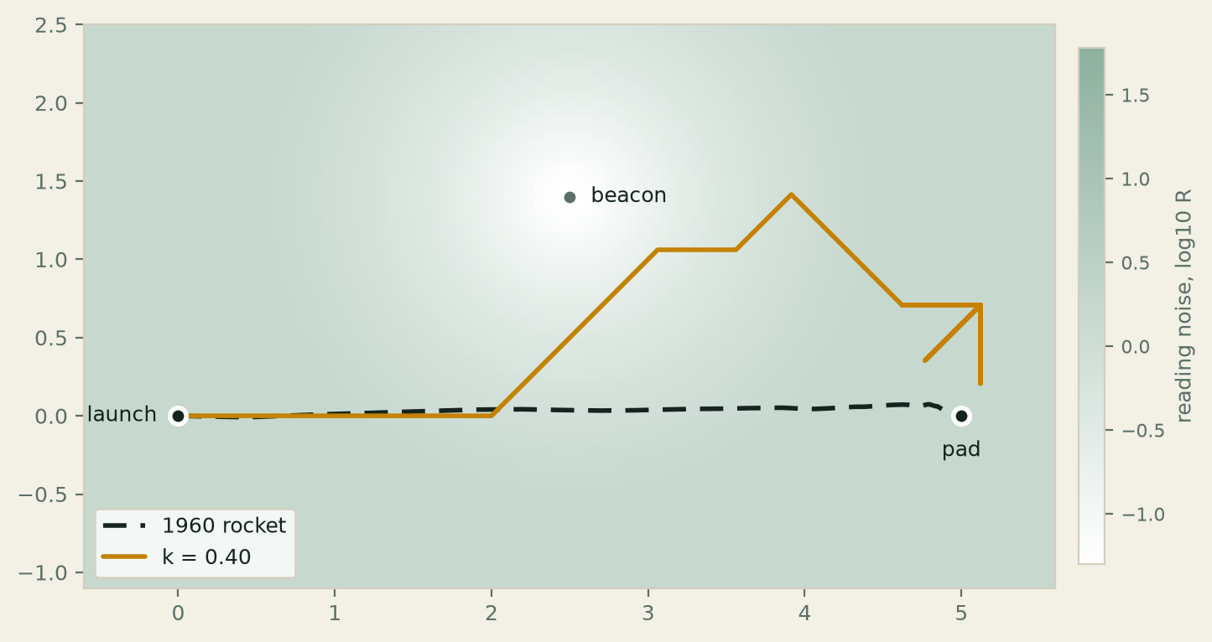
The beacon bends the route
task 2
k = 0.40
1.41
off the straight line. It lands 0.24 from the pad.
Paste in chat
your k
The rocket bends 1.41 off the straight line and lands 0.24 from the pad. It matches the workshop's beacon_sensor.
Poll 2 · 60 s
Notes:
Planned at 0:58. Keyboard shows check_my_sensor's line for k = 0.4. The rocket bends 1.41 off the straight line and lands 0.24 from the pad.
It's the same map as the last route slide. Only the field and the amber line are new.
Ask for k in the chat, then poll 2 for 60 s. Kev reads the split.
Poll 2
At k = 0.6 the rocket stops short of the pad. Why?
1. From near the beacon it cannot see the pad.
2. It still looks too few moves ahead.
3. It prefers a reading of the pad. At that k the pad reads so badly that a spot nearer the beacon is expected to read closer to "on the pad".
4. The thruster cost stops it.
Answer.
3. The preference is over readings, and the expected miss includes the reading's own noise. Where the noise is large, standing on the pad still reads far from it on average. The curious rocket carries no thruster cost, so 4 cannot apply.

Slide 17
What steers the route
task 2
the expected miss from “on the pad”
½ (o⁺ − o*)ᵀ Λ (o⁺ − o*) + ½ tr(Λ S)
S = C Σ⁺ Cᵀ + R(μ⁺) the sensor's own noise, where the move is expected to land
At each step the rocket scores the nine moves. The first part of each score is how far its reading is expected to land from “on the pad”.
That expectation includes the sensor's own noise. Where the noise is large, even a reading taken on the pad lands far from it on average, so moves towards the beacon score better.
It takes a sensor whose noise depends on position. The 1960 rocket's never does.
At k = 0.6 the rocket stops short of the pad, however many moves ahead it looks.
Notes:
Kev. The answer to poll 2.
Each step, the rocket scores the nine moves by expected free energy. Its first term is the expected miss from the preferred reading, on the pad. That expectation carries S, and S carries R where the move is expected to land. In the book's terms, this noise sets the ambiguity in expected free energy (Active Inference, eq. 2.6), and now it depends on where the rocket is.
That term changes between moves only when R depends on position. For the 1960 rocket it's the same for every move, and LQR is what's left.
At k = 0.6 the rocket stops 1.49 short of the pad looking one move ahead, 1.65 looking two and 1.86 looking three. Looking further doesn't help, because the pad itself reads badly at that k.
Bonus 2 varied the preference's precision. A stronger preference for a reading isn't guaranteed to give a better landing, because a higher precision scales the whole expected miss, the reading's own noise included. It can't make a noisy pad read any better.

Slide 18
What happens when observations become unreliable?
task 3
The beacon
Observations become more reliable as the rocket approaches the beacon.
The blackout
Observations become increasingly noisy towards the centre of the blackout.
A rock
There's a rock inside the blackout, but none of the rockets has any representation of it in its model.
How might the rockets respond, and what can their routes tell us about their behaviour?
Notes:
Planned at 1:06. Kev. In Task 2, the beacon made observations more reliable nearby. Now we'll add a blackout on the straight line to the pad, where the noise rises sharply towards its centre.
There's also a rock in the blackout, and none of the rockets knows it's there. In the book's terms, the rock is in the generative process, the world, but not in any rocket's generative model (Active Inference, Figure 2.2).
We'll fly three rockets past it: the 1960 rocket, yours with the k on the slider, and one at k = 0.20.

Slide 19
Task 3 · Two lines to write
task 3
def my_world(x, params):
height, width = params["blackout_gain"], params["blackout_width"]
from_blackout = jnp.sum((x - params["blackout"]) ** 2)
blindness = ... # height times jnp.exp of minus from_blackout over width
return my_sensor(x, params) + jnp.eye(2) * blindness
beacon_gain = 0.08 # @param {type:"slider", min:0.02, max:0.4, step:0.02}
backend = ... # task 1's model as a graph of one node
check_backends(KalmanBackend(model), backend) # paste max |difference| in chat
plot_world(my_world, (0.0, beacon_gain, 0.20))
There's a rock in the blackout. None of the rockets knows.
Write the two amber lines
Hints are below the cell
Paste in chat max |difference|
Notes:
Keyboard. Two lines again: the blackout's extra noise in my_world, and the 1960 rocket's model as a graph of one node. The slider sets k for your rocket.
plot_world flies three rockets past the rock. check_backends flies the 1960 rocket on the Kalman filter and on the graph, and prints the largest difference between them. That's the number for the chat.

Slide 20
Task 3 · Over to you
task 3
1 Write the two amber lines and run the cell.
2 Move the k slider and watch the routes. Paste max |difference| in the chat.
3 Finished early? Try the two bonuses.
0
5
10
15 min
Time's up. Run checkpoint 3, even if everything worked.
Stuck on an error? workshop.symptoms() lists the five most common, with their fixes.
Notes:
Planned at 1:10. Keyboard. Leave this slide up for the whole 15 minutes. The bar starts when the slide appears and needs no click. It starts again if you leave the slide and come back, so share the notebook from another window if you need to.
Nobody pastes hints. Each person opens the collapsed hint and reference cells when they like. Whoever isn't at the keyboard watches the chat and the anonymous form. We don't debug anyone's code from the front. Point people at the hints, the reference cell and workshop.symptoms().
When the bar fills, the line under it appears. Read it out. Checkpoint 3 restores the reference setup the next part needs.

Slide 21
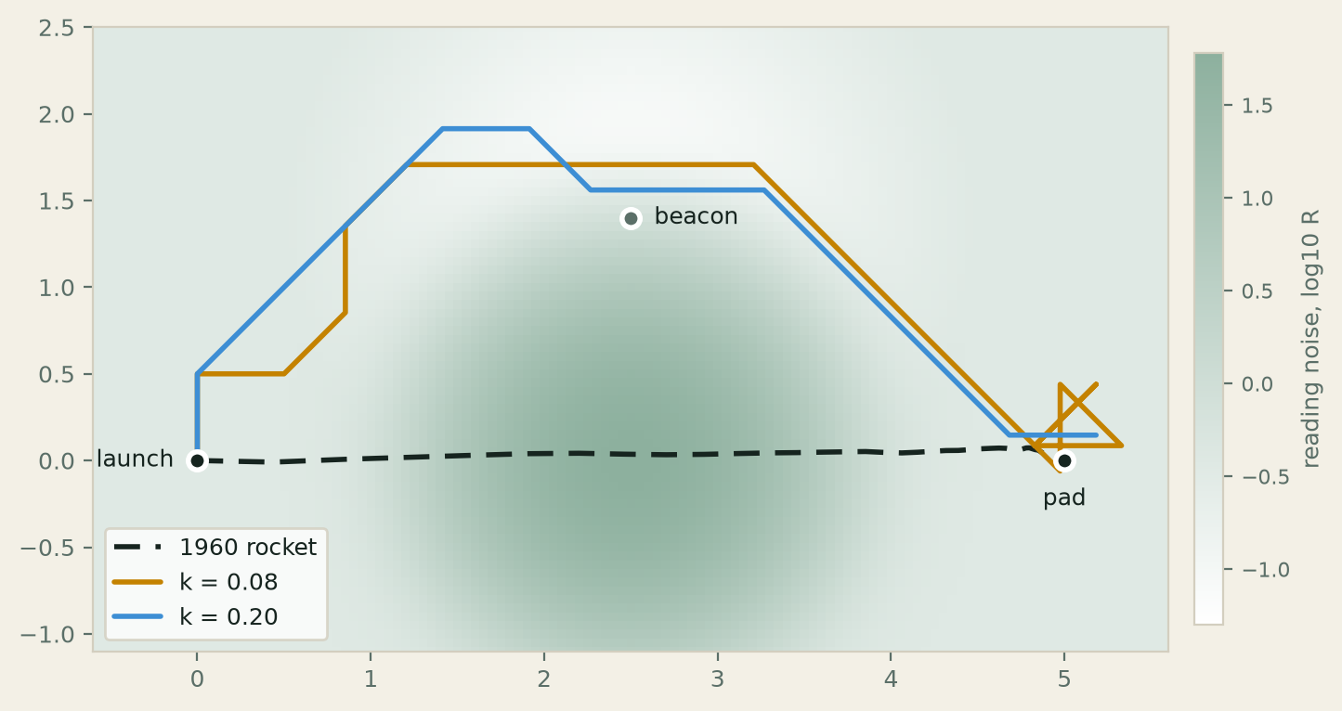
The blackout, before the rock
task 3
Near the blackout's centre the sensor noise is very large.
The 1960 rocket flies straight through. Its model has one noise level.
The curious rockets swing wide.
Seed 3. No rock yet.
Notes:
Planned at 1:25. Kev. It's the same map again, and the field now has the blackout.
The 1960 rocket flies the line it flew in Task 1. Its model has one noise level, and it flies in the world that model describes. The curious rockets swing wide of the noisy patch.
There's no rock yet. The next slide adds it and nothing else.

Slide 22
The 1960 rocket hits the rock
task 3
1960 rocket
step 6
None of the rockets models the rock.
Paste in chat
max |difference|
Seed 3. Both curious rockets clear the rock. The 1960 rocket hits it on every seed from 0 to 9.
Poll 3 · 60 s
Notes:
Kev. One thing added, the rock in the blackout. None of the rockets models it.
The 1960 rocket hits it on step 6, on every seed from 0 to 9. The figure is seed 3, and both curious rockets clear it there. k = 0.08 peaks at y = 1.71 and ends at (4.83, 0.09). k = 0.20 peaks at 1.91 and ends at (5.18, 0.15).
Ask for max |difference| in the chat. Below 1e-9 means the two engines agree. Then poll 3 for 60 s.
Poll 3
Why did the curious rockets clear the rock in the blackout?
1. They modelled the rock.
2. They looked far enough ahead to see it coming.
3. A reading in the blackout is swamped, so a move into it is expected to read far from "on the pad". The rock sits in the blackout.
4. Luck. Another seed would hit it.
Answer.
3. No rocket knows the rock is there, and each looks one move ahead. Where the noise is large, a reading lands far from "on the pad" on average, so moves into the blackout score badly. 4 is partly true. Over the first ten seeds the k = 0.08 rocket clips the rock twice and the k = 0.20 rocket three times. The figure is seed 3. Bonus 1 moves the rock into clear sky where their routes pass, and they hit it more often.

Slide 23
A rock never changes a route
task 3
Rock in the blackout
seeds where it hits the rock
1960 rocket 10 of 10
k = 0.08 2 of 10
k = 0.20 3 of 10
Rock in clear sky, at (4.2, −0.7)
seeds where it hits the rock
1960 rocket 0 of 10
k = 0.08 6 of 10
k = 0.20 5 of 10
With or without the rock, a rocket flies exactly the same path until the moment it collides.
The curious rockets steer away from noisy readings, and the rock sits where the readings are noisiest.
Missing the rock isn't evidence that a rocket represented it or meant to avoid it.
Notes:
Kev. The answer to poll 3, and bonus 1's result.
The rockets aren't avoiding the rock at all. A rock never changes a route. Inside the blackout, over seeds 0 to 9, the k = 0.08 rocket hits it on 2 seeds and the k = 0.20 rocket on 3, while the 1960 rocket hits it every time. Moved into clear sky on their routes, it's hit on 6 and 5 of the 10 seeds by the curious rockets, and never by the 1960 rocket.
So here the blackout makes the curious rockets hit the rock less often, although they know nothing about it. Seed 3 is one seed, and the picture earlier shows its less common route.
Bonus 2 tuned two of the rocket's settings to land more and hit less. The best setting led the default by one flight, and the seeds mattered more than the settings. Tuning against one rock in one place can carry our own knowledge of the rock into the rocket.

Slide 24
One rocket, two engines
task 3
sensor = FixedSensor(jnp.eye(2), observation_noise=0.05 * jnp.eye(2))
graph = CouplingGraph(dims=[2], couplings=[], observation_models={0: sensor})
backend = CouplingGraphBackend(
graph,
[GaussianTransition(jnp.eye(2), dynamics_noise=1e-3 * jnp.eye(2))],
prior=Belief(mean=LAUNCH, cov=4 * jnp.eye(2)),
control_matrix=jnp.eye(2),
)
rocket = Agent.from_backend(backend, goal)
KalmanBackend
the Kalman filter
CouplingGraphBackend
the same model as a graph of one node
KalmanBackend mean (4.844446, 0.098086) cov diagonal (0.006589, 0.006589)
CouplingGraphBackend mean (4.844446, 0.098086) cov diagonal (0.006589, 0.006589)
The two agree below 1e-9. The graph engine also runs models one Kalman filter can't hold.
Notes:
Keyboard. The 1960 rocket on two engines. The code is what one_node builds. Agent.from_backend puts a rocket on either backend.
The two print the same belief to six places, and max |difference| sits below 1e-9. A graph of one node is a Kalman filter, so this is the check that the graph engine is right before we trust it with shapes a Kalman filter isn't. The self-guided cells show one.

Slide 25
What a printed number entitles us to say
why it matters
import cpomdp_workshop as workshop
print(curious.selector.certificate)
print(workshop.axis_certificate())
PROVED (set compass-9, |A|^H = 9^1 = 9, visited 9)
PROVED (set axis-5, |A|^H = 5^7 = 78125, visited 78125)
PROVED means the search scored every plan in a declared, versioned set. The certificate counts them.
It says what the computation did. It doesn't say the model is right.
Notes:
Planned at 1:33. Kev. Run the coda cell. What does a printed number entitle us to say?
The certificate names the set by its version, compass-9, and counts every plan the search scored, 9 a step. The axis set is five moves, and seven moves deep it's 78125 plans, every one scored.
That supports a specific claim: this computation was exhaustive over this set. The same goes for the backend agreement in Task 3. Neither is a general guarantee that the model is correct or that its behaviour generalises.

Slide 26
A working model is the beginning, not the end
why it matters
What have we demonstrated?
How changing the observation model and the preferences can influence an agent's behaviour.
What remains to be established?
Whether those behaviours generalise, how robust they are, and which parts of the computational model have been independently validated.
The rest of this section is about cpomdp itself: what it adds, and what has been built on it.
Notes:
Kev. Four things to keep from today.
Fixed observation noise can give the same information gain for every action, even if the overall uncertainty changes.
A preference for precise observations doesn't, by itself, establish an epistemic motive. In Task 2, the expected observations and their noise shaped how the moves were scored.
A route that happens to miss an unmodelled rock isn't evidence that the rocket represented it or avoided it on purpose.
A certificate, a backend agreement or a working demo supports a specific claim. None of them is a general guarantee.

Slide 27
What makes cpomdp different
why it matters
pymdp
Discrete states, in Python.
cpomdp
Continuous states, in Python on JAX. pymdp's continuous-state sibling.
RxInfer
Message passing on factor graphs, in Julia.
R(x)
Noise that depends on the state makes the expected information gain differ between actions, where fixed noise makes it the same for all of them.
Factor graphs
CouplingGraph runs models one Kalman filter can't hold, and refuses to flatten them into one.
Certificates
An exhaustive search over a declared set of plans returns a certificate that counts every plan it scored.
Warrants
warrantlib labels each check by how well it's warranted, apart from whether it held.
Notes:
Kev. Where cpomdp sits. pymdp is the leading active inference package, and it works with discrete states. cpomdp is its continuous-state sibling, and pymdp's A, B, C and D map onto its fields. RxInfer does Bayesian inference by message passing on factor graphs, in Julia, and cpomdp checks its own filter against it.
What cpomdp adds is the four cards. State-dependent noise is what made today's rockets differ from the 1960 one. The factor graph engine takes models a single filter can't hold. Certificates and warrants say how far each printed number can be trusted.
This comparison is the project's own description. We haven't run the three packages against each other.

Slide 28
Already built on cpomdp
why it matters
Biology
A bacillus hunts for food it can't see, and a beacon gives the food's position away. E. coli chemotaxis runs as a factor graph, its hidden CheA hub inferred from the cell's readouts.
cpomdp.inferogenesis.com/examples/
Factor graphs
With R(x) on a branch, a model can't be flattened into one Kalman filter, and cpomdp refuses to try before it sees any data. With R(x), an agent reads a cue and crosses to the reward. With fixed noise, it stays put.
cpomdp.inferogenesis.com/examples-ffg/
State-dependent observation noise
Coupling R(x) to a mean the agent controls makes the posterior covariance, and so the Kalman gain, depend on the action. A preprint.
inferogenesis.com/research/state-dependent-observation-noise/
Industry: a compressor's surge margin
Two flow meters of equal accuracy, with noise that moves opposite ways with flow, settle the same agent on opposite sides of the surge line.
inferogenesis.com/projects/cpomdp/applied/anti-surge/
Notes:
Kev. Pointers, not results. Each card links to the write-up.
Biology. In the bacillus example, four bacilli differ only in how precise their goal is. Some go straight for the food, one detours to the beacon first, one parks at the beacon. The chemotaxis model is the shape of the signalling network, not its biophysics.
Factor graphs. The two-node models are the shapes a single Kalman filter isn't. The cue example is a statement about control, not biology.
State-dependent noise. The preprint is the theory behind today's Task 2 and Task 3: once R depends on a mean the agent controls, no fixed linear-Gaussian filter reproduces it. The README adds a caution. Non-constant isn't the same as decision-changing.
Industry. An agent holds a compressor's surge margin. A differential-pressure meter keeps it on the safe side. A Coriolis meter of the same accuracy settles it past the surge line. The write-up's conclusion is that the information term isn't a safety factor, and surge protection belongs in the setpoint or a hard limit.

Slide 29
Where the research goes next
why it matters
p*
certifiable active inference
Hold the agent's model and the world apart. How much free energy does an agent pay for being wrong about the world, and how much for being wrong about what its own model implies?
Active
Seam Networks
agents that meet through a world
Active inference agents that meet only through a shared world. Does that structure make sense to explore, and can cpomdp tell?
Planned. Nothing has run yet.
The Individuating Membrane
[owner: one line on The Individuating Membrane, and its status]
p* and its gates inferogenesis.com/programmes/p-star/
Notes:
Kev. Three programmes, at different stages.
p* is active. The standard derivation lets one distribution play both the agent's model and the world, so a wrong model has nowhere to show up. p* holds the two apart and asks how tightly each cost can be certified. Its gates are public, passes and failures both.
Seam Networks is a string of thought experiments that grew out of p* and cpomdp's harness. Each cell is a whole active inference agent, and cells meet only through a world object, the seam. It's planned, and nothing has run.
TODO owner: The Individuating Membrane, a line for the card and what to say here.
TODO owner: the lost deck's 'What comes next' slide carried the status 'scoped, starts after p*'. Put it on the programme it belonged to.

Slide 30
Keep going
questions
Two moves ahead
The world again, two moves ahead. Each step scores 81 plans in place of 9.
A model one filter cannot hold
Two nodes that cpomdp refuses to flatten into one Kalman filter, with its reason.
repository
github.com/inferogenesis/cpomdp-workshop
cpomdp on PyPI
pypi.org/project/cpomdp/
Inferogenesis
inferogenesis.com/
Discord
[Zenodo DOI of cpomdp 0.5.1]
the cpomdp channel on the AII Discord
Notes:
Planned at 1:45. The open time starts here. The self-guided cells sit below the last checkpoint, and each stands on checkpoint 3. Nothing there runs live.
Recording, notebook, package, slides and notes go to the Discord channel and the README within 48 hours.
TODO owner: the Zenodo DOI once minted.

Slide 31
Thank you
Questions now, or on the anonymous form.
One up, one down before you go.
Kevin on LinkedIn
inferogenesis.com
[survey link]
[email]
Everything shown runs on cpomdp 0.5.1 from PyPI.
Notes:
Leave this up through the questions. The survey link goes in the chat as well, while the room is still here. One up, one down: one thing that worked and one that didn't.
Everything shown runs on cpomdp 0.5.1 from PyPI.
The QR codes open Kev's LinkedIn and inferogenesis.com.
TODO owner: the survey link and the email.

