Slide 1
实验二：栈和队列(一)
打印队列模拟

Slide 2
实验背景
无论是网络上路由器的存储转发还是图的广度优先遍历算法，队列在计算机科学和信息技术中的应用是非常广泛的。
网络上的打印作业的管理应用中要决定用户得到打印服务的优先次序。如果我们按照作业到来的顺序采用先来先服务的策略，那么队列就可以实现这种先来先服务的机制。

Slide 3
实验目标
对队列的理解
对STL中的queue的使用
实验要仿真一个网络打印过程

Slide 4
实验目标
仿真过程要从一个文件中读、处理事件表
Event record（a job）构成
  The time (in seconds)
  The length in pages of the job
  The name of the computer
从文件中读出后存储在workload(inherited queue)

Slide 5
类
job
string user; int number_of_pages;
job(); job(int number_of_pages, string user); string getuser() const; int getnumpages() const;
event
job j; int wait_until;
event(); event(job j, int wait_until); job getjob() const; int arrival_time() const;

Slide 6
实验目标
class simulator
int seconds_per_page; queue<event> workload; virtual void addevent(event e); virtual void loadworkload(string file);
simulator(int seconds_per_page); virtual void simulate(string file) = 0; virtual ~simulator();

Slide 7
实验方案
simulate the passage of time by incrementing a counter
  A print job “arrives”.
  pop this event.
  place it in another queue<event> object.
  The job waiting in this queue.

Slide 8
工程文件
  main.cpp - Includes function main
  simulator.h - Declaration of class simulator
  simulator.cpp - Definition of class simulator
  event.h - Declaration of class event
  event.cpp - Definition of class event
  job.h - Declaration of class job

Slide 9
存储结构
  job.cpp - Definition of class job
  arbitrary.run - Data file containing arbitrary print jobs
  arbitrary.out - Output from a sample solution when run using arbitrary.run
  bigfirst.run - Data file containing larger jobs first
  bigfirst.out - Output from a sample solution when run using bigfirst.run

Slide 10
void Part::describe(void)
declare and implement class fifo.

Slide 11
void Part::describe(void)
First
declare your class fifo in a file named fifo.h.
Declare class fifo appropriately to model the following relationship:
a fifo is a type of simulator.

Slide 12
void Part::describe(void)
Next
complete the implementation of fifo::simulate.

Slide 13
void Part::describe(void)
Next
This member function should first load the data file using the inherited loadworkload.
Then it should implement the simulation as described above.
Use the inherited seconds_per_page data member to help determine how long a print job takes to print. Your solution's output should match the output from the sample solutions.

Slide 14
void Part::describe(void)
latency ：作业到来之后等待开始打印的时间
Aggregate latency ：所有打印作业的总的等待时间
mean latency：作业的平均等待时间

Slide 15
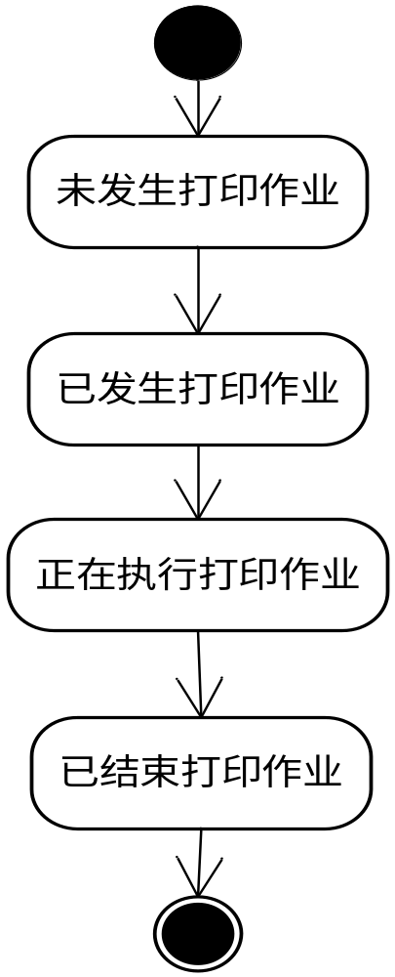
打印作业状态图
Workload队列中
等待队列中
从等待队列中删除

Slide 16
fifo::simulate流程
开 始
读入文件中数据
放入workload队列
add_event()
初始化时间counter
等待时间累加器
作业个数累加器
模拟counter计数
是否没有未发生的作业等待作业
是否有打印作业发生
是否有打印作业结束
结 束

