Slide 1
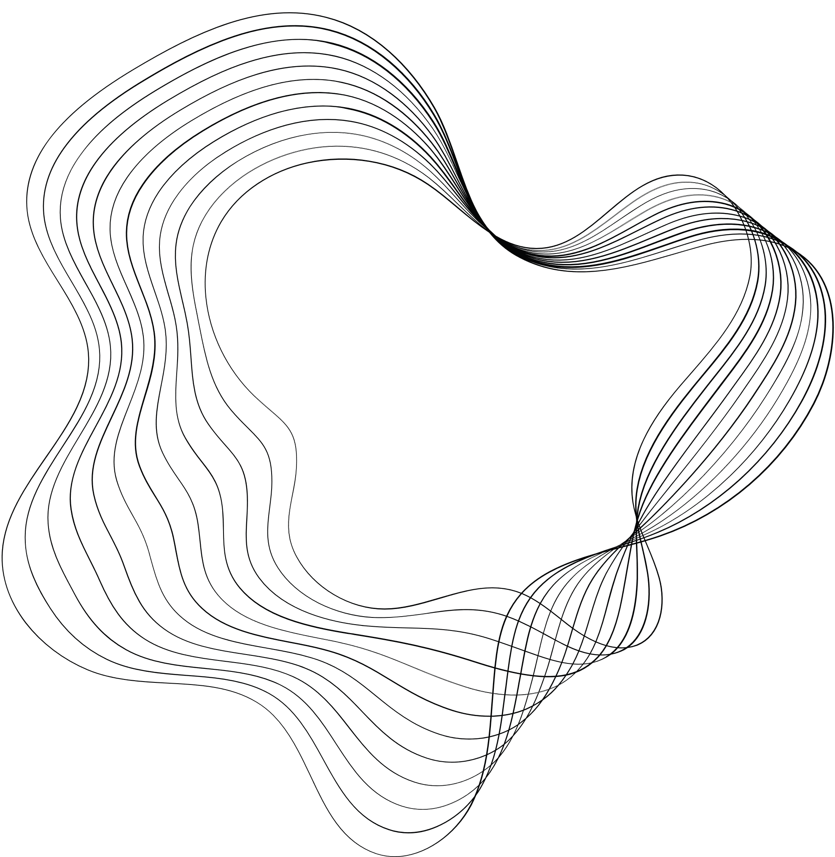


TRAFFIC SIGN RECOGNITION SYSTEM
SUPERVISIOR: PAWAN KUMAR PAL
PRESENTED BY: ASISH KUMAR
PRASHANT GUPTA
ANUBHAV KUMAR

Slide 2

CONTENT
01
PROBLEM STATEMENT
02
OBJECTIVES
03
TECHNOLOGIES USED
04
WORKFLOW DIAGRAM
05
PATENT STATUS
06
RESEARCH PAPER STATUS
07
PROJECT STATUS
08
REFERENCES

Slide 3

PROBLEM STATEMENT
To improve road safety and driving assistance, we aim to develop a computer vision system that accurately identifies and interprets traffic signs from real-time camera feeds.
Challenges such as detection, classification, and adaptability to various environmental and lighting conditions.
The system should aim to contribute safer and more informed driving experiences by addressing these challenges in traffic sign recognition.

Slide 4
OBJECTIVES
Traffic Safety
Reduced Human Error
Adaptability
Improve road safety by promptly detecting and interpreting traffic signs, reducing the risk of accidents, and assisting drivers.
Mitigate the potential for human error, distraction, or fatigue by automating the recognition and communication of traffic sign information.
Recognize and interpret a wide range of traffic signs, including regional and international variations, to accommodate diverse driving environments.
Efficiency
Real-time Processing
Process traffic sign information in real-time to provide immediate feedback to the driver, ensuring timely responses.
Enhance traffic flow and reduce congestion by assisting drivers in making informed decisions, such as lane changes, speed adjustments, and right-of-way prioritization.

Slide 5





TECHNOLOGY USED
It is a fundamental library in the Python programming language for numerical and mathematical computations
Pandas is an open-source Python library designed for data manipulation and analysis for working with structured data.
It provides a flexible and highly customizable interface for creating a wide variety of charts, graphs, plots, and other visual representations of data
It provides a comprehensive set of tools and algorithms for various machine learning tasks, including classification, regression, clustering, dimensionality reduction, model selection, and more

Slide 6




It is one of the most popular and widely used libraries for building and training machine learning models, particularly deep learning models.
It is designed to be user-friendly, modular, and highly extensible, making it a popular choice for building and training deep neural networks.
Python is widely used in various domains, including web development, data science, machine learning, scientific computing, automation, and more.
OpenCV (Open Source Computer Vision Library) is an open-source computer vision and machine learning software library designed to provide a comprehensive infrastructure for computer vision applications.

Slide 7
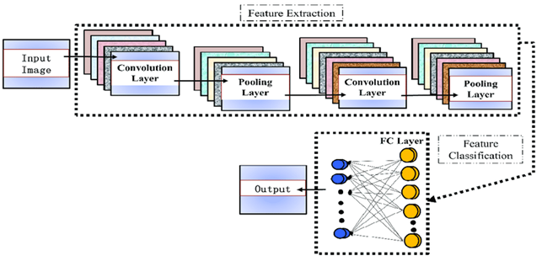
WORKFLOW DIAGRAM

Slide 8
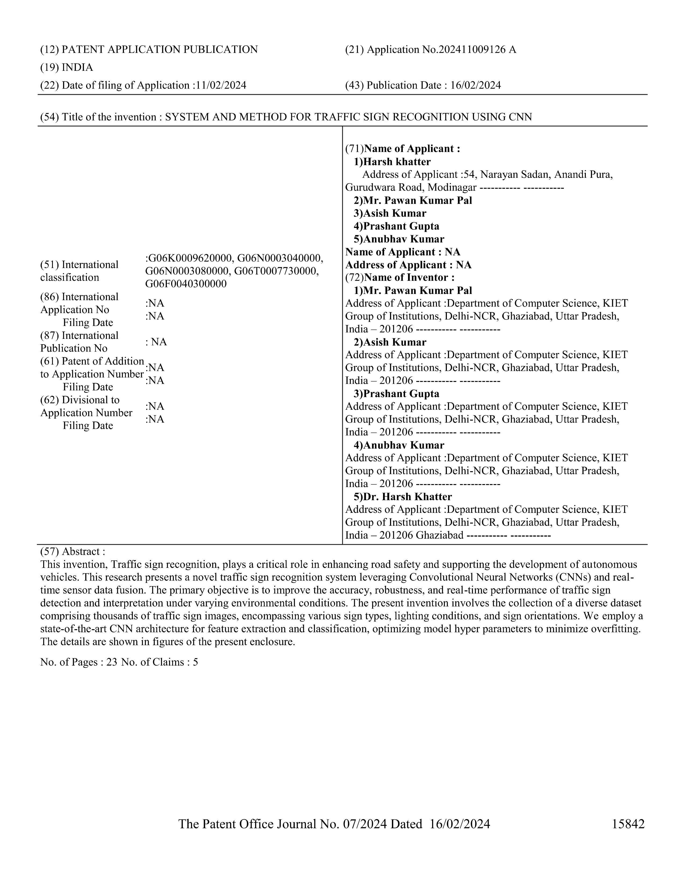
PATENT STATUS
Patent has been publish..!!!

Slide 9
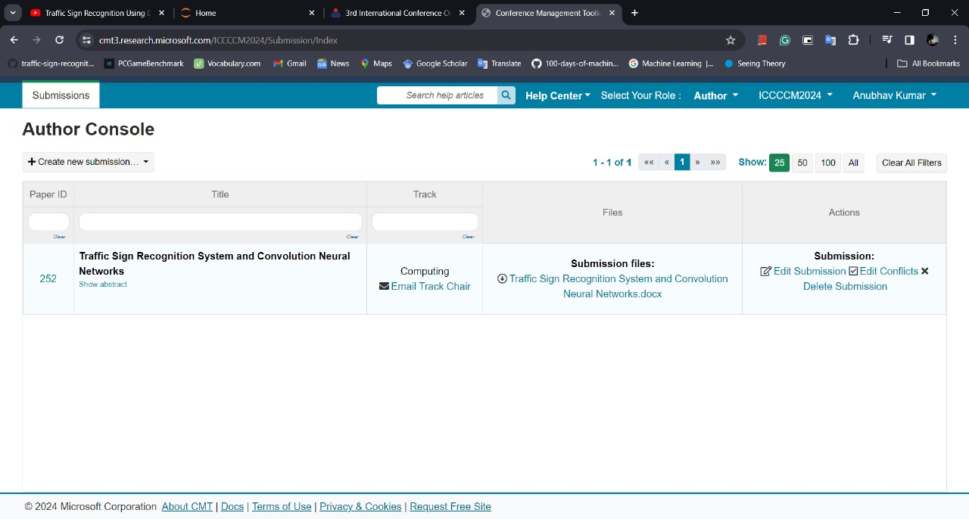

RESEARCH PAPER STATUS
Research paper submitted to conference and waiting for approval..

Slide 10
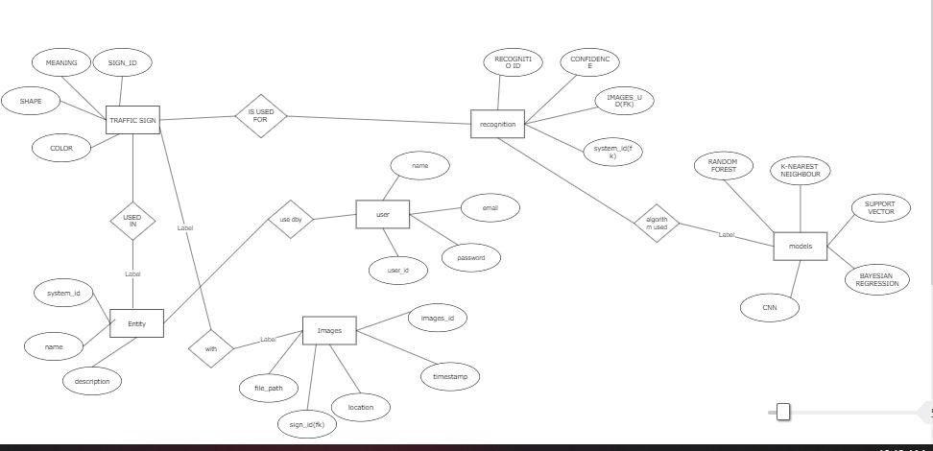
ER Diagram

Slide 11
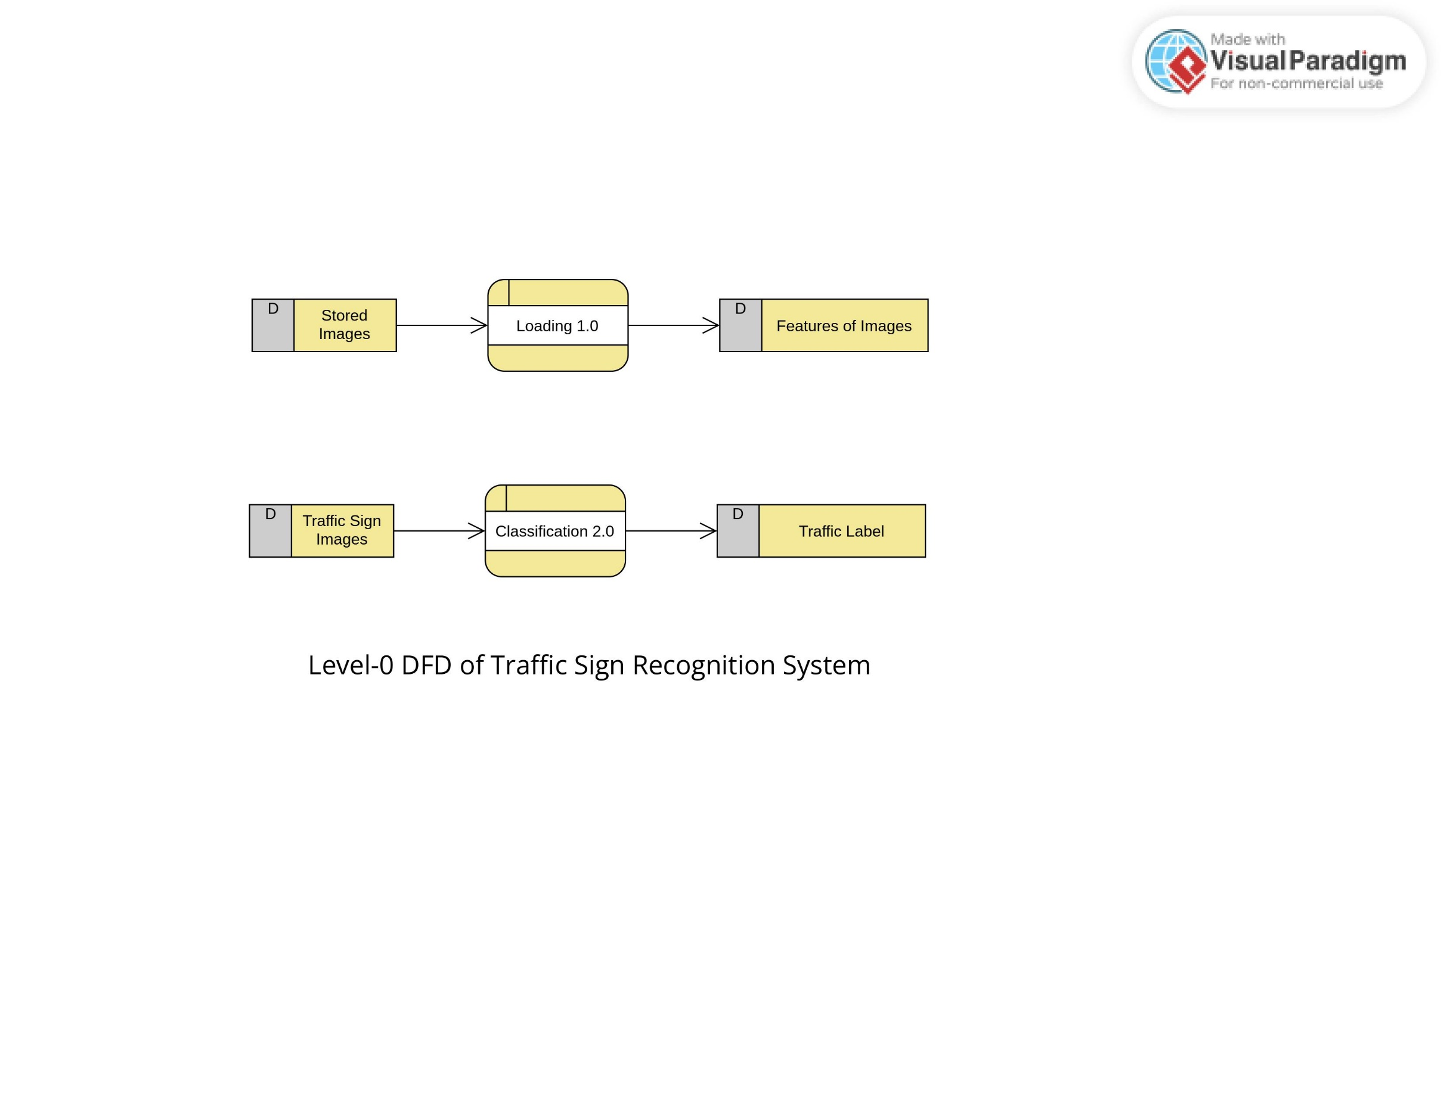
d
DFD level 0

Slide 12
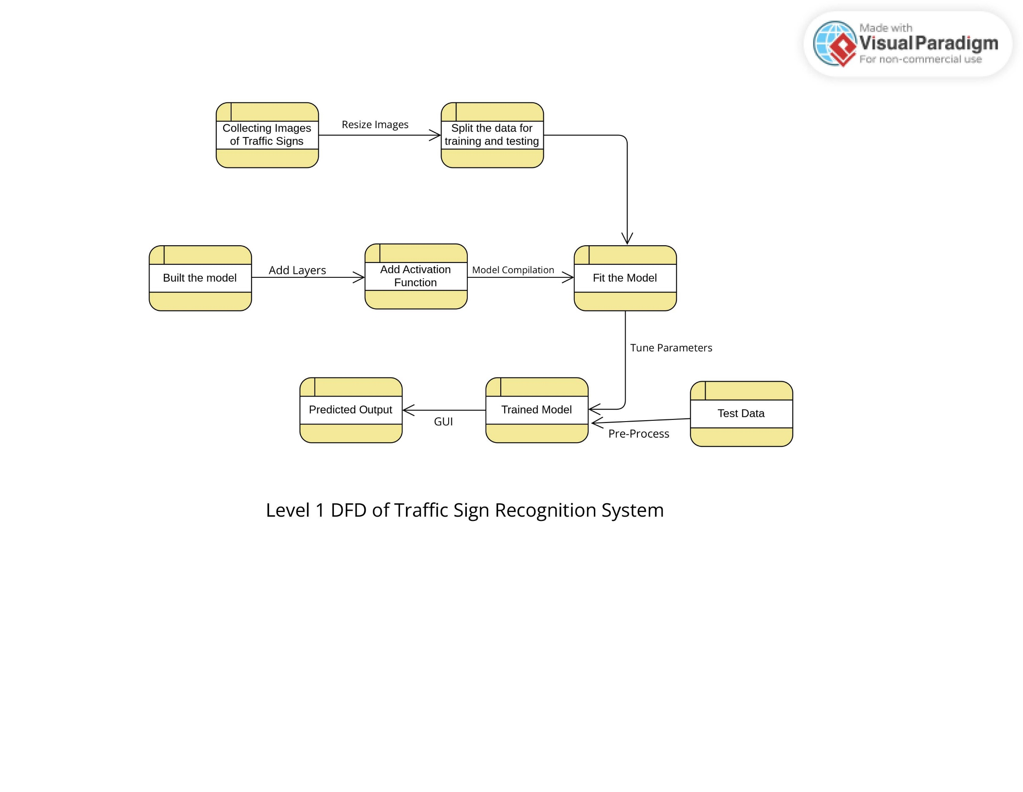
DFD level 1

Slide 13
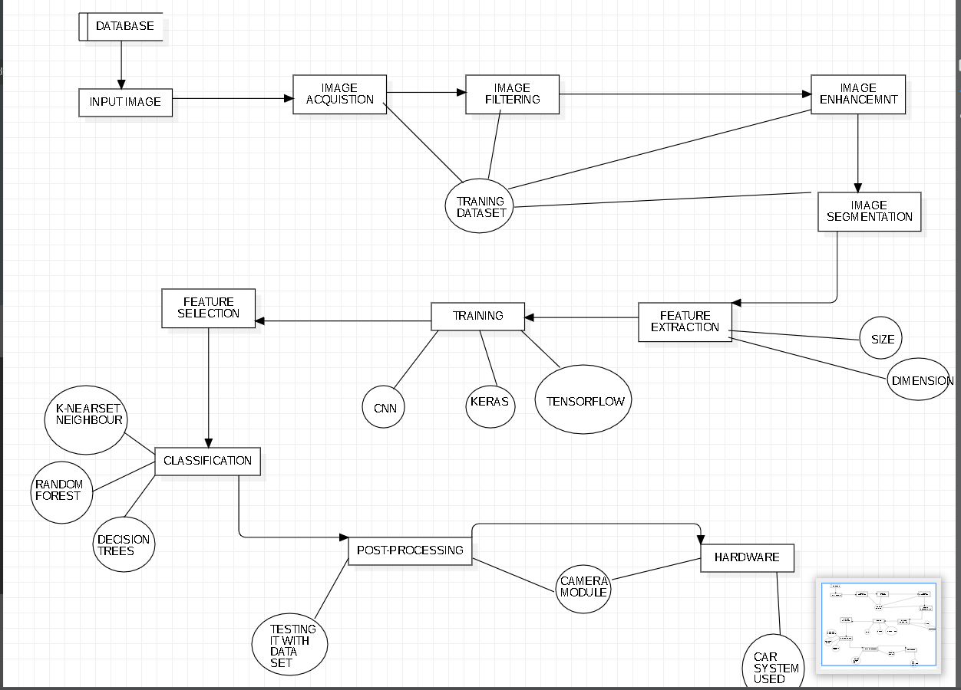
DFD level 2

Slide 14
PROJECT STATUS
Our Traffic Sign Recognition System project has reached an impressive 100% completion milestone and is working properly.

Slide 15
REFERENCES
[1] A. Nikonorov, P. Yakimov, M. Petrov, Traffic sign detection on GPU using color shape regular expressions, VISIGRAPP IMTA-4, Paper 8 (2013).
[2] R. Belaroussi, P. Foucher, J.P. Tarel, B. Soheilian, P. Charbonnier, N. Paparoditis, Road Sign Detection in Images, A Case Study, 20th International Conference on Pattern Recognition (ICPR), 2010, pp. 484-488
[3] Aditya, A.M., & Moharir, S. (2016). Study of Traffic Sign Detection and Recognition Algorithms
4] Mogelmose, M. M. Trivedi and T. B. Moeslund, "Vision-based traffic sign detection and analysis for intelligent driver assistance systems: Perspectives and survey", IEEE Trans. Intell. Transp. Syst., vol. 13, pp. 1484-1497, Dec. 2012.

Slide 16
[5] L. Fletcher, N. Apostoloff, L. Petersson and A. Zelinsky, "Vision in and out of vehicles", IEEE Intell. Syst., vol. 18, no. 3, pp. 12-17, May/Jun. 2003
[6] S. Lafuente-Arroyo, P. Gil-Jimnez, R. Maldonado-Bascn, F. Lpez-Ferreras and S. Maldonado-Bascn, "Traffic sign shape classification evaluation I: SVM using distance to borders", Proc. IEEE Intell. Veh. Symp., pp. 557-562, 2005-Jun
[7] K. C. P. Wang, Z. Hou and W. Gong, "Automated road sign inventory system based on stereo vision and tracking", Computer.-Aided Civil Infrastructure. Eng., vol. 25, no. 6, pp. 468-477, 2010.

