Slide 1
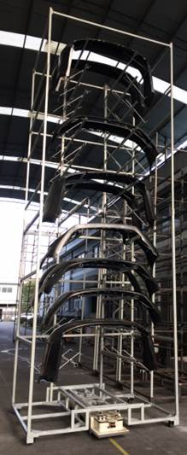
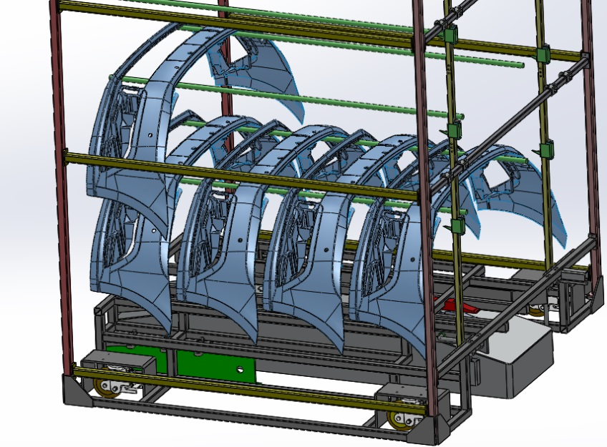
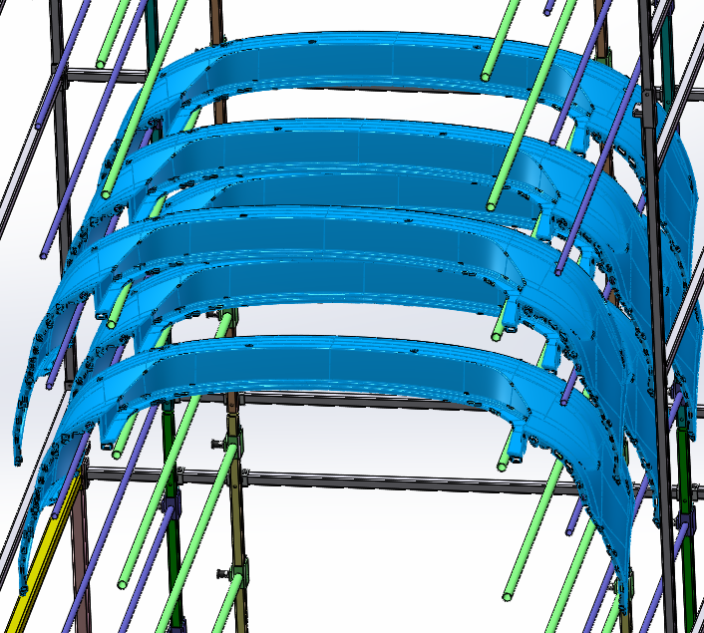
高位料架 High-rack
PAGE 1 /17

Slide 2
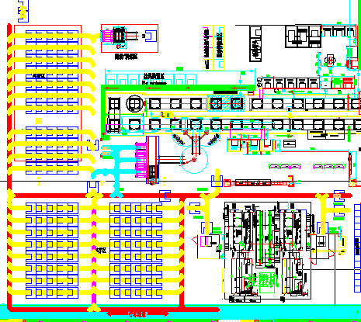
大布局 Macrozone
存储区域
翻箱/拼箱点
装件点
卸货点
PAGE 2 /17

Slide 3
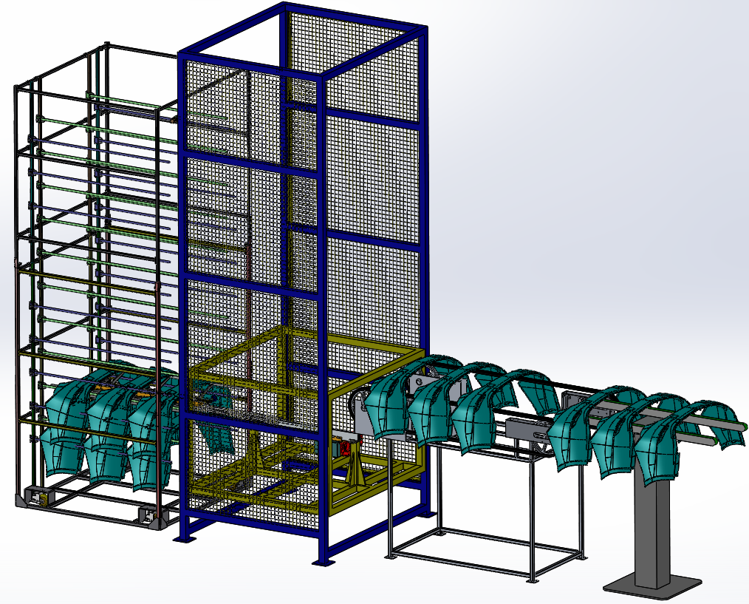
注塑下件布局 Injection Layout
PAGE 3 /17

Slide 4
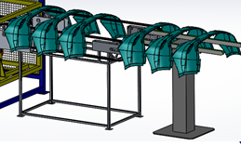

注塑传送带
缓冲位
扫描位
下件位
PAGE 4 /17

Slide 5
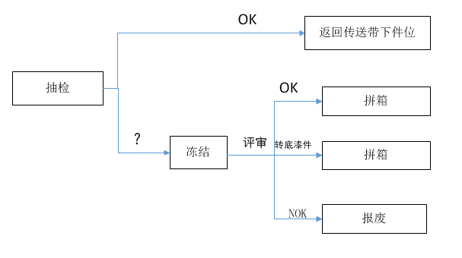
可疑品处理 Suspect Product Management
PAGE 5 /17

Slide 6
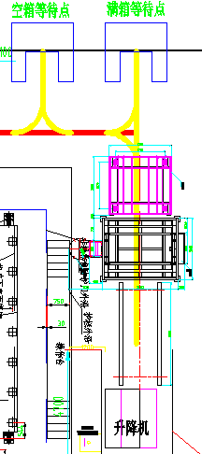
空满交换 Full-Empty Exchange
PAGE 6 /17

Slide 7
料道状态 Rack Path Status
全满
ALL FULL
全空
ALL EMPTY
前空后满EMPTY+ FULL
前满后空FULL+EMPTY
料道内的4种状态.
PAGE 7 /17

Slide 8
Part Flow A(Injection parts into WIP)
Path 1
A
A
A
A
A
A
A
A
A
Path 2
A
A
A
A
A
A
Path 3
B
B
B
B
B
B
B
B
B
Path 4
B
B
B
B
B
B
Path 5
A
A
A
A
A
PAGE 8 /17

Slide 9
Part Flow B(Injection parts into WIP)
Path 1
A
A
A
A
A
A
A
A
A
Path 2
A
A
A
A
A
A
Path 3
B
B
B
B
B
B
B
B
B
Path 4
B
B
B
B
B
B
Path 5
A
A
A
A
A
PAGE 9 /17

Slide 10
涂装出库 Painting Request
WINCC
FANUC
Planner
MES
AGV
LIFT
PAGE 10 /17

Slide 11
涂装出库 Painting Request
Planner
MES
WINCC
FANUC
AGV
LIFT
PAGE 11 /17

Slide 12
Part Flow C(Painting rack back to WIP )
Path 1
A
A
A
A
A
A
A
A
A
Path 2
A
A
A
A
A
Path 3
B
B
B
B
B
B
B
B
B
Path 4
B
B
B
B
B
B
Path 5
A
A
A
A
PAGE 12 /17

Slide 13
Part Flow D(Painting rack back to WIP )
Path 1
A
A
A
A
A
A
A
A
A
Path 2
A
A
A
A
A
Path 3
B
B
B
B
B
B
B
B
B
Path 4
B
B
B
B
B
B
Path 5
A
A
A
A
PAGE 13 /17

Slide 14
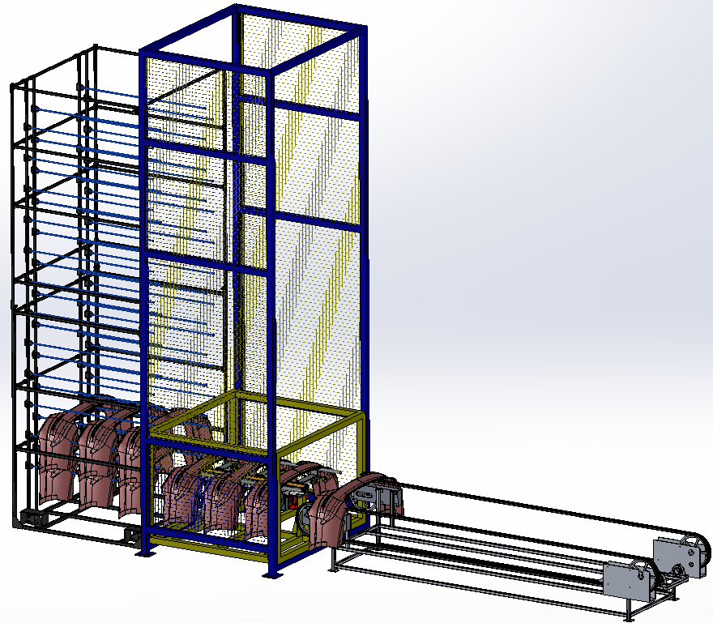
涂装线边布局 Painting Loading Layout
PAGE 14 /17

Slide 15
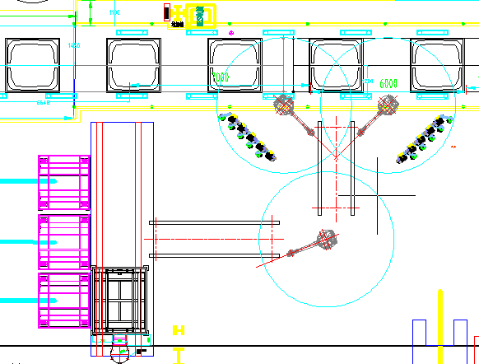
涂装上件 Painting Loading
PAGE 15 /17

Slide 16
Q&A
PAGE 16 /17

Slide 17


THANKS
FOR WATCHING

