Slide 1
On Efficient ML Model Training in Data Lakes
Wenbo Sun
TU Delft

Slide 2
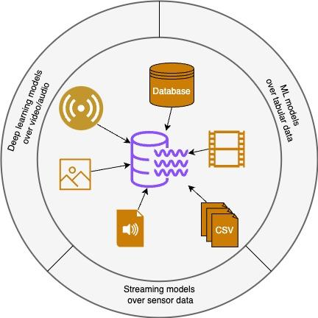
ML Model Training in Data Lakes
Prediction: Fraud detection, mortality prediction
Generation: Image segmentation, video segmentation
Multimodal Learning: Video/Audio understanding/summarization,
Notes:
Let’s start by understanding what a data lake is and how it differs from a traditional data warehouse. A data lake is a repository for storing both structured and unstructured data at any scale. Unlike a data warehouse, which stores data in predefined schemas, a data lake retains data in its raw format. This allows for data to be stored as-is and processed later, providing greater flexibility. Data lakes can handle various data types, from text and numbers to images and videos.
While both data lakes and data warehouses support complex analytics, data lakes offer more flexibility and lower costs. They support multiple storage formats, such as JSON and Parquet, which can be more cost-effective. Storing data in its original format also reduces the need for preprocessing, saving on storage costs and speeding up insights.
Beyond analytics, data lakes are increasingly used in machine learning. For example:
- **Tabular Data:** ML can be applied to tabular data in a data lake for predictive analytics, like using historical sales data to forecast future trends.
- **Images:** Data lakes support unstructured data like images, enabling advanced ML tasks such as image segmentation and generation.
- **Multimodal Data:** Data lakes are good at handling multimodal data, allowing for complex ML tasks like video analysis, where you might identify objects, sounds, or entities in text or metadata.

Slide 3
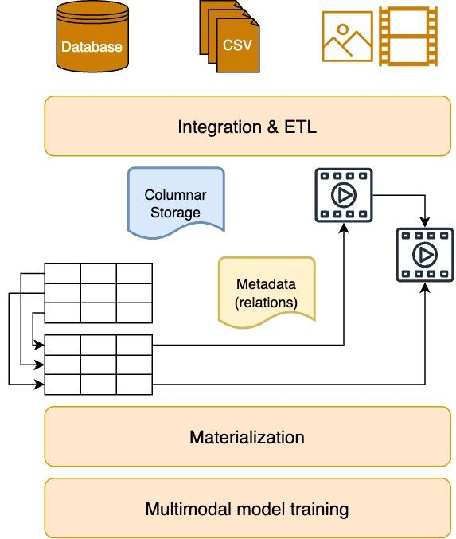
Challenges
Interconnected files and keep evolving relations
Segmented ETL processes for different modalities
Costly materialization over various format
Notes:
Despite their advantages, data lakes present significant challenges for ML tasks.
A major challenge is managing the complex, interconnected nature of the data. Data lakes store diverse information in flexible formats, but this flexibility complicates metadata management. Relationships between data entities are vast and constantly evolving, making it difficult to track and manage metadata, which is crucial for understanding data structure and provenance.
Another issue is the segmented ETL processes required for different data modalities, particularly in multimodal ML tasks. Preparing text, images, and videos demands different tools, leading to complex workflows and significant maintenance efforts. This siloed approach increases inconsistencies, complicating the data pipeline.
Finally, integrating and transforming diverse data formats into a unified structure for ML training is time-consuming and resource-intensive. Processing raw data into a standard format involves significant data movement, temporary storage, and computation, leading to inefficiencies that can slow down ML training in data lakes.

Slide 4
Research Questions
How can ML models be efficiently trained directly over columnar files without the need for costly data materialization processes?
What modifications to file formats, such as Parquet, can make columnar storage more compatible with training a wide range of ML models?
What techniques can be employed to leverage GPU acceleration for both data integration and ML training tasks within data lakes?
Notes:
Given all these challenges, 3 research questions are concluded for my phd journey.

Slide 5
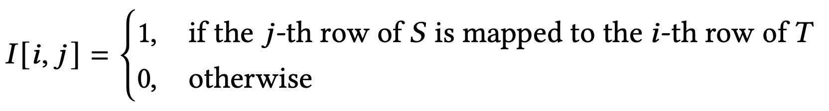
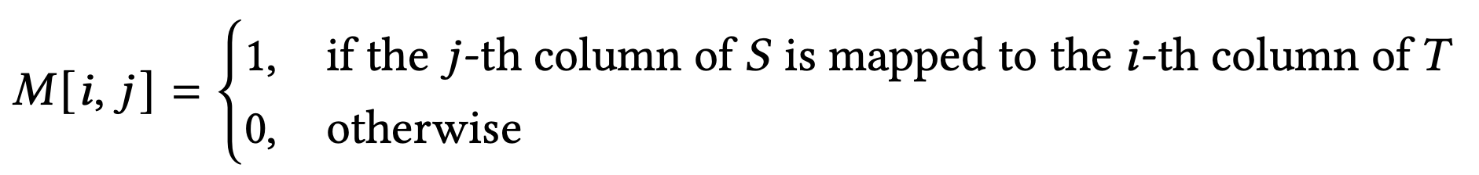
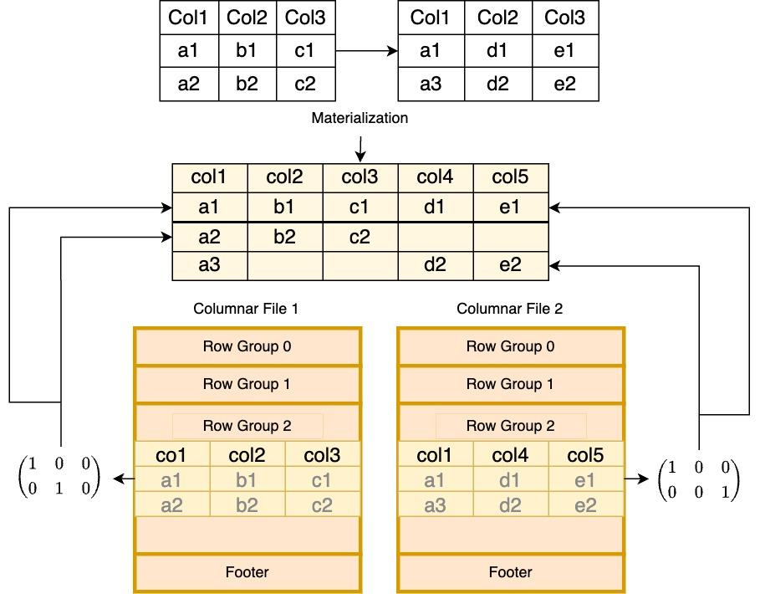
Metadata Representation
Notes:
In a typical data preparation pipeline, we gather data from various storage files and aggregate it into a large table for model training. This aggregation is necessary to map the data schema to the model features. But if we want to train models directly on storage files, we need metadata to create this map and skip the aggregation process.
The challenge is that most ML algorithms use linear algebra, while traditional metadata relies on relational algebra, leading to a mismatch. To solve this, we’ve developed a binary matrix-based metadata system. This matrix tracks connections between entities and schemas across different data sources in the data lake.
For example, if two datasets share the same entity in their first row, we traditionally perform a relational join, which requires converting columnar storage into relational tables. With our matrix-based metadata, we can directly map the physical location of an entity across files, eliminating the need for materialization. This metadata works on three levels: identifying the file, the row group, and the physical address of the entity. It can also link binary data like video and audio, supporting multimodal deep learning in data lakes.

Slide 6

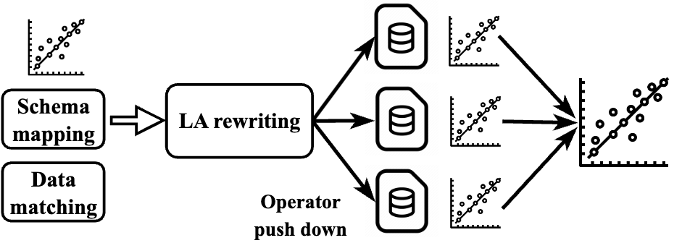
ML over factorized tables:
ML over Columnar Storage
Similarly, ML operators can separately computed close to where files are located
Notes:
Now, I would like to present how to use binary matrix metadata enabling ML training over columnar files. First I want to introduce factorised learning. Factorized learning can learn machine learning models over factored tables. Based on the metadata matrix, we can express the aggregation process by a sequence matrix multiplication as the formula indicates, on this basis, learning algorithms such as gradient descent can be rewritten as this way. That is to say, part of ML model weights can be push down to the physical place that is close to the data location.
But factorized learning has limitations, only linear models or generalised linear models can be trained in this way. However, we have some preliminary conclusion that using matrix metadata for non-linear models such as neural networks is also possible, although due to non-linearity, communication after each epoch is still mandatory, but the communication overhead can be reduced with some mathematical transformation

Slide 7
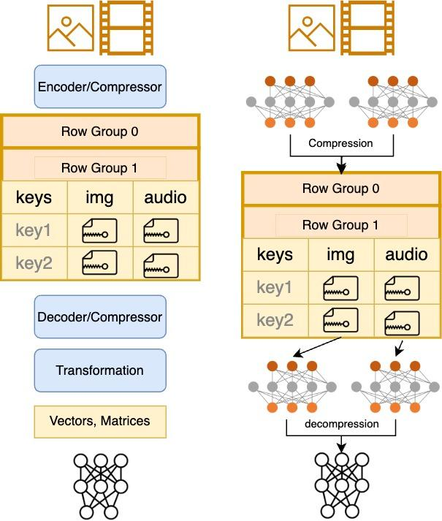
Autoencoder as a Compressor
Lossless compression:
Repeated (de)compression process
intensive data transformation and movement
Lossy compression with AE:
Integrated AE with downstream models
The compressor itself is compressable
Only encoding once
Leveraging DL models robustness
Notes:
So, we have discussed how to represent relations between datasets in columnar files, now let's discuss the data within columnar files. We know data lake has many types of data, apart from tabular data, there maybe video, audio, images. raw data of multimedia files are usually very large, they are usually first compressed and converted to binary streams in data lake. when training deep learning models with multimedia data, files are first decompressed and generate very large intermediate data, using lots of I/O bandwidth and influence the throughput. So if we can directly use compressed data for deep learning training, we can improve the I/O efficiency as well as reduce the storage space of multimedia.
Traditional lossless compression algorithms are hard to be integrated with downstream deep learning models because compressed data doesn't keep semantics of raw data. Therefore, the questions becomes to do we have a compression algorithm that can keep semantics? So that we can learn ML models from compressed data. One way of semantic-retained compression is using auto encoder to reduce the dimension of input. The latent space of auto encoder has much lower dimension numbers than input. Another advantage is that the compressed data are vectors, which are exactly the form of input to most of deep learning models, therefore we can save the overhead in transformation. Although AE is lossy compression, it may degrade the performance of downstream models. Considering the robustness of deep learning models, the trade-offs are still need further exploration.

Slide 8
GPU-accelerated ML Pipeline in Data Lakes
1. Leveraging Modern Hardware for Pipeline Acceleration: From Parquet file operations to model training, can be accelerated by transforming file operations into linear algebraic operations.
2. Role of Autoencoders in Decompression: Autoencoders can be employed for data decompression within the pipeline. Their operations, aligned with linear algebraic principles, allow efficient processing on GPUs, enhancing the overall performance of the ML pipeline.
3. Stacking Autoencoders with Deep Learning Models: Integrating autoencoders with other deep learning models not only improves compression effectiveness but also helps mitigate the loss during compression, offering new opportunities for optimization.
Notes:
Given the matrix-form metadata and auto encoder-based compressor, the relations and content of columnar files become linear algebra compatible. Given that, can we use modern linear algebra accelerators to further improve the efficiency of ML training in data lakes.
Specifically, from Parquet file operations to model training, can be accelerated by transforming file operations into linear algebraic operations, and further be accelerated by modern hardware like GPUs.
Autoencoders can be employed for data decompression within the pipeline. Their operations, aligned with linear algebraic principles, allow efficient processing on GPUs, enhancing the overall performance of the ML pipeline.
3. Integrating autoencoders with other deep learning models not only improves compression effectiveness but also helps mitigate the loss during compression, offering new opportunities for optimization.

Slide 9
Materialization is not mandatory when we know entity relations
ML training algorithms can run over columnar storage file without aggregating them to human-readable records.
Autoencoder is a promising lossy compressor for multimedia data in data lakes
Binary metadata representation and AE-based compressor can serve as a middleware and enable GPU-accelerated data lakes
Conclusion
Notes:
Materialization is not mandatory when we know entity relations
ML training algorithms can run over columnar storage file without aggregating them to human-readable records.
Autoencoder is a promising lossy compressor for multimedia data in data lakes
Binary metadata representation and AE-based compressor can serve as a middleware and enable GPU-accelerated data lakes

