Slide 1
Perl
Given by: Joydeep Bhattacharjee
Contact me: joydeep.bhattacharjee@slkgroup.com
joydeepubuntu@gmail.com
@alt227Joydeep
https://github.com/infinite-Joy
http://joydeepbhatt.com/

Slide 2
All scripts, ppt and code discussed here can be found at:
https://github.com/infinite-Joy/perl-tuts

Slide 3
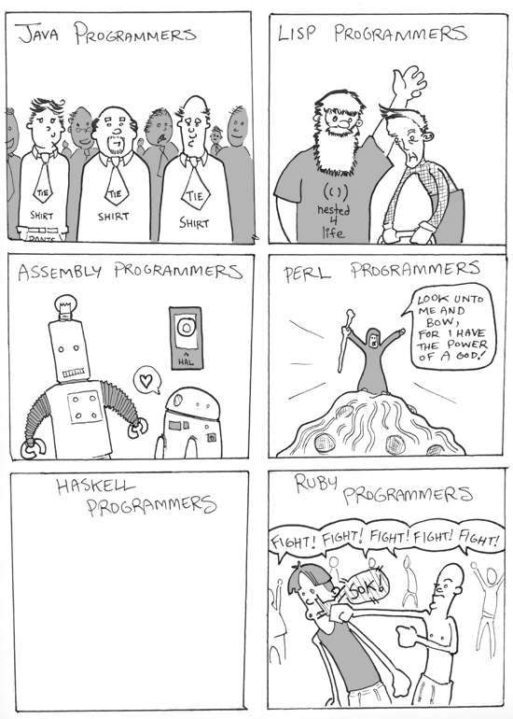

Slide 4
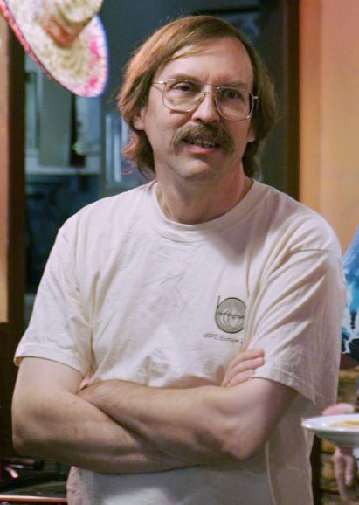
Larry Wall

Slide 5
What is Perl
Powerful, stable, mature, portable
Perl 5 is a highly capable, feature-rich programming language with over 29 years of development. Perl 5 runs on over 100 platforms from portables to mainframes and is suitable for both rapid prototyping and large scale development projects.
"Perl" is a family of languages, "Perl 6" is part of the family, but it is a separate language which has its own development team. Its existence has no significant impact on the continuing development of "Perl 5".
Source: https://www.perl.org/about.html

Slide 6
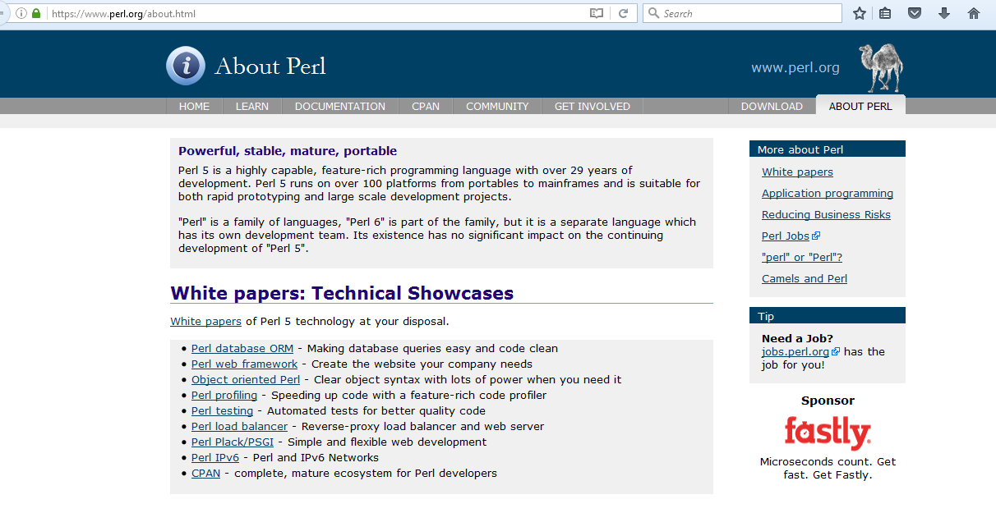
Website

Slide 7
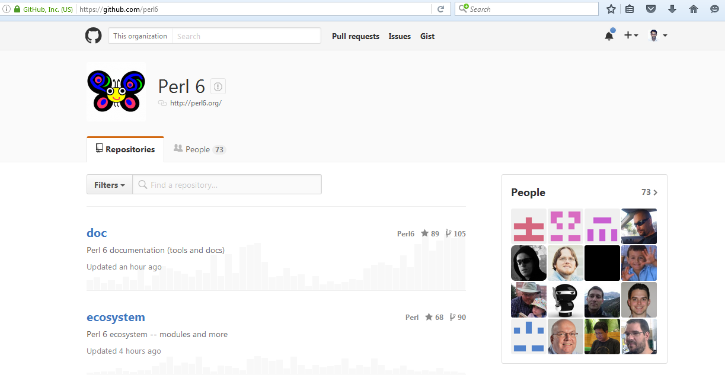
Github perl 6

Slide 8
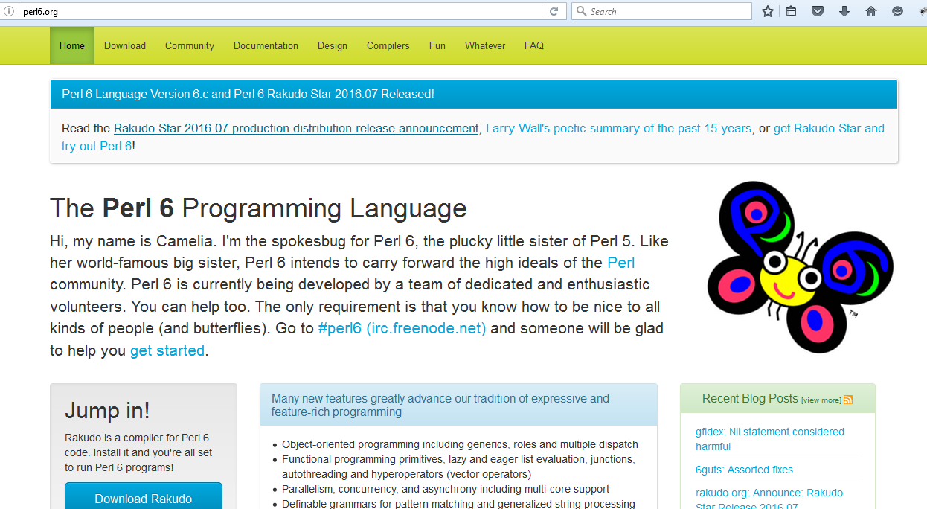
Perl 6 website

Slide 9
Features
Mission critical
Object-oriented, procedural and functional
Easily extendible
Text manipulation
C/C++ library interface
Open Source

Slide 10
Three Virtues
According to Larry Wall⁽¹⁾, the original author of the Perl programming language, there are three great virtues of a programmer; Laziness, Impatience and Hubris
Laziness: The quality that makes you go to great effort to reduce overall energy expenditure. It makes you write labor-saving programs that other people will find useful and document what you wrote so you don't have to answer so many questions about it.
Impatience: The anger you feel when the computer is being lazy. This makes you write programs that don't just react to your needs, but actually anticipate them. Or at least pretend to.
Hubris: The quality that makes you write (and maintain) programs that other people won't want to say bad things about.
Source: http://threevirtues.com/

Slide 11
Source Control

Slide 12
cpan
module-starter:
module-starter --module=Foo::Bar,Foo::Bat --author="joydeep" --email=abc@def.com
PAR:
# to make par
$ perl Makefile.PL
$ make
$ cd blib
$ zip –r mymodule.par arch/ lib/
# to use
$ perl –MPAR=./foo –Mhello
# search for foo.par in the @INC
$ perl –MPAR –Ifoo perl_script.pl

Slide 13
Design
Decide What to Make
Set Up a Text Editor
Design!
Plan Your Code
Think about the Extras

Slide 14
TDD
The act of writing a unit test is more an act of design than of verification. It is also more an act of documentation than of verification. The act of writing a unit test closes a remarkable number of feedback loops, the least of which is the one pertaining to verification of function.
It’s a discipline.
Source: http://www.agiledata.org/essays/tdd.html

Slide 15
Test::Simple
Test::More
Devel::Cover

Slide 16
Plain Old Documentation
(POD)
Source: http://perldoc.perl.org/perlpod.html

Slide 17
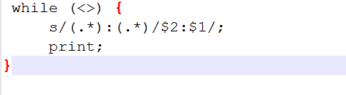
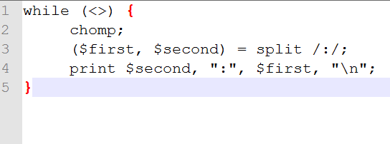
Readability matters
Perl isn't going to make you. It's up to you.

Slide 18
Clean Code:
Don’ts
1. A 5000-line main program.
2. A sub that reads and writes global variables.
3. A sub that does not have a single purpose; for example, instead of a sin function and a tan function, someone defines a sin_and_tan function
Dos
strict-safe
Simple, Clear, General
Comprehensive test suite.

Slide 19
Do not Trust
Verify!!

Slide 20
Benchmarking

