Slide 1
SDN-based Intrusion Detection System for Mitigating Automated Malicious Traffic
Flows

Slide 2
PROJECT GUIDE
Dr. V. Vetriselvi
Professor,
Department of Computer Science and Engineering,
College of Engineering Guindy,
Anna University.
TEAM MEMBERS
Sobika S - 2018103067
Srinath S - 2018103070
Lekha Shanthini R - 2018103558

Slide 3
INTRODUCTION
The Distributed Denial of Service (DDoS) attack has impaired network availability for decades with no effective defense mechanism against it.
A DDoS attack disrupts the normal traffic of a targeted server, service or network by flooding the target or its surrounding infrastructure with Internet traffic.
The emerging Software Defined Networking (SDN) provides a new way to reconsider the defense against DDoS attacks.
The traditional IP router forms its routing table from BGP, Inter-AS or Intra-AS protocols.
Doesn’t have the capability to analyse the flow or can’t accommodate applications to differentiate this traffic.
Software-Defined Networks on the other hand, can accommodate applications that are capable of analysing and deploying mitigation measures in case of malicious flows.

Slide 4
OVERALL OBJECTIVES
To tackle the DDoS flow to our server
Integrate a feature extraction and classification application to detect any malicious flow entering the system.
Make the system sensitive to suspicious flows. At the same time we also need to reduce the false positive rate as low as possible.
Implement a defense mechanism to mitigate the attack by redirecting the malicious flow to a CAPTCHA server.

Slide 5
LITERATURE SURVEY

Slide 6
S.No | TITLE | AUTHORS | PUBLICATION | ADVANTAGE | LIMITATION | DATASET | ALGORITHM
1 | A cooperative DDoS attack detection scheme based on entropy and ensemble learning in SDN | Shanshan Yu, Jicheng Zhang, Ju Liu, Xiaoqing Zhang, Yafeng Li, Tianfeng Xu | EURASIP Journal on Wireless Communications and Networking, 2021 | employs a coarse grained entropy detection and fine grained classification using random forests and CART. | Mitigation measure is very primitive where false positives might block legit users. | Generated attack and normal traffic using scapy and nettich-ng | Random Forest, CART
2 | A New Framework for DDoS Attack Detection and Defense in SDN Environment | Liang Tan, Yue Pan, Jing Wu, Jianguo Zhou, Hao Jiang, Yuchuan Deng | IEEE Access, Vol. 8, 2020 | Provides an effective classification method combining KNN and K-Means Algorithm and provides a defensive mechanism | Places huge burden on controller and does not scale to large scale traffic | NSL-KDD | K-Means, KNN

Slide 7
S.No | TITLE | AUTHORS | PUBLICATION | ADVANTAGE | LIMITATION | DATASET | ALGORITHM
3 | Smart detection: an online approach for DoS/DDoS attack detection using machine learning | Francisco Sales de Lima Filho, Frederico AF Silveira, Agostinho de Medeiros Brito Junior, Genoveva Vargas-Solar, Luiz F Silveira | Hindawi Security and Communication Networks Volume 2019, Article ID 1574749 https://doi.org/10.1155/2019/1574749 | Used a sampled dataset sourced from various benchmark datasets to make an efficient online classification system using the random forest algorithm. | Does not deal with a mitigation that could deal with the malicious traffic | CIC-Dos, CICIDS2017, CSE-CIC-IDS2018 and customised dataset | Random Forest
4 | Denial of Services Attack Detection using Random Forest Classifier with Information Gain | Dr. Sanjay Agrawal, Reena Singh Rajput | International Journal of Engineering Development and Research, 2017 | Achieves high F-Score and accuracy using Random Forest and better feature selection using Information Gain | Outdated dataset and was not real time | NSL-KDD | Random Forest

Slide 8
S.No | TITLE | AUTHORS | PUBLICATION | ADVANTAGE | LIMITATION | DATASET | ALGORITHM
5 | Detection of DNS DDoS Attacks with Random Forest Algorithm on Spark | Liguo Chen, Yuedong Zhang, Qi Zhao, Guanggang Geng, ZhiWei Yan | The 2nd International Workshop on Big Data and Networks Technologies, 2018 | A novel method to reduce the DDoS traffic on TLD servers is introduced using Random Forests | The technique is limited to DNS traffic and cannot be extended to other types of traffic | Query logs collected during Water Torture attack of .CN site in Hong Kong in 2015 | Random Forest
6 | Detection of Distributed Denial of Service Attacks using Machine Learning Algorithms in Software Defined Networks | Nisharani Meti, Narayan D G, V. P. Baligar | International Conference on Advances in Computing, Communications and Informatics (ICACCI), 2017 | Compared the performance of Bayes, support vector machine and neural network methods in detecting DDoS attacks, and found the performance of SVM is the best. | Focuses only on the TCP traffic and cannot be extended to other traffic types | Real time traffic collected in Lawrence Berkley Laboratory | SVM, Neural Network

Slide 9
ARCHITECTURE DIAGRAM

Slide 10
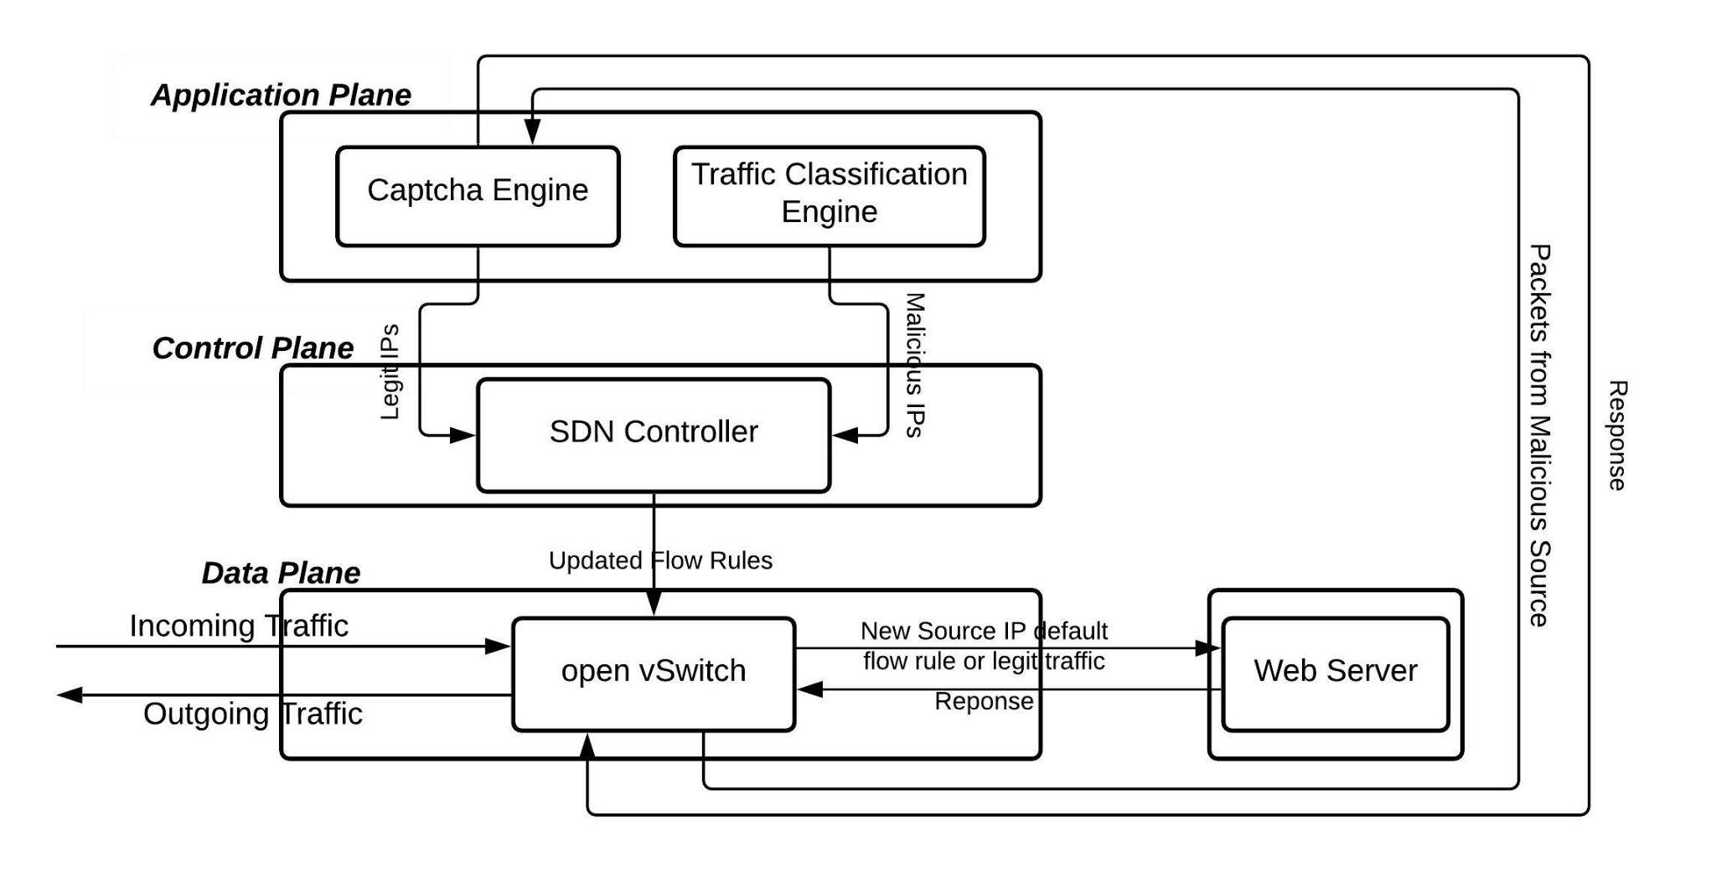

Slide 11
BLOCK DIAGRAM

Slide 12
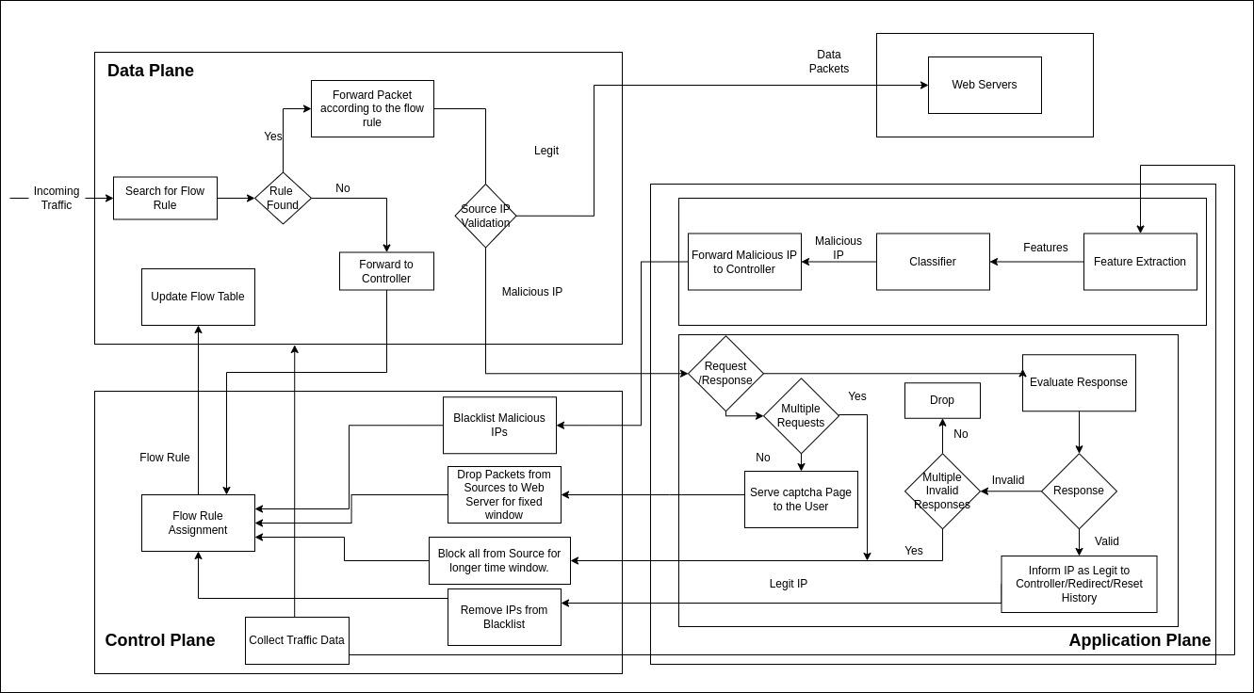

Slide 13
MODULES
Feature Extraction, Training and Classification
CAPTCHA Engine
Deploying Northbound APIs
Flow Rule Assignment

Slide 14
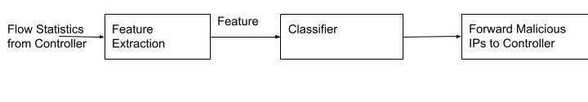
Feature Extraction, Training & Classification
INPUT : Flow statistics from Controller
OUTPUT : Packet count, Byte count, Duration of flow, Packet per flow, Bytes per flow, Packet rate, etc

Slide 15
2. Captcha Engine
CASE - I
INPUT : Redirected source packet of malicious traffic
OUTPUT : Recaptcha Challenge to the malicious
CASE - II
INPUT: Redirected captcha response
OUTPUT : API call to Controller to flag IP as legit and redirect to server.

Slide 16
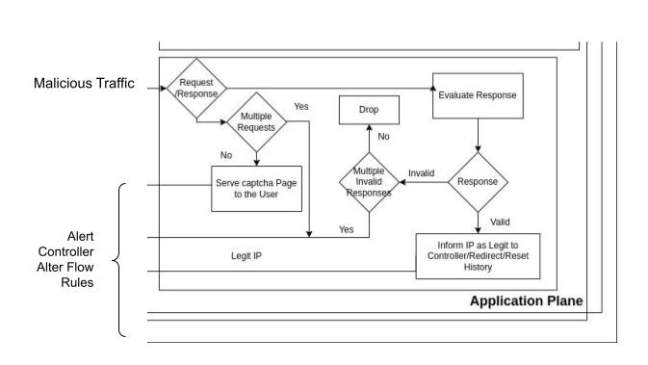
2. Captcha Engine

Slide 17
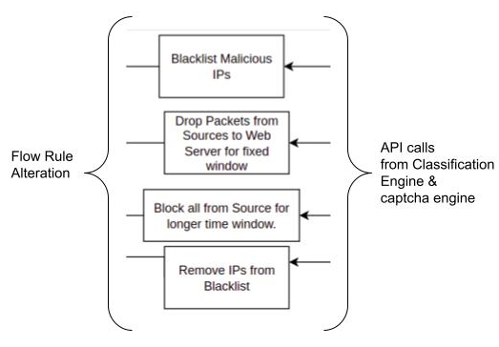
3. Deploying Northbound APIs
This is the communication middleware for the
Control Plane - Application Plane communication.
OUTPUT: REST API endpoints for
application layer to communicate
with the Controller

Slide 18
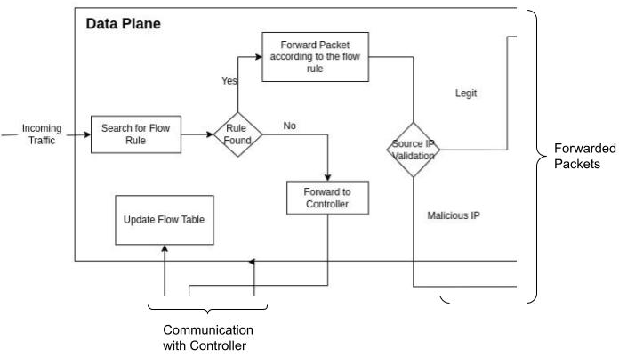
4. Flow Rule Assignment
INPUT : Malicious IP from
Classification Engine/
Legit IP from captcha
engine
OUTPUT : Flow rule to the
switch

Slide 19
DATASET
We use the datasets produced by Canadian Institute for Cybersecurity. We collect samples for malicious and benign traffic from three different datasets, produced in three different environments to build a random forest classifier. Source: [17]
CSE-CIC-IDS2018 on AWS - In CSE-CIC-IDS2018 dataset, we use the notion of profiles to generate datasets in a systematic manner, which will contain detailed descriptions of intrusions and abstract distribution models for applications, protocols, or lower level network entities. Link: https://www.unb.ca/cic/datasets/ids-2018.html
Intrusion Detection Evaluation Dataset (CIC-IDS2017) - CICIDS2017 dataset contains benign and the most up-to-date common attacks, which resembles the true real-world data (PCAPs). - Link - https://www.unb.ca/cic/datasets/ids-2017.html
CIC DoS dataset (2017) - Generated application layer DoS attacks were intermixed with the attack-free traces from the ISCX-IDS dataset. Link - https://www.unb.ca/cic/datasets/ids-2018.html

Slide 20



PERFORMANCE MEASURES
ANOMALY DETECTION PERFORMANCE
Accuracy is the ratio of the total number of correct predictions and the total number of predictions.
Precision is the ratio between the True Positives and all the Positives.
The recall is the measure of our model correctly identifying True Positives.

Slide 21

PERFORMANCE MEASURES
F1-score is the Harmonic mean of the Precision and Recall.
MITIGATION
File Transfer Time is the elapsed time between the end of an inquiry or demand on a computer system and the beginning of a response. We are going to compare the file transfer time with and without mitigation of malicious traffic.

Slide 22
REFERENCES
Yu, S., Zhang, J., Liu, J. et al. A cooperative DDoS attack detection scheme based on entropy and ensemble learning in SDN. J Wireless Com Network 2021, 90 (2021). https://doi.org/10.1186/s13638-021-01957-9
L. Tan, Y. Pan, J. Wu, J. Zhou, H. Jiang and Y. Deng, "A New Framework for DDoS Attack Detection and Defense in SDN Environment," in IEEE Access, vol. 8, pp. 161908-161919, 2020, doi: 10.1109/ACCESS.2020.3021435.
Lima Filho Francisco Sales de, Silveira Frederico A. F., de Medeiros Brito Junior Agostinho, Vargas-Solar Genoveva, Silveira Luiz F., “Smart Detection: An Online Approach for DoS/DDoS Attack Detection Using Machine Learning”, Security and Communication Networks Hindawi, 2019
Reena Singh Rajput, Dr. Sanjay Agrawal, A Survey on Denial of Service Attack Detection Techniques in Cloud Computing, International Journal for Scientific Research & Development| Vol. 4, Issue 06, 2016 | ISSN (online): 2321-0613
Research, Mahadev & Kumar, Vinod & Sharma, Himani. (2019). Detection and Analysis of DDOS Attack at Application Layer Using Naïve Bayes Classifier. 208-217.
Liguo Chen, Yuedong Zhang, Qi Zhao, Guanggang Geng, ZhiWei Yan, Detection of DNS DDoS Attacks with Random Forest Algorithm on Spark, Procedia Computer Science, Volume 134, 2018, Pages 310-315, ISSN 1877-0509
N. Meti, D. G. Narayan and V. P. Baligar, "Detection of distributed denial of service attacks using machine learning algorithms in software defined networks," 2017 International Conference on Advances in Computing, Communications and Informatics (ICACCI), 2017, pp. 1366-1371, doi: 10.1109/ICACCI.2017.8126031.
Allam S.K., Prasad G.S. (2021) Prevention of DDoS Attacks and Detection on Cloud Environment—A Review and Survey. In: Satapathy S., Bhateja V., Janakiramaiah B., Chen YW. (eds) Intelligent System Design. Advances in Intelligent Systems and Computing, vol 1171. Springer, Singapore. https://doi.org/10.1007/978-981-15-5400-1_47

Slide 23
REFERENCES
Boukari Souley, Hauwa Abubakar, A CAPTCHA – BASED INTRUSION DETECTION
MODEL,International Journal of Software Engineering & Applications (IJSEA), Vol.9, No.1, January 2018
Manu, B. (2016). A Survey on Secure Network: Intrusion Detection & Prevention Approaches. American Journal of Information Systems, Vol. 4, No. 3,Science & Education Publishing, pp 69-88.
http://mininet.org/
https://www.openvswitch.org/
https://www.google.com/recaptcha/about/
Iman Sharafaldin, Arash Habibi Lashkari, and Ali A. Ghorbani, “Toward Generating a New Intrusion Detection Dataset and Intrusion Traffic Characterization”, 4th International Conference on Information Systems Security and Privacy (ICISSP), Portugal, January 2018
Hossein Hadian Jazi, Hugo Gonzalez, Natalia Stakhanova, and Ali A. Ghorbani. "Detecting HTTP-based Application Layer DoS attacks on Web Servers in the presence of sampling." Computer Networks, 2017
Ali Shiravi, Hadi Shiravi, Mahbod Tavallaee, Ali A. Ghorbani, Toward developing a systematic approach to generate benchmark datasets for intrusion detection, Computers & Security, Volume 31, Issue 3, May 2012, Pages 357-374, ISSN 0167-4048, 10.1016/j.cose.2011.12.012.
M Devendra Prasad, Prasanta Babu V, C Amarnath, “Machine Learning DDoS Detection Using Stochastic Gradient Boosting,” International Journal of Computer Sciences and Engineering, Vol.7, Issue.4, pp.157-166, 2019.

