Slide 2
Language : TINY
WE WILL FIND ALL TOKENS DEFINED BY TINY.
TOOS : LEX/FLEX

Slide 3
1、learn how to use a tool , configure it’s enviorment, ready for use.
2、how to write the regular expression.
3、how to use the tool to get the tokens.
4、what is the complicate part of the problem

Slide 4
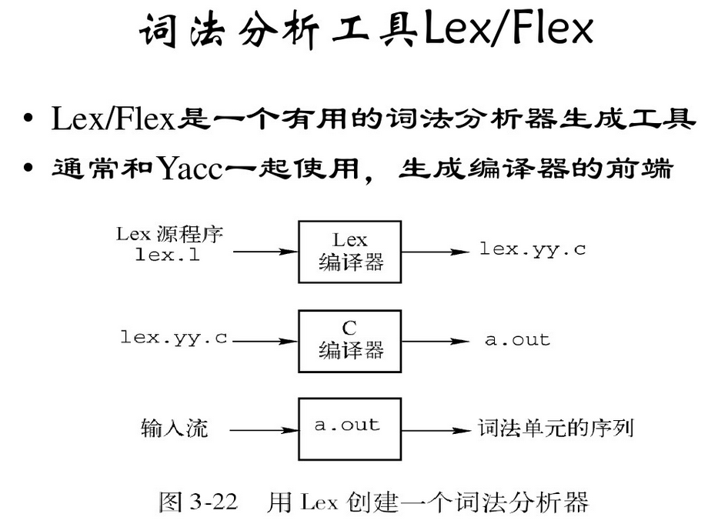
+-------+
Source -> | Lex | -> yylex
+-------+
+-------+
Input -> | yylex | -> Output
+-------+
An overview of Lex
Figure 1

Slide 5
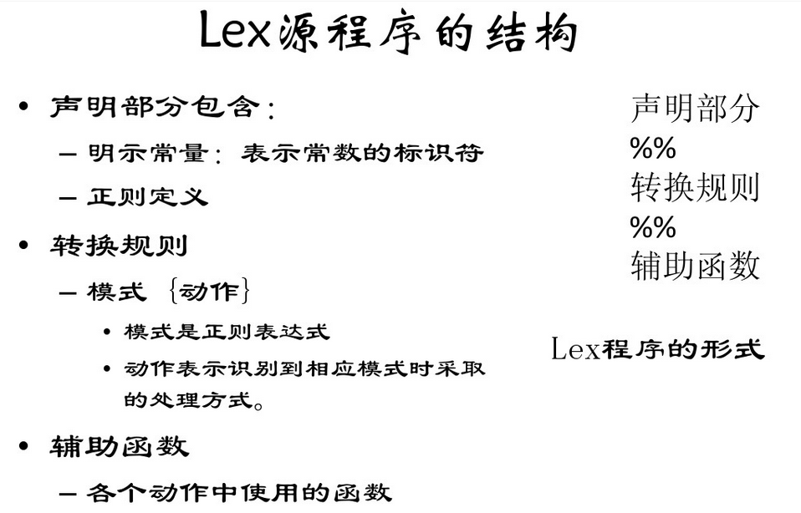
设定目录
选择 Tools ->Options->Directories tab->Executable Files
In the Directories box click the last empty directory. Type the name of the directory where you installed Parser Generator, followed by "\bin". For instance, if you installed Parser Generator in "C:\Program Files\Parser Generator", then you would type "C:\Program Files\Parser Generator 2\Bin". Note though that case is not important when specifying directory names.
5 Click the OK button. The Options dialog box should close accepting your changes.

Slide 6
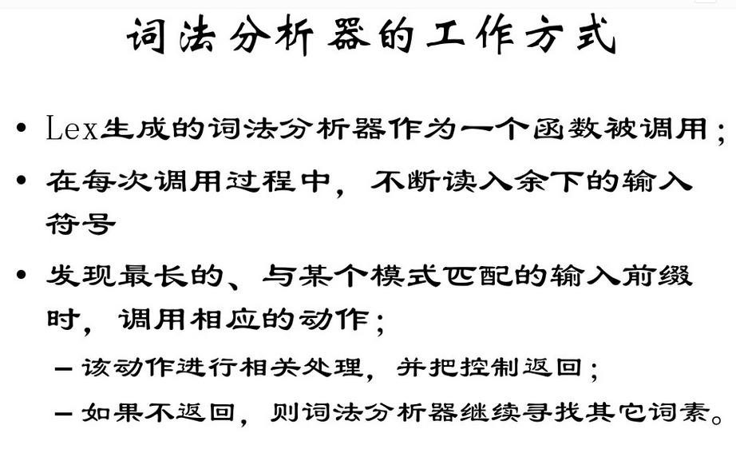

项目设定

Slide 7
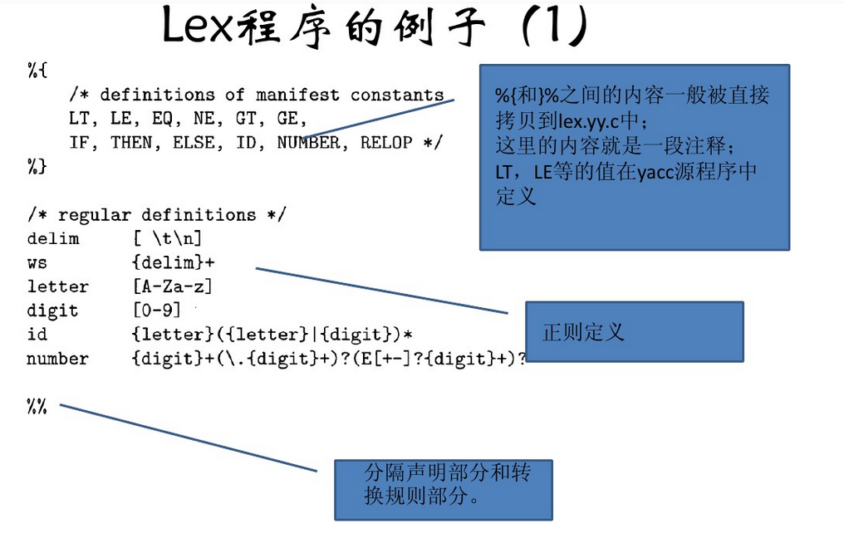

Slide 8
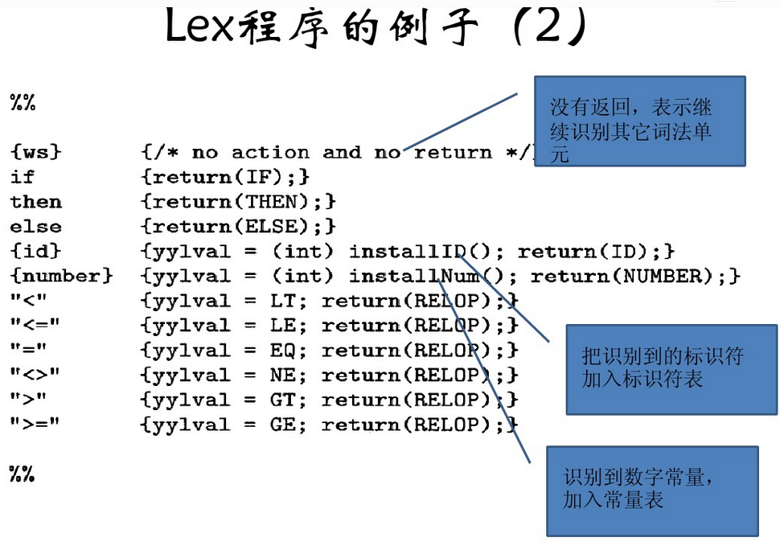

Slide 9
