Slide 1
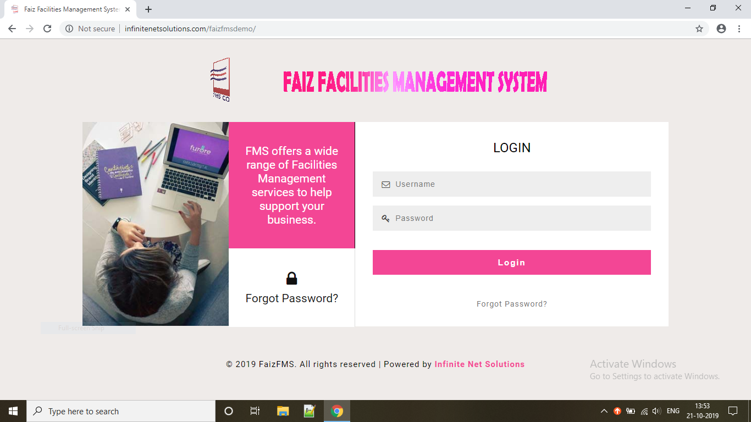
S
ADMIN LOGIN PAGE

Slide 2
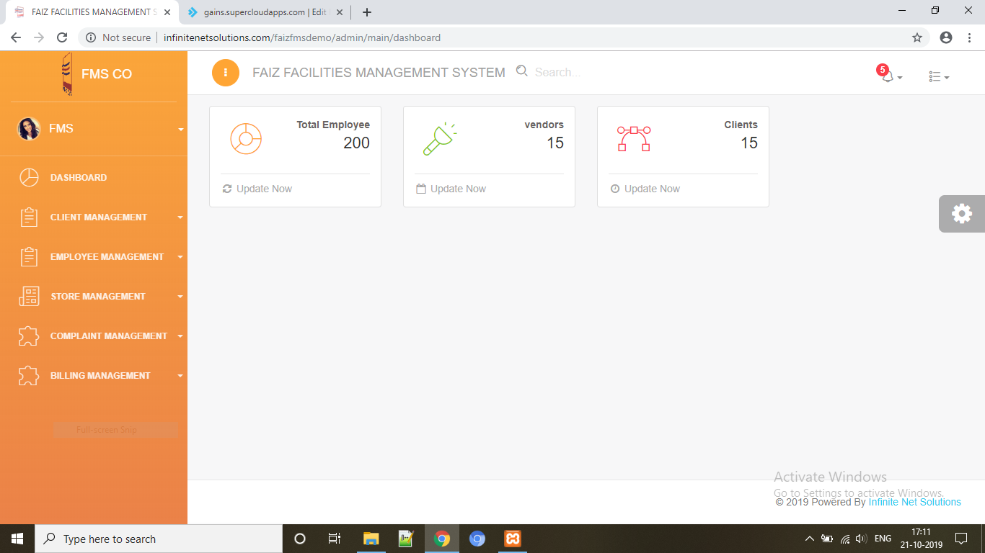
DASHBOARD

Slide 3
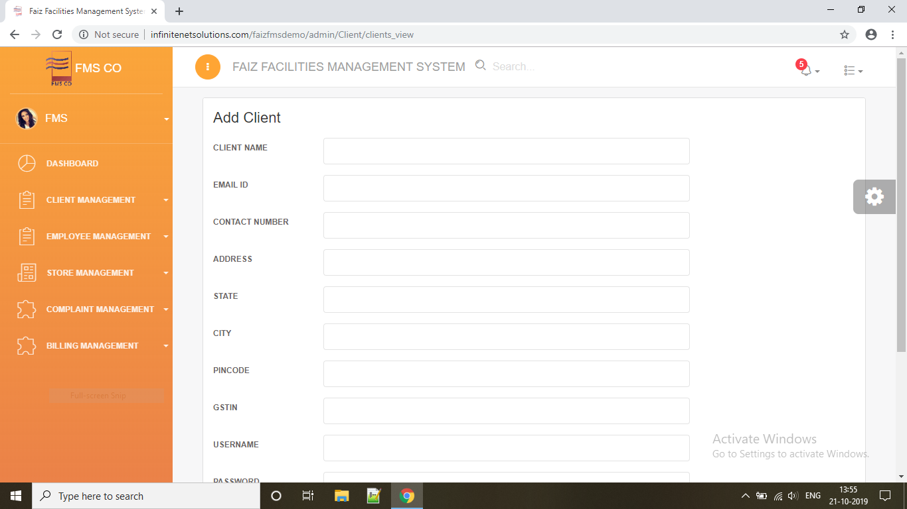
CLIENT MANAGEMENT
ADD CLIENT

Slide 4
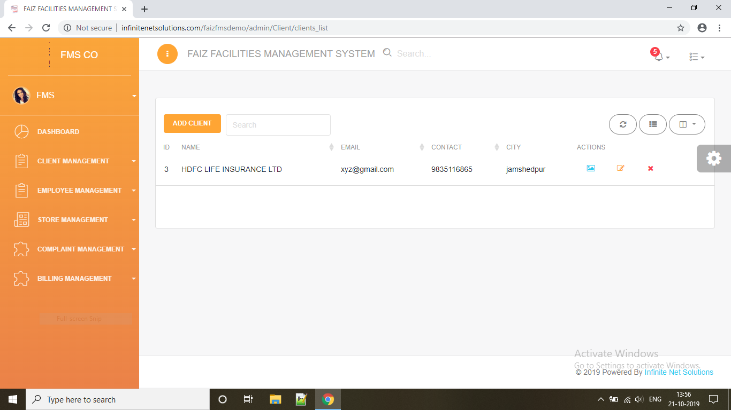
MANAGE CLIENTS

Slide 5
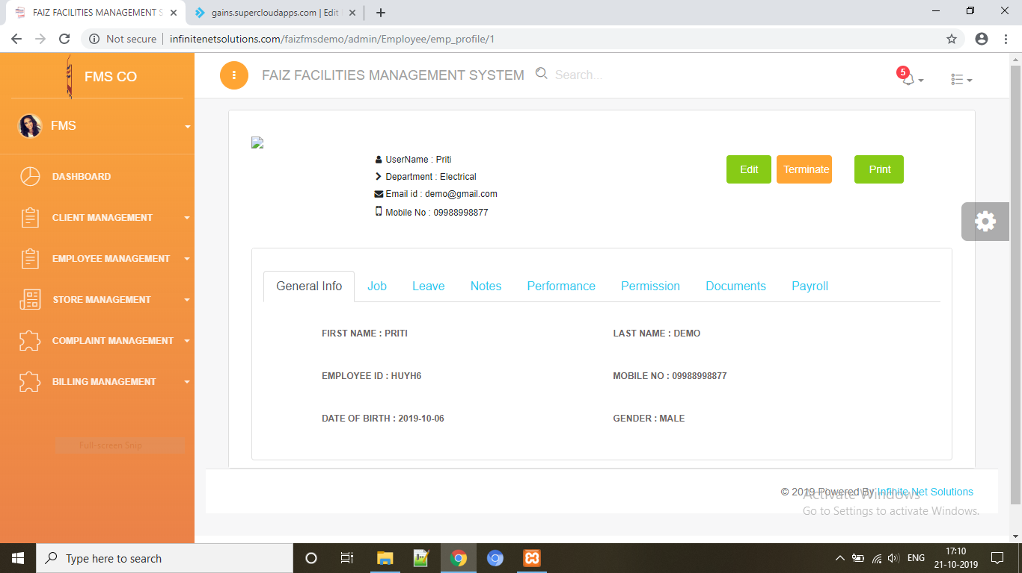
EMPLOYEE PROFILE

Slide 6
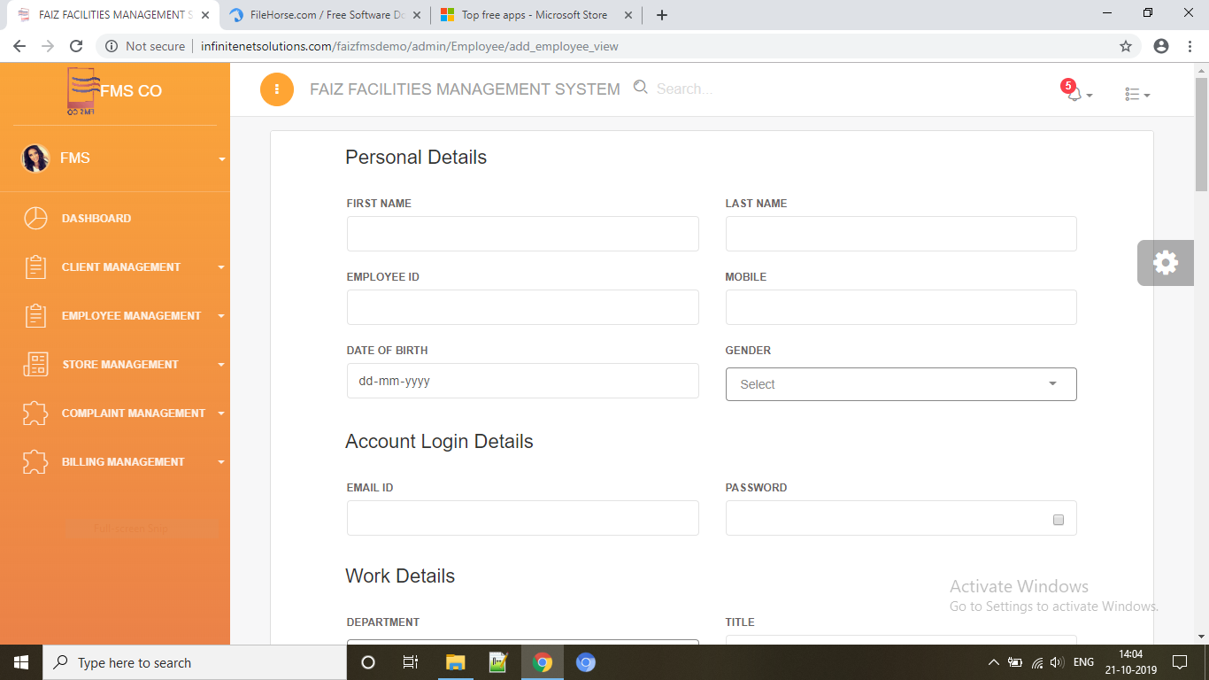
EMPLOYEE MANAGEMENT
ADD EMPLOYEE

Slide 7
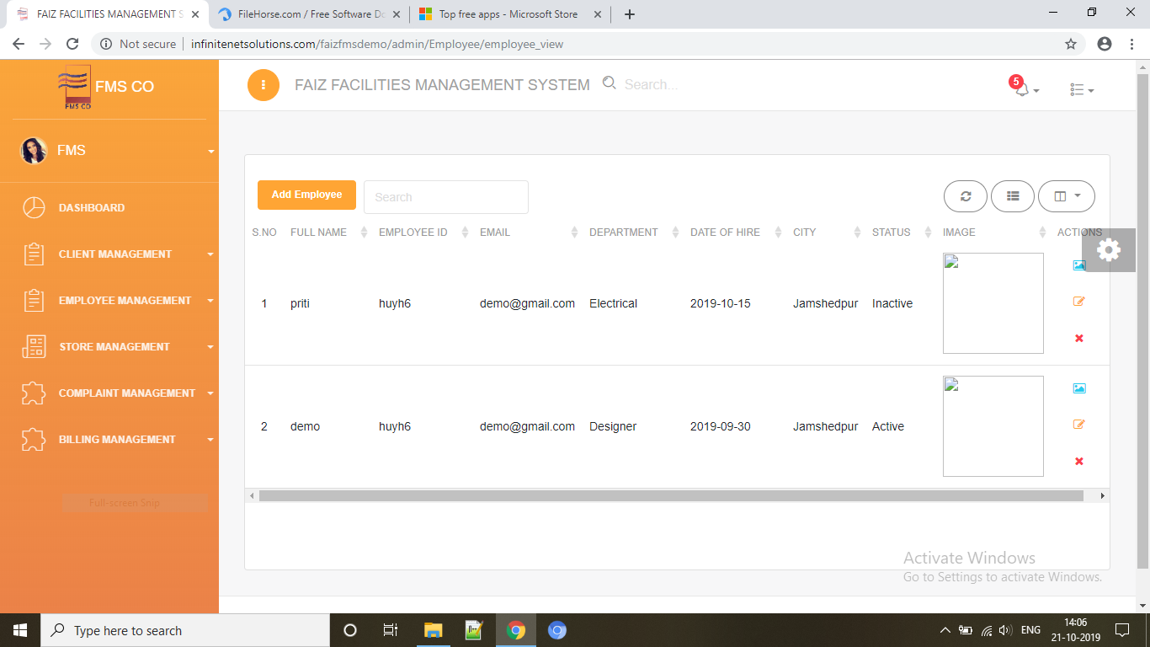
EMPLOYEE LIST

Slide 8
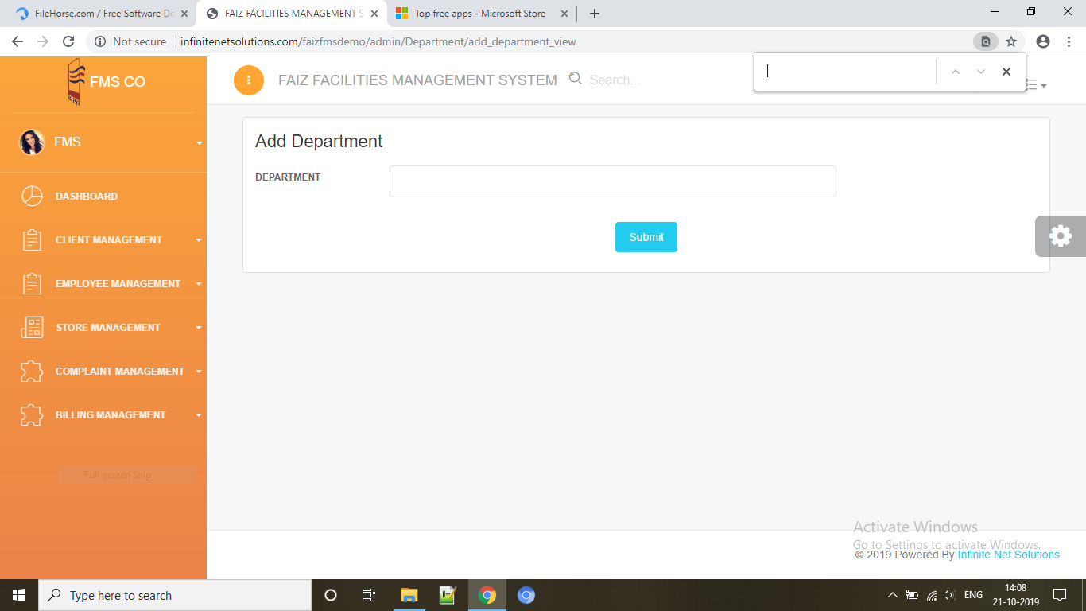
ADD DEPARTMENT

Slide 9
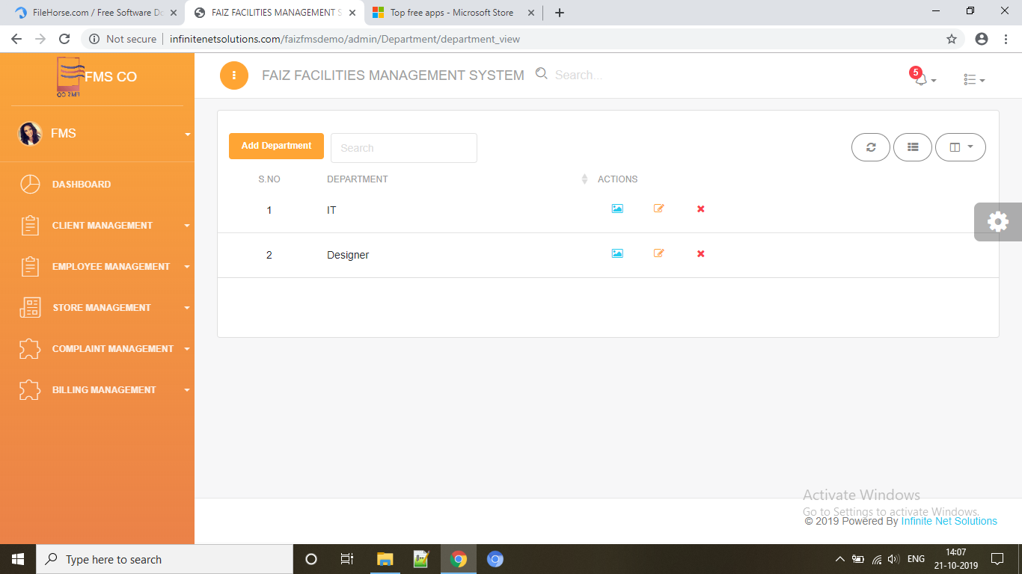
VIEW DEPARTMENT

Slide 10
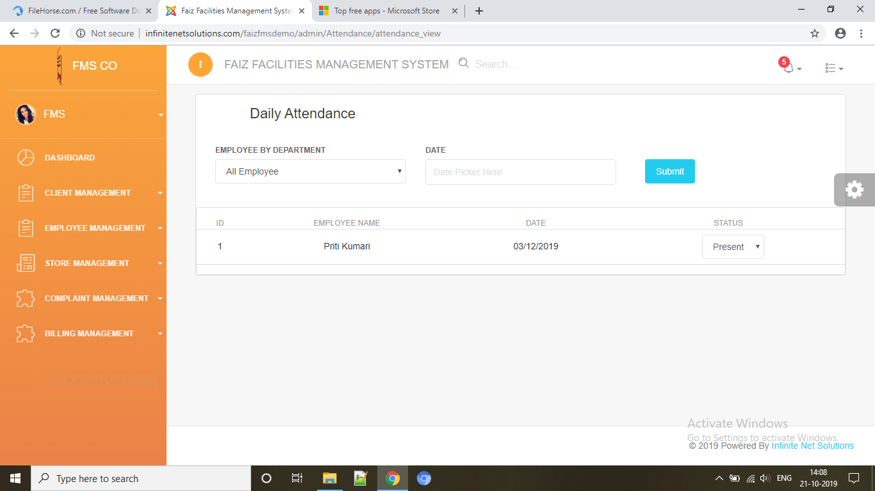
VIEW ATTENDANCE

Slide 11
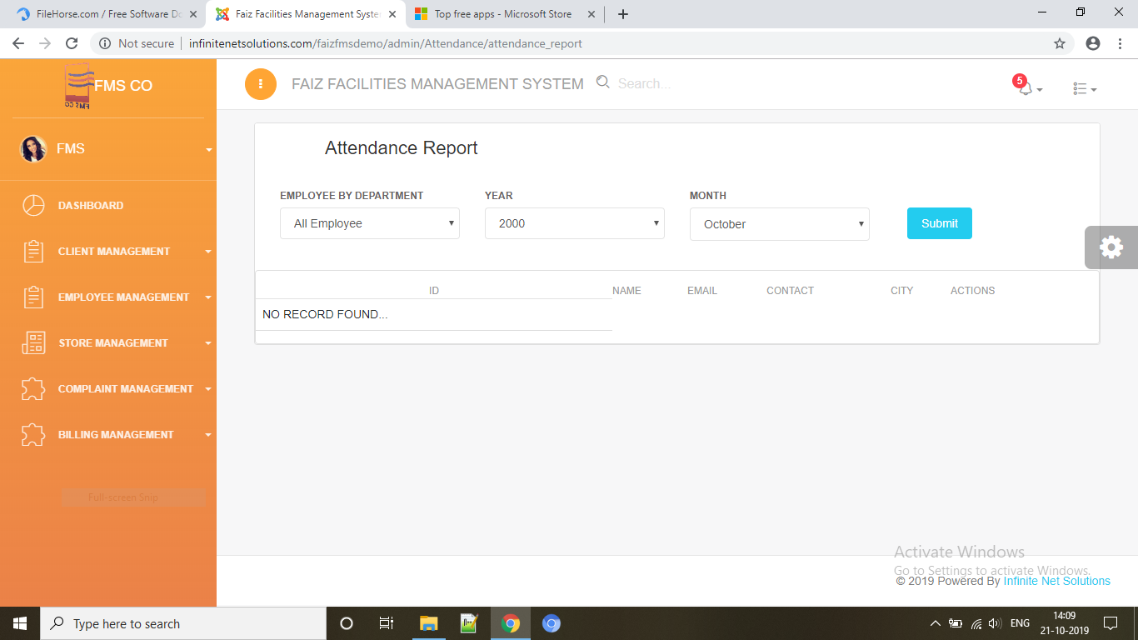
ATTENDANCE REPORT

