Slide 1


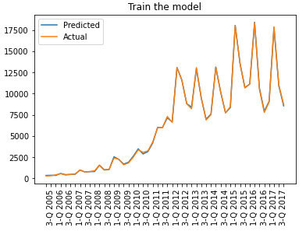
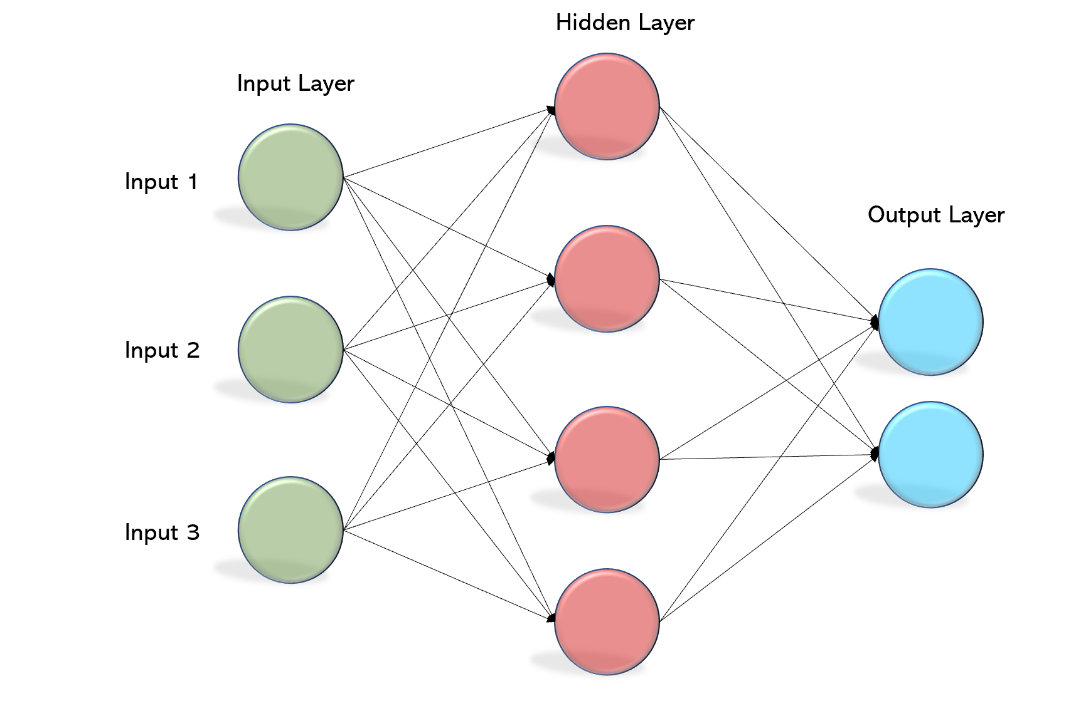
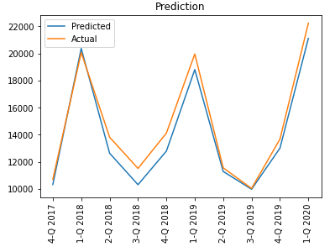
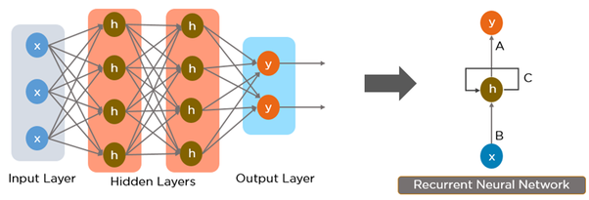
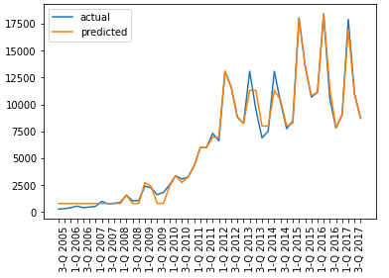
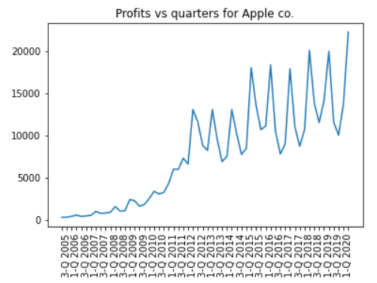
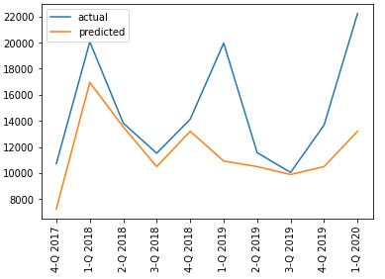
Market Forecasting Using Deep Learning Model
Qianhe Niu, Xinyue Ma, Yufei Wang
INTRODUCTION
EXPERIMENTS AND RESULTS
CONCLUSION
Market forecasting is important for companies since it can guide important decisions such as the prices of new products and new product launch. How to make rational decisions based on the previous information is a necessary part of a company. As machine learning develops rapidly, more and more analyzations about data have been accomplished by machine learning such as Artificial Neural Networks (ANNs). Using neural networks to learn the pattern in the past quarters and make right decisions to improve the revenue and profit of the next quarter.
Trainset: | Data from the first 50 quarters
Testset: | Data from the last 10 quarters
From the results, we can see that when both neural networks have been trained properly, multilayer perceptron has a better prediction than recurrent neural network.
The results also indicates that the profit and revenue of companies do not heavily depend on the profits from the previous quarter but depend on the decisions that the company will make in the next quarter such as whether launches new technologies or new version of devices.
In conclusion, multilayer perceptron neural network is a better choice for forecasting companies’ profits.
Multilayer
Perceptron
Training
Prediction
METHOD
Multilayer
Perceptron
FUTURE WORK
So far, many neural networks have been used in stock price prediction, such as Long Short Term Memory (LSTM) and Convolutional Neural Network (CNN). And for predicting stock prices, CNN is the best choice and both LSTM and RNN have better performances than MLP since stock prices heavily depends on the price of the previous days.
For the future work, we are going to test the performances of more neural networks like LSTM. Since LSTM is a special type RNN, we expect that LSTM will have a similar performance as RNN. Also CNN is another choice for this project. We assume CNN will have the best performance on market profit forecasting, since it did well in stock forecasting and it does not depend on the previous data.
Recurrent Neural Network
Recurrent Neural Network
Training
Prediction
DATASET
Dataset is based on Apple’s financial report
from 2005 to 2019 including 60 quarters.
Features include cost of sales, operating expenses, operating income, net sales by iPhone, net sales by iPad, net sales by Mac, net sales by service, net sales by Wearables, Home and Accessories, if new product comes out (iPhone) , if new product comes out (iPad) , if new product comes out (Mac), if new product comes out (wearables, home and accessories), new revolutional technique.
REFERENCES
Vaisla, K. S., & Bhatt, A. K. (2010). An analysis of the performance of artificial neural network technique for stock market forecasting. International Journal on Computer Science and Engineering, 2(6), 2104-2109.
Hiransha, M., Gopalakrishnan, E. A., Menon, V. K., & Soman, K. P. (2018). NSE stock market prediction using deep-learning models. Procedia computer science, 132, 1351-1362.
[Footer: links, additional logos, QR codes etc., remove box if not needed]

