Slide 1

This Photo by Unknown Author is licensed under CC BY

Slide 2

Real-Time Network Intrusion Detection Using Wireshark and Advanced Ensemble Learning Techniques
Department of Computer Sciences,
Virtual University of Pakistan

Slide 3



Real-Time Network Intrusion Detection Using Wireshark and Advanced Ensemble Learning Techniques
Presented by:
Name: MAHBOOB ALAM
Roll No.: BC210427835
Program: BS (SE)
Group ID: F24PROJECTA686A
Supervisor:
Laraib Sana

Slide 4
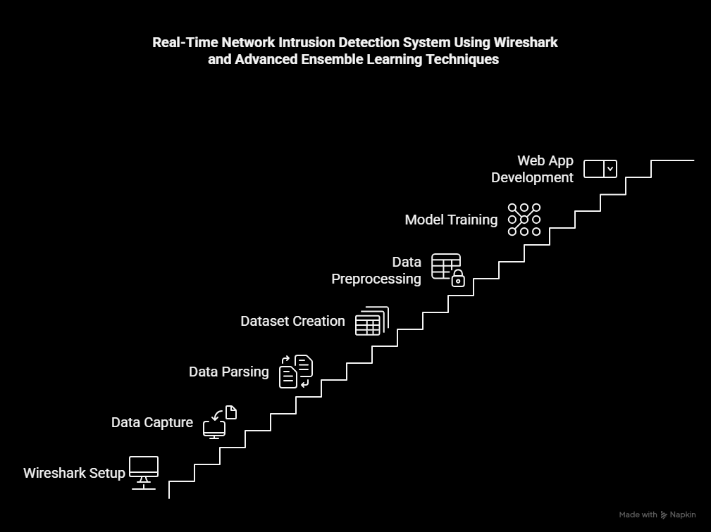
INTRODUCTION
🛡️ Traditional NIDS like Snort, Suricata, and Bro rely heavily on predefined rules or protocol behavior, limiting their ability to detect unknown threats (zero-days) and requiring frequent manual updates.
✔️ My Project introduces a real-time, machine-learning-based NIDS using ensemble models (XGBoost, LightGBM, TabNet). It:
1. Automatically analyzes uploaded PCAP files
2. Detects both known and novel threats
3. Offers a modern Django-based web interface

Slide 5
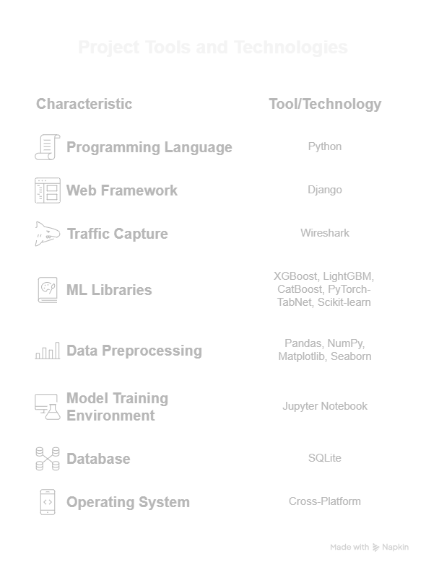
Tools & Technologies

Slide 6
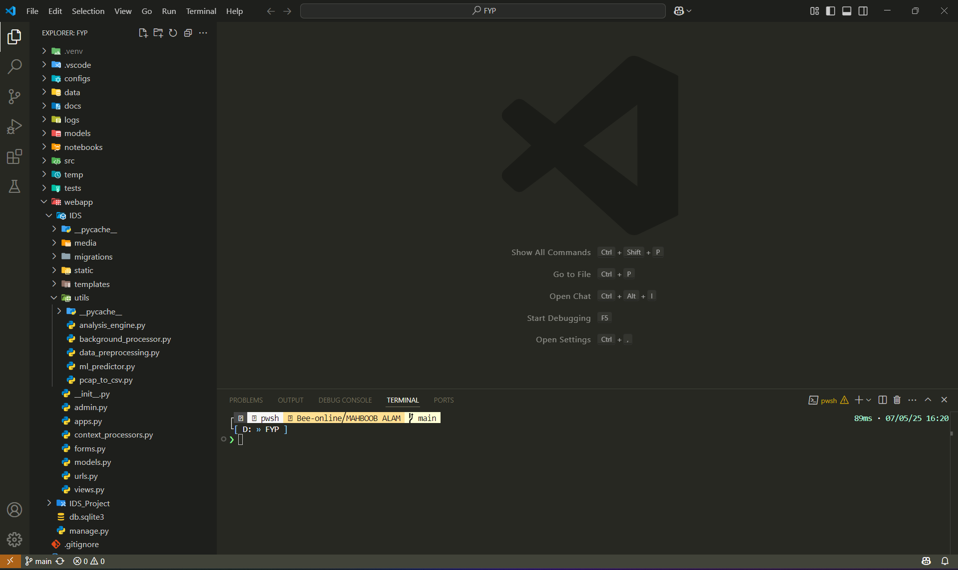
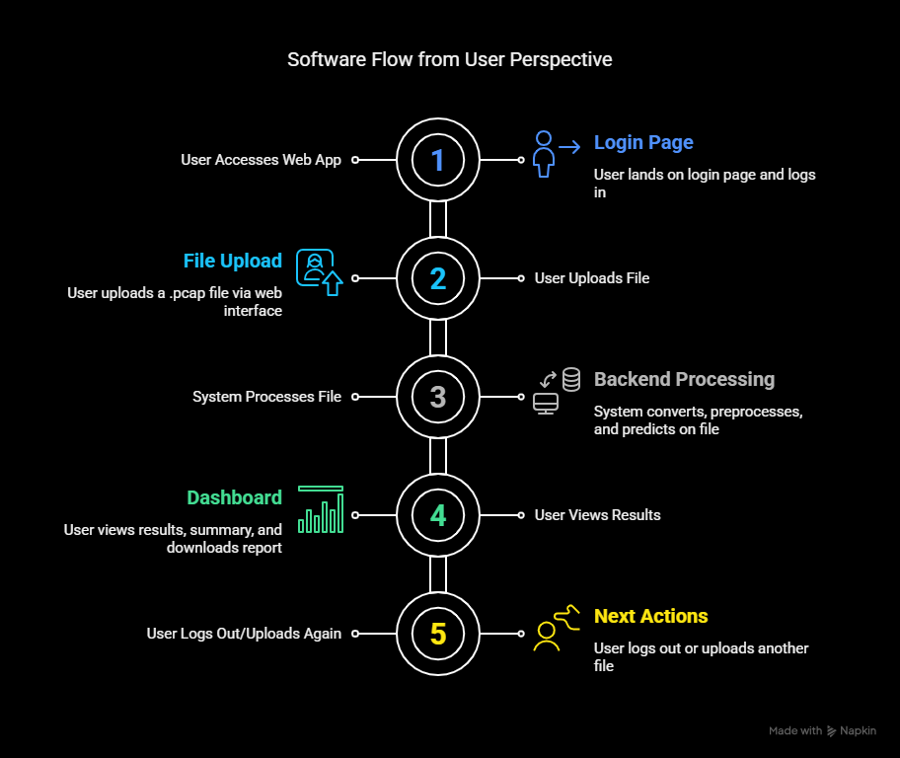
Project Structure

Slide 7
FUNCTIONAL REQUIREMENTS
FR1. The system must enable users to upload network traffic capture files in .pcap or .pcapng format through a secure web interface for subsequent analysis.
FR2. Upon upload, the system must automatically parse .pcap files into a structured dataset (e.g., CSV format) using tools such as tshark or PyShark, facilitating further data processing.
FR3. The parsed data must undergo preprocessing to ensure quality and consistency. This includes cleaning missing or invalid entries, encoding categorical variables (e.g., protocol types), and normalizing numerical features such as packet sizes and time intervals.
FR4. The system must support the generation of labeled datasets, classifying network traffic as either “normal” or “malicious” to facilitate supervised machine learning.

Slide 8
FUNCTIONAL REQUIREMENTS
FR5. The system must integrate ensemble learning models—including TabNet, CatBoost, XGBoost and LightGBM—to perform intrusion detection based on the preprocessed data.
FR6. The machine learning models must be evaluated using standard performance metrics such as accuracy, precision, recall, F1-score, and ROC-AUC to validate their effectiveness.
FR7. A Django-based web application must be implemented, providing an interactive platform for users to upload files, view analysis results, and monitor system status.

Slide 9
FUNCTIONAL REQUIREMENTS
FR8. The system must present the analysis outcomes clearly, including traffic classification (normal/malicious), intrusion likelihood scores, affected IP addresses, involved protocols, and visual representations of traffic patterns.
FR9. The system must incorporate robust error-handling measures to detect invalid or unsupported files and provide informative feedback to users.

Slide 10
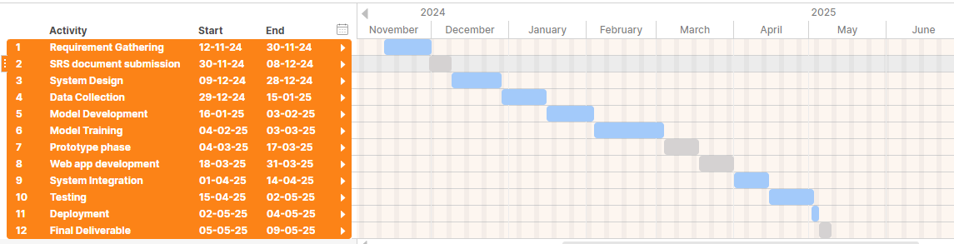
Project Schedule

Slide 11
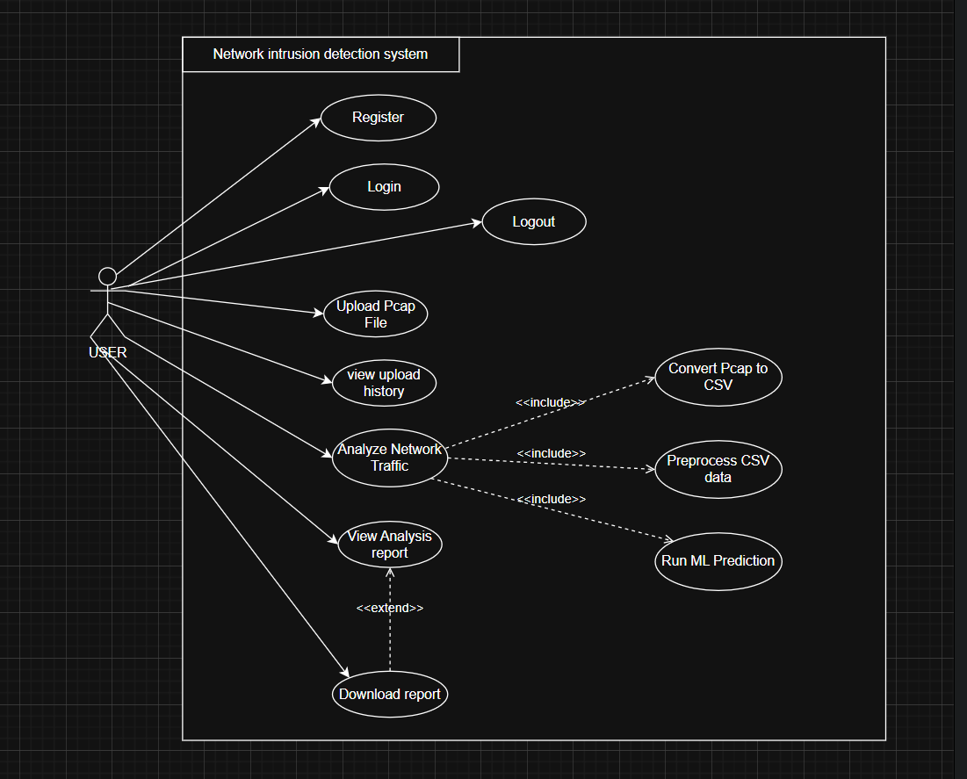
USE CASE DIAGRAM

Slide 12
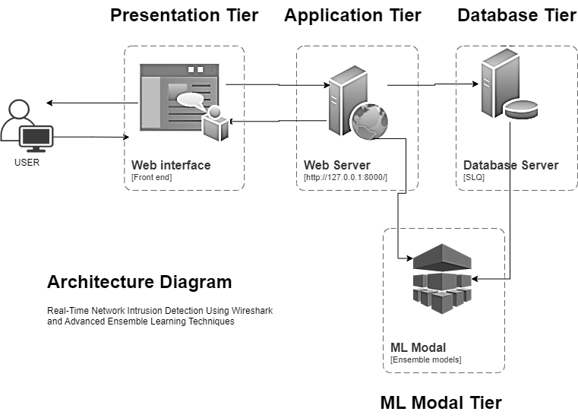
Architecture Design

Slide 13
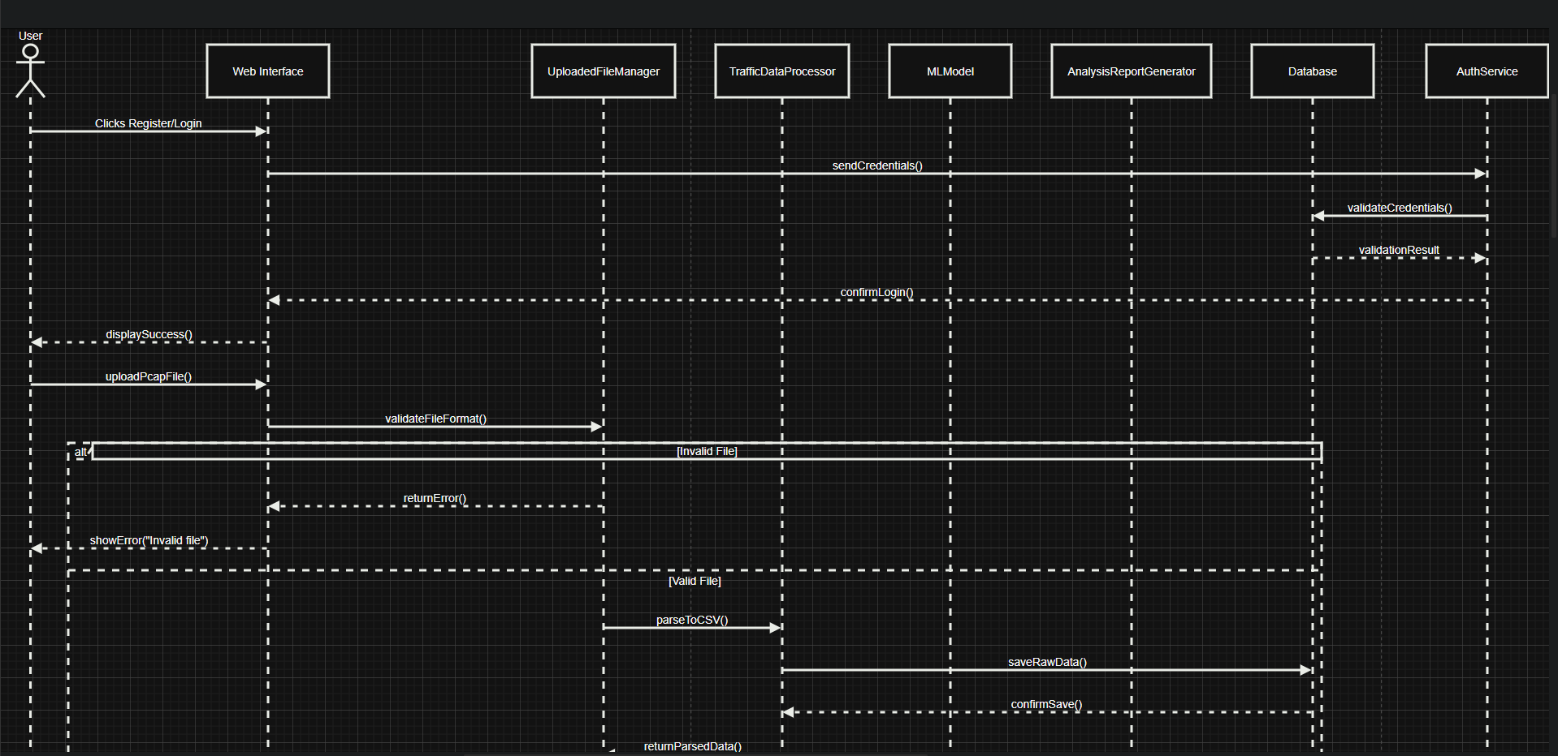
Sequence Diagram

Slide 14
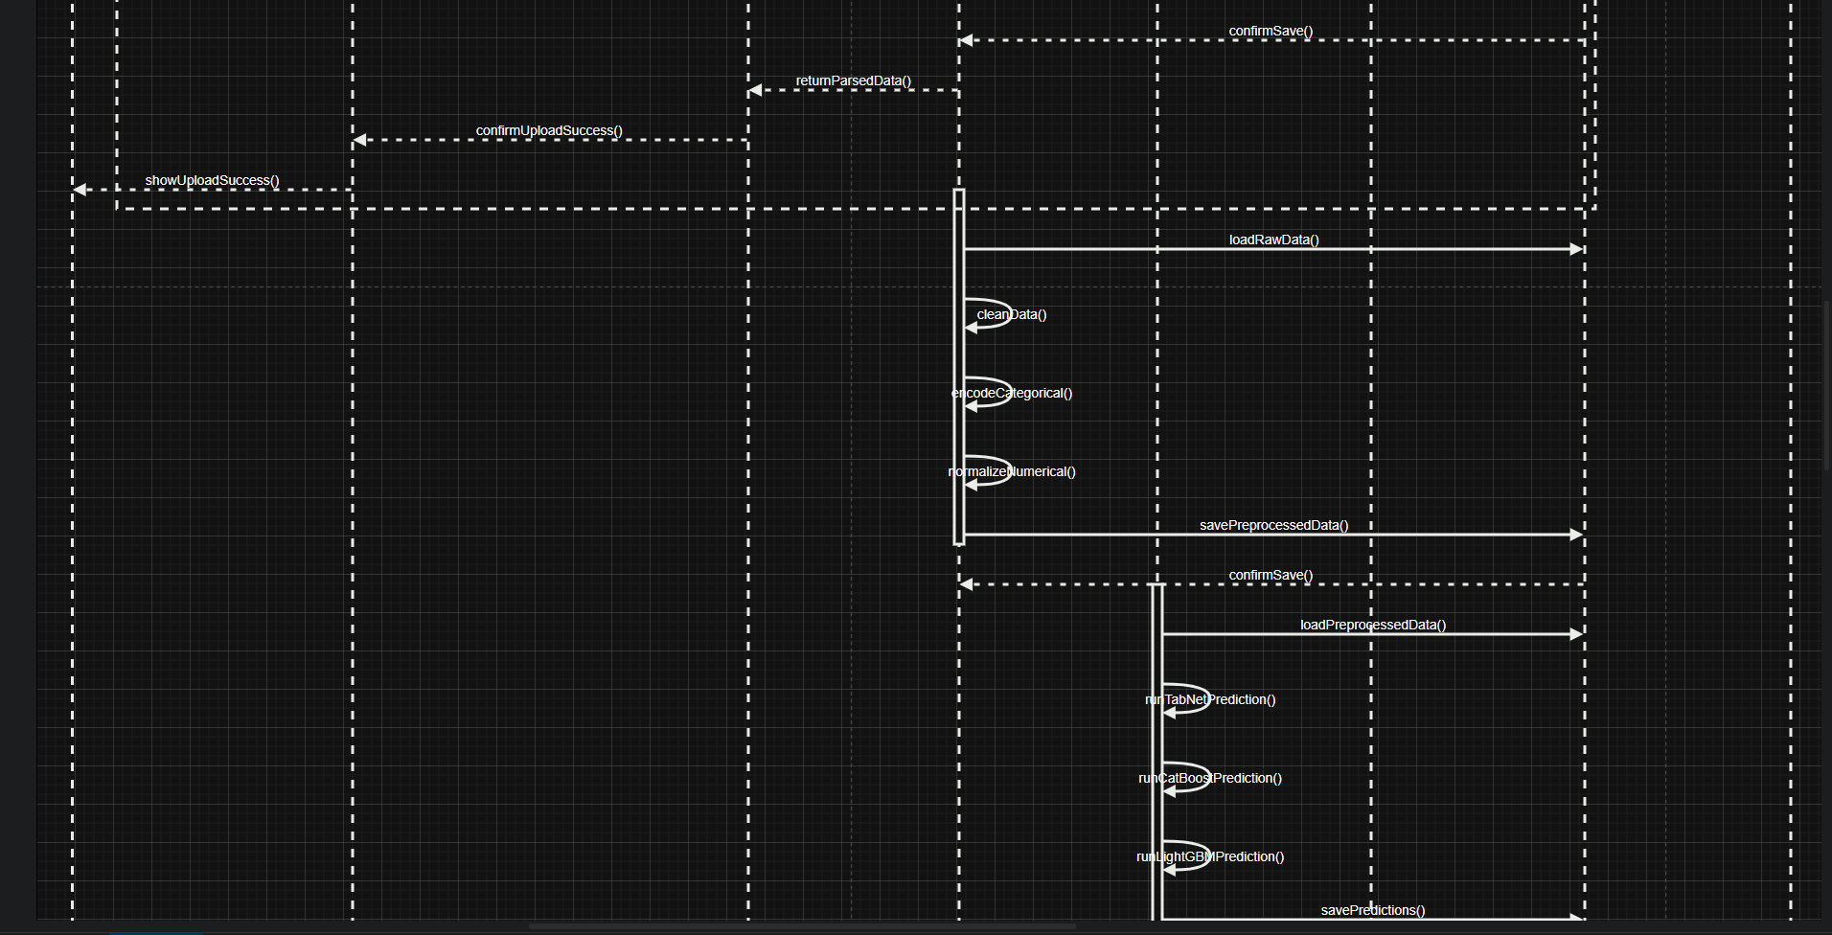
Sequence Diagram

Slide 15
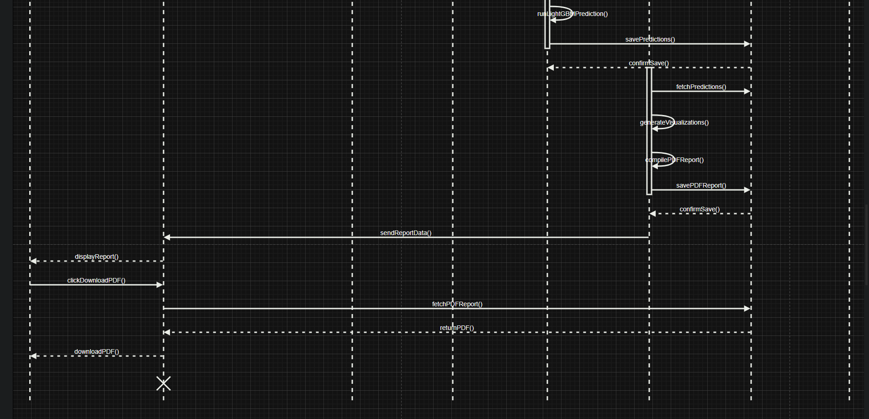
Sequence Diagram

Slide 16
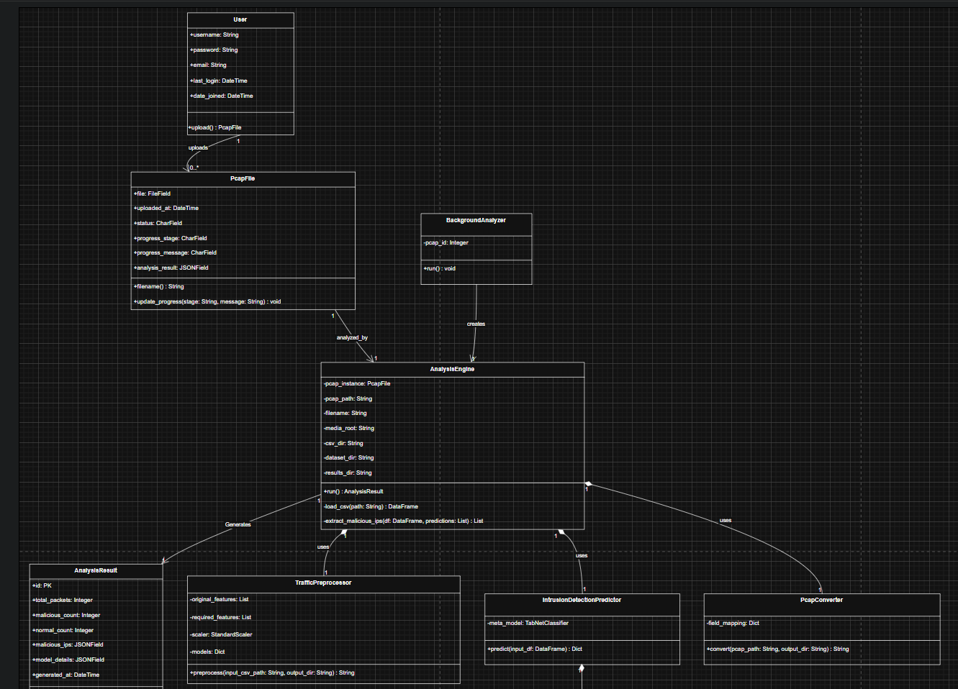
Class Diagram

Slide 17
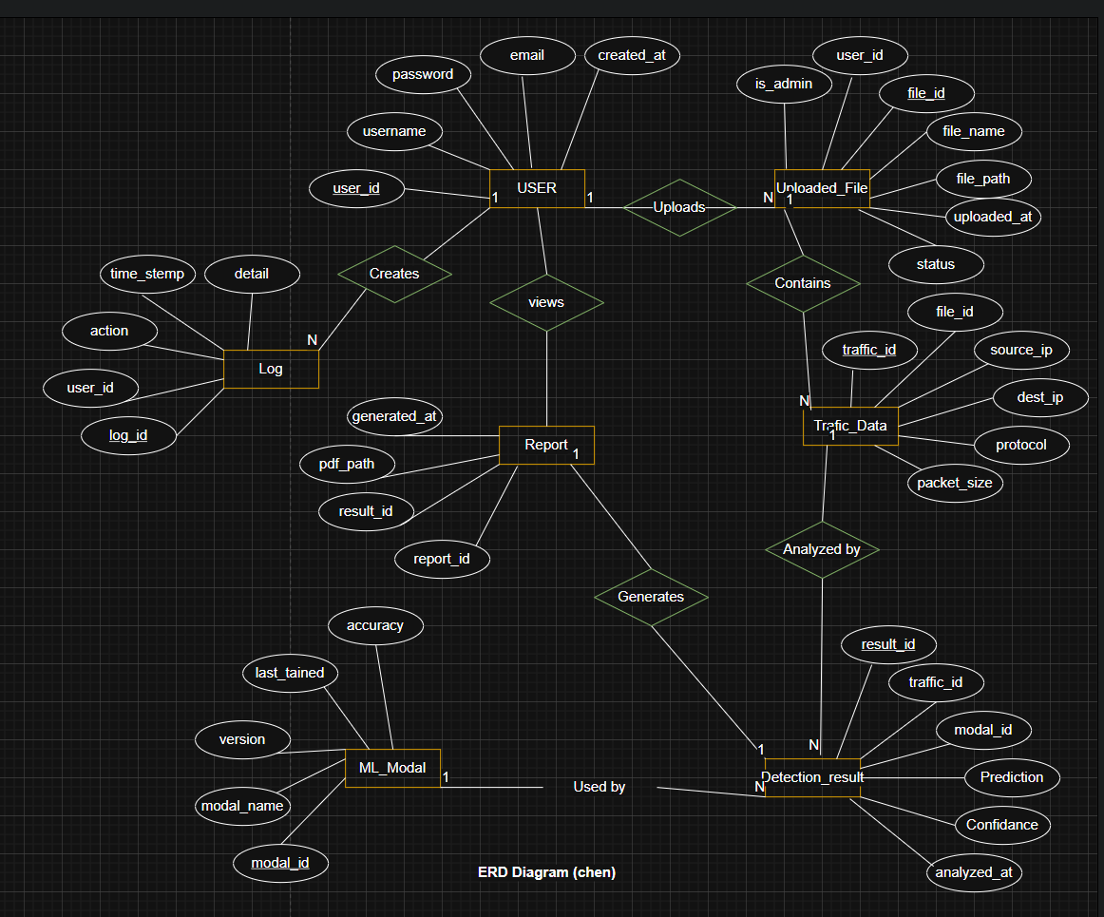
Entity-Relationship Diagram

Slide 18
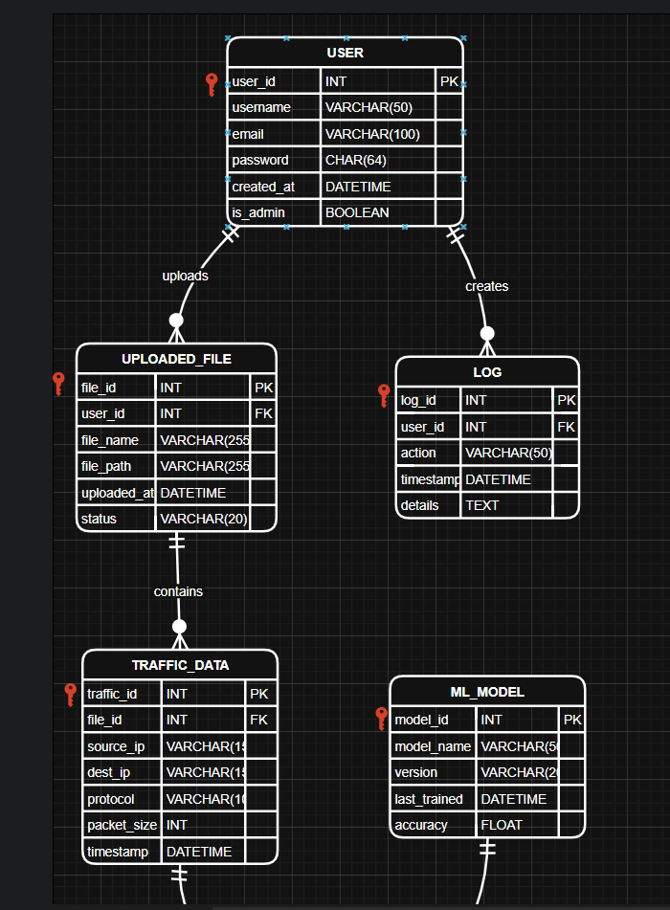
Database Diagram

Slide 19
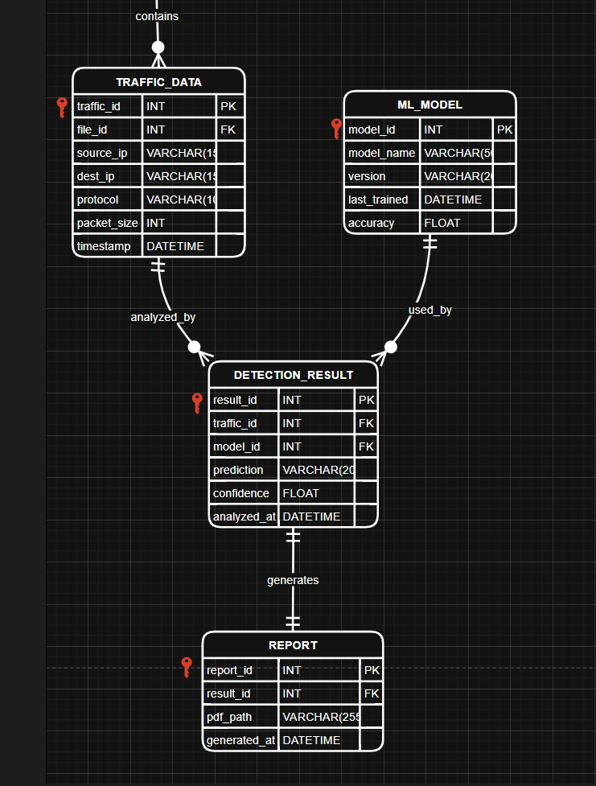
Database Diagram

Slide 20
USER INTERFACE IMAGES

Slide 21
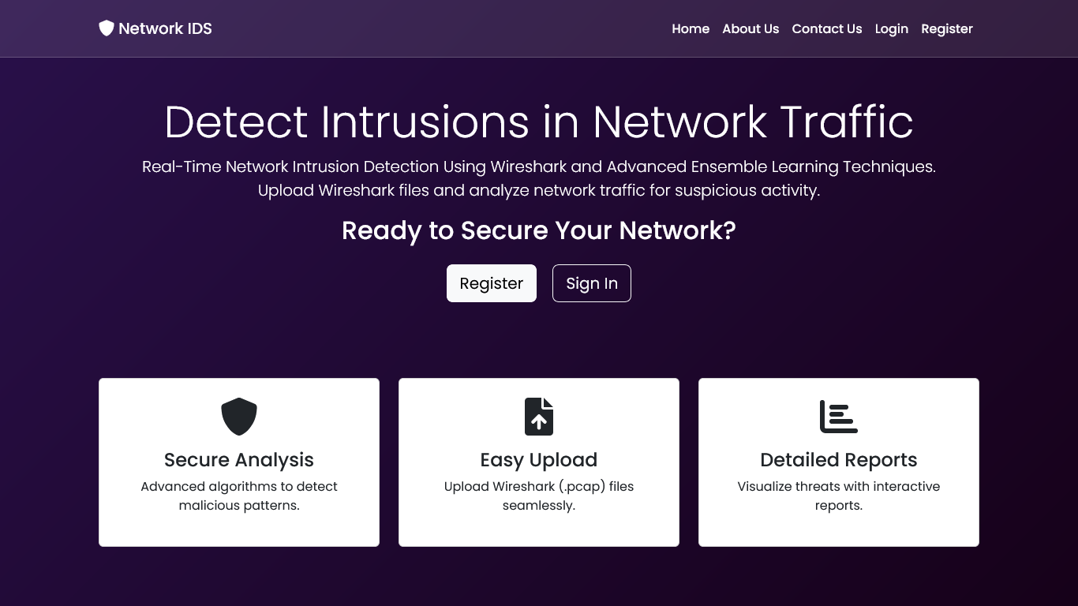

Slide 22
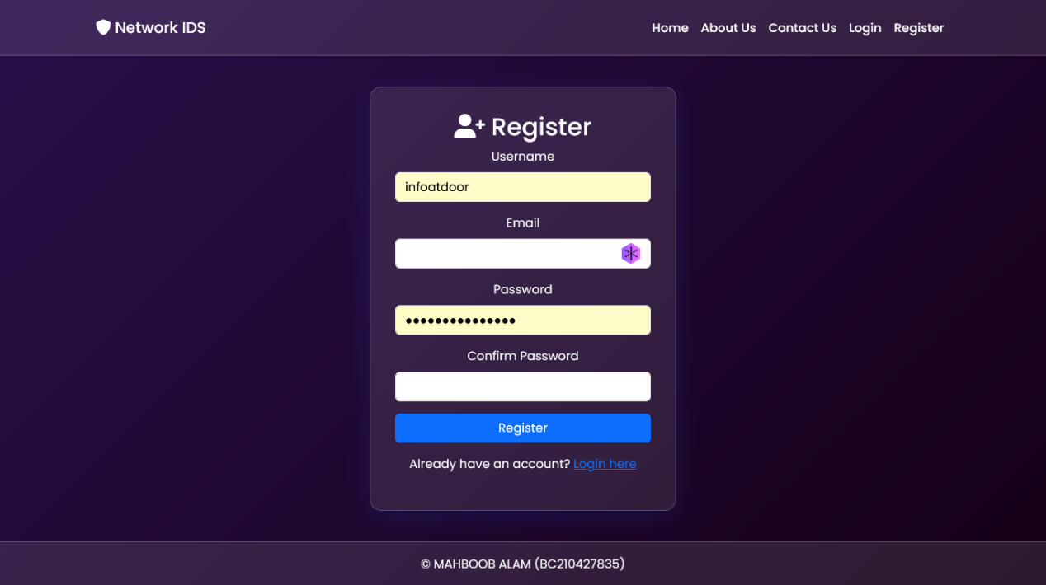

Slide 23
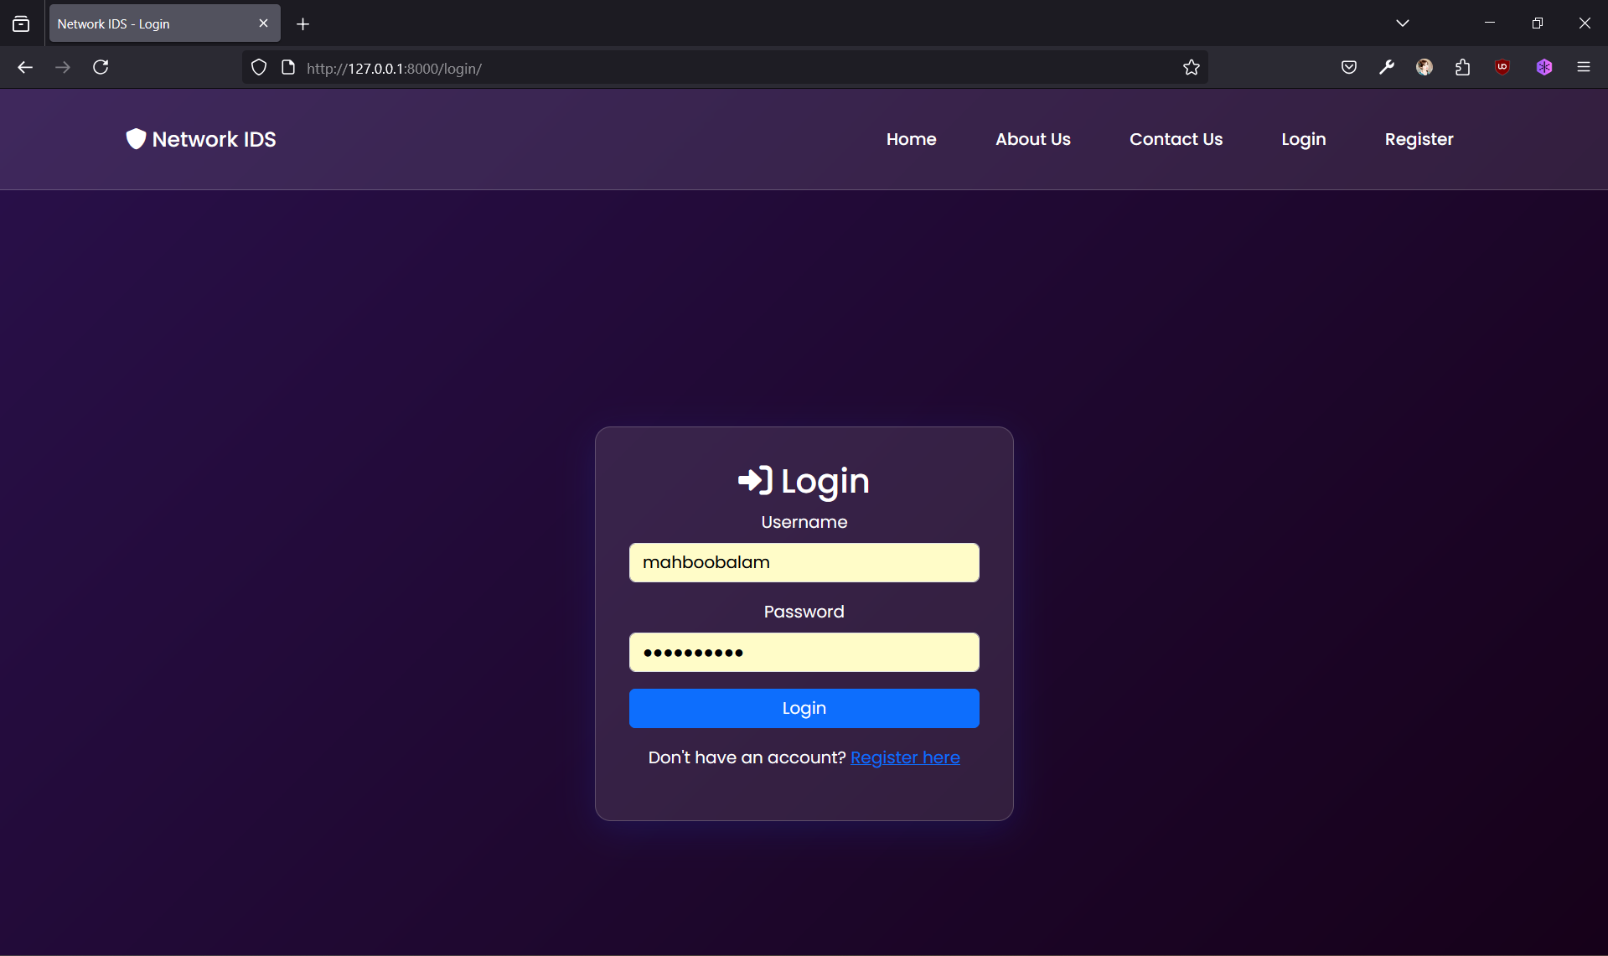

Slide 24
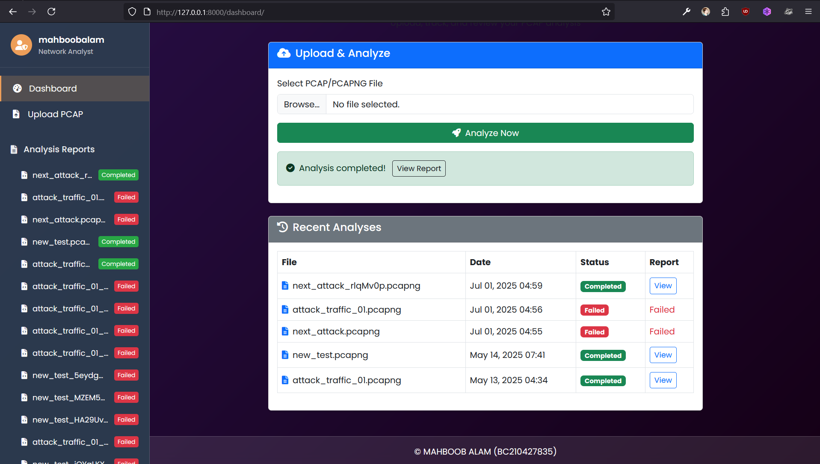

Slide 25
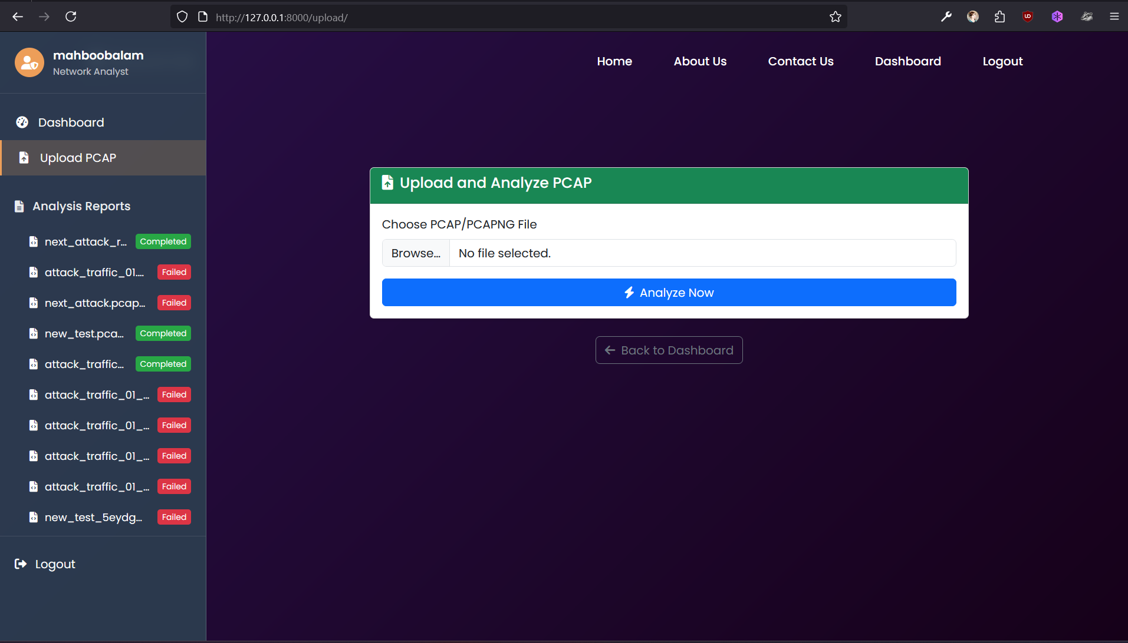

Slide 26

THANK YOU

Slide 27



ANY QUESTION?

