Slide 1
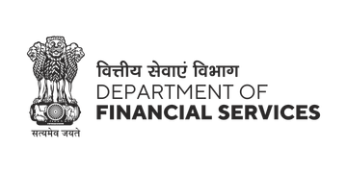
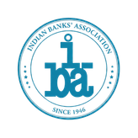



PSBs Hackathon Series 2026
(An Initiative of Government of India, Ministry of Finance , Department of Financial Services)
PRESENTS

Slide 2

PROBLEM STATEMENT & TEAM DETAILS
TEAM NAME (AS SUBMITTED ON PORTAL) |  | Bhadra
PROBLEM STATEMENT TITLE |  | Tracking of Funds within Bank for Fraud Detection
 | NAME | GENDER | AREA OF EXPERTISE
Member 1 | Anant Asati | Male | Agentic AI
Member 2 | Prashant Gautam | Male | Graphs and ML
Member 3 | Yash Kumar Maru | Male | Web Development
Member 4 | Satyadev Suvesh | Male | Agentic AI

Slide 3

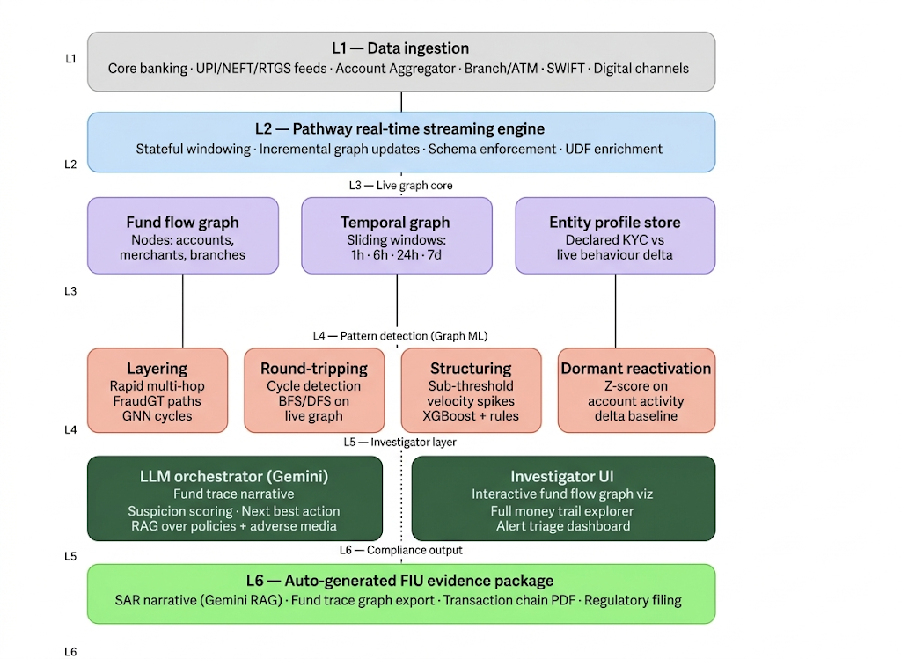
Rudra — Shield Against Deception
Rudra solves the problem of delayed fraud detection by tracking fund flows in real time using a live transaction graph, enabling instant detection of complex patterns like layering and round-tripping instead of next-day batch analysis. Combined with graph ML and an LLM copilot, it provides immediate traceability, automated investigation, and compliance-ready reports—cutting detection time from days to seconds.
Proposed Solution
System Architecture
Streaming-native fund flow graph on Pathway — tracks every rupee across accounts, branches, products & channels with <200ms end-to-end latency
5 parallel Graph ML detectors: Layering - Round-tripping - Structuring - Dormant account reactivation - KYC-profile mismatch
LLM assisted copilot helps investigators trace complex fund flows and generate compliant reports in seconds, reducing investigation time from days to minutes
Auto-generated FIU evidence package: SAR narrative, subgraph export, transaction chain PDF + PMLA section citations
Innovation & Uniqueness
Live heterogeneous graph updated per-transaction vs. overnight batch snapshots — fraud rings blocked in milliseconds, not next morning
FraudGT + BDH model ensemble combines graph-theoretic cycle enumeration with GNN scoring
Tool-calling LLM agent compresses investigation from days to seconds; produces fully auditable FIU-ready evidence autonomously

Slide 4
OUTLINE OF UNIQUE & INNOVAITVE SOLUTION
1
Live Heterogeneous Graph
2
5-Pattern Parallel Detector
3
LLM Investigator Copilot
vs. overnight batch snapshots
Graph ML + heuristic ensemble
Natural language fund tracing
Pathway streaming engine updates the fund flow graph on every transaction. Fraud rings detected at 10:00 AM are blocked by 10:00:01 AM — not the next business day. Nodes: accounts, merchants, branches. Edges carry amount, timestamp, channel, and branch metadata.
Five specialised detectors run in parallel on the live graph — Layering (FraudGT path scoring), Round-tripping (Johnson's cycle enumeration), Structuring (sliding-window threshold analysis), Dormant activation (Z-score spike), Profile mismatch (LLM reasoning over KYC delta).
LLM with tool-calling over the live graph answers investigator queries in plain language. Tools: trace_funds(), find_cycles(), explain_alert(), get_profile_delta(). Compresses investigation from days to seconds with a full reasoning audit trail.
✗ Usual: T-1 batch snapshot
✗ Usual: 1 generic rule engine
✗ Usual: Manual case reconstruction
✓ Rudra : <200ms incremental
✓ Rudra : 5 targeted detectors
✓ Rudra : Seconds with LLM copilot
4
FraudGT + BDH Ensemble
5
DPI-Native Architecture
6
Auto FIU Evidence Package
7
Unified White-Space Layer
Graph Transformer (FraudGT) detects structural anomalies — cyclic payments, chain depth, motif patterns — on the IBM AML-HI-Large dataset (2.1M nodes, 180M txns). BDH model generates human-readable fraud reasons forwarded to the LLM for SAR drafting.
Explicitly built for India's Digital Public Infrastructure. Leverages Account Aggregator (AA) framework for consent-based real-time financial data ingestion. Aligns with RBI Real-time FRM mandate and DPDP Act 2023 data minimisation principles.
When a pattern is confirmed, the system autonomously generates: SAR narrative (Gemini RAG over ChromaDB), fund trace subgraph export, full transaction chain PDF, and regulatory filing citations — eliminating manual SAR drafting entirely.
Eliminates the 'spaghetti stack' of disconnected KYC, fraud, and credit vendors. A single shared middleware where a mule pattern from the fraud module immediately influences credit underwriting and KYC status — all in one real-time state.
F1: 0.72
vs. 0.42 XGBoost
PMLA
Auto section citations
<5s
Full package generation
3-in-1
KYC + Fraud + Credit unified

Slide 5
TECHNICAL APPROACH
Streaming Engine
Graph ML
LLM / AI
Backend / API
Data & Compliance
Pathway
PyTorch Geometric
Open AI
FastAPI (Python)
Account Aggregator AA
Kafka / NATS
FraudGT (Graph Transformer)
ChromaDB (RAG)
PostgreSQL / AWS RDS
DiliSense API (KYC)
Apache Flink
BDH Model
Qwen (local explainer)
SQLite audit DB
IBM AML-HI-Large
XGBoost
all-MiniLM-L6-v2
AWS (deployment)
GDELT (adverse media)
Methodology & Implementation Pipeline
Core banking · UPI · AA
PyTorch Geometric
Pathway sliding windows
FraudGT · BDH · XGBoost
Gemini 2.0 Flash + RAG
SAR · PDF · Regulatory
1
2
3
4
5
6
Ingest
Build Graph
Feature Eng.
Detect
LLM Reason
FIU Package
Pathway connectors
PyG HeteroData
Windowed aggs
5 pattern detectors
Gemini copilot
SAR + graph export
Kafka / AA streams
Nodes + edges live
1h / 6h / 24h / 7d
FraudGT + BDH
Trace + explain
PMLA citations
<200ms end-to-end latency · Pathway stateful streaming
FraudGT Graph Transformer · F1: 0.72 on IBM AML-HI-Large (180M txns)
To be deployed on AWS · FastAPI backend · React + Vite dashboard
<200ms
F1: 0.72
6-step
Auto SAR
Detection latency
IBM AML benchmark
End-to-end pipeline
FIU evidence in <5s

Slide 6
FEASIBILITY & VIABILITY
Proven Performance
Challenges & Mitigations
Regulatory Alignment
Tested on IBM AMLSim (large-scale AML benchmark)
Large-scale graphs → Incremental updates (Medium)
RBI fraud risk management guidelines
Graph-based methods outperform traditional models
Data privacy → DPDP principles, minimal usage (Medium)
PMLA reporting requirements
Designed for <2s detection latency
New users → 70+ rule-based cold-start checks (Low)
DPDP Act 2023 compliance
vs T+1 next-day batch systems at most banks
Model drift → 30-day retraining + feedback loop (Low)
Deployable on standard AWS cloud infrastructure
Risk Classification & Mitigation Strategy
1
2
3
4
Large-Scale
Transaction Graphs
Real-Time Data
Consent & Privacy
New Users
No History
Model Accuracy
Over Time
MEDIUM RISK
MEDIUM RISK
LOW RISK
LOW RISK
Incremental updates
data split by account groups
DPDP principles
minimal data + sensitive filtering
70+ rule-based checks for cold-start scenarios
30-day retraining cycle
with investigator feedback

Slide 7
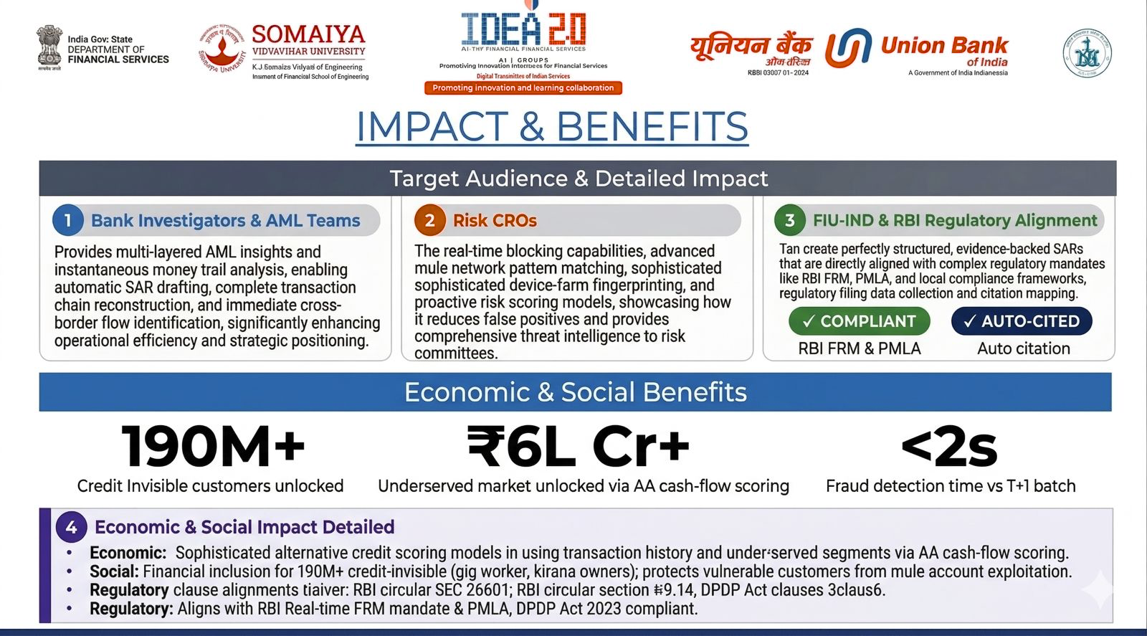
<200ms

Slide 8



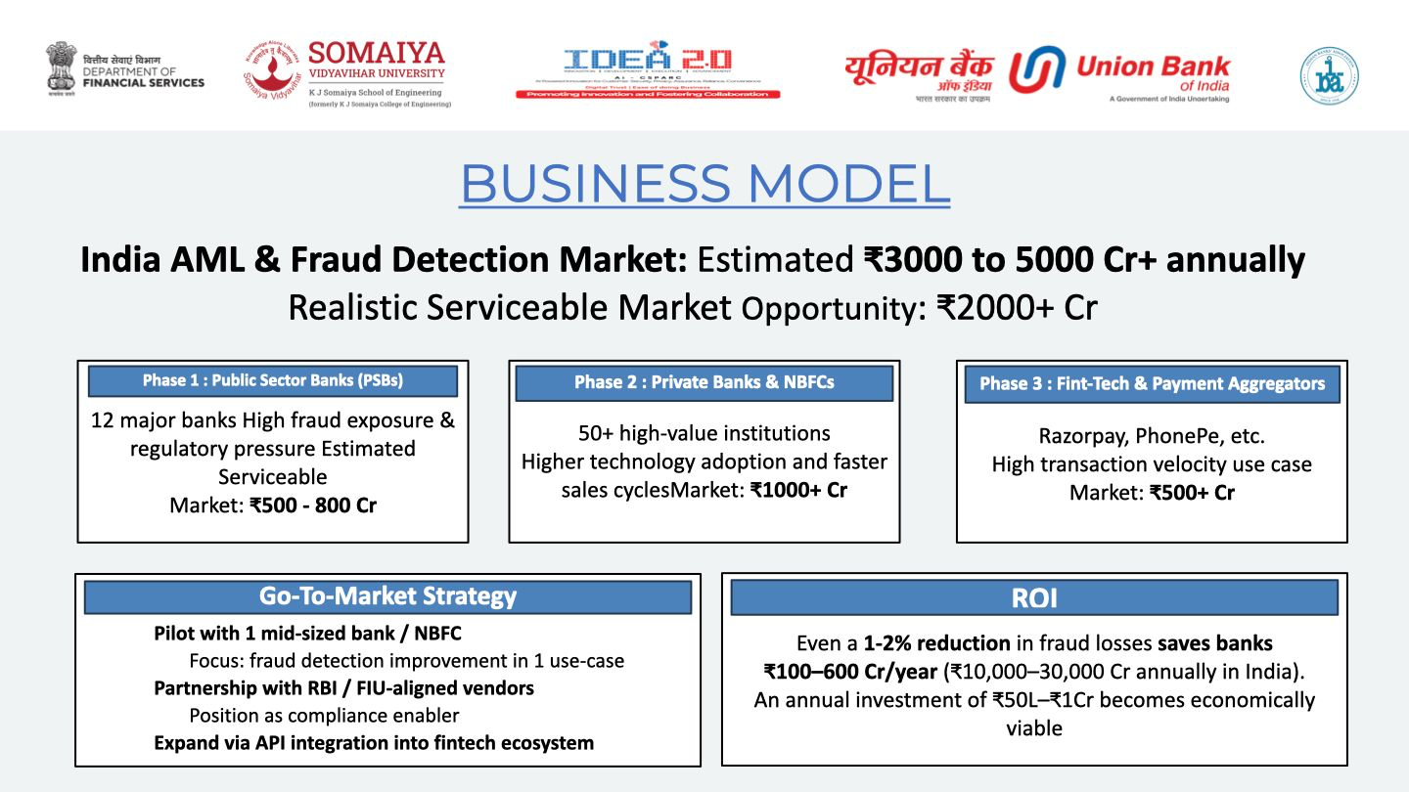

Slide 9
RESEARCH & REFERENCES
One-page summary PDF: https://drive.google.com/file/d/1bZRwidHAtManqokLAnIr4I55p5bti7jY/view
[1] Lin, J. et al. (2024). FraudGT: A Simple, Effective, and Efficient Graph Transformer for Financial Fraud Detection. ACM ICAIF 2024, pp. 292–300.
[2] Lopez-Rojas, E.A. & Axelsson, S. (2014). BankSim: A Bank Payment Simulation for Fraud Detection Research. ECMS 2014.
[3] Kosowski, A. et al. (2025). The Dragon Hatchling: The Missing Link Between the Transformer and Models of the Brain. arXiv preprint.
[4] IBM AML Anti-Money Laundering Dataset (AML-HI-Large): 2.1M nodes, ~180M transactions. IBM Research, 2023.
[5] RBI (2023). Framework for Real-time Fraud Risk Monitoring (FRM).
[6] MeitY (2023). Digital Personal Data Protection Act 2023.
[7] Account Aggregator Framework, RBI / Sahamati, 2016 (amended 2021).

