Slide 1
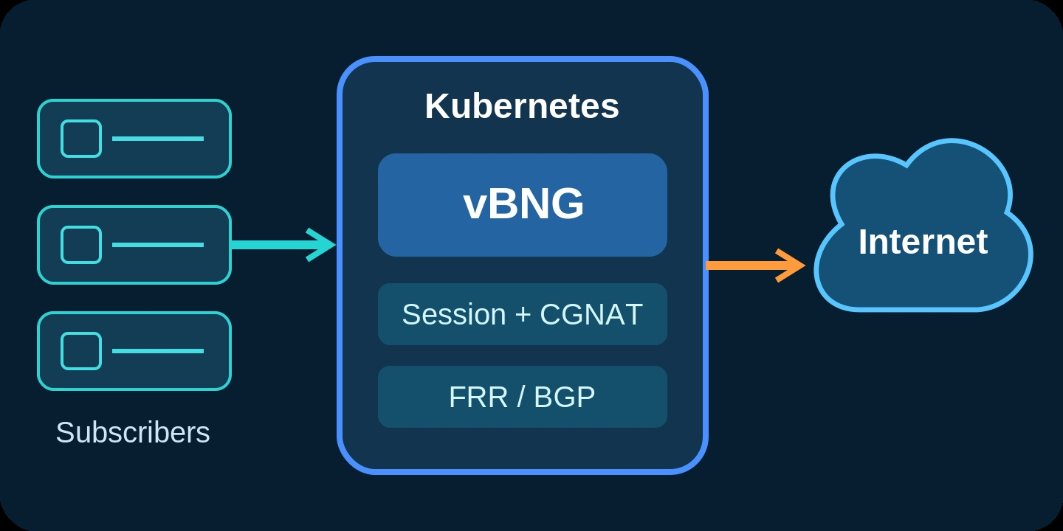
Cloud-Native
Broadband Edge
Deploying a High-Performance vBNG on Kubernetes
An overview of architecture, routing integration, and operational design.
KUBERNETES
DPDK / VPP
HELM
Presented by Christopher Adigun • October 2026
01
Notes:
[0:00–0:20 · 20s] Ask the question this talk answers: can Kubernetes run a broadband edge function and still forward subscriber traffic at line rate, with normal routing behaviour? In ten minutes: what a BNG does, how I built one on Kubernetes, what the lab proved, and how to take it to production.

Slide 2




SPEAKER INTRODUCTION
Christopher Adigun
Cloud-Native AI & Telecom Architect
AREAS OF FOCUS
Cloud-native AI Infrastructure Design
Scalable platforms for AI inference, agentic workloads & orchestration
Cloud-native telecom platforms
Scalable infrastructure for edge & core network services
Kubernetes data-plane design
Deterministic packet I/O and high-performance routing
Perspective
Passionate about AI infrastructure and telecommunications architecture, with a focus on cloud-native design, scalable systems, and intelligent automation.
Disclaimer
The views expressed in this presentation are my own and do not represent those of my employer.
02
Notes:
[0:20–0:50 · 30s] One sentence on who you are: cloud-native AI and telecom architect, focused on telecom platforms and Kubernetes data planes. Read the disclaimer: these views are my own and not my employer's. Move on quickly.

Slide 3
01 • THE ROLE
The BNG is the subscriber edge control point
It joins subscriber access, policy, addressing, routing, and internet reachability.
1
2
3
4
Session control
Policy + AAA
Traffic services
Core routing
IPoE / DHCP sessions
subscriber lifecycle
RADIUS-backed identity
and service policy
CGNAT, QoS, counters
and forwarding
BGP reachability
toward the ISP edge
Key design question
How can Kubernetes serve as a cloud-native platform for deploying, orchestrating, and managing a BNG while meeting carrier-grade networking and performance requirements?
Source: veesix-networks/osvbng project overview and feature list.
03
Notes:
[0:50–1:50 · 60s] The BNG is where a subscriber meets the ISP: it starts the session, checks identity and policy through RADIUS, hands out addresses, runs CGNAT and QoS, and advertises routes to the core. Kubernetes doesn't change any of that. It changes how the function is packaged, placed, upgraded and observed. Land the key design question.

Slide 4
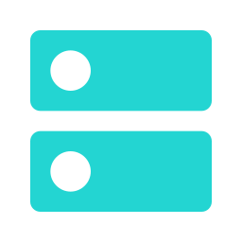
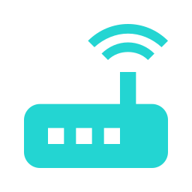


02 • THE SOFTWARE
OSVBNG: an open-source virtual BNG
A Go control plane combined with VPP, FRR, and DPDK on commodity x86 servers.
Why OSVBNG
Runtime Stack Architecture
Standard x86 Hardware
Open-source BNG optimized for commodity x86 servers
OSVBNG Control Plane (Go)
Subscriber lifecycle management, dynamic configuration, and management APIs
Flexible Subscriber Access
Full support for IPoE and PPPoE subscriber access
Comprehensive Telecom Suite
CGNAT, dynamic routing, AAA, QoS, and monitoring
VPP + DPDK Data Plane
High-speed packet processing engine and direct hardware/NIC access
Cloud-Native Workflows
Containerized deployment with declarative configuration
REST & gRPC APIs
Northbound control & management APIs
FRR Routing
Integrated routing protocol suite
Prometheus Metrics
Real-time operational telemetry
Project: github.com/veesix-networks/osvbng
04
Notes:
[1:50–2:50 · 60s] The software is OSVBNG, an open-source BNG from veesix-networks. A Go control plane manages subscribers; VPP with DPDK forwards packets; FRR handles routing. It supports IPoE and PPPoE, CGNAT, AAA, QoS and Prometheus metrics. My work packages it as a Kubernetes StatefulSet with Helm. Source: github.com/veesix-networks/osvbng

Slide 5
03 • THE DESIGN
One cluster, dedicated data-plane NICs
Management uses the normal pod network. Subscriber and core traffic run on two VFIO-bound NICs the SR-IOV device plugin assigns to each BNG pod.
UE generator
OSVBNG StatefulSet
FRR routers
Upstream edge
BNG Blaster
VLAN sessions and tests
VPP + DPDK
subscriber forwarding
and CGNAT
BGP toward the BNG
and MikroTik
Regional DC, PE router
or internet transit
Subscriber access
VLANs 100–119
BNG–FRR transit
172.31.255.0/29
FRR–MikroTik uplink
192.168.88.12 / .13
Kubernetes manages scheduling, rollout, configuration, secrets, and observability.
05
Notes:
[2:50–4:20 · 90s] Walk left to right. BNG Blaster creates VLAN-tagged subscribers. The OSVBNG pods own dedicated VFIO NICs and run VPP with DPDK, including CGNAT. Two FRR pods peer with both BNG members over BGP and connect upstream to the MikroTik on .12 and .13. Key point: Kubernetes runs scheduling, rollout, config and monitoring, but subscriber traffic never touches the default pod network; it runs on NICs handed directly to the BNG pod.

Slide 6
04 • KUBERNETES INTEGRATION
Four plugins wire every data-plane interface
The BNG requests its NICs like CPU or memory; Multus wires the routers and test subscribers — shown on the running cluster.
Networking and device plugins
kubectl get pods -n osvbng-ha
NAME READY STATUS NODE
osvbng-0 1/1 Running node-01
osvbng-1 1/1 Running node-02
osvbng-frr-isp-a 1/1 Running node-02
osvbng-frr-isp-b 1/1 Running node-01
osvbng-freeradius 1/1 Running node-03
osvbng-radius-postgresql-0 1/1 Running node-03
$ _
Multus CNI
Adds secondary networks to the FRR and BNG Blaster pods
SR-IOV Device Plugin
Assigns two VFIO-bound virtio NICs to each BNG pod
host-device CNI
Moves a dedicated NIC into the BNG Blaster pod
macvlan CNI
Connects FRR core and upstream interfaces
Observed from the running cluster on 10 October 2026.
06
Notes:
[4:20–5:50 · 90s] Four plugins wire the data plane. The SR-IOV device plugin is what gives the BNG its NICs: it advertises the VFIO-bound virtio devices as a resource, and each BNG pod requests two of them like CPU or memory, so no CNI attachment is needed for the BNG. Multus gives the other pods extra networks: macvlan for the FRR core and upstream interfaces, and host-device to move a dedicated NIC into the BNG Blaster pod that generates subscribers. The terminal is the live cluster: two BNG pods, two FRR pods, FreeRADIUS and PostgreSQL, spread across nodes.

Slide 7
05 • THE PACKET WALK
From a subscriber packet to the internet and back
A successful end-to-end ping proves the session, CGNAT, routing, and the return path together.
1
2
3
4
5
Attach
Classify
Translate
Route
Return
DHCP / IPoE
creates a UE session
VLAN and policy
select service
CGNAT maps UE
to public pool
BGP selects an
FRR next hop
MikroTik learns
the CGNAT prefix
VALIDATED IN THE LAB • PROXMOX VE 9 (QEMU 10.1) VMS, 4-NODE MICROK8S, CLEAN INSTALL 11 OCT 2026
20 / 20
60 / 60
4 / 4
20 / 256
IPoE sessions established and DHCP-bound, one namespace per UE
internet pings to 4.2.2.2 answered: 0% loss across all 20 UEs, ~9 ms avg
BNG–FRR BGP sessions up; both FRRs peer eBGP with the MikroTik
CGNAT addresses in use from 100.64.100.0/24, 32,236 port blocks free
Upstream OSVBNG: 691 control-plane test cases across 53 suites. Dataplane load tests run manually on Cisco TRex (64 B to IMIX); results are not yet published, and the README cites 400+ Gbps and 20,000+ sessions as targets.
07
Notes:
[5:50–7:50 · 2 min] Walk the five steps fast: the subscriber gets a session, the BNG classifies it, CGNAT translates it, BGP picks an FRR next hop, and the upstream router must learn the CGNAT prefix for the reply to come back. That is why one ping proves the whole path. The lab runs on Proxmox VE 9 virtual machines with QEMU 10.1.2. That release includes the virtio-net VLAN filter fix (QEMU commit 6071d13, first in 10.1.0); some earlier QEMU 10.0 builds could drop VLAN-tagged traffic. With 10.1, QinQ subscriber traffic passes cleanly through the virtio NICs. These are functional results on virtual NICs, not throughput figures. Then the evidence from a clean install on 11 October: all 20 IPoE sessions established and DHCP-bound; every UE pinged 4.2.2.2 on the internet, 60 of 60 replies, 0% loss, about 9 ms average. That single result exercises the session, CGNAT, the ECMP routes from the BNGs to both FRRs, and eBGP to the MikroTik. The active BNG holds 20 CGNAT addresses from a 256-address pool. If asked about HA: both members run ACTIVE/STANDBY with BGP up, but automatic forwarding recovery after a hard BNG failure is still being improved upstream and was not part of this test. If asked about throughput: upstream OSVBNG has not published TRex numbers yet, so 400+ Gbps is a project target, not a result here.

Slide 8
06 • PRODUCTION BLUEPRINT
A repeatable broadband edge, delivered as Helm charts
Five decisions that take the lab design to a production edge site.
01
Capacity profile
Subscriber target, CPU, hugepages, and NIC queues
TAKEAWAY
Kubernetes can run the broadband edge when subscriber traffic gets dedicated NICs, not the default pod network.
02
Data-plane placement
Dedicated VFIO resources and topology-aware affinity
03
Routing integration
BGP to redundant FRR instances and upstream return routes
✓Package the function.
✓Reserve the resources.
✓Test the complete path.
04
Operations
Versioned Helm releases, Gitops, metrics, logs, and rollback
05
Availability
Two placements, anti-affinity, and recovery testing
Reference implementation: github.com/infinitydon/cloud-native-vbng-edge-lab
08
Notes:
[7:50–9:20 · 90s] Five steps from lab to production. Size it: subscriber target, CPU, hugepages, NIC queues. Place it: dedicated VFIO NICs and topology-aware placement. Route it: BGP to redundant FRR and correct return routes. Operate it: versioned Helm releases, GitOps, metrics, rollback. Keep HA simple and test recovery. The bigger picture: modern NICs and DPDK let a small edge site run the vBNG and routing on one cluster instead of a box per function. Land the takeaway on the right.

Slide 9

QUESTIONS & DISCUSSION
Thank You
Cloud-Native vBNG & Broadband Edge Architecture
GitHub Repository
https://github.com/infinitydon/cloud-native-vbng-edge-lab
SUMMARY
Repeatable broadband edge • Dedicated data-plane NICs • Disaggregated operations
Demonstrated with OSVBNG, VPP/DPDK, FRR, Multus CNI, and the SR-IOV device plugin.
Notes:
[9:20–10:00 · 40s] Repeat the one-line takeaway, point to the repo for the Helm charts and validation record, and open for questions. Backup slides after this one (hidden): Why now (NIC consolidation) and the optional MCP/AI operations layer, for Q&A.

Slide 10
BACKUP • WHY THIS IS PRACTICAL NOW
The NIC is becoming part of the edge compute platform
DPDK, SR-IOV, SmartNICs, and DPUs shift packet work away from general-purpose CPU cores.
Traditional edge
NIC OFFLOAD
Consolidated Kubernetes edge
BNG appliance
vBNG
FRR
Services
Router appliance
DPDK / VPP
BGP routing
AAA / observability
Security appliance
Shared lifecycle • dedicated resources per function • fewer edge boxes
Design caveat: consolidation reduces boxes, not failure domains. Keep resource isolation and simple HA where service continuity matters.
B1
Notes:
This is the strategic point. High-speed NICs, SR-IOV, DPDK, SmartNICs, and DPUs increasingly provide acceleration and isolation. At smaller edge sites, that can make separate hardware for each network function unnecessary. A shared Kubernetes cluster may host the vBNG, software routers, AAA, and observability. Be careful with the claim: consolidation is an option, not a universal prescription. Capacity, blast radius, and operational policy still decide the production design. Sources: https://networking-docs.nvidia.com/bf3dpu/introduction and https://networkbuilders.intel.com/docs/networkbuilders/re-architecting-the-broadband-network-gateway-bng-in-a-network-functions-virtualization-nfv-and-cloud-native-world-1633374232.pdf

Slide 11
BACKUP • AI-ASSISTED OPERATIONS
An optional MCP and AI operations layer
Deployed separately from the network-function Helm charts, read-only by default.
01
02
03
04
Operations UI
AgentGateway
ToolHive + MCP
BNG + Kubernetes
Natural-language queries and formatted responses
Authentication and tool authorization
Managed MCP servers and tool discovery
Health, sessions, BGP, routes, and diagnostics
Practical next step
Start with read-only diagnostics, role-based tools, evidence in every response, and approval before changes.
OPTIONAL
This MCP and AI layer is a separate deployment and is not included in the vBNG Helm chart.
Demonstrated separately with AgentGateway, ToolHive, Open WebUI, and OSVBNG MCP tools.
B2
Notes:
Close with the path beyond the deployment itself. A separate operations layer can expose read-only BNG and Kubernetes diagnostics through MCP tools. AgentGateway provides the security boundary, ToolHive manages MCP servers, and an operations UI presents well-formatted answers. Start with health, BGP, routing, and subscriber visibility. Require authorization and approval before any change. Emphasize that this layer remains a separate deployment and does not belong inside the vBNG Helm chart.

