Slide 1
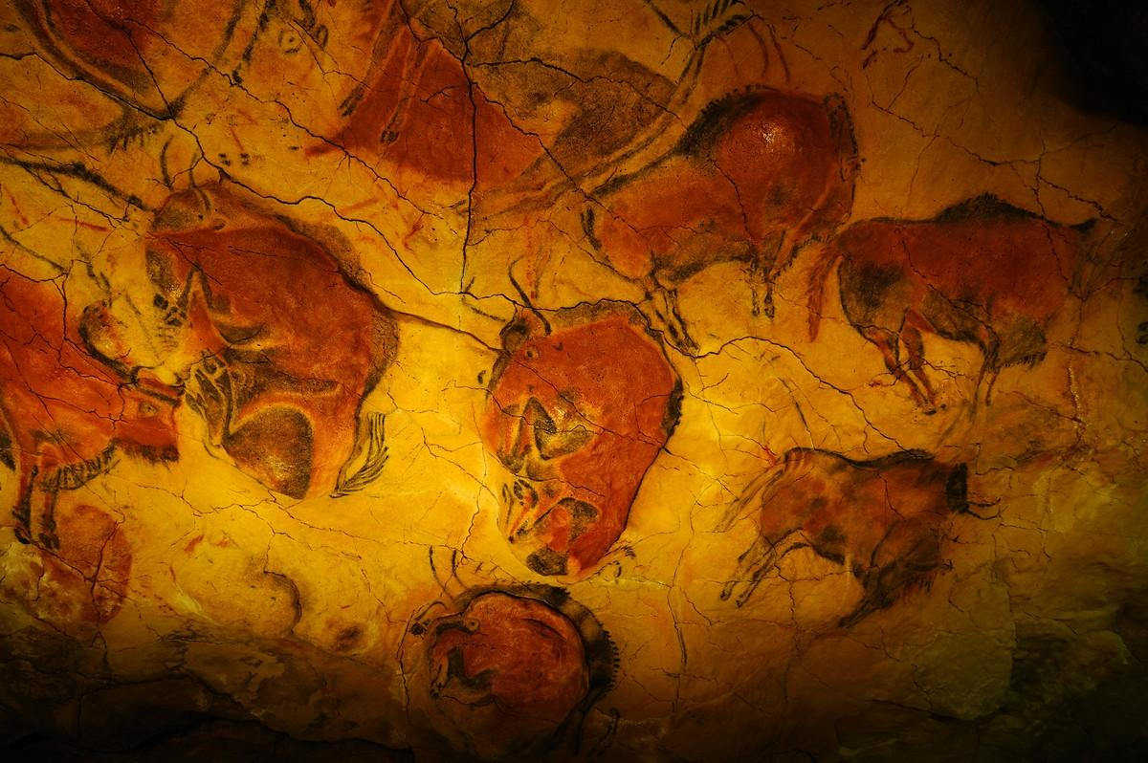

LEARNING
PREHISTORY

Slide 2

quit

