Slide 1
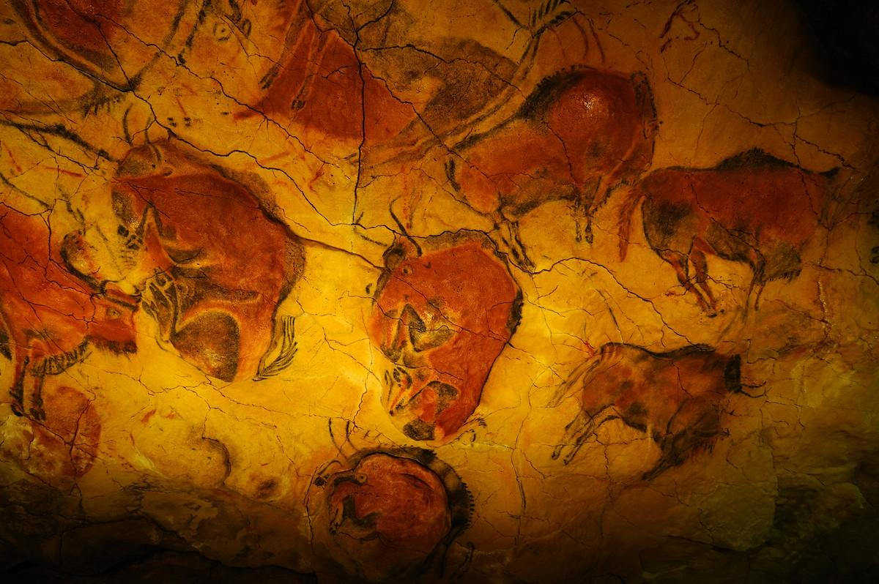

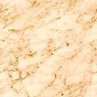

LEARNING
PREHISTORY
New game
help
quit

Slide 2
quit

