Slide 1
UNIT -3
Sorting and Searching

Slide 2
Syllabus
Insertion,
Selection,
Bubble sort methods,
Divider and conquer:
Quick sort,
Merge Sort,
Shell short & Radix sort,
Comparison of various sorting techniques.
Searching Techniques: Sequential search, Binary search, Comparison trees, Performance Comparison of searching algorithms,
Hashing: Hash Function- Open and Closed Hashing, Hash collisions, Rehashing techniques, Extendible hashing.

Slide 3
BUBBLE SORT
In this sorting algorithm, multiple swapping take place in one iteration. Smaller elements move or ‘bubble’ up to the top of the list.
In this method ,we compare the adjacent elemnent of the list to be sorted , if the item on top is greater than the item immediately below it, they are swapped.

Slide 4
Example
Suppose the following numbers are stored in an array A:
32, 51, 27, 85, 66, 23, 13, 57
Pass 1. We have the following comparison:
(a) Compare Al and A2 Since 32 < 51, the list is not altered.
(b) Compare A2 and A3 Since 51 > 27, interchange 51 and 27 as follows:
32, (27), (51), 85, 66, 23, 13, 57
(c) Compare A3 and A4. Since 51 < 85, the list is not altered.
(d) Compare A4 and A5. Since 85 > 66, interchange 85 and 66 as follows:
32, 27, 51, (66), (85), 23, 13, 57
(e) Compare A5 and A6. Since 85 > 23, interchange 85 and 23 as follows:
32, 27, 51, 66, (23), (85), 13, 57
(f) Compare A6 and A7. Since 85 > 13, interchange 85 and 13 as follows:
32, 27, 51, 66, 23, (13), (85), 57
(g) Compare A7 and A8. Since 85 > 57, interchange 85 and 57 as follows:
32, 27, 51, 66, 23, 13, (57), (85)

Slide 5
At the end of Pass 2, the second largest number, 66, has moved its way down to the next-to-last position.
27, 33, 51, 23, 13, 57, 66, 85
At the end of Pass 3, the third largest number, 57, has moved its way down to its position in the list.
27, 33, 23, 13, 51, 57, 66, 85
At the end of Pass 4, the fourth largest number, 51, has moved its way down to its position in the list.
27, 23, 13, 33, 51, 57, 66, 85
At the end of Pass 5, the fifth largest number, 33, has moved its way down to its position in the list.
23, 13, 27, 33, 51, 57, 66, 85
At the end of Pass 6, the sixth largest number, 27, has moved its way down to its position in the list.
13, 23, 27, 33, 51, 57, 66, 85
At the end of Pass 7 (last pass), the seventh largest number, 23, has moved its way down to its position in the list.
13, 23, 27, 33, 51, 57, 66, 85

Slide 6
BUBBLE SORT
Algorithm: (Bubble Sort) BUBBLE (A, N)
Repeat Steps 2 and 3 for K = 1 to N-1.
Set PTR := 1. [Initializes pass pointer PTR.]
Repeat while PTR ≤ N – K.
        If A [PTR] > A[PTR+1], then:
Interchange A[PTR] & A[PTR+1].
[End of IF structure.]
        Set PTR := PTR + 1.
[End of While loop.]
[End of Step 1 loop.]
Exit.

Slide 7
Complexity
The first pass requires (n-1) comparisons to fix the highest element to its location, the second pass requires (n-2)……kth pass requires (n-k) and the last pass requires only one comparison to fixed at its proper position.
Therefore the total comparisons are
F(n)=(n-1)+(n-2)+(n-3)+……+(n-k)+….+3+2+1
=n(n-1)/2
=O(n 2 )

Slide 8
SELECTION SORT
In this sorting we find the smallest element in this list and put it in the first position.
Then find the second smallest element in the list and put it in the second position. And so on.

Slide 9
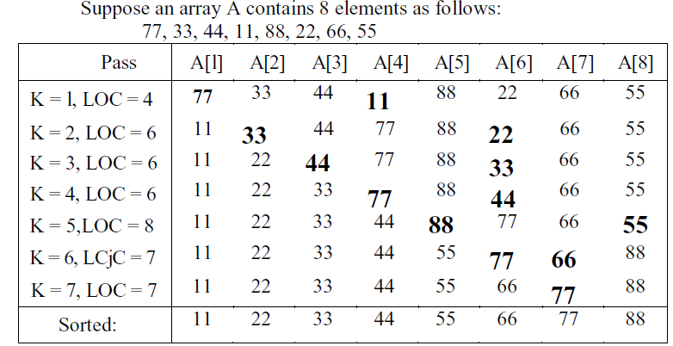

Slide 10
SELECTION SORT
Algorithm: (Selection Sort) SELECTION (A, N)
Repeat Steps 2 and 3 for K = 1,2,3,…,N-1.
Call MIN(A,K,N,LOC).
[Interchange A[K] and A[LOC].]
[End of Step 1 loop.]
Exit.

Slide 11
SELECTION SORT
Procedure: MIN(A, K, N, LOC)
Set MIN : = A[K] and LOC:=K.
Repeat for J = K+1, K+2,….,N.
If MIN > A[J], then:
Set MIN := A[J] and LOC:=J.
[End of loop.]
Return.

Slide 12
Complexity of selection sort
The first pass requires (n-1) comparisons to find the location loc of smallest element, the second pass requires (n-2)……kth pass requires (n-k) and the last pass requires only one comparison.
Therefore the total comparisons are
F(n)=(n-1)+(n-2)+(n-3)+……+(n-k)+….+3+2+1
=n(n-1)/2
=O(n 2 )

Slide 13
INSERTION SORT
The insertion sort works just like its name suggest-it inserts each item its proper place in the final list.
During the first iteration, the element position 2nd is compared with the element at the 1st position.
During the second iteration, the element at the position 3rd is compared with the element at the 2nd and 1st positions.
This process is repeated for all the elements in the array up to (n-1) iterations.
This method is widely used by card players.

Slide 14
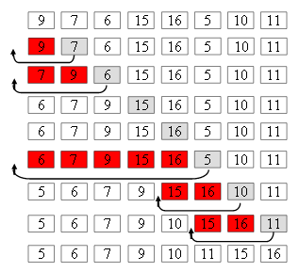
Example

Slide 15
INSERTION SORT
Algorithm: INSERTION(A, N)
Repeat Steps 2 to 4 for K = 2,3,…, N.
Set TEMP := A[K] and PTR := K – 1.
Repeat while TEMP<A[PTR]
(a) Set A[PTR+1] := A[PTR].
(b) Set PTR := PTR – 1.
[End of Loop.]
Set A[PTR + 1] := TEMP.
[End of Step 1 loop.]
Exit

Slide 16
Complexity of insertion sort
The first pass requires 1 comparison, the second pass requires 2……kth pass requires k and the last pass requires (n-1) comparisons.
Therefore the total comparisons are
F(n)=1+2+3+……+(n-1)
=n(n-1)/2
=O(n 2 )

Slide 17
Divide-and-Conquer
Divide the problem into a number of sub-problems
  Similar sub-problems of smaller size
Conquer the sub-problems
  Solve the sub-problems recursively
  Sub-problem size small enough ⇒ solve the problems in straightforward manner
Combine the solutions of the sub-problems
  Obtain the solution for the original problem

Slide 18
QUICK SORT
Also known as Partition Exchange Sort.
Works by partitioning the array to be sorted.
One of the array elements is chosen as a key value(Pivot element).
Key element divides the main list into two parts such that:
  One partition contains elements smaller than the key value.
  Another partition contains elements larger than the key value.

Slide 19
QUICK SORT
Algorithm: QuickSort (a, l, r)// a=array, l=first index, r=last index
If l<r
2. Call partition(a,l,r)
3. Quicksort(a, l, j-1) // sort the left hand
4. Quicksort(a, j+1,r) // sort the right hand
5. Exit

Slide 20
Procedure partition(a,l,r)
P→ Pivot element
1. p=a[l], i=l, j=r
2. Repeat
repeat i=i+1 until a[i] ≥ p
repeat j=j-1 until a[j] ≤ p
Swap(a[i], a[j])
until i ≥ j
3. Swap (a[i], a[j]) // undo last swap
4. Swap (p,a[j])
5. Return j

Slide 21
Example
5 3 1 9 8 2 4 7
P=5
i=a[l]=5
J=a[r]=7
5 3 1 9 8 2 4 7
i
j

Slide 22
5 3 1 9 8 2 4 7
Swap(a[i], a[j])
5 3 1 4 8 2 9 7
5 3 1 4 8 2 9 7
Swap(a[i], a[j])
5 3 1 4 2 8 9 7
i stop
j stop
i
j
i stop
j stop
i
j

Slide 23
5 3 1 4 2 8 9 7
Swap(a[i], a[j])
5 3 1 4 8 2 9 7
I >J
Swap (a[i], a[j])
5 3 1 4 2 8 9 7
j stop
i stop
j
i
j
i

Slide 24
Swap (p,a[j])
2 3 1 4 5 8 9 7
Here the pivot element 5 come to the proper position so repeat the same process for left array and right array.

Slide 25
Complexity of Quick sort
Worst-case: O(N2)
This happens when the pivot is the smallest (or the largest) element. Then one of the partitions is empty, and we repeat recursively the procedure for N-1 elements.
Best-case O(NlogN) The best case is when the pivot is the median of the array, and then the left and the right part will have same size. There are log N partitions, and to obtain each partitions we do N comparisons. Hence the complexity is O(NlogN)

Slide 26
Merge Sort
To sort an array A[p . . r]:
Divide
  Divide the n-element sequence to be sorted into two subsequences of n/2 elements each
Conquer
  Sort the subsequences recursively using merge sort
  When the size of the sequences is 1 there is nothing more to do
Combine
  Merge the two sorted subsequences

Slide 27
Example – n Power of 2
Divide
1
2
3
4
5
6
7
8
5
2
4
7
1
3
2
6
q = 4
1
2
3
4
5
6
7
8
5
2
4
7
1
3
2
6
1
2
3
4
5
6
7
8
5
2
4
7
1
3
2
6
1
2
3
4
5
6
7
8
5
2
4
7
1
3
2
6

Slide 28
Example – n Power of 2
Conquer
and
Merge
1
2
3
4
5
6
7
8
1
2
2
3
4
5
6
7
1
2
3
4
5
6
7
8
2
4
5
7
1
2
3
6
1
2
3
4
5
6
7
8
2
5
4
7
1
3
2
6
1
2
3
4
5
6
7
8
5
2
4
7
1
3
2
6

Slide 29
Example – n Not a Power of 2
1
2
3
4
5
6
7
8
9
10
11
Divide
4
7
2
6
1
4
7
3
5
2
6
q = 6
1
2
3
4
5
6
7
8
9
10
11
q = 3
4
7
2
6
1
4
7
3
5
2
6
q = 9
1
2
3
4
5
6
7
8
9
10
11
4
7
2
6
1
4
7
3
5
2
6
1
2
3
4
5
6
7
8
9
10
11
4
7
2
6
1
4
7
3
5
2
6
1
2
4
5
7
8
4
7
6
1
7
3

Slide 30
Example – n Not a Power of 2
Conquer
and
Merge
1
2
3
4
5
6
7
8
9
10
11
1
2
2
3
4
4
5
6
6
7
7
1
2
3
4
5
6
7
8
9
10
11
1
2
4
4
6
7
2
3
5
6
7
1
2
3
4
5
6
7
8
9
10
11
2
4
7
1
4
6
3
5
7
2
6
1
2
3
4
5
6
7
8
9
10
11
4
7
2
1
6
4
3
7
5
2
6
1
2
4
5
7
8
4
7
6
1
7
3

Slide 31
Algorithm
p
q
r
1
2
3
4
5
6
7
8
MERGE-SORT(A, p, r)
if p < r Check for base case
then q = ⎣(p + r)/2⎦ Divide
MERGE-SORT(A, p, q) Conquer
MERGE-SORT(A, q + 1, r) Conquer
MERGE(A, p, q, r) Combine
5
2
4
7
1
3
2
6

Slide 32
MERGING
Merging is a process in which two lists are merged to form a new list.
Suppose, L is a sorted list with ‘n1’ elements and R is a sorted list with ‘n2’ elements. The operation that combines the elements of L and R into a single sorted list C with ‘n=n1+n2’ elements is called merging.

Slide 33
MERGING
p
q
r
1
2
3
4
5
6
7
8
2
4
5
7
1
2
3
6
Algorithm: MERGE(A,p,q,r )
Compute n1 and n2.
Copy the first n1 elements into L[] and the next n2 elements into R[]. Final result is stored in c[].
[Initialize.] Set i = 1 ,j = 1, k=1
[Compare.] Repeat while i ≤ n1 and j ≤ n2.
If L[i] < R[j], then
(a) [Assign element from L to C.]
Set C[k] = L[i].
(b) [Update pointers.] Set k = k + 1 and i = i + 1
Else if L[i] > R[j], then:
(a) [Assign element from R to C.]
Set C[k] = R[j].
(b) [Update pointers.] Set k = k + 1 and j = j + 1
n1
n2

Slide 34
MERGING
Else (a) [Assign element from L to C.]
Set C[k] = L[i].
(b) [Update pointers.] Set k = k + 1, i =i+1, and j = j + 1
[End of If structure.]
[End of loop.]
[Assign remaining elements to C.]
If i > n1, then:
Repeat for l=j to n2:
Set C[k] = R[l], k=k+1
Else: Repeat for l=i to n1
Set C[k] = L[l], k=k+1
[End of loop.]
[End of If structure.]
Exit.

Slide 35
Example
L = 4 12 13 21 80
R= 1 41 62 200 412 816
i | j | k | i≤l1 and j≤l2 | C[k]
1 | 1 | 1 | T | 1
1 | 2 | 2 | T | 4
2 | 2 | 3 | T | 12
3 | 2 | 4 | T | 13
4 | 2 | 5 | T | 21
5 | 2 | 6 | T | 41
5 | 3 | 7 | T | 62
5 | 4 | 8 | T | 80
6 | 4 | 9 | F | 200
6 | 5 | 10 | F | 412
6 | 6 | 11 | F | 816

Slide 36
Complexity of merge sort
O(n log n)

Slide 37
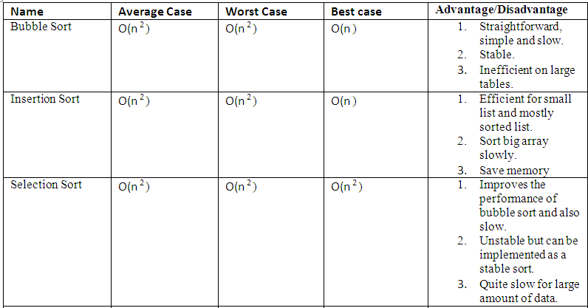

Slide 38
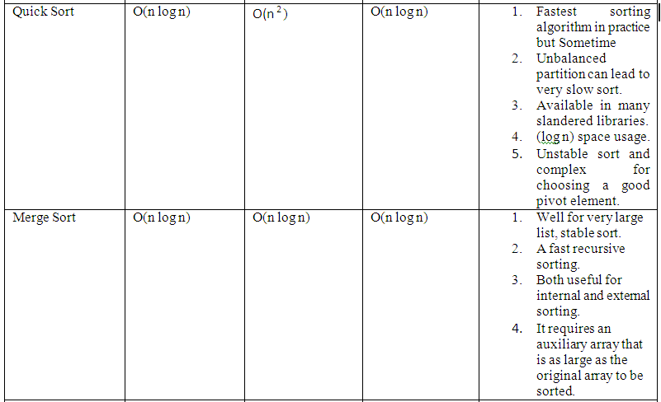

Slide 39
SEARCHING
Searching refers to the operation of finding the location of a given item in a collection of items.
The search is said to be successful if ITEM does appear in DATA and unsuccessful otherwise.

Slide 40
LINEAR SEARCH
Suppose DATA is a linear array with n elements.
Given no other information about DATA, the most intuitive way to search for a given ITEM in DATA is to compare ITEM with each element of DATA one by one.
That is , first we test whether DATA[1]= ITEM, and then we test whether DATA[2]= ITEM, and so on.
This method is called linear search or sequential search.

Slide 41
LINEAR SEARCH(Algorithm)
LINEAR( A, N, ITEM, LOC)
1. Set K=0 and LOC=-1
2. Repeat steps 3 and 4 while LOC=-1 and K<N
3. If ITEM= A [K], then: set LOC=K
4. Set K=K+1
[end of step 2 loop]
5. If LOC=-1, then:
Write : ITEM is not in the array A.
Else:
Write : LOC is the location of ITEM.
[end of if structure]
6. Exit

Slide 42
Complexity of the Linear Search Algorithm
O(n)

Slide 43
BINARY SEARCH
Suppose DATA is an array which is sorted in increasing numerical order.
Then there is an extremely efficient searching algorithm, called binary search, which can be used to find the location LOC of a given ITEM of information in DATA.
The item or the location can be search quickly by reducing the no. of possible locations for it in the array.
The search begins with the middle of the array.
If item is found then search is stopped.
Otherwise:
  If it is smaller than the middle element, then upper bound is shifted to middle-1.
  If it is greater than the middle element, then lower bound is shifted to middle+1.

Slide 44
BINARY SEARCH(Algorithm)
BINARY( DATA, LB, UB, ITEM, LOC)
SET BEG := LB, END := UB, MID = INT(BEG+END)/2.
Repeat Steps 3 and 4 while BEG≤END and DATA[MID]≠ITEM
If ITEM<DATA[MID], then:
Set END := MID -1.
Else:
Set BEG := MID +1.
[End of If structure.]
Set MID = INT(BEG+END)/2.
[End of Step 2 loop.]
If DATA[MID] = ITEM, then:
Set LOC := MID.
Else:
Set LOC := NULL.
[End of If structure.]
Exit.

Slide 45
Complexity of the Binary Search Algorithm
f(n) = O(log n)

Slide 46
Example
Let DATA be the following sorted 13-element array:
DATA: 11, 22, 30, 33, 40, 44, 55, 60, 66, 77, 80, 88, 99
We apply the binary search to DATA for different values of ITEM.
(a) Suppose ITEM = 40. The search for ITEM in the array DATA is pictured in where the values of DATA[BEG] and DATA[END] in each stage of the algorithm are indicated by parenthesis and- the value of DATA[MID] by a bold.

Slide 47
Specifically, BEG, END and MID will have the following successive values:
(1) Initially, BEG = 1 and END 13. Hence,
MID = INT[(1 + 13) / 2 ] = 7 and so DATA[MID] = 55
(2) Since 40 < 55, END = MID – 1 = 6. Hence,
MID = INT[(1 + 6) / 2 ] = 3 and so DATA[MID] = 30
(3) Since 40 > 30, BEG = MID + 1 = 4. Hence,
MID = INT[(4 + 6) / 2 ] = 5 and so DATA[MID] = 40
The search is successful and LOC = MID = 5.
(1) (11), 22, 30, 33, 40, 44, 55, 60, 66, 77, 80, 88, (99)
(2) (11), 22, 30, 33, 40, (44), 55, 60, 66, 77, 80, 88, 99
(3) 11, 22. 30, (33), 40, (44), 55, 60, 66, 77, 80, 88, 99

Slide 48
