Slide 1
INTRODUCING
DocFlow
Intelligent Documentation & Modeling Toolkit
Whiteboard → Diagram → Code
In Seconds.

Slide 2
The Problem
Whiteboard sessions produce great ideas...
...that get lost when someone "cleans up the notes"
Partner API integrations take weeks
Manual mapping, manual DTOs, manual client code
Documentation drifts from reality
Diagrams ≠ Code ≠ What's actually deployed
SLA violations go undetected
Until a customer complains about stale data

Slide 3

The Solution: Canonical Semantic Model
One universal truth layer:
Whiteboard Sketches
Semantic
Mermaid Diagrams
Model
Universal Truth
C# Domain Models
External API Schemas

Slide 4
Whiteboard Module Demo
Whiteboard → Diagram → Code
📸
🤖
📊
💻
→
→
→
Photo
AI Computer Vision
Mermaid UML
C# Code
$ Terminal
docflow scan whiteboard.png -c “Context of Sketch" -o FormalOutputDiagram.mmd
docflow codegen diagram.mmd -o Domain.cs
✓ DDD Pattern Recognition
✓ Stereotype Extraction
✓ Relationship Mapping
AggregateRoot, Entity, ValueObject
«aggregate root» → classification
Composition, inheritance, association

Slide 5
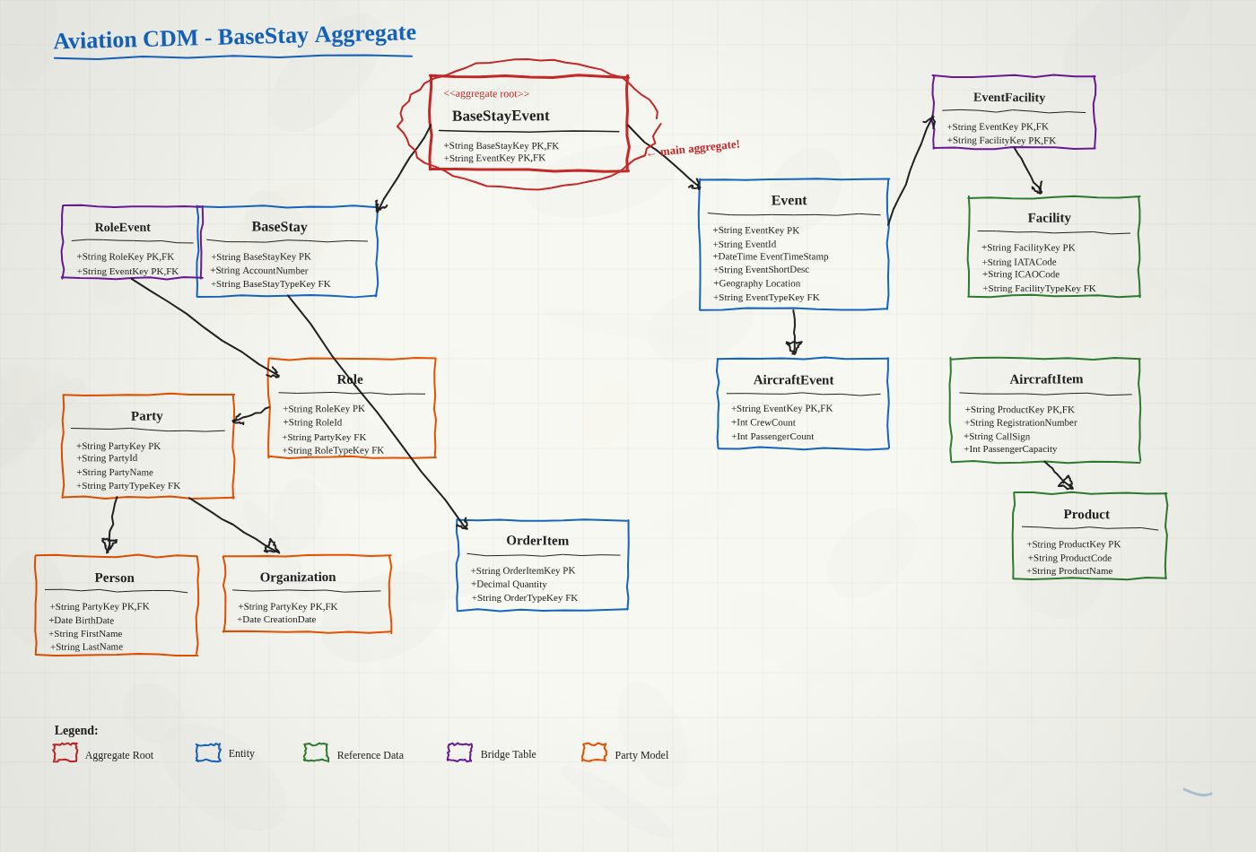
LIVE DEMO
The Source: Aviation CDM Whiteboard Sketch
docflow scan whiteboard-aviation-cdm.png -c “Aviation CDM Class Diagram" -v

Slide 6
Integration Module
Same CDM pattern used for diagram transformation → now applied to API integration
integrate parse
integrate sla
Parse OpenAPI specs (JSON/YAML)
Validate data freshness
Extract entities & endpoints
Catch stale data automatically
integrate analyze
integrate generate
Map external API → your CDM
Generate DTOs, AutoMapper
Confidence scores & reasoning
HTTP clients, validators

Slide 7
API Integration Module Demo
API Analysis & CDM Mapping
Step 1: Parse the API spec
docflow integrate parse flightbridge-api-spec.json -v
Step 2: Analyze mapping to CDM
docflow integrate analyze flightbridge-api-spec.json --cdm AviationCdm/ -v
Aviation Pattern Matches
CDM Gaps Identified
✓ Regn → TailNumber (85%)
✗ Icao - not in CDM
✓ Origin → OriginAirportCode (85%)
✗ Blocksoff - not in CDM
✓ paxCount → PassengerCount (85%)
✗ Blockson - not in CDM
⚠ Flight → FlightLeg (74%)
→ Legitimate gaps to address

Slide 8

Service Level Agreement Compliance Module Demo – Lesson Learned Integration Non-Compliant
SLA Data Freshness Validation
The Problem We Found:
Vendor SLA promised 30-second data freshness. Actual data was 2-5 hours stale.
Discovered manually. This tool would have caught it automatically.
Automated SLA Compliance Check
docflow integrate sla "https://api.vendor.com/flights" --expected 30s -v
🔄 Samples endpoint multiple times
📊 Calculates actual data age
🚨 Returns clear verdict
Extracts timestamp from response
Min, max, average freshness
COMPLIANT or VIOLATION
✓ CI/CD ready - Run as scheduled job to catch SLA drift early

Slide 9
API Integration Code Generation Module Demo
Integration Code Generation
docflow integrate generate flightbridge-api.json --cdm AviationCdm/ --output ./generated/
📦 External DTOs
🔄 AutoMapper
[JsonPropertyName("...")]
// 85% confidence
🌐 Typed HTTP Clients
✓ FluentValidation
IFlightBridgeClient
RuleFor(x => x.Name)...
36 files • 1,269 lines • Weeks/Months → Seconds

Slide 10
Architecture
12 Projects • 91 Tests
Tech Stack
DocFlow.Core - Semantic Model
.NET 8.0 - C# 12
DocFlow.CodeAnalysis - Roslyn
DocFlow.Diagrams - Mermaid
Roslyn - Code Analysis
DocFlow.CodeGen - C# Gen
Claude Vision API
DocFlow.Vision - AI Scanner
DocFlow.AI - Claude API
Microsoft.OpenApi
DocFlow.Integration - APIs
DocFlow.CLI + Tests
Spectre.Console
Xunit / Fluent Assertion – Unit Tests

Slide 11
Commands Reference
🔌 Integration Pipeline
📊 Diagram Pipeline
docflow integrate parse <spec>
Parse OpenAPI
docflow diagram <file.cs>
C# → Mermaid
docflow integrate analyze --cdm
Map to CDM
docflow codegen <file.mmd>
Mermaid → C#
docflow integrate generate
Generate code
docflow scan <image>
Photo → Mermaid (AI)
docflow integrate sla --expected
Validate freshness

Slide 12
Questions?
DocFlow
📸
→
📊
→
💻
Idea
Architecture
Reality
docflow --help

