Slide 1
From dev shop to insurance software vendor
SEO & AI Search plan for diceus.com: why the site underperforms the product strategy, what to change, and the 90-day plan
Evidence: own crawl of 815 URLs · 44 SERPs · 20-prompt AI panel · 13 competitors · 7 pivot case studies | October 2026
Notes:
Purpose: agree the direction and the first 30 days. Everything shown is from public data; GSC, GA4 and CRM were not available and are marked as such in the full deliverables (01-06).

Slide 2
The answer on one slide
Change the weight, not the URLs: fix, reposition, then win alternative risk first
1
2
3
Fix this week
Reposition: days 1-60
Win alt-risk: days 1-90
3 product pages are noindexed, including Captive Management and RRG: the pages where DICEUS already wins in search and AI answers
Homepage, navigation and internal links still sell custom development. Make products the strongest pages, keep services as a secondary line
Captive and RRG software is winnable now: DICEUS is #1 in our sample and no vendor owns the category. Add proof, buyer assets and AI-ready facts
Remove stray tag · deploy guardrail
Homepage · nav · links · schema
Hub · proof · reviews · comparisons
Notes:
Pyramid: main message first. 1) A free fix protects the only territory where DICEUS already wins. 2) The site and entity still say 'dev shop'; repositioning is done through homepage, navigation, links and schema - no URL migration. 3) Alternative risk is the highest relevance x feasibility territory; build it as the first complete product cluster with real proof.

Slide 3
Today the site tells Google, buyers and AI: "dev shop"
Five measured symptoms (own crawl and panels, 6 Oct 2026)
23 : 192
24 vs 93
3
product pages vs generic service, expertise and non-insurance industry pages
median in-content links a product page gets vs a generic service page
product pages excluded by noindex: Captive Mgmt, RRG, Group Health
2 / 16
0 / 23
Homepage H1
"Custom software development company"
unbranded AI prompts that name DICEUS (captive and RRG only)
product pages with product schema; 0 reviews on product listings
last modified 2022 · 0.99 title match with a services page
Notes:
Sources: crawl of 815 URLs (02_Current_State_Audit.xlsx Summary, Layer_Links, Indexability); AI panel (03 AI_Panel). Contextual links exclude the ~300 sitewide mega-menu links. AI panel = Claude with web search, 1 run per prompt, directional.

Slide 4
The homepage tells the agency story first
Current H2 order (crawl) vs proposed order: products, segments and proof first, services as one strip
NOW
PROPOSED
1 Need a custom software solution?
1 H1: Insurance software for carriers, MGAs & alt-risk
2 Ready-made insurance software
2 Choose your path: captives · RRGs · MGAs · carriers
3 Custom software services and solutions
3 Product families: core, distribution, finance & data, alternative risk
4 Case studies · Focus industries · Clients
4 Proof band: named outcomes, VCIA partner, product reviews
5 Benefits of custom software solutions
5 How we deliver: implementation in weeks, security & trust
6 Software development life cycle
6 Services strip: implementation, modernization, custom dev
7 Why choose DICEUS as a business software development company?
7 Insights: captive, RRG and PAS guides
8 Tech stack · Team · Articles · FAQ
8 Book a demo
Notes:
Current H2 sequence taken verbatim from the crawl. Proposed: title 'DICEUS - Insurance Software for Carriers, MGAs & Captives'; H1 'Insurance software products for carriers, MGAs and alternative risk'. Staged change: first hand the generic 'custom software development company' query to /services/custom-software-development/, check GSC, then retitle the homepage (rollback ready).

Slide 5
Product pages lose on proof, not on features
DICEUS has the deepest captive feature content in the set, but none of the trust signals buyers and AI look for
 | DICEUS | Luzern Risk | Riskonnect | Insly | Socotra / hx
Feature depth for captives | Strong | Medium | Low | n/a | n/a
Customer proof with metrics | No | Anon. cases | Named quote | Named execs | Logos + metrics
Product-level reviews | 0 | - | G2: 35 | - | Analyst
Pricing model explained | No | Flat rate | No | Tiers, no prices | No
Security / trust page | No | - | SOC 2 page | - | ISO 27001, SOC
Buyer assets (guide, RFP, calculator) | No | Calculators | Guide + RFP | Glossary | Docs
FAQ + product schema | No | FAQ schema | FAQ | - | -
Curated llms.txt | PAS only | Yes | Auto | No | Auto / no
Notes:
Competitor teardown (data/competitor_teardown.md): Luzern Risk (4 anonymised testimonials with titles + quantified cases e.g. ~$55M premium, hand-written llms.txt with flat-rate pricing model, calculators), Riskonnect (named Municipal Association of SC quote, buying guide + RFP template, FAQ, Platform Security page with SOC 2 Type 2; G2 35 reviews), Insly (pricing tiers by segment, custom quotes - no figures), Socotra (ISO 27001, SOC 1 T2 security page; 2021 Gartner MQ Visionary) / hx (SOC 2 + ISO 27001 on homepage), Vertafore MGA Systems (SoftwareApplication + FAQPage schema). Fact-checked 6 Oct 2026: data/factcheck_external.md. DICEUS's Gartner 5/5 and Clutch 4.9 are company-level ratings of the services business.

Slide 6
Others made this pivot: the winners put products first
Six insurance software companies that started as services firms (public sources, Wayback snapshots)
Adacta → AdInsure
Decerto
Mastek → Majesco
Sold services unit (2019), product company on new domain
Insurance products + software-house services, one domain
Demerger (2014); services dropped from top nav
Full commitment; analyst recognition and investment followed
Closest to DICEUS: separate Products and Services menus
Gartner MQ Leader, 375+ customers, acquired for ~$729M
Exigen → EIS
Stratoflow → Openkoda
Damco → InsureEdge
Services spun off, product brand renamed
New product domain; dev shop kept as partner
Product left inside a services site
Clear product identity for buyers and analysts
Works only for a new product with no search equity yet
Warning: weakest product presence = DICEUS today
Recommended for DICEUS: Model A, one domain with products first (the Decerto / Majesco path)
Keep diceus.com: it already ranks #1 for captive and RRG software, and the Capterra, Gartner and Microsoft listings point there. A new domain would throw that away. Demote services in navigation now. Prune or merge them only when GSC and CRM show they earn nothing (a 'virtual spin-off', not a blind cut).
Notes:
Source: data/pivot_case_studies.md. Adacta sold its ~300-person Dynamics services unit to BE-terna (2019); adacta.si now 301s to adacta-fintech.com; Gartner/Celent recognition and Volpi Capital investment (2021). Decerto: one domain with separate Products and Services menus; it still sells IT outsourcing / custom development alongside its insurance products (fact-check #15); satellite higson.io splits authority (no canonical). Majesco: demerged from Mastek 2014; 2016 nav mixed dev/testing services; today no Services in top nav; Gartner MQ Leader (2025), 375+ customers (Feb 2026, after the Vitech acquisition); acquired by Thoma Bravo ~$729M (2020). Exigen -> EIS: services spun off, product renamed. Stratoflow -> Openkoda: new product domain, services sister brand as implementation partner (works only for a brand-new product without search equity). Damco: InsureEdge still under a Services menu = where DICEUS is today.

Slide 7
Where to compete: alternative risk first
Priority score = 0.45 business relevance + 0.35 SEO feasibility + 0.20 demand evidence (volumes not available, so demand weighs least)
Win now
Captive + RRG: DICEUS #1 in our sample, thin SERPs, VCIA partner (Jun 2026), ~262 US RRGs and 40 US captive domiciles
Win the long tail
PAS, underwriting, reinsurance: segment variants ("for MGAs", "for captives") and reviews, not head terms owned by Guidewire, Oracle and G2
Notes:
From 03_Search_Market_and_Opportunity.xlsx / Territories. Sensitivity check: with equal weights the top two (captive, RRG) and bottom two (services) do not change. PAS has the most demand but Oracle/Guidewire/G2 own the head terms - win its long tail (PAS for MGAs / captives / RRGs) instead.

Slide 8
The whitespace nobody owns yet
Gaps no competitor fills, from the teardown of 13 vendors
1
Software-only for captive managers
2
One captive + RRG + self-insured family
Luzern ($45M Series B) now runs captives itself and competes with the managers who would buy DICEUS. Position as the platform independent managers run on.
Origami and Riskonnect treat captives as an RMIS sub-feature; their homepages never mention them.
3
RRG search is almost uncontested
4
No category guide, no curated llms.txt
SERP = DICEUS, a 2022 press release and Ventiv-era pages. An RRG hub (LRRA, domiciles, NAIC calendar) can own the topic.
No authoritative 'best captive management software' guide: only directories and thin aggregator lists. No captive software vendor has a fact-dense llms.txt.
Notes:
Luzern Risk raised $45M and is an AI-native captive MANAGER: it competes with DICEUS's buyers, so 'software-only platform for independent captive managers' is a real wedge. Origami and Riskonnect never mention captives on their homepages; Websure's captive page is ~250 words. No authoritative 'best captive management software' guide exists: the exact query returns directories (incl. DICEUS's own Capterra/GetApp listings) and thin aggregator listicles.

Slide 9
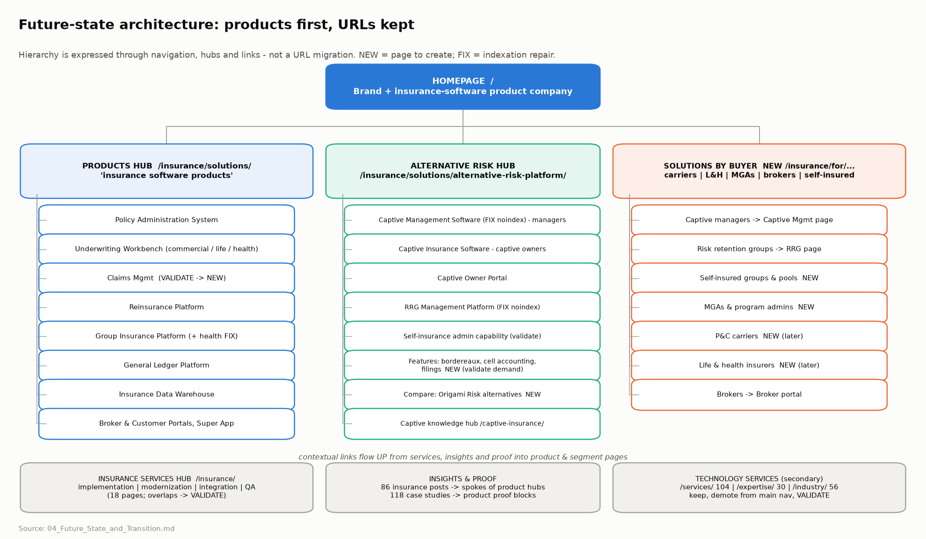
Target architecture: products first, URLs kept
Hierarchy through navigation, hubs and links; services and content link up into products
Notes:
Products hub /insurance/solutions/, Alternative Risk hub (AROP page), buyer pages for MGAs and self-insured groups. Captive managers, RRGs and brokers are served by their product pages to avoid self-cannibalisation. Generic services stay live but leave the primary nav until GSC/CRM show their value.

Slide 10
What changes on the site
Concrete changes, each tied to evidence and a best-in-class example
Area | Today (fact) | Change | Model to copy
Homepage | H1 "Custom software development company" | Product-category H1, segment self-select, proof band, services strip | Decerto, Luzern
Navigation | ~300 links, services-dominant mega-menu | Products · Alternative risk · Buyers · Services · Resources; 30-40 menu links (<=120 links/page) | Luzern, Insly
Product pages | Modules + benefits only | Who it's for, video, integrations, proof, pricing model, FAQ, security | Riskonnect, Vertafore
Captive pages | Noindex; two pages target the same audience | Fix; managers vs owners split; spec in 04 App. A | -
Proof | Company-level Gartner / Clutch ratings | 2-3 alt-risk case studies; 10+ product reviews | Luzern, Riskonnect
New pages | None | /trust/, /pricing/ (model), RRG hub, comparison, RFP template | Socotra, Insly, Riskonnect
AI readiness | No product schema; llms.txt = PAS | SoftwareApplication + FAQ schema; curated llms.txt; Wikidata | Vertafore, Luzern
Notes:
Examples: Decerto keeps separate Products and Services menus on one domain; Luzern segment-first nav; Riskonnect PAS page (named quote, buying guide, RFP template, FAQ); Insly pricing tiers (custom quotes); Socotra/hx security pages; Vertafore SoftwareApplication schema.

Slide 11
AI search: own the captive and RRG answer
Brands named across 16 unbranded prompts (Claude + web search, 1 run each, directional)
Be indexable
1
Fix noindex on the pages that win today
Carry the brand
2
"DICEUS Captive Management Platform" on every listing
Be cited by third parties
3
Product reviews, Celent VendorMatch, captive trade press
Be easy to quote
4
SoftwareApplication + FAQ schema, curated llms.txt, Wikidata, pricing model
Notes:
Broad answers are assembled from analyst lists (Celent, Datos), G2/Capterra category pages and listicles - DICEUS is in none. 'What is DICEUS?' resolved to homonyms (no Wikidata). Listings surfaced without the brand name and with 0 reviews. ChatGPT, Perplexity and Google AI Overviews: not measured yet (panel v2 in days 5-20).

Slide 12
90 days: fix, reposition, prove
Destructive changes (redirects, merges, pruning) only after GSC/CRM evidence
Days 1-30
Days 31-60
Days 61-90
Fix · baseline · decide
Reposition · build
Validate · scale
Remove noindex + deploy guardrail
Connect GSC, GA4, CRM; baseline per URL
Product truth table (what is a sellable SKU)
Query-ownership map: one URL per cluster
Rebuild Captive Management page (spec)
Brand directory listings; start review drive
AI panel v2 across 4 engines
Homepage in 2 GSC-gated steps
Nav v2: products first, 30-40 menu links
Alternative Risk hub + self-insured page
+ contextual links from 86 insurance posts
/trust/ and /pricing/ (model) pages
Comparison page + RFP template
Wikidata entity; trade-press pitch
MGA & program administrator page
Merge overlaps only where GSC proves it
Claims / feature pages only if validated
Case-study archives noindex if 0 traffic
Weekly automated crawl + GSC + AI digest
Day-90 review and re-prioritisation
Notes:
Full plan with owners, dependencies and Definition of Done: 05_90_Day_Execution_Plan.xlsx (32 tasks). Governance: baseline + change log + 14-day check + rollback for every risky change.

Slide 13
What we won't do yet, what we need, how we'll measure
Evidence before irreversible moves
Not yet (validate first)
What we need from DICEUS
KPIs at day 90
Prune or redirect the ~190 generic service pages
Move products to a new /products/ URL folder
Merge the two captive pages or service overlaps
GSC, GA4, CRM and Cloudflare log access
Product truth table: what is sellable today
One referenceable US alt-risk customer
Security facts (ISO / SOC status)
23/23 product pages indexed (now 20/23)
Product in-content links: median 24 to 60+
AI share of voice: 2/16 to 5/16+ (Claude)
5+ published product reviews (now 0)
Alt-risk impressions and demos vs baseline
Notes:
Not yet: (1) pruning ~190 generic service pages - their traffic and leads are unknown; (2) moving products to a new /products/ URL folder - equity and directory links at risk, no evidence the path hurts; (3) merging the two captive pages or overlapping service pages - need GSC query-by-page data.

Slide 14
First step: fix three tags this week
Then make products the strongest pages on diceus.com, and make DICEUS the answer for captive and RRG software in search and AI.
Notes:
Close on the decision: approve days 1-30 (fix, data access, product truth table, captive page rebuild).

