Slide 1

Predicting Market Value of Soccer Players
Made by- Tapan Chudasama
16BIT038
Guided by- Prof. Pronoya Bhattacharaya

Slide 2
Methodology Followed
Finding the appropriate dataset which contains the required features for training the model and then predicting the market value of soccer players.
Carefully removing the unwanted attributed from the dataset.

Slide 3
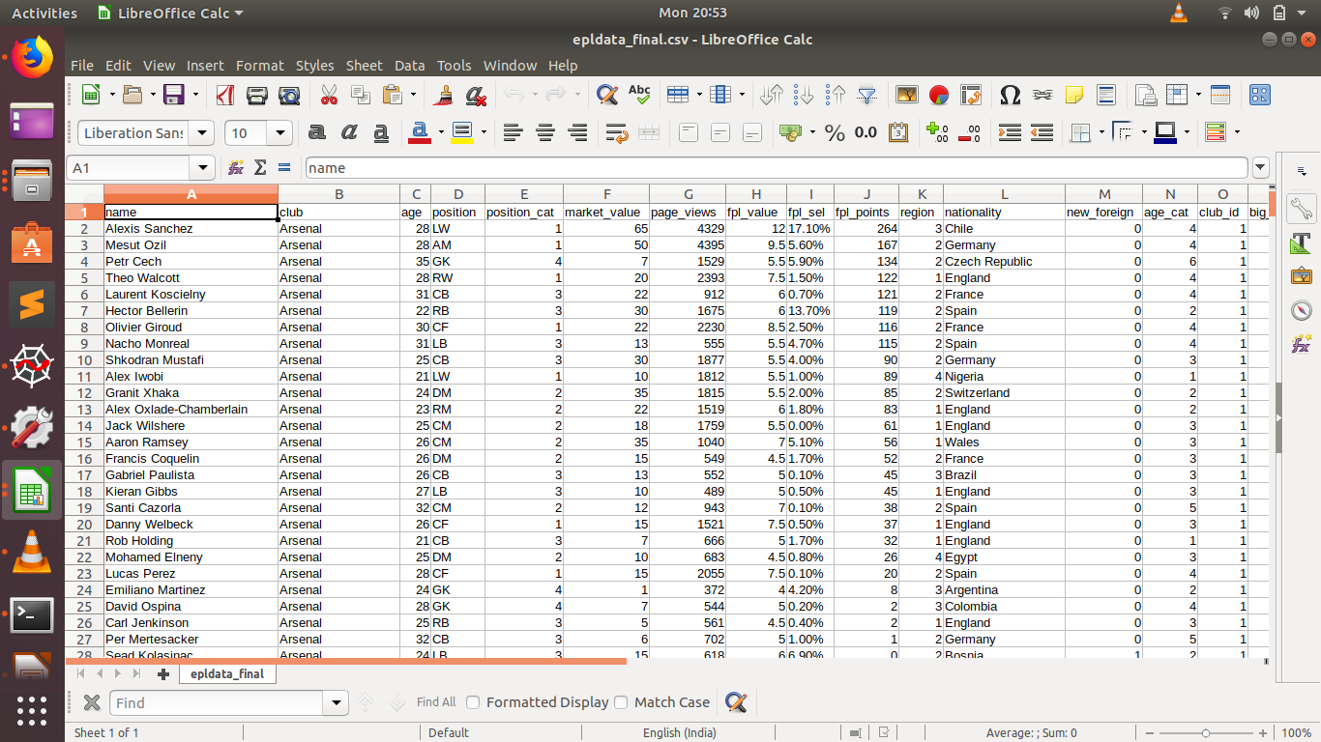

Slide 4
Implementing Random Forest Regression
Three main libraries of Python are used:
Pandas (For handling the dataset)
Numpy (For performing numerical calculation)
Matplotlib (For plotting intuitive graphs)
After importing the dataset, we split the dataset into training set and test set. Training Set is used to train the model and test its performance on the Test Set.
We use the Scikit Learn library of Python for splitting the dataset.

Slide 5
Implementing Random Forest Regression
After splitting the dataset, we perform feature scaling on the dataset to make the data entries more closer to each other.
Then we use Scikit Learn’s Random Forest Regressor to model the data using the training set. And thereafter test its accuracy on the test set.
We plot a graph of Predicted Market Value v/s Actual Value for getting a better understanding of the model.

Slide 6
Thank You

